Slide 1


Transylvania County
Planning Board Meeting | March 2024

Slide 2

Transylvania County Planning Board

Slide 3
Public Comment

Slide 4
Agenda Modifications

Slide 5
Consent Agenda

Slide 6
Minutes
February 15, 2024
Consent Agenda

Slide 7
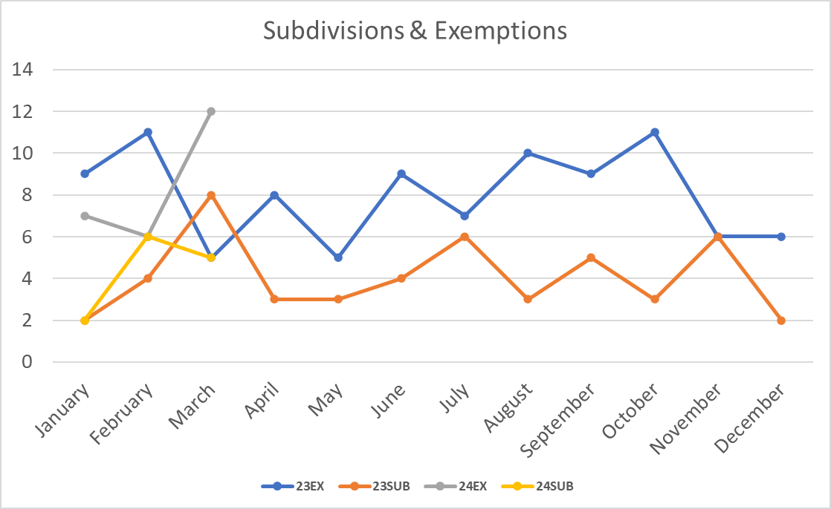
Subdivision Approval & Update
Consent Agenda

Slide 8
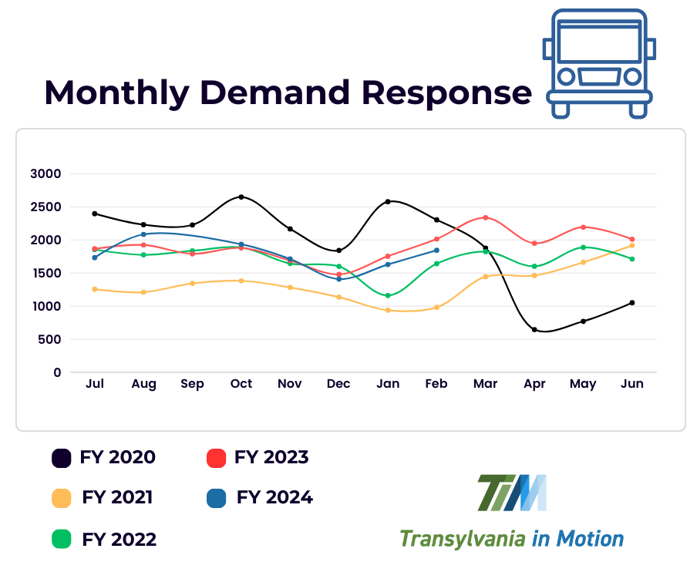
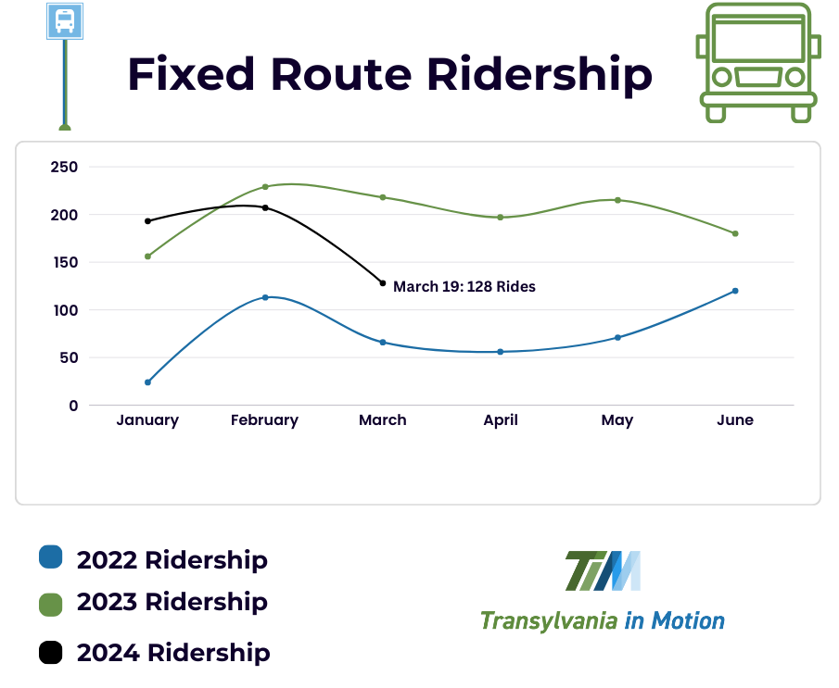
Transportation Update
Consent Agenda

Slide 9


Slide 10
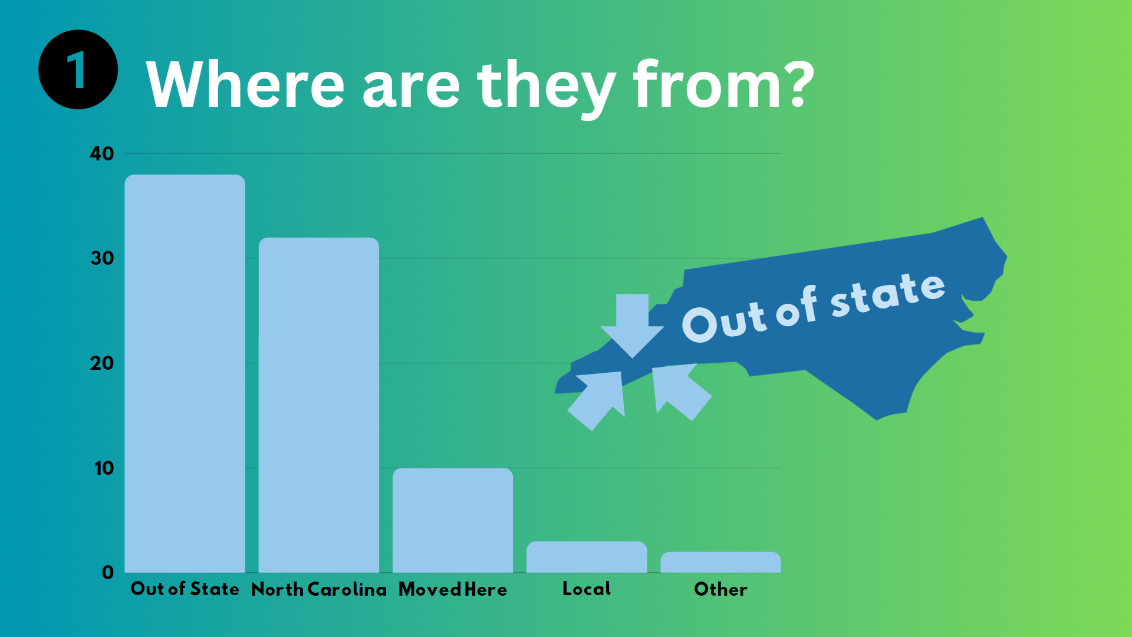

Slide 11


How many responded?
Out of 300 Surveys passed out, we received:
survey’s back!

Slide 12
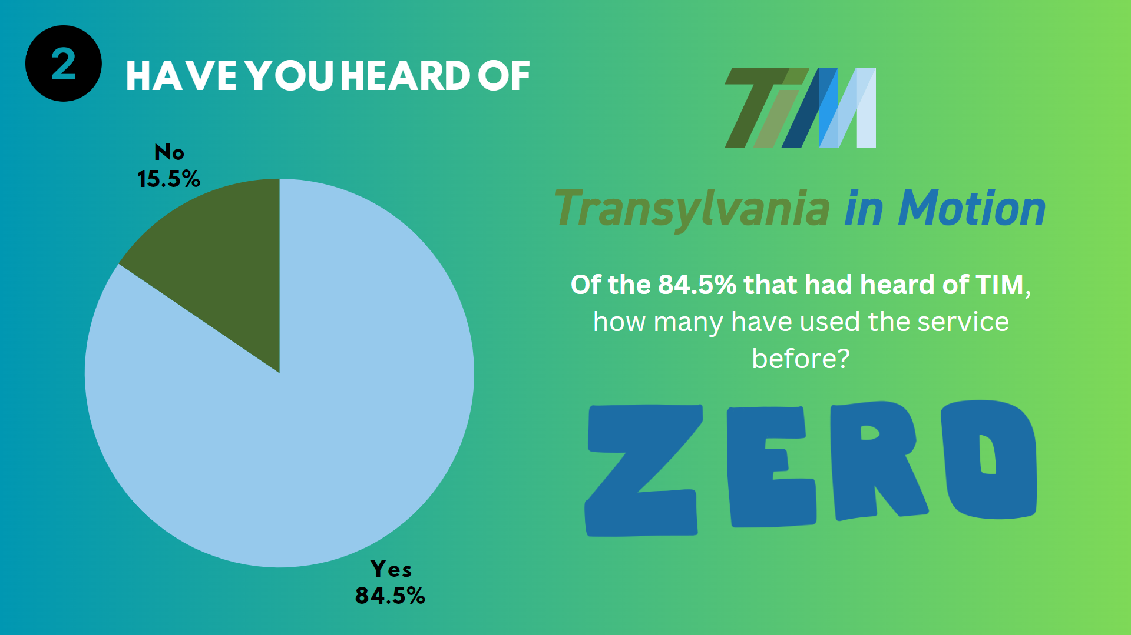

Slide 13
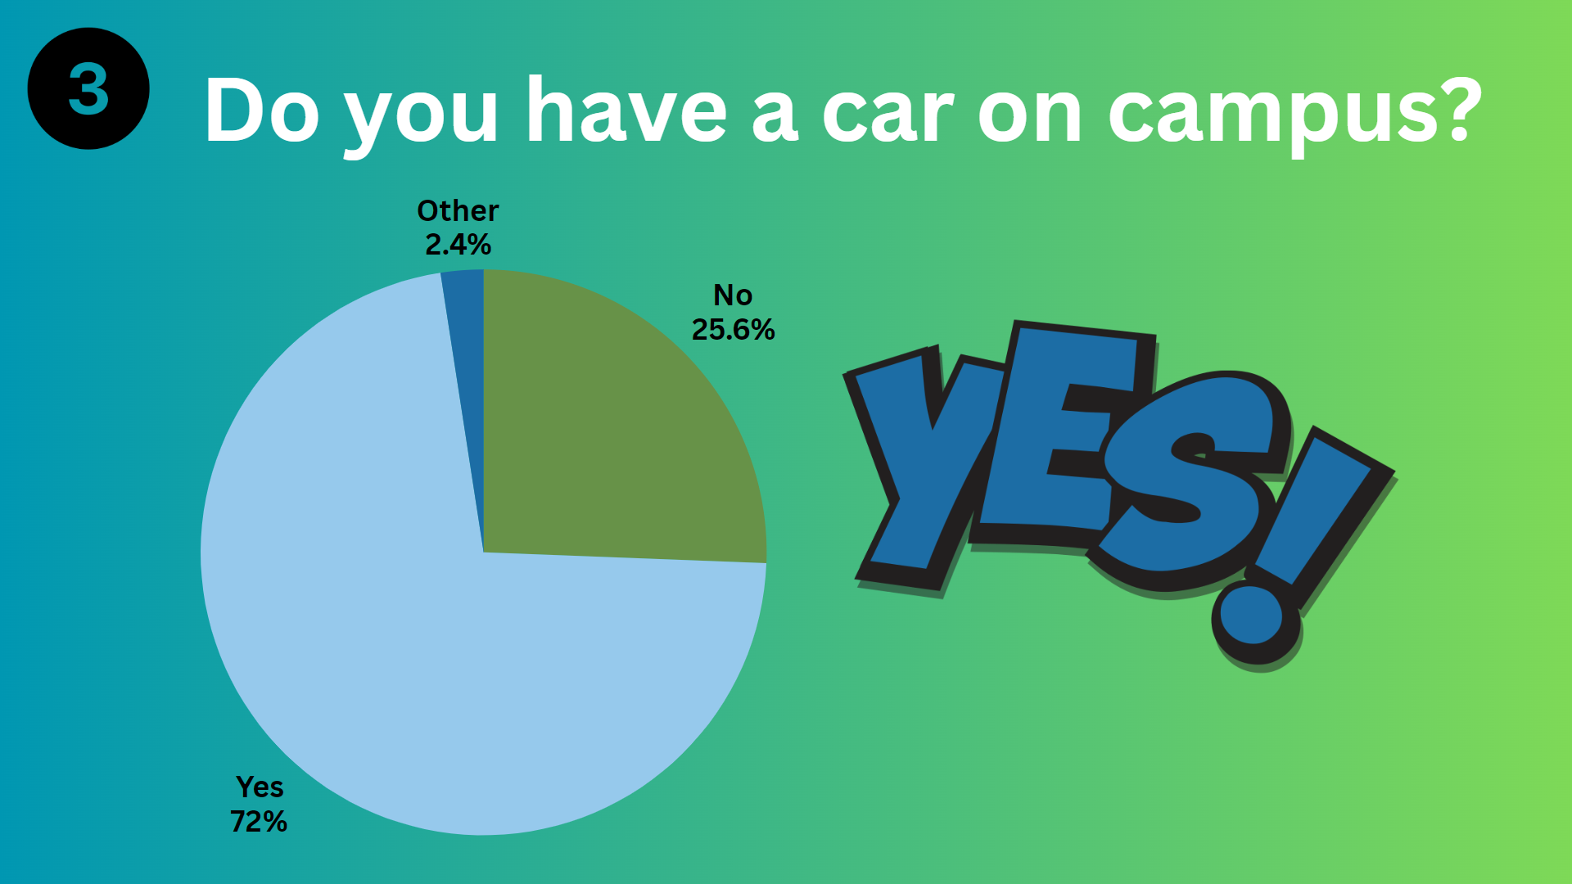

Slide 14
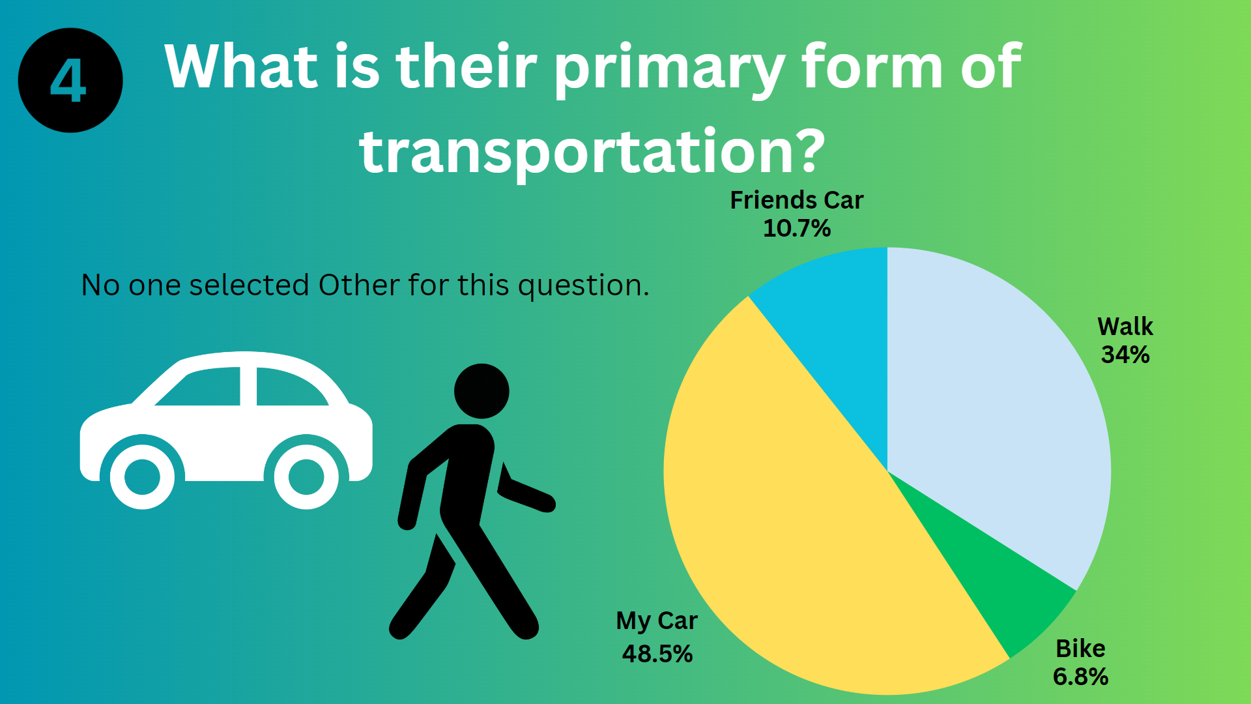

Slide 15
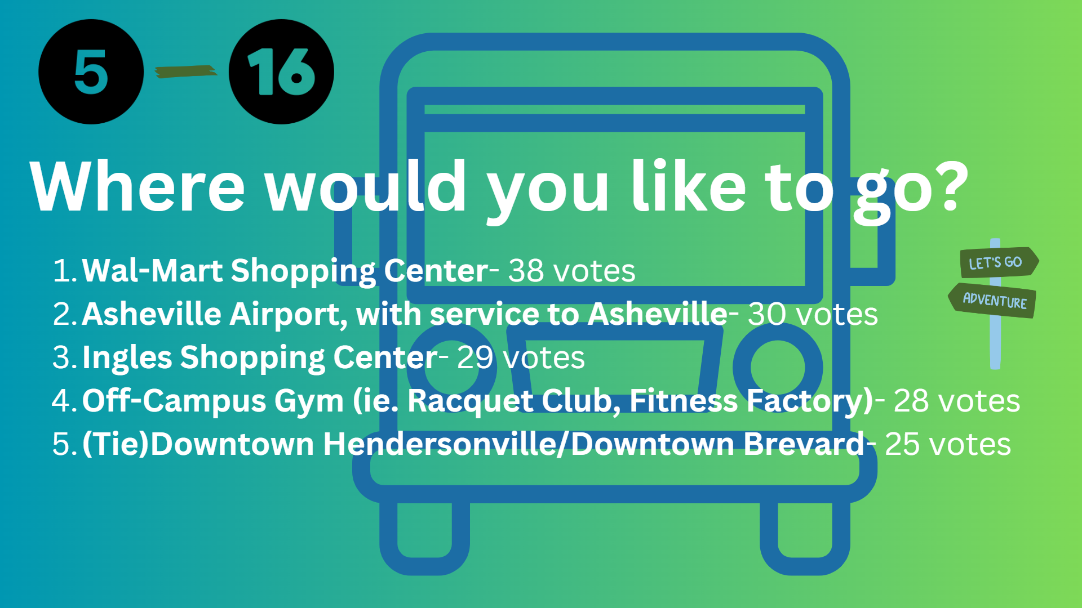

Slide 16


Slide 17
Old Business

Slide 18
New Business

Slide 19
A. CAI# 24-01

Slide 20
Community Appearance Initiative# 24-01
Application
Site Map and Detail
Background Information
Applicable Standards
Staff Recommendation
Decision
CAI# 24-01

Slide 21
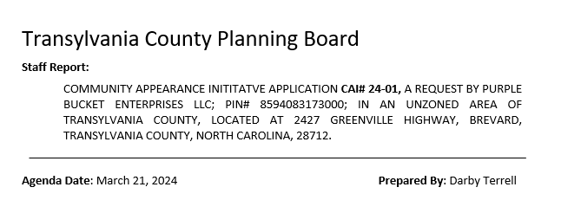
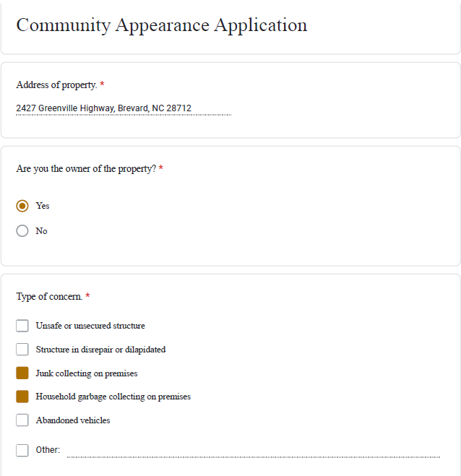
CAI# 24-01: Application

Slide 22
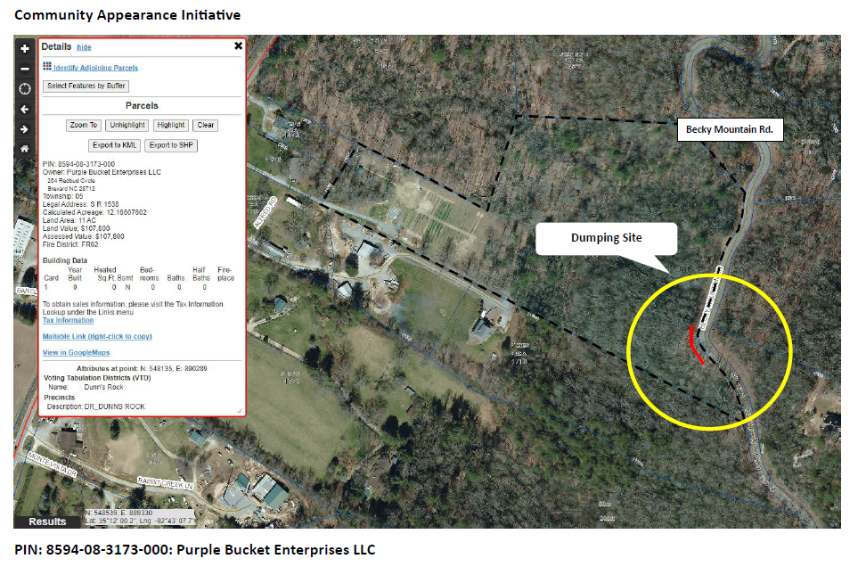
CAI# 24-01: Site Map

Slide 23
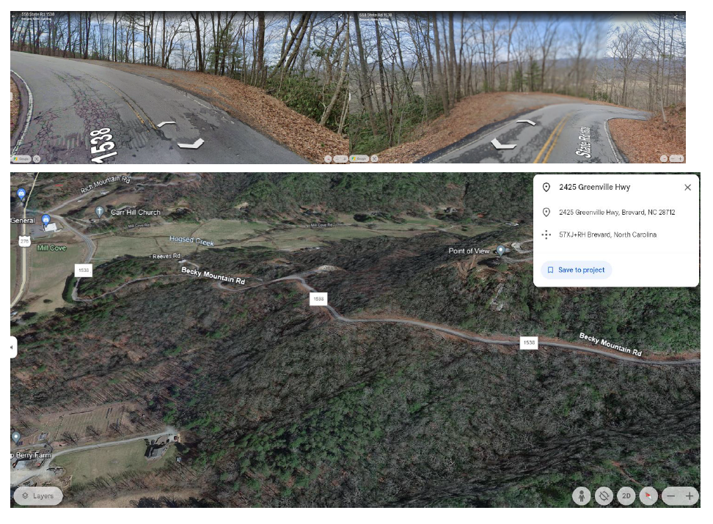
CAI# 24-01: Background Information

Slide 24
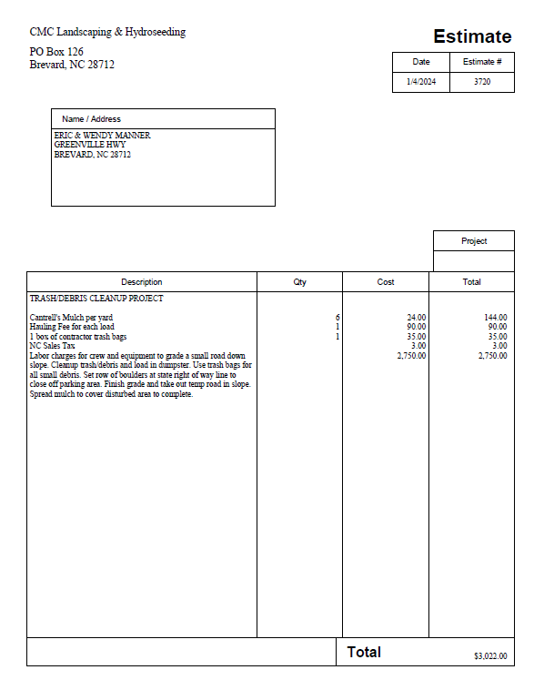
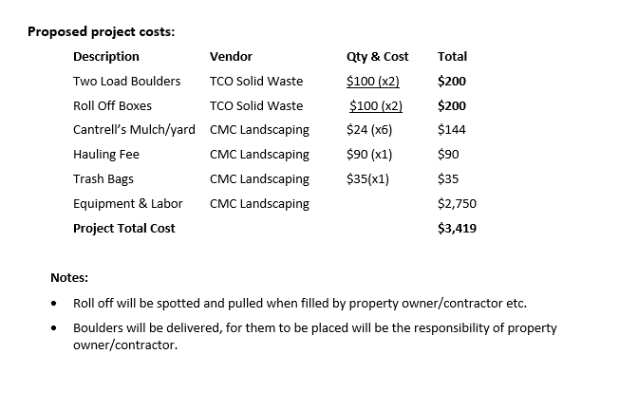
CAI# 24-01: Background Information

Slide 25
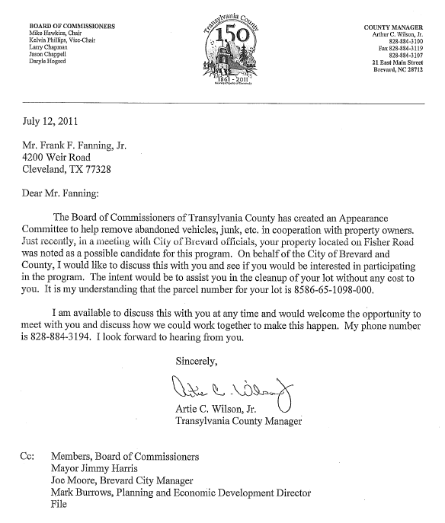
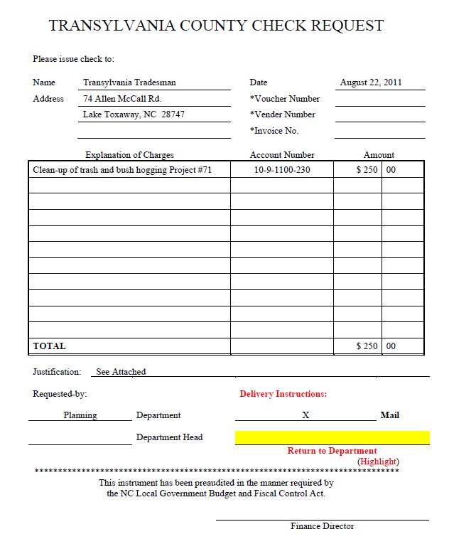
CAI# 24-01: Site Map

Slide 26
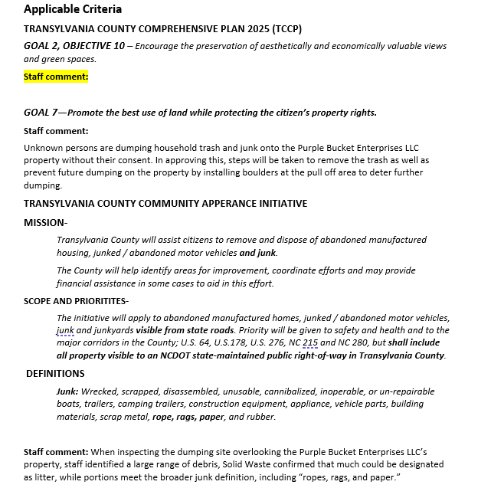
CAI# 24-01: Applicable Standards

Slide 27
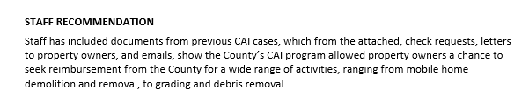
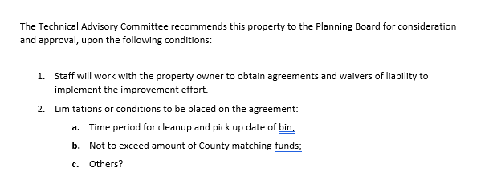
CAI# 24-01: Staff Recommendation

Slide 28
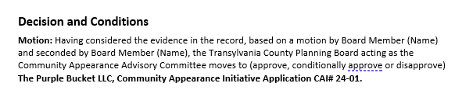
Community Appearance Initiative# 24-01
CAI# 24-01: Decision

Slide 29
Informational & Discussion Items

Slide 30
Comprehensive Plan Work Session,
    Outreach, Survey Questions & Issue Areas
Informational & Discussion Items

Slide 31
B. Comprehensive Plan

Slide 32
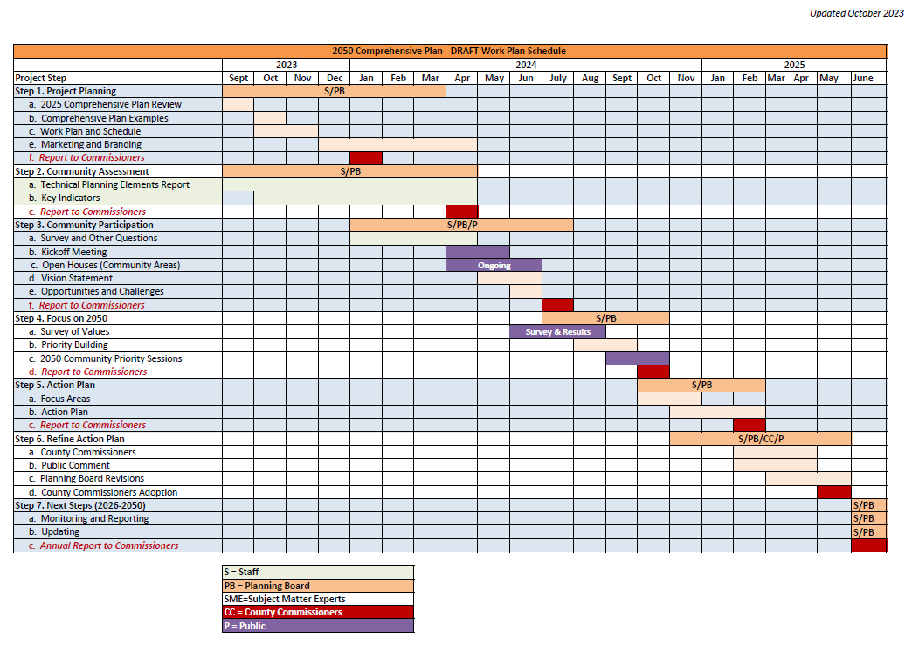
Comprehensive Plan: Outreach

Slide 33
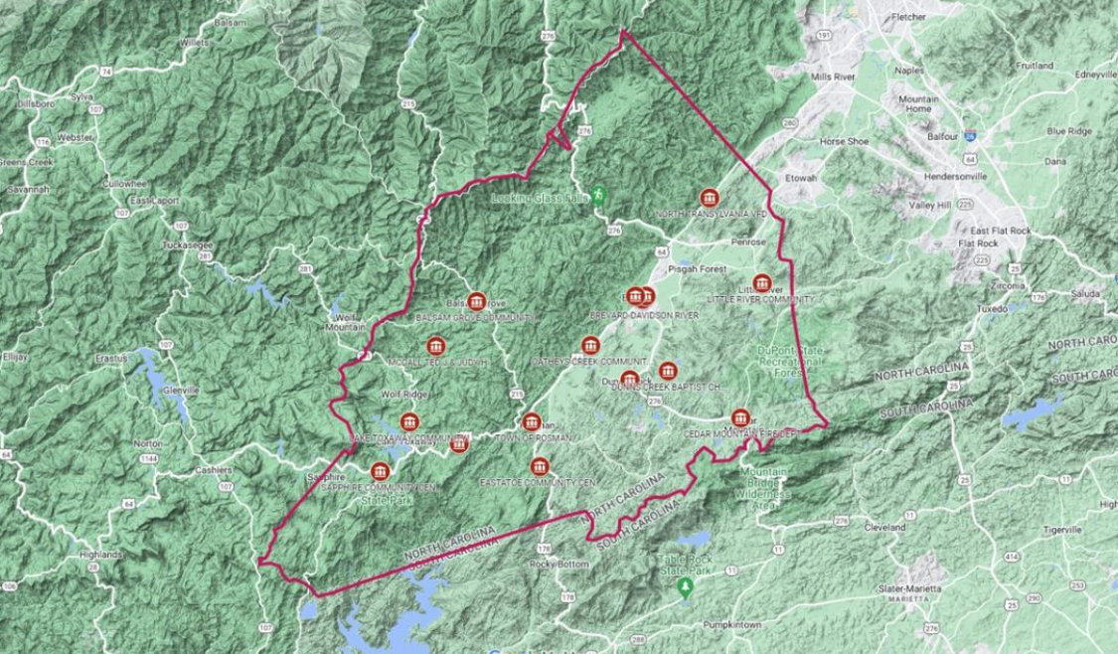
Comprehensive Plan: Outreach

Slide 34
Kick-Off
Events
Priority
Sessions
Community
Meetings
Community
Survey
Draft
Update
Review &
Adoption
Comprehensive Plan: Survey Questions

Slide 35
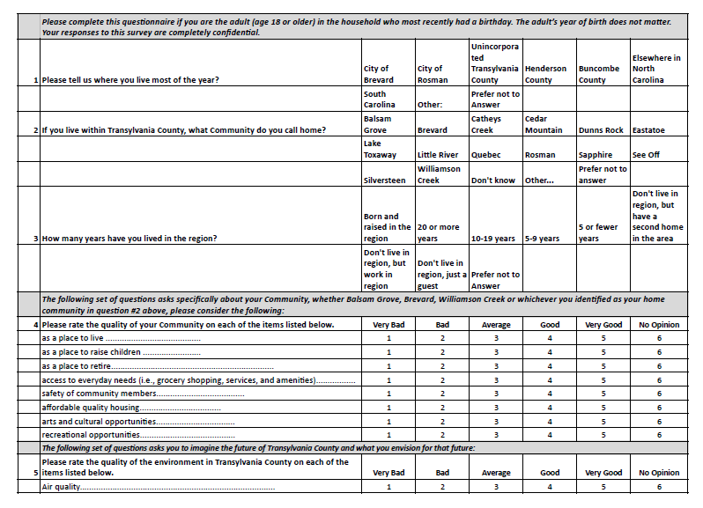
Comprehensive Plan: Survey Questions

Slide 36

Comprehensive Plan: Issue Areas

Slide 37
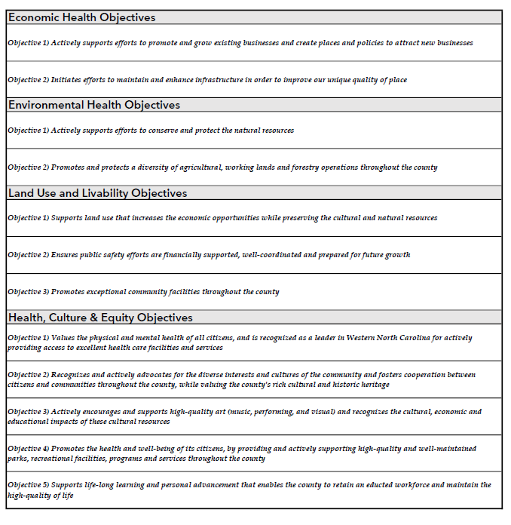
Comprehensive Plan: Issue Areas

Slide 38
Comprehensive Plan: Issue Areas

Slide 39
Number of occupied dwellings
Number of people in the Household
Number of households with children
Race/ethnicity of households
Ages/Average age of people in the household
Educational levels of people in the household
Household income (bracket values are fine)
Other demographics/parameters I haven’t listed but that you feel are important
Enrollment in public school system - total ADMs - is that trending up, down, or steady over past 10 years
Percentage of students receiving free/reduced lunches, and trend lines on that if available
Total school budget in FY23, including all sources - and 10 year trend lines is available
Total local only support in FY23, with 10 year trend lines
Graduation rates FY23, with 10 year trend lines
3rd Grade reading proficiency, with 10 year trend lines
Percentage of students attending university or community college
Comprehensive Plan: Data Questions & Sources

Slide 40
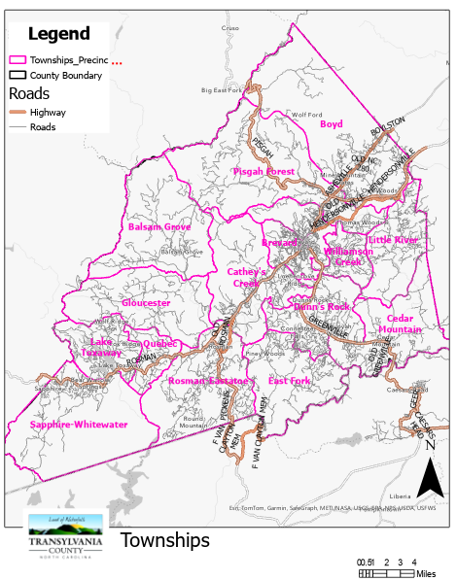
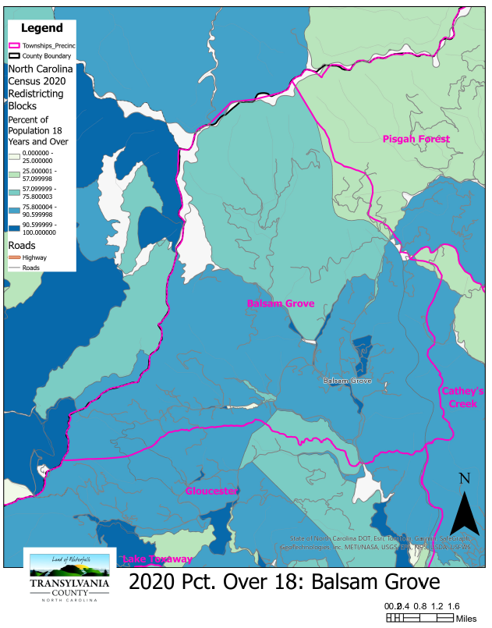
Comprehensive Plan: Issue Areas

Slide 41
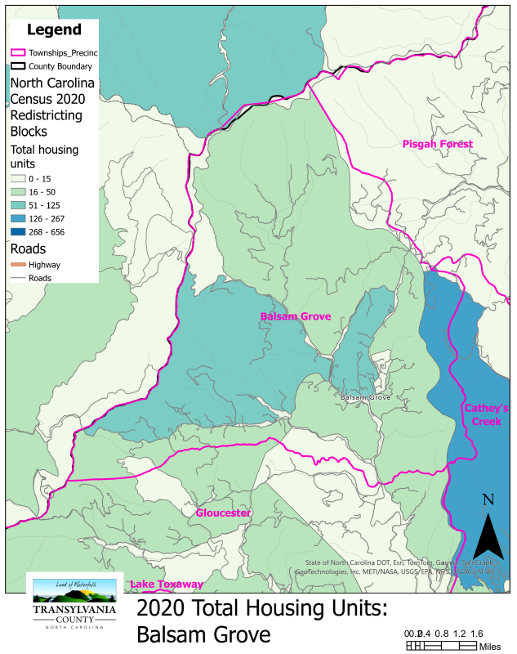
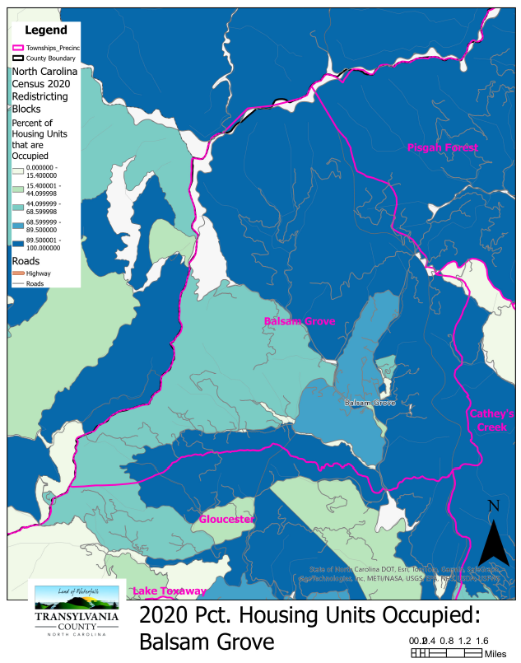
Comprehensive Plan: Issue Areas

Slide 42
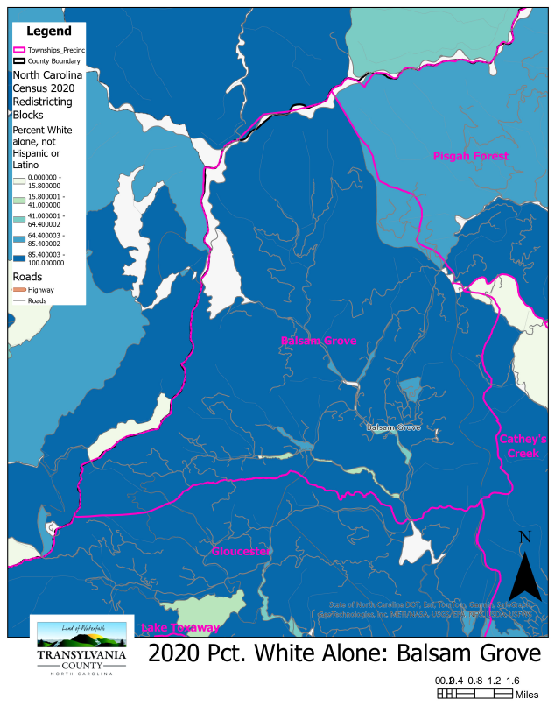
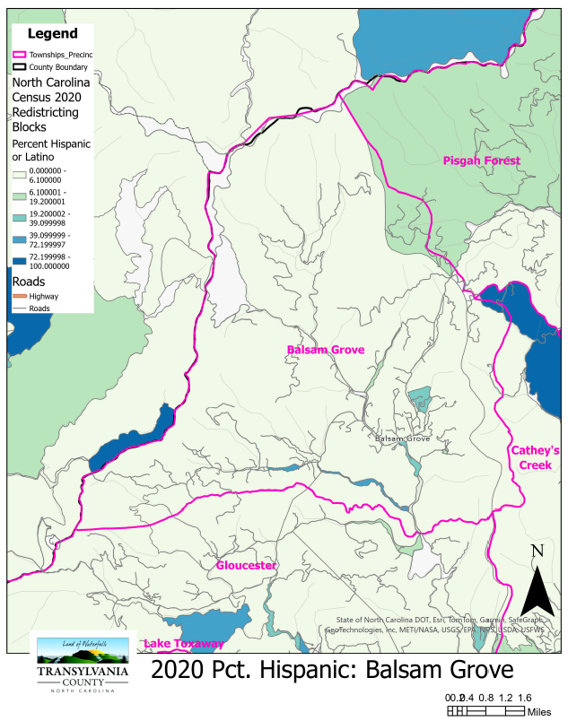
Comprehensive Plan: Issue Areas

Slide 43
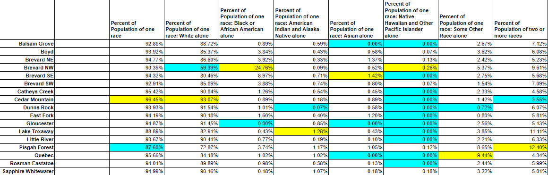
Comprehensive Plan: Demographics

Slide 44
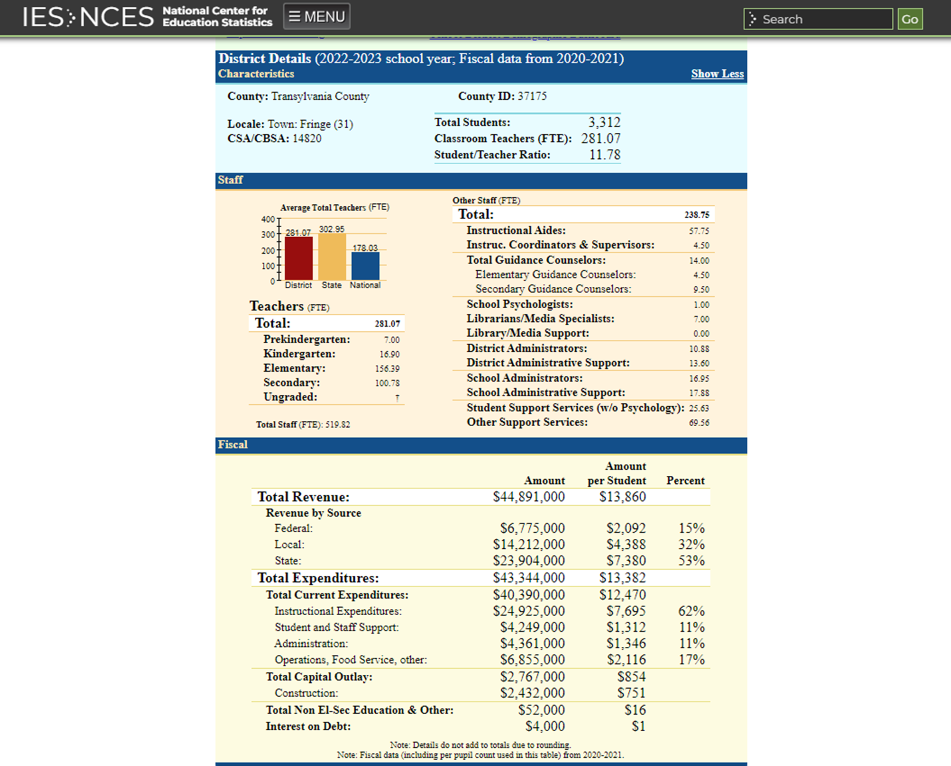
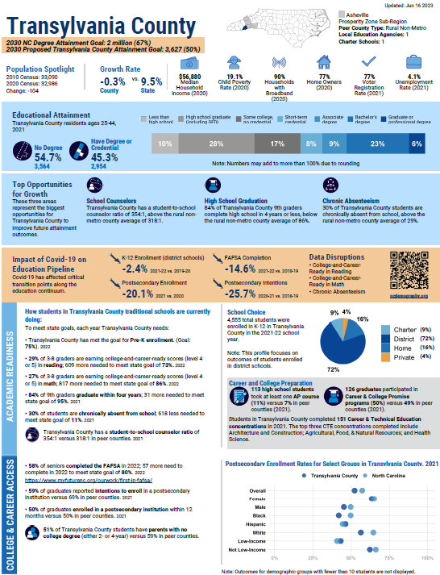
Comprehensive Plan: Demographics

Slide 45
Comprehensive Plan: Demographics

Slide 46
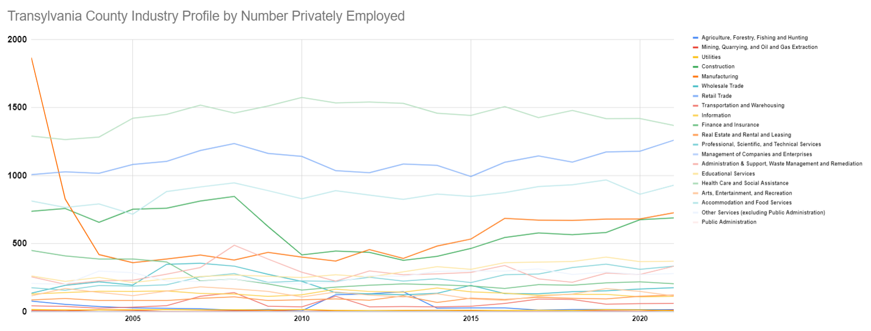
Comprehensive Plan: Issue Areas

Slide 47
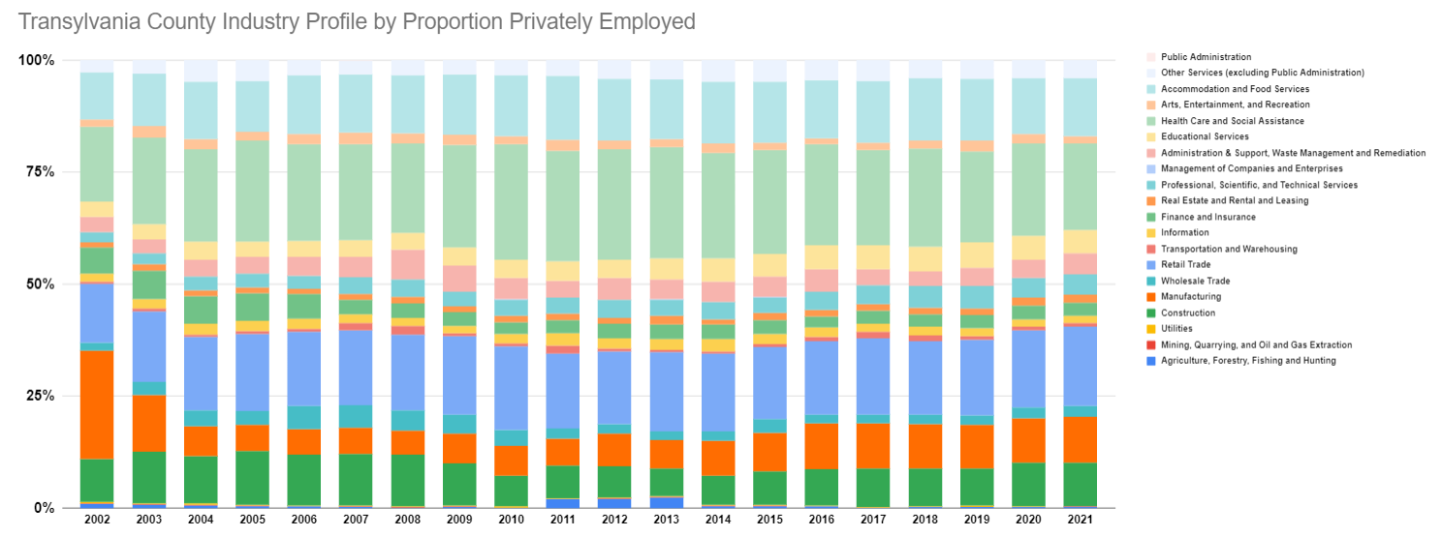
Comprehensive Plan: Issue Areas

Slide 48
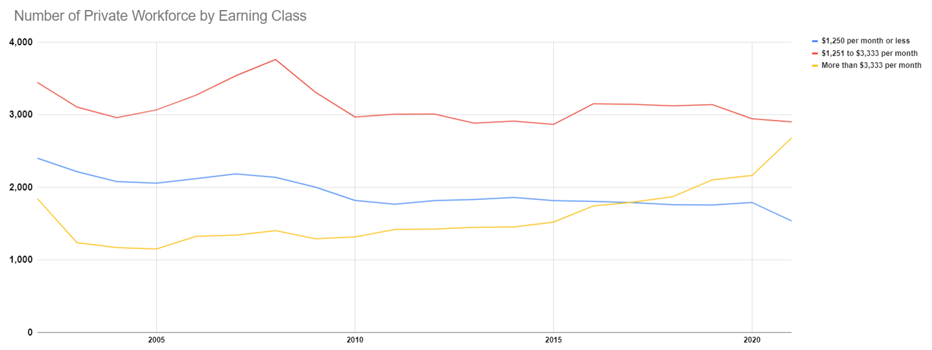
Comprehensive Plan: Issue Areas

Slide 49
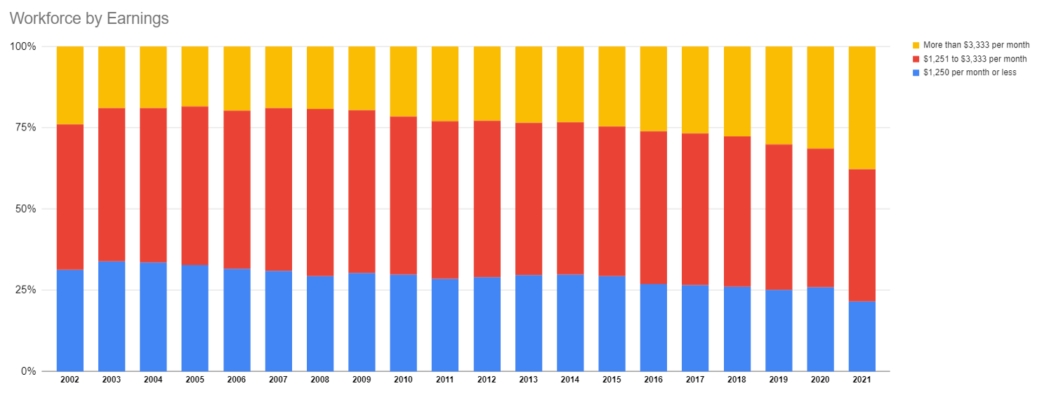
Comprehensive Plan: Issue Areas

Slide 50
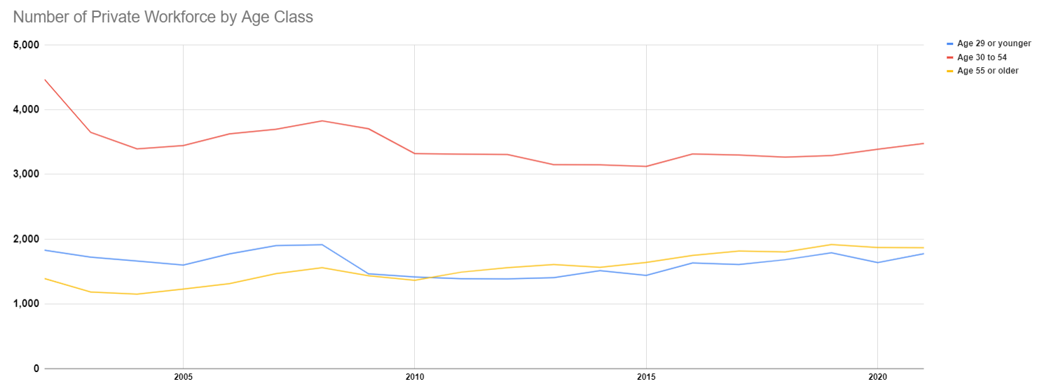
Comprehensive Plan: Issue Areas

Slide 51
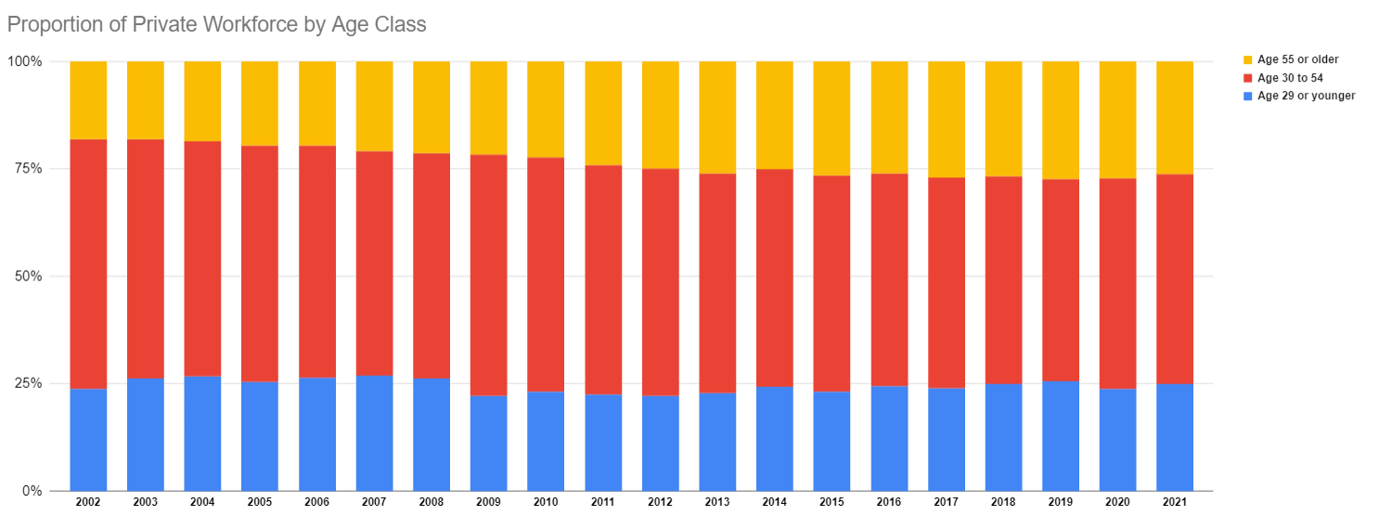
Comprehensive Plan: Issue Areas

Slide 52
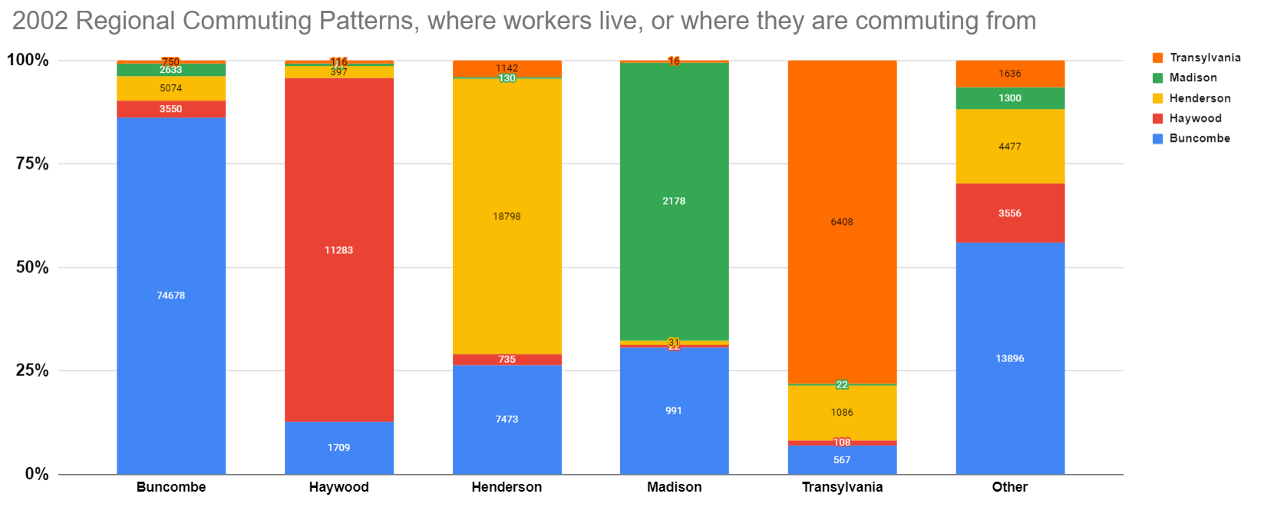
Housing Graphics 2050

Slide 53
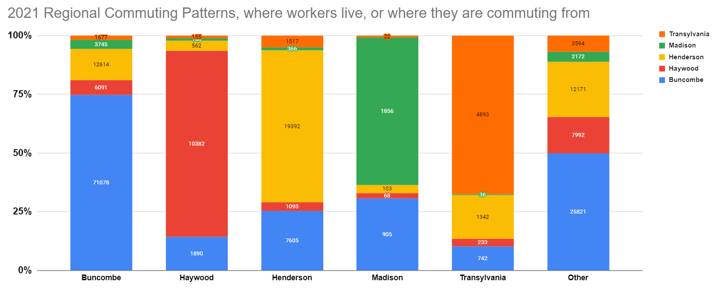
Housing Graphics 2050

Slide 54
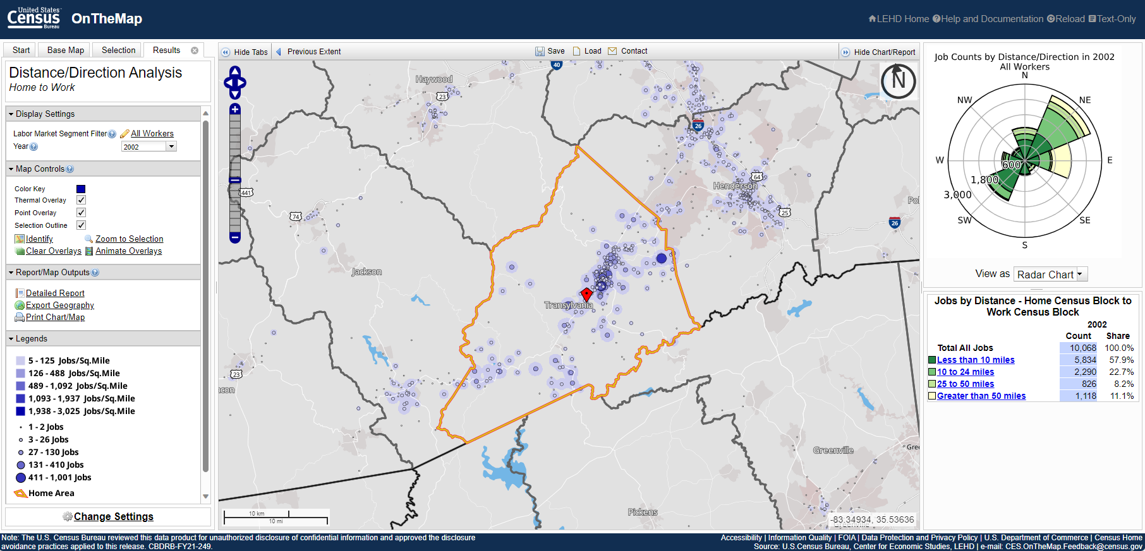
Housing Graphics 2050

Slide 55
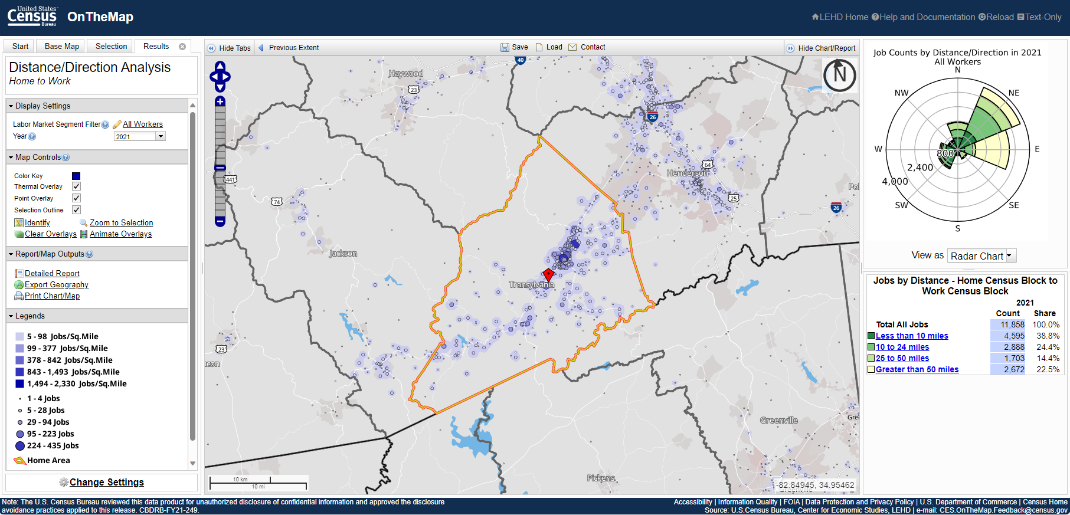
Housing Graphics 2050

Slide 56
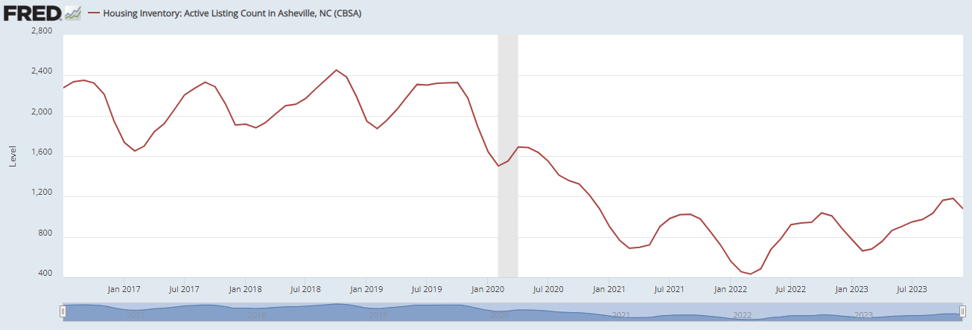
Housing Graphics 2050

Slide 57
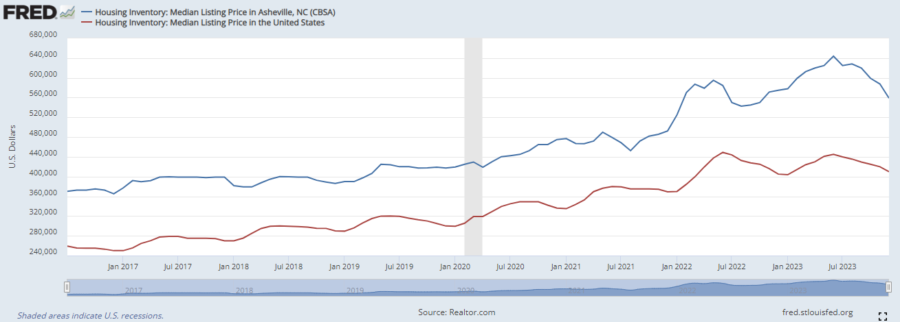
Housing Graphics 2050

Slide 58
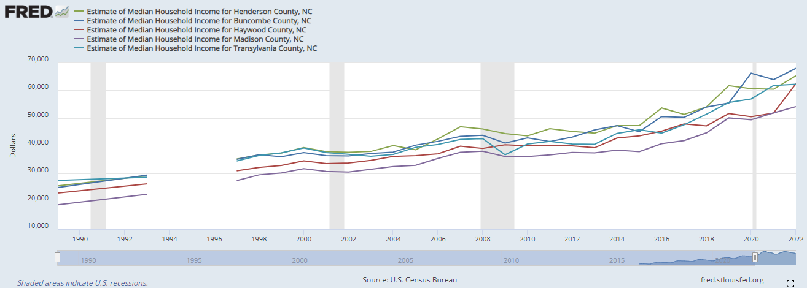
Housing Graphics 2050

Slide 59
Company Name | Industry | Class | Employment Range | 2022 Rank | 2012 Rank | 2002 Rank | 1992 Rank
Transylvania County Schools | Educational Services | Public Sector | 500-999 | 1 | 1
Transylvania County | Public Administration | Public Sector | 250-499 | 2 | 3 | 5 | 6
Mh Transylvania Regional Hospital L | Health Care and Social Assistance | Private Sector | 250-499 | 3 | 2*
Brevard College Corp | Educational Services | Private Sector | 250-499 | 4 | 5< | 7 | 9
Ingles Markets, Inc | Retail Trade | Private Sector | 100-249 | 5 | 4 | 13 | 19<
Gaia Herbs Inc | Manufacturing | Private Sector | 100-249 | 6 | 11 | 16<
Transylvania Vocational Services | Health Care and Social Assistance | Private Sector | 100-249 | 7 | 10 | 10 | 11
Lowes Home Centers Inc | Retail Trade | Private Sector | 100-249 | 8 | 12
City Of Brevard | Public Administration | Public Sector | 100-249 | 9 | 6 | 15< | 15
Wal-Mart Associates Inc. | Retail Trade | Private Sector | 100-249 | 10 | 7 | 8 | 18<
Oskar Blues | Manufacturing | Private Sector | 100-249 | 11
Mcneely's Store & Rental | Retail Trade | Private Sector | 50-99 | 12
Trails Carolina | Health Care and Social Assistance | Private Sector | 50-99 | 13
M B Industries Inc | Manufacturing | Private Sector | 50-99 | 14 | 8> | 9 | 8
Connestee Falls Property Owners | Other Services (except Public Administration) | Private Sector | 50-99 | 15 | 16
College Walk Retirement | Health Care and Social Assistance | Private Sector | 50-99 | 16 | 15 | 19 | 22
U S Department Of Agriculture (Nfc) | Public Administration | Public Sector | 50-99 | 17 | 13 | 12> | 13
New Excelsior Inc | Manufacturing | Private Sector | 50-99 | 18 | 17*
Brevard Academy | Educational Services | Private Sector | 50-99 | 19
The Oaks - Brevard Llc | Health Care and Social Assistance | Private Sector | 50-99 | 20
Tores Home Inc | Health Care and Social Assistance | Private Sector | 50-99 | 21
Brevard Music Center Inc | Educational Services | Private Sector | 50-99 | 22
Citizens Telephone Co | Information | Private Sector | 50-99 | 23 | 18 | 20 | 21
U S Postal Service | Transportation and Warehousing | Public Sector | 50-99 | 24 |  | 22
The Greystone Inn | Accommodation and Food Services | Private Sector | 50-99 | 25
Comprehensive Plan: Issue Areas

Slide 60
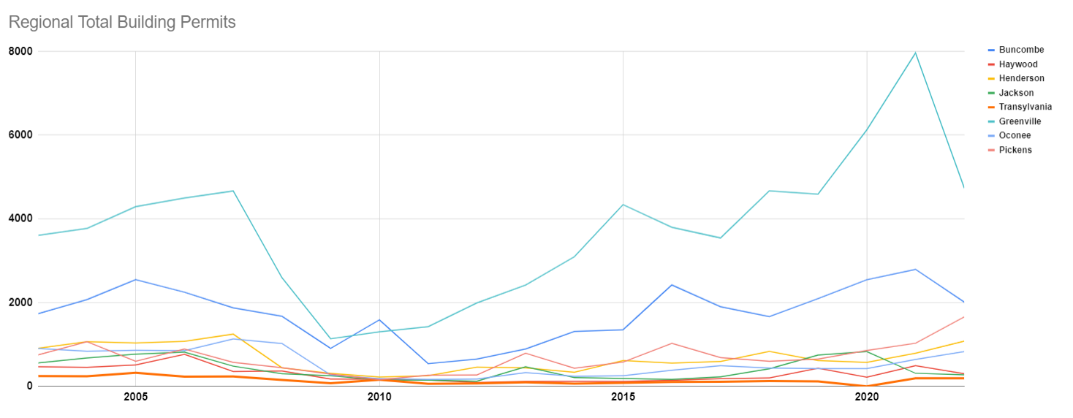
Comprehensive Plan: Issue Areas

Slide 61
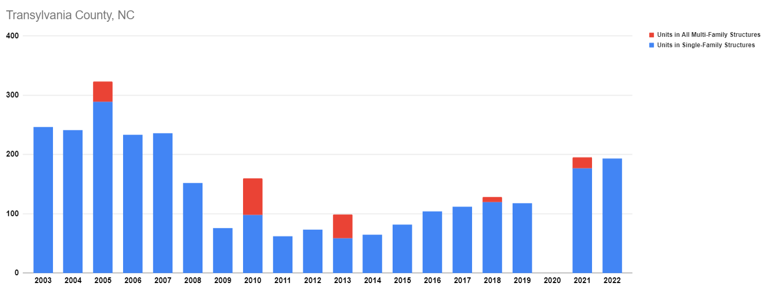
Comprehensive Plan: Issue Areas

Slide 62
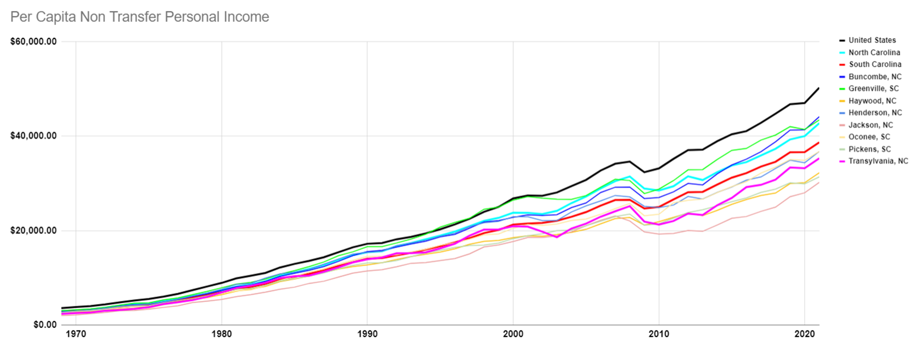
Comprehensive Plan: Issue Areas

Slide 63
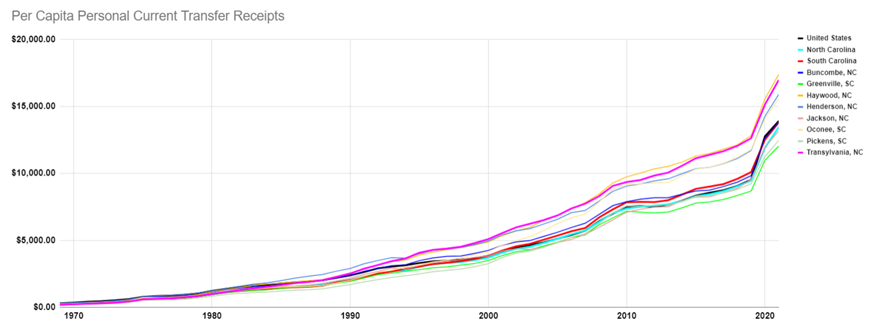
Comprehensive Plan: Issue Areas

Slide 64

Comprehensive Plan: Issue Areas

Slide 65

Comprehensive Plan: Issue Areas

Slide 66

Comprehensive Plan: Issue Areas

Slide 67

Comprehensive Plan: Issue Areas

Slide 68

Comprehensive Plan: Issue Areas

Slide 69

Comprehensive Plan: Issue Areas

Slide 70

Comprehensive Plan: Issue Areas

Slide 71

Comprehensive Plan: Issue Areas

Slide 72

Comprehensive Plan: Issue Areas

Slide 73

Comprehensive Plan: Issue Areas

Slide 74

Comprehensive Plan: Issue Areas

Slide 75

Comprehensive Plan: Issue Areas

Slide 76

Comprehensive Plan: Issue Areas

Slide 77

Comprehensive Plan: Issue Areas

Slide 78

Comprehensive Plan: Issue Areas

Slide 79

Comprehensive Plan: Issue Areas

Slide 80

Comprehensive Plan: Issue Areas

Slide 81

Comprehensive Plan: Issue Areas

Slide 82

Comprehensive Plan: Issue Areas

Slide 83

Comprehensive Plan: Issue Areas

Slide 84

Comprehensive Plan: Issue Areas

Slide 85

Comprehensive Plan: Issue Areas

Slide 86

Comprehensive Plan: Issue Areas

Slide 87

Comprehensive Plan: Issue Areas

Slide 88

“The Lives of Children” Report
2016 data, no update
Comprehensive Plan: Issue Areas

Slide 89
Economic & Social Mobility:
    Brain Drains, Springs & Dams
Aging America
    Aging In & Out of Place
Future of Work
    Workforce Dynamic, Static & Elastic States
Housing
    A Home by Any Other Name…
Comprehensive Plan: Trends

Slide 90
Dynamic | Local | Regional | State | National | Global
Mobility
Aging
Workforce
Housing
Comprehensive Plan: Trends

Slide 91
Dynamic | Local | Regional | State | National | Global
Mobility
Aging
Workforce
Housing
…
…
…
Comprehensive Plan: Trends

Slide 92
Public Comment

Slide 93
Board Members’ Comments

Slide 94

Adjournment

