Slide 1
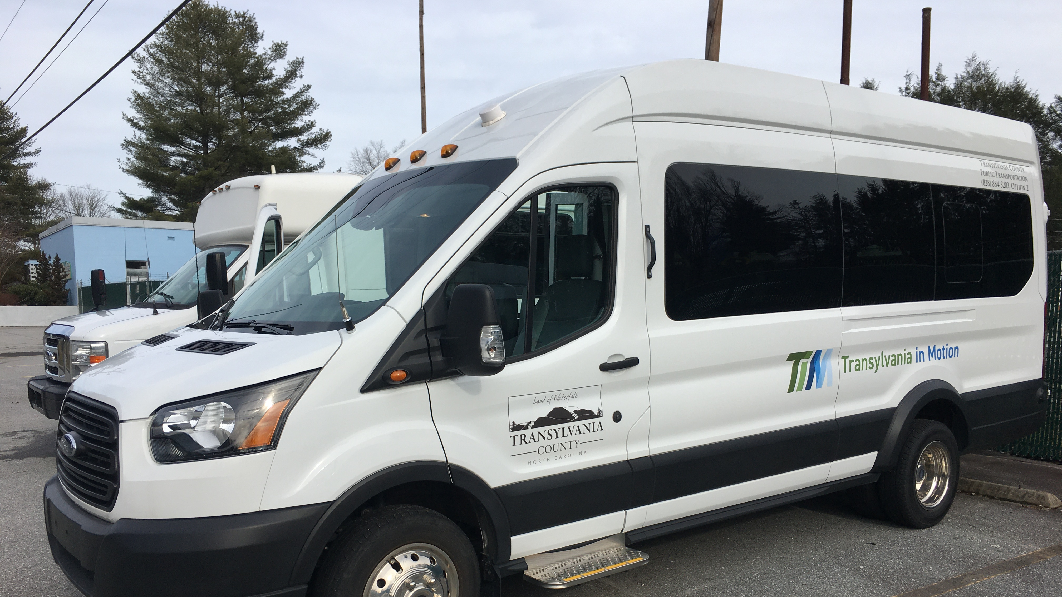
Transportation Advisory Board
August 9, 2023

Slide 2
I. Welcome

Slide 3
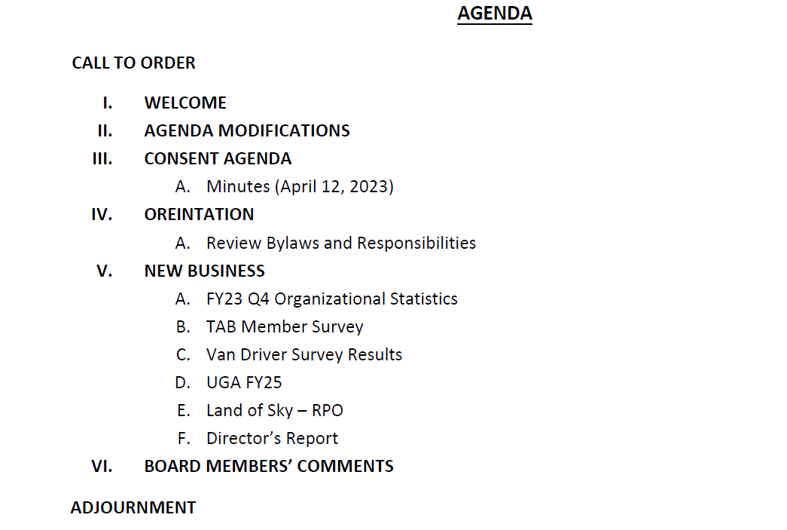
III. Agenda Modifications

Slide 4
IV. Consent Agenda
August 10, 2022 Draft Meeting Minutes

Slide 5
IV. Organizational Meeting
Review of Bylaws and Responsibilities

Slide 6
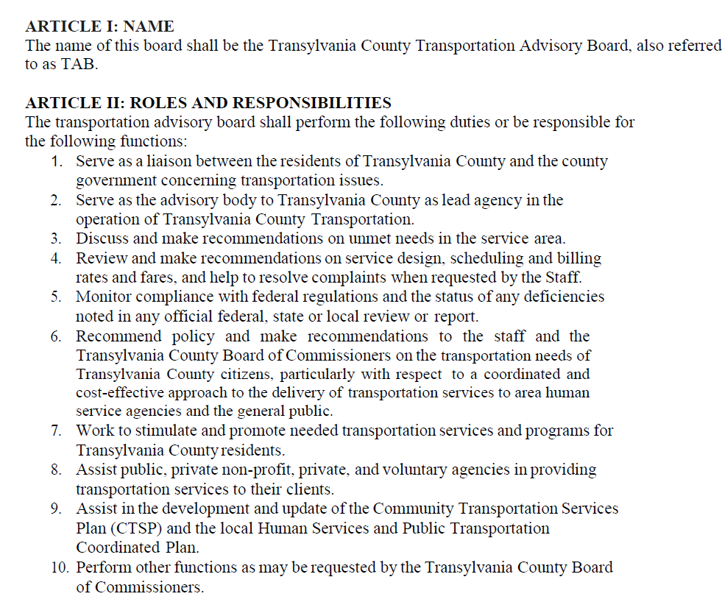
Agency by-laws.

Slide 7
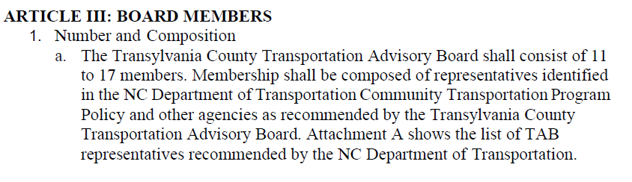
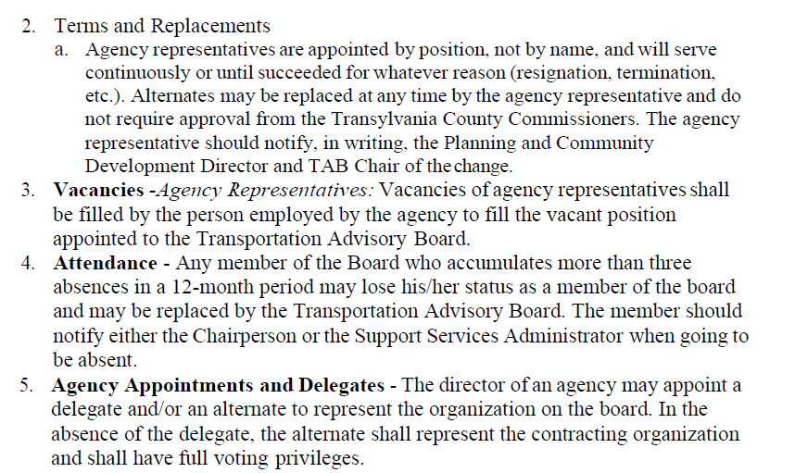
Agency by-laws.

Slide 8
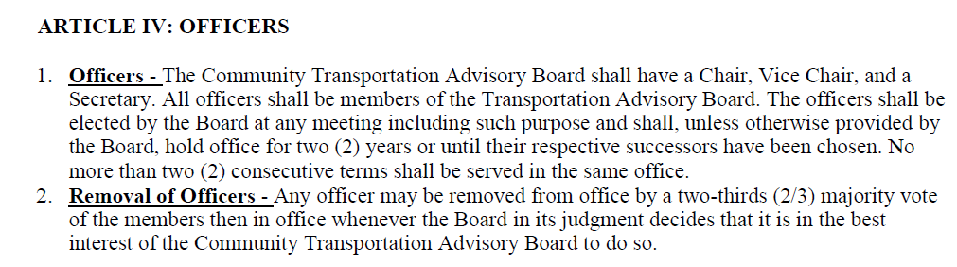
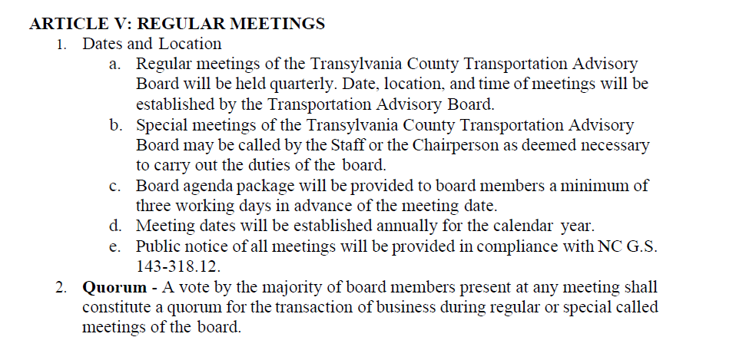
Agency by-laws.

Slide 9
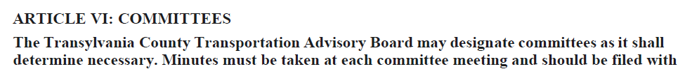
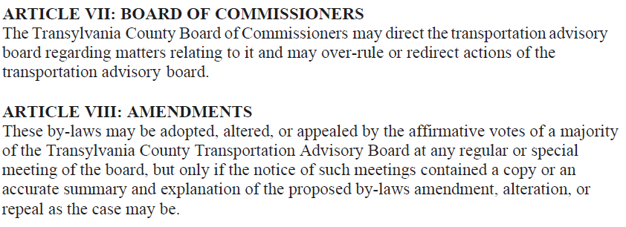
Agency by-laws.

Slide 10
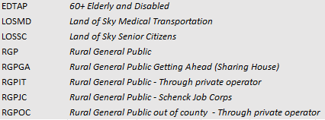
V-A. Q-3 FY23 Transportation Operational Statistics
 | 1/1/2023 - 3/31/2023 |  |  | 1/1/2022 - 3/31/2022
 | Pass Miles | Passengers |  | Pass Miles | Passengers
EDTAP | 5,055 | 1,574 |  | 2,919 | 934
LOSMD | 413 | 113 |  | 300 | 76
LOSSC | 3,363 | 792 |  | 5,310 | 1,007
RGP | 2,948 | 688 |  | 2,043 | 287
RGPGA | 3 | 5 |  | 31 | 15
RGPIT | 0 | 561 |  | 0 | 375
RGPJC
RGPOC | 0 | 4 |  | 0 | 0
RGPVC | 0 | 129 |  | 0 | 153
RGPVO | 0 | 48 |  | 0 | 32
RGP subtotal | 2,951 | 1,435 |  | 2,074 | 862
TCTVS
TVSED | 9,128 | 1,314 |  | 9,699 | 1,312
TVSGP | 1,691 | 233 |  | 354 | 86
TVS subtotal | 10,819 | 1,547 |  | 10,053 | 1,752
Overall total | 22,601 | 5,461 |  | 20,656 | 4,631

Slide 11
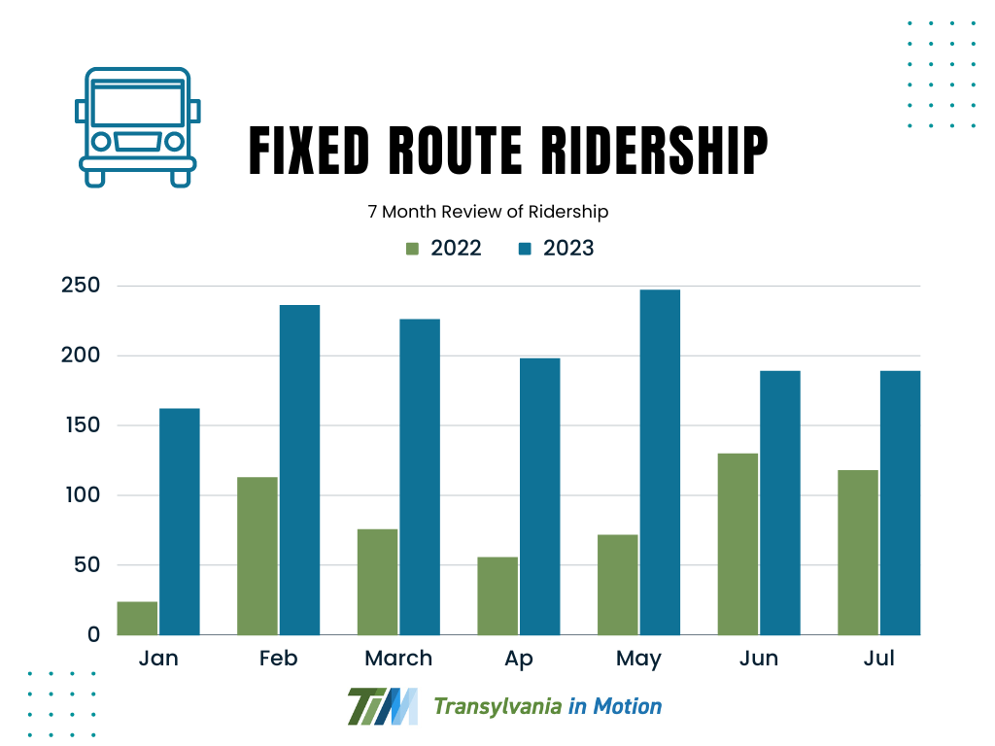

Slide 12
V. Tab member survey
Staff will pass around a quick survey

Slide 13
V-C. Van Driver Survey
Out of 8 Van drivers, (full and part time), 6 answered the survey
Drivers who answered stated they believe daily 21-40% of riders are under the classification of disabled, while 61-80% are elderly, and 1-20% are with children.
They rarely transport bikes or from one mode of transportation to another.
41-61% of riders are transporting groceries or goods when using our service

Slide 14
V-C. Van Driver Survey

Slide 15
V-C. Van Driver Survey

Slide 16
V-C. Van Driver Survey

Slide 17
V-D. FY25 Unified Grant Application
Section 5311 Administrative, Capital Programs and Section 5310 Operating Program for FY 2025
FY2025
FY2024
Project | Total Amount | Local Share
5311 Administrative | $164,470 | $24,671
Combined Capital | $435,000 | $43,500
5310 Operating | $104,000 | $52,000
Total Project | $703,470 | $120,171
Project | Total Amount | Local Share
5311 Administrative | $164,470 | $24,671
Combined Capital | $145,000 | $14,500
5310 Operating | $104,000 | $52,000
Total Project | $413,470 | $91,171

Slide 18
V-D. FY25 Unified Grant Application
Transylvania County Transportation requests a total of $164,470 in support for the administrative expenditures of its transit program. This requires a County local match of $24,671 (15%) of the total.
Transylvania County requests a total of $435,000 in capital funding for replacement for two (3) vans with lifts that have bike racks. This requires a County match of $43,500 (10%) of the total.
For Fiscal Year 2023, Transylvania County plans to apply for the same amount of $104,000, this requires a County match of $52,000 (50%) of the total. The County currently budgets $52,000 for the purchase of rides through a local private operator.

Slide 19
V-C. Land of Sky – RPO
Vicki Eastland

Slide 20
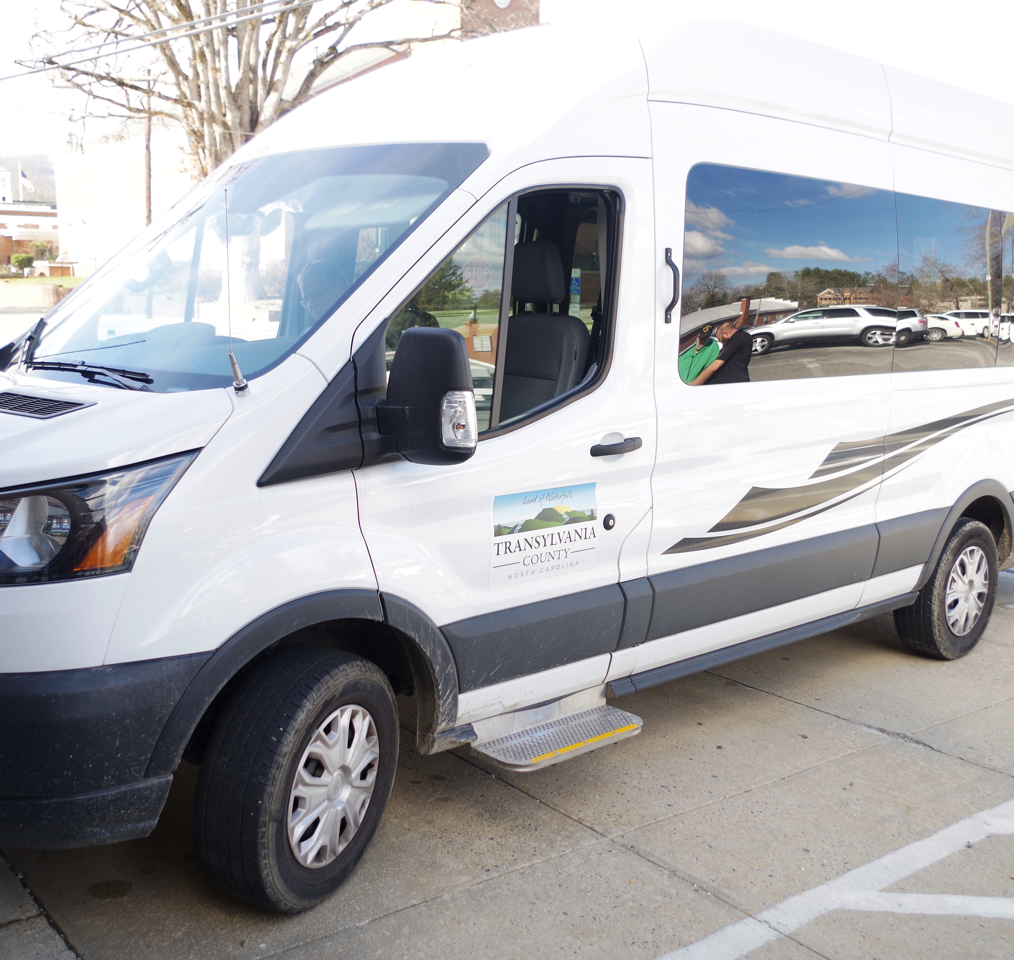
V-D. Staff’s Report
Will be presenting to the County Commissioners with the UGA at their September meeting
The UGA will be sent to NCDOT IMD by October 11
Next TAB meeting will be on November 8th at 2:00 PM, in the downstairs DSS Conference Room,1st Floor.

Slide 21
VI. Public Comment
15-Minute Time limit (speakers are held to three minutes)

Slide 22
VII. Board Members Comments

Slide 23
Thank you for attending

