Slide 1
TAC
Tuesday, July 13, 2021 @ 7pm

Slide 2
Public Comment
To allow recommended social distancing practices, public comment can be submitted by email or physical mail prior to each Planning Board meeting.
Arrangements can also be made for those wishing to speak in public comment to call in and speak via conference call.
Speakers are limited to three minutes.
The public comment period will close when there are no more speakers, or the 15-minute limit is reached.
Public Comment will also be taken at the end of the meeting.

Slide 3
Organizational Meeting

Slide 4
Nomination and Election of a Chairperson
Recommendations
  Staff recommends the Committee hold nominations for a Chair to serve a term of one (1) year and vote to elect the nominee to the position.

Slide 5
Nomination and Election of a Vice-Chairperson
Recommendations
  Staff recommends the Committee hold nominations for a Vice-Chair to serve a term of one (1) year and vote to elect the nominee to the position.

Slide 6
Agenda Modifications

Slide 7
Consent Agenda
All items under the Consent Agenda are recommended for approval.
        Minutes
          April 13th, 2020

Slide 8
Old Business
NCDOT State Transportation Improvement Program (STIP) - Update
Transylvania County Comprehensive Transportation Plan (CTP) - Update

Slide 9
Old Business
NCDOT State Transportation Improvement Program (STIP) - Update
Transylvania County Comprehensive Transportation Plan (CTP) - Update

Slide 10
NCDOT State Transportation Improvement Program (STIP) - Update
  Background
    Vicki Eastland Eastland of Land of Sky RPO and Steve Williams, NCDOT update the committee on the current state of NCDOT. They will also be discussing the prioritization process, SPOT 6.0. Vicki and Steve will also be answering any questions that the committee members have on these topics

Slide 11


STIP Program Update
Joey Hopkins, PE – Deputy Chief Engineer – Planning Leigh Wing, PE – STIP Eastern Regional Manager
Connecting people, products and places safely and efficiently
June 30, 2021

Slide 12
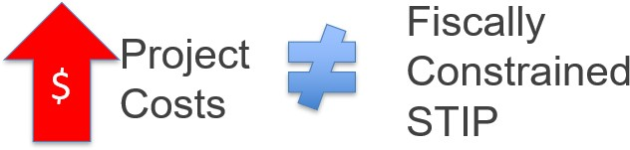
Summer 2020 Reprogramming
Project cost increases received September 2019 – June 20 20 , a long with re duce d re ve nues and cas h is s ues , we re large ly res pons ible for t he S ummer 20 20 S TIP
Re programming
Emphas ize d t he ne e d t o improve accuracy of NCDOT’s cos t e s t imation practice s
Multiple e fforts curre nt ly unde rway

Slide 13
Cost Estimation
Imp rove me nt Proc e s s

Slide 14
Cost Estimation Improvement Process
Workgroup of NCDOT staff reviewed existing cost estimation process and made
re comme ndations for improve me nts
Major Findings :
GIS -bas e d Cos t Es t imation Tool re s ult s are ofte n low
Right of Way (ROW), Utilit ie s (UTIL), and Cons t ruction (CON) e s t imate s not a lways update d re gularly and cons is te ntly dis t ribute d
Lack of ce ntral data-repos it ory for es t imates led t o multiple es t imates for s ame proje c t
Goals :
Create cons is te nt , e ngrained proces s for updating es t imates t hroughout NCDOT
Ens ure e s t imate s are update d on a re gular bas is and prope rly dis t ribute d t o all partie s
Cre ate a s ingle data-re pos it ory for a ll e s t imate s

Slide 15
Key Activities Underway
Ensure all cost estimates are based on engineering analysis (Express Designs)
All cost estimates will be updated at a minimum of every 2 years
  Centrally let projects will have construction estimate updated prior to entering 12 Month Let List
  ROW estimates will be updated prior to entering 6 month ROW list
Ensure appropriate contingencies are accounted for at all stages
Create a cost estimate application for storing and distributing estimates
Value Engineering/Value Assessments

Slide 16
STIP Cost Review

Slide 17
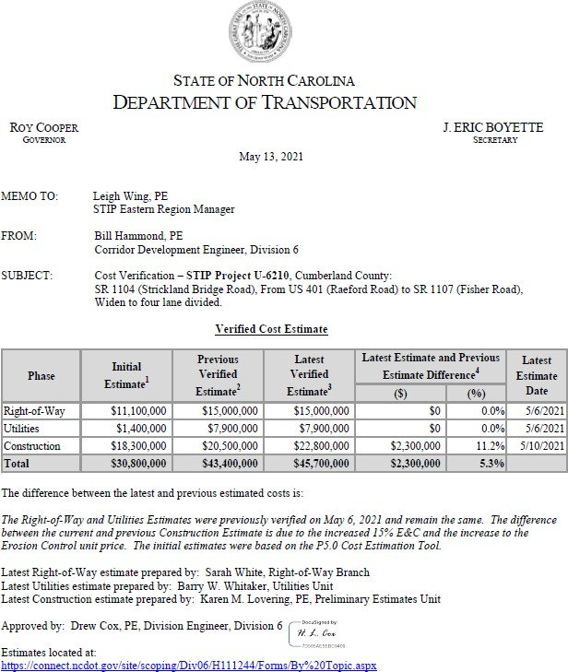
STIP Cost Review
In Summer 2020, NCDOT staff re vie wed a ll S TIP highway cos t es t imates
Recomme ndations made on es t imates t hat needed updating
4 5 0 + proje c t s
Include s 10 0 0 + e s t imate s for ROW, UTIL, and CON
Updating quantitie s and ve rifying s cope accuracy
Conducting Expres s Des igns whe re needed
Comple t e by S umme r 20 21
Divis ion Engine e rs are approving a ll ve rifie d cos t me mos
17

Slide 18
P6.0 Funding Availability
– Commit t e d & Non-Committe d Proje c ts
Statewide Mobility
Regional Impact
Division Needs
Available Funding
Programming Status
Region | Available Funding | Programming Status
A (D1 & D4) | $588.8M | $518.0M Over
B (D2 & D3) | $855.1M | $540.4M Over
C (D5 & D6) | $1.56B | $183.5M Over
D (D7 & D9) | $1.17B | $538.8M Over
E (D8 & D10) | $1.46B | $492.9M Over
F (D11 & D12) | $784.0M | $715.0M Over
G (D13 & D14) | $609.2M | $997.0M Over
Division | Available Funding | Programming Status
1 | $506M | $91.7M Over
2 | $506M | $409.3M Over
3 | $506M | $162.2M Over
4 | $506M | $142.8M Over
5 | $506M | $148.2M Over
6 | $506M | $434.9M Over
7 | $506M | $5.5M Over
8 | $506M | $346.6M Over
9 | $506M | $105.1M Over
10 | $506M | $256.4M Over
11 | $506M | $300.7M Over
12 | $506M | $198.1M Over
13 | $506M | $262.8M Over
14 | $506M | $193.4M Over
$9.4B
$2.79B Over
Available funding bas e d on 20 24 -20 3 3 t ime frame
As of June 29, 2021
18

Slide 19
P6.0 Funding Availability
– Committe d Proje c ts Only
Statewide Mobility
Regional Impact
Division Needs
Available Funding
Programming Status
Region | Available Funding | Programming Status
A (D1 & D4) | $588.8M | $172.7M Over
B (D2 & D3) | $855.1M | $346.0M Over
C (D5 & D6) | $1.56B | $15.4M Over
D (D7 & D9) | $1.17B | $404.9M Over
E (D8 & D10) | $1.46B | $450.8M Over
F (D11 & D12) | $784.0M | $249.2M Over
G (D13 & D14) | $609.2M | $756.8M Over
Division | Available Funding | Programming Status
1 | $506M | $30.8M Over
2 | $506M | $121.0M Over
3 | $506M | $108.7M Under
4 | $506M | $192.0M Under
5 | $506M | $128.3M Over
6 | $506M | $123.2M Under
7 | $506M | $91.7M Under
8 | $506M | $22.1M Over
9 | $506M | $49.8M Under
10 | $506M | $38.9M Over
11 | $506M | $54.1M Under
12 | $506M | $144.1M Over
13 | $506M | $165.5M Over
14 | $506M | $80.1M Over
$9.4B
$2.04B Over
Available funding bas e d on 20 24 -20 3 3 t ime frame
As of June 29, 2021
19

Slide 20
Questions for Prioritization Workgroup
Continue or modify P6.0?
Methodology used to determine funding schedules for 2024
-2033 STIP?
Next STIP to include Committed projects only or Committed + Non -Committed projects?
Input on STICR guidelines?
Other requests or input for the Workgroup to consider?
20

Slide 21
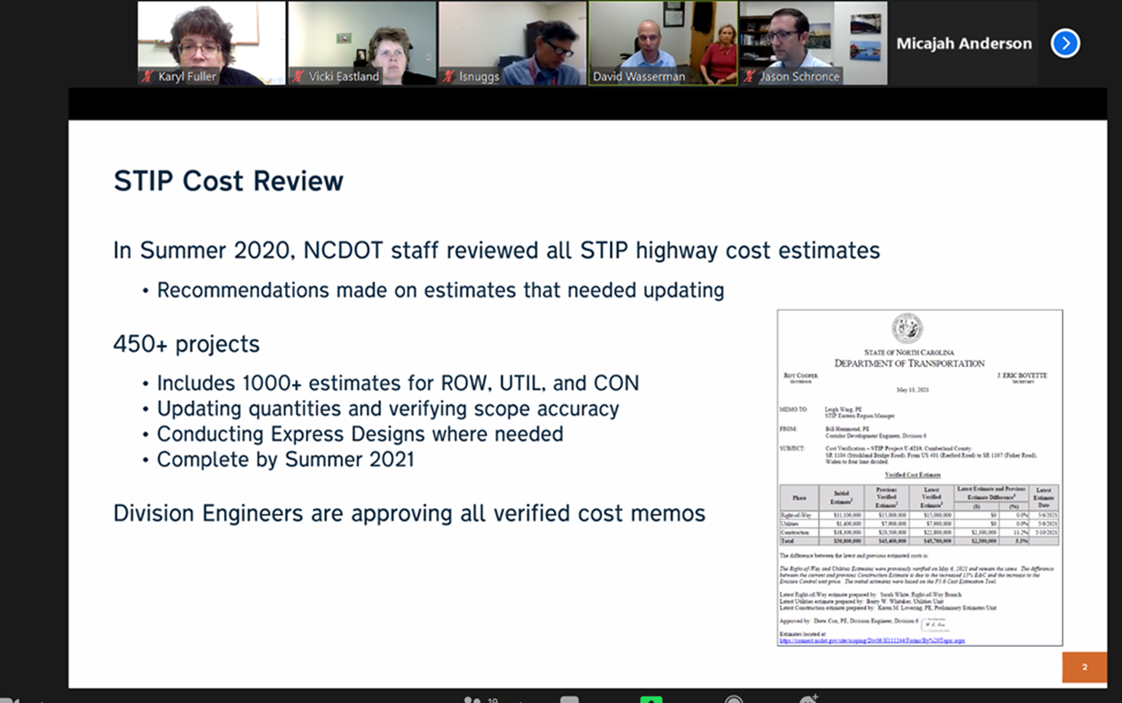
NCDOT State Transportation Improvement Program (STIP) - Update
  92% as of July 13th, 2021
  $5B in increases since last summer. Including last summer, $7B. STCR and value engineering is going to be coming

Slide 22
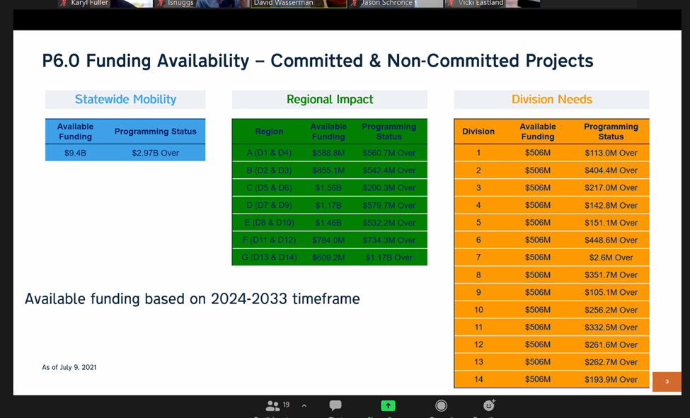
NCDOT State Transportation Improvement Program (STIP) - Update

Slide 23
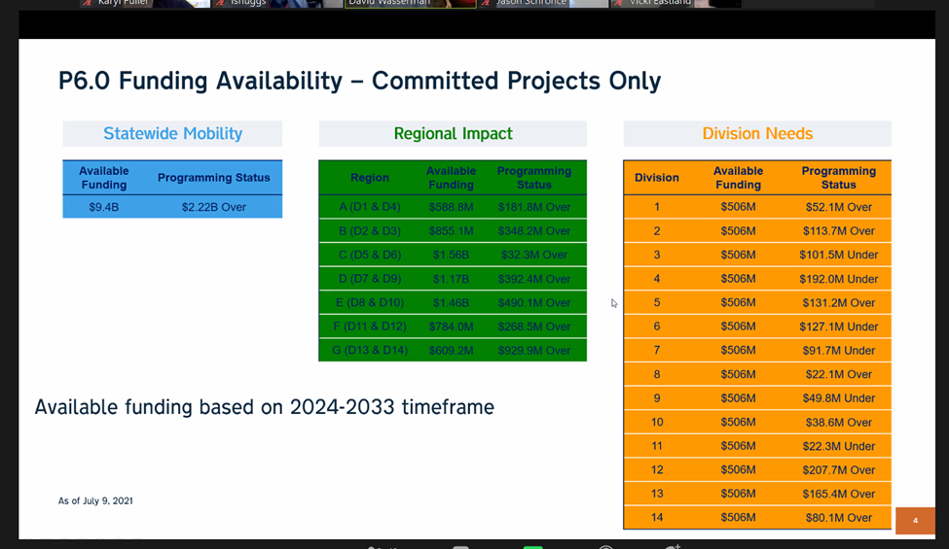
NCDOT State Transportation Improvement Program (STIP) - Update

Slide 24
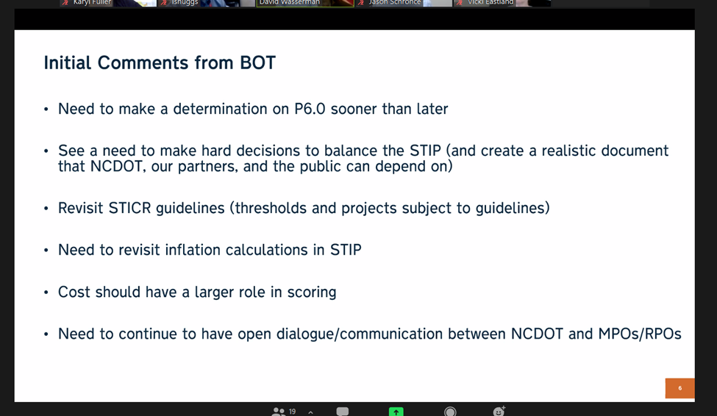
NCDOT State Transportation Improvement Program (STIP) - Update

Slide 25
Old Business
NCDOT State Transportation Improvement Program (STIP) - Update
Transylvania County Comprehensive Transportation Plan (CTP) - Update

Slide 26
Transylvania County Comprehensive Transportation Plan (CTP) - Update
  Background
    During Vicki Eastland’s presentation she will update the committee on the progress of the CTP as well as discuss next steps. She will be answering any questions the committee members have on the topics discussed in the CTP meetings and the direction the committee is going.

Slide 27
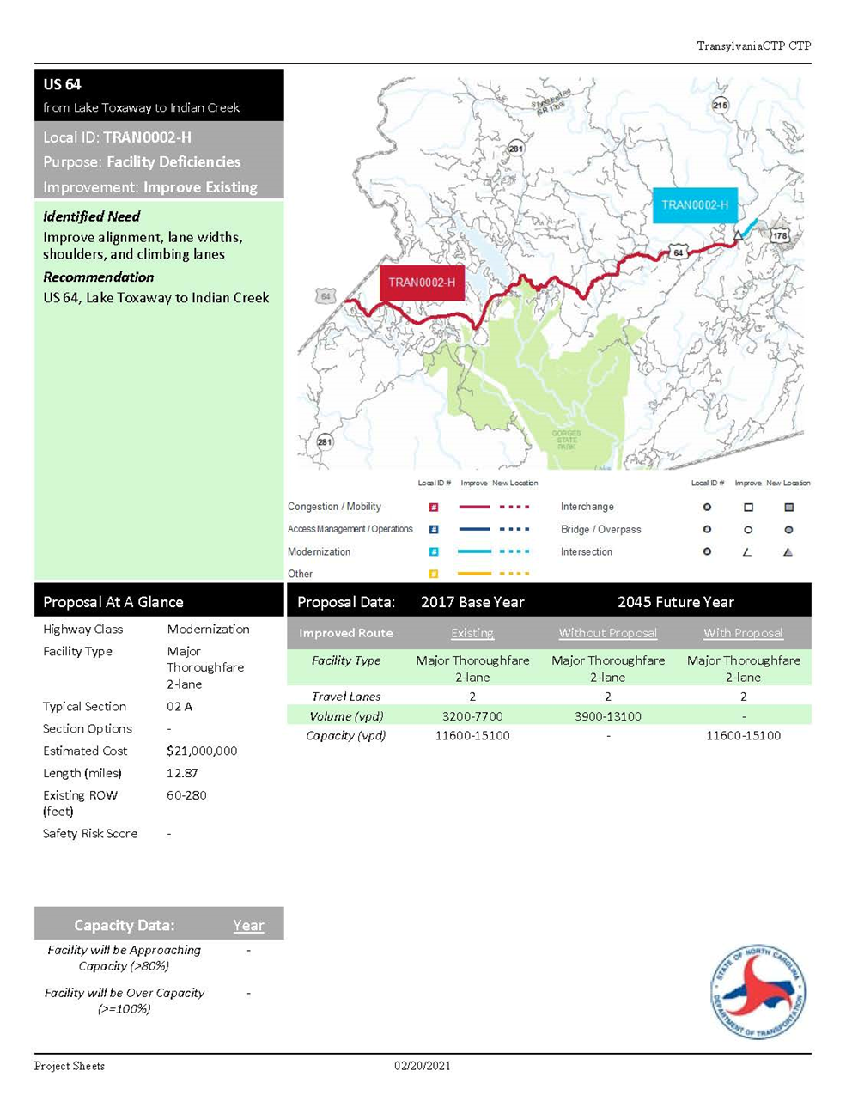
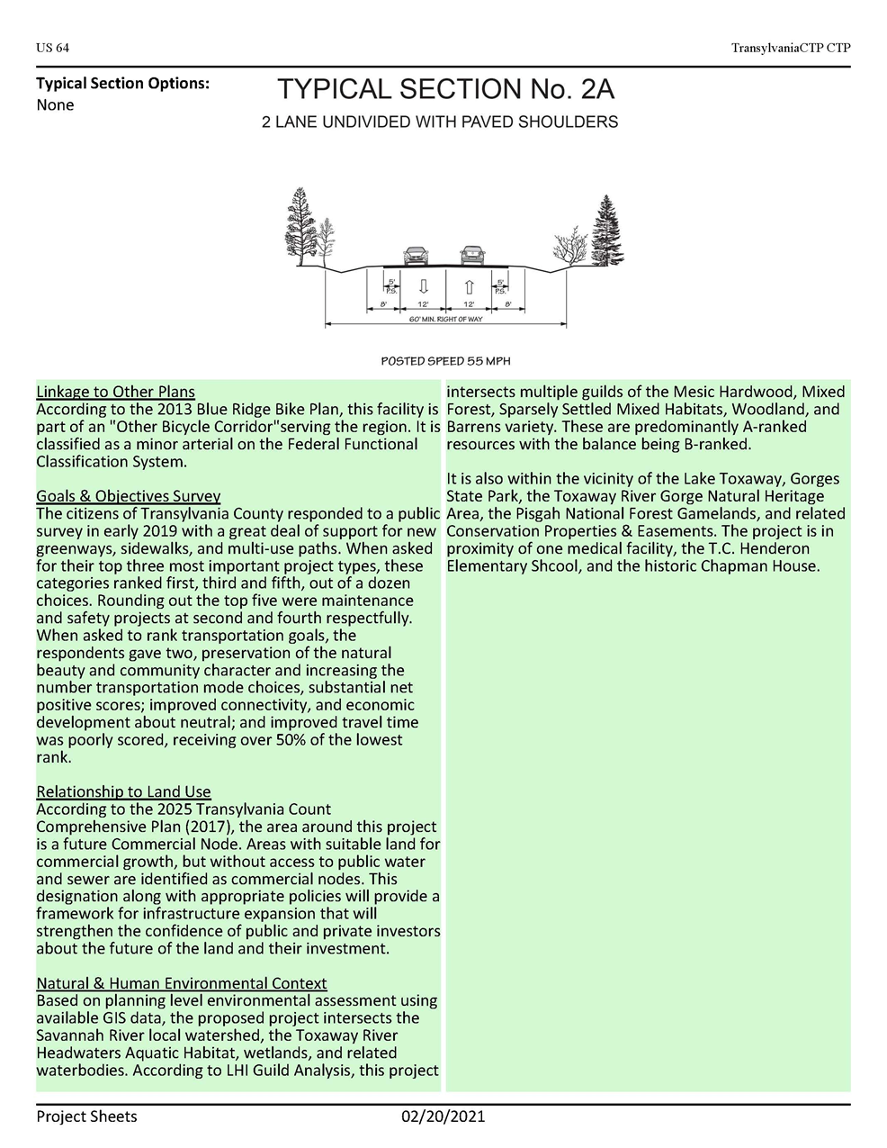

Slide 28
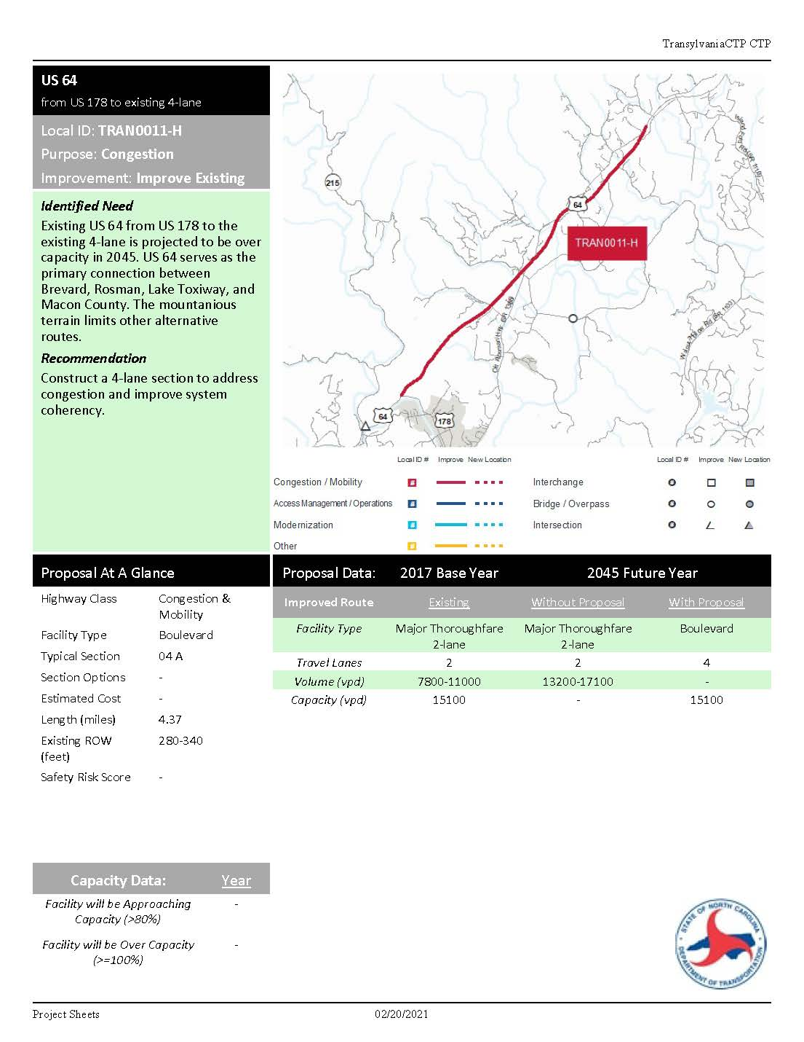
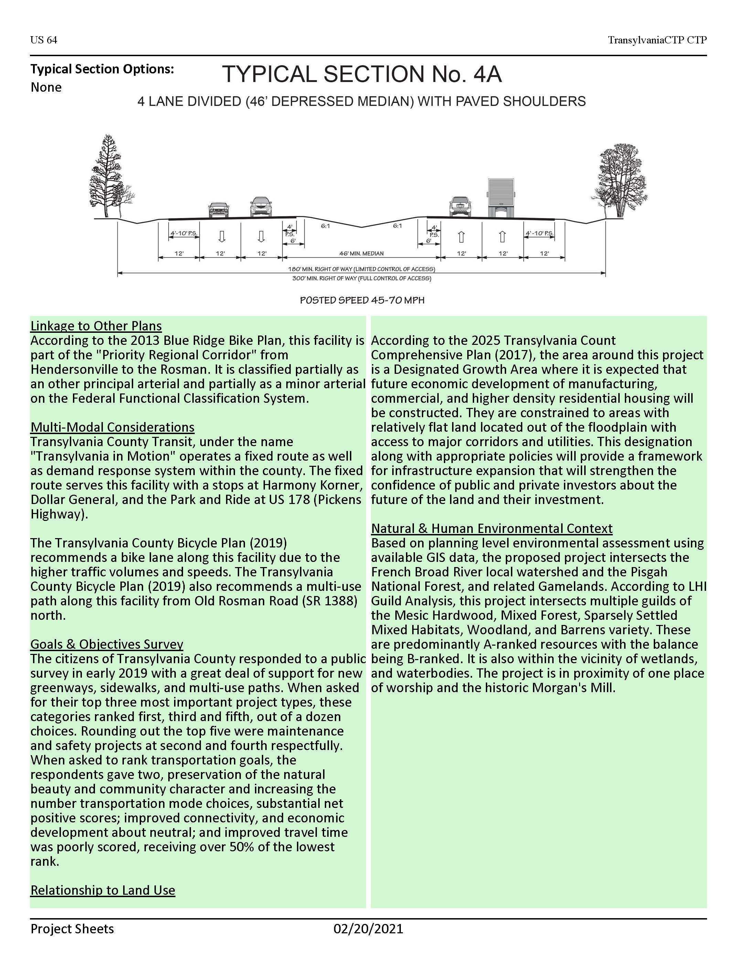

Slide 29
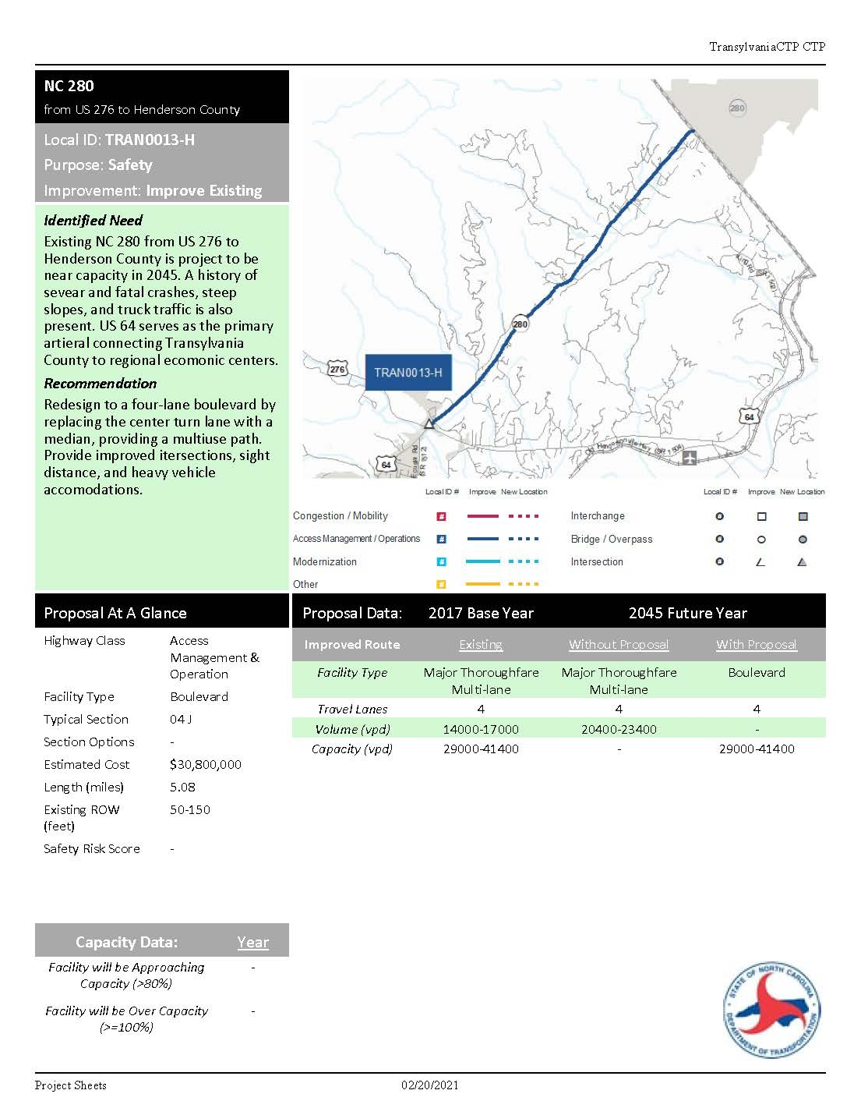
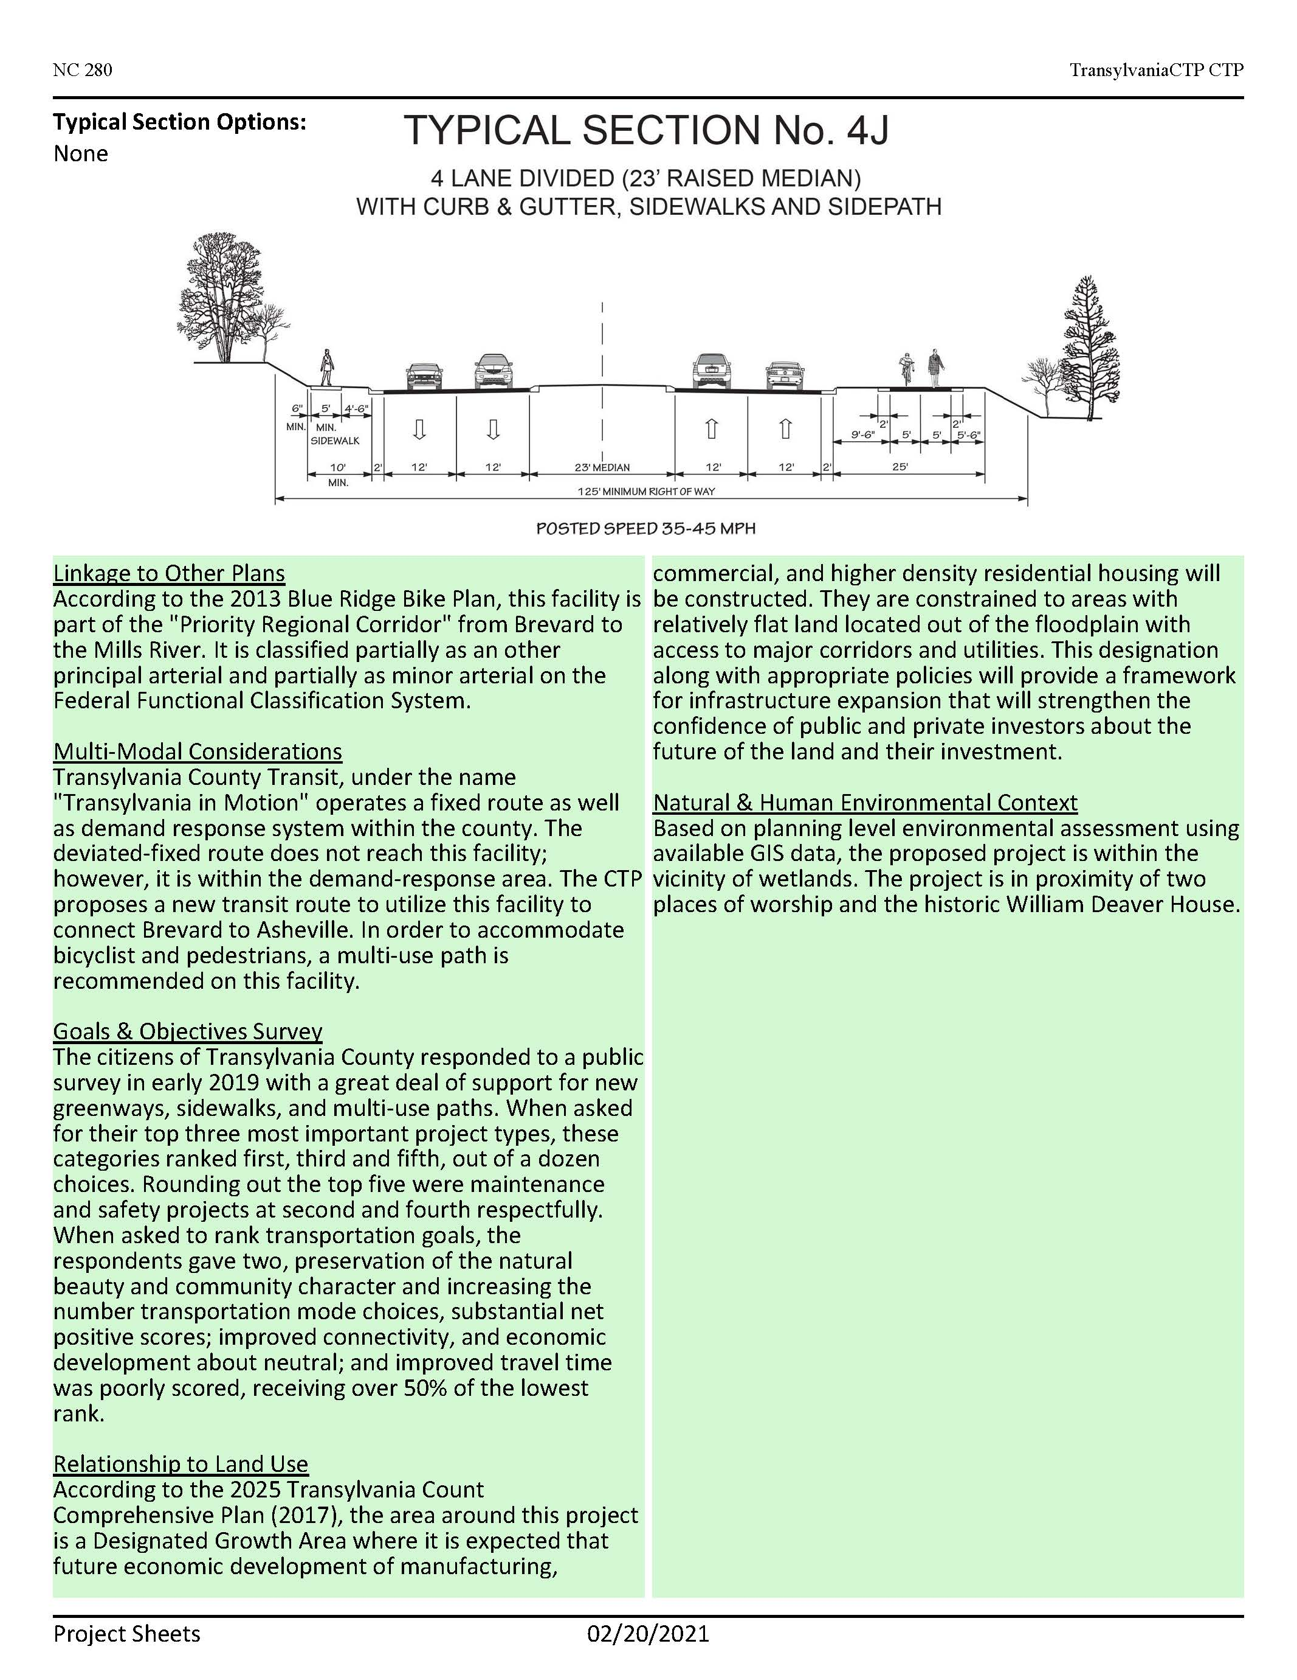

Slide 30
Transylvania County Comprehensive Transportation Plan (CTP) - Update
  Background cont…
    Core Documentation
    https://connect.ncdot.gov/projects/planning/TPB%20Documents/Example-County-CTP-Core%20Section%202021-6-7.pdf
    Appendices
    https://connect.ncdot.gov/projects/planning/TPB%20Documents/Example-County-CTP-Appendix-2021-06-02.pdf
    https://demo.metroquestsurvey.com/?u=jno21#!/?p=web&pm=dynamic&s=1&popup=WTD

Slide 31
New Business
Director’s Report

Slide 32
New Business
Director’s Report

Slide 33
Director’s Report
  Next Meeting
    Tuesday, October 12th, 2021 at 7:00 PM

Slide 34
Public Comment

Slide 35
Committee Members’ Comments

Slide 36
Adjournment
Thank you for attending!

