Slide 1
JHPC
Tuesday January 30, 2024 @ 4pm

Slide 2
Public Comment
Transylvania Heritage Museum

Slide 3
Agenda Modifications

Slide 4
Consent Agenda
All items under the Consent Agenda are recommended for approval.
        Minutes
          November 14, 2023

Slide 5
V. Old Business
A. The Inn at Brevard

Slide 6
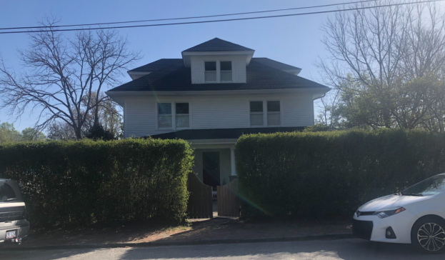
B. The Bryant House
132 King Street
Brevard, NC

Slide 7
VI. New Business
A. May Preservation Month

Slide 8
VI. New Business
B. Staff’s Report
-Next Meeting March 12, 2024 @ 4:00PM

Slide 9
Public Comment

Slide 10
Commission Members’ Comments

Slide 320
Adjournment
Thank you for attending!

