Slide 1
JHPC
Tuesday March 12, 2024 @ 4pm

Slide 2
Public Comment

Slide 3
Agenda Modifications

Slide 4
Consent Agenda
All items under the Consent Agenda are recommended for approval.
        Minutes
          January 30, 2024

Slide 5
V. Old Business
A. The Inn at Brevard

Slide 6
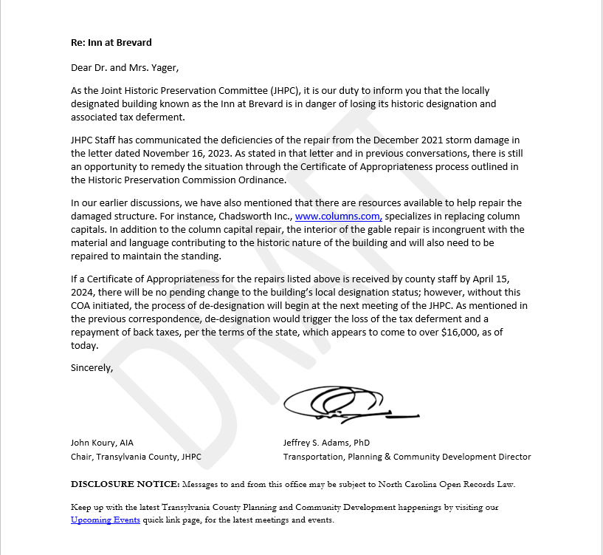

Slide 7
B. May Preservation Month

Slide 8
VI. New Business
Staff’s Report
CLG Training
U.S.A. 250th Anniversary- 2026
Bryant House- Joint Public Hearing- March 18th

Slide 9
VI. New Business
Next Meeting May 14, 2024 @ 4:00PM

Slide 10
Public Comment

Slide 11
Commission Members’ Comments

Slide 321
Adjournment
Thank you for attending!

