Slide 1
Transylvania County
InfoGraphics | 2050

Slide 2
InfoGraphics 2050

Slide 3
Socio-Demographic

Slide 4
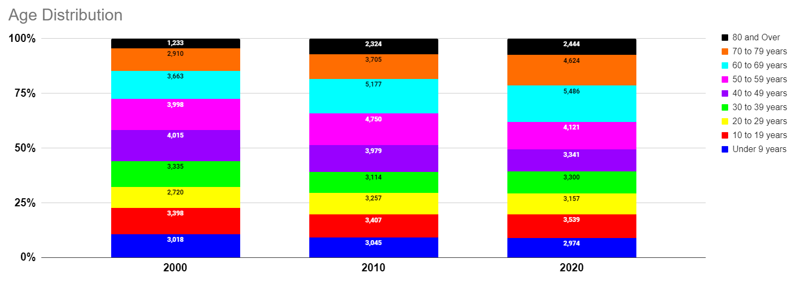
InfoGraphics 2050

Slide 5
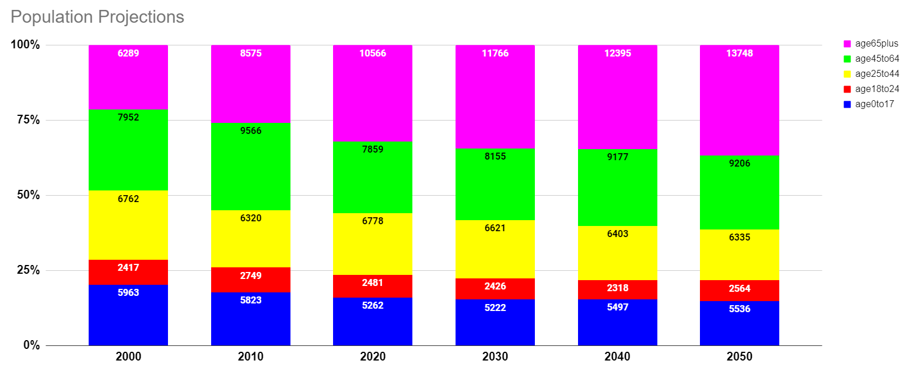
InfoGraphics 2050

Slide 6
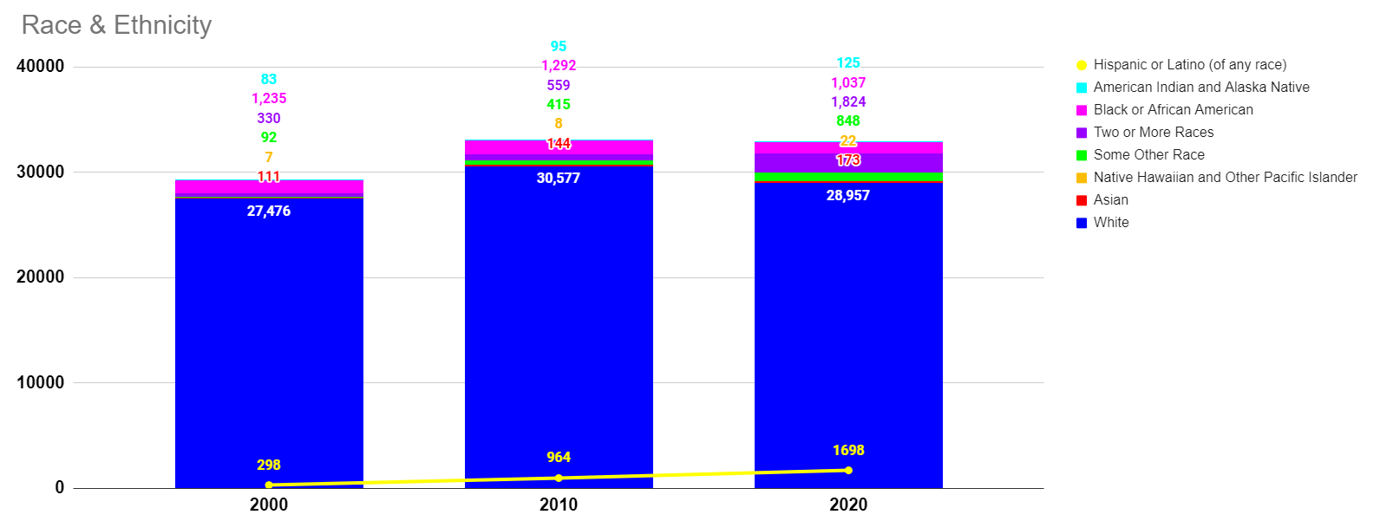
InfoGraphics 2050

Slide 7
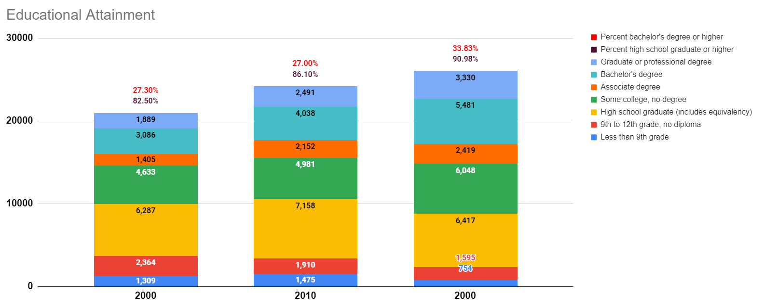
InfoGraphics 2050

Slide 8
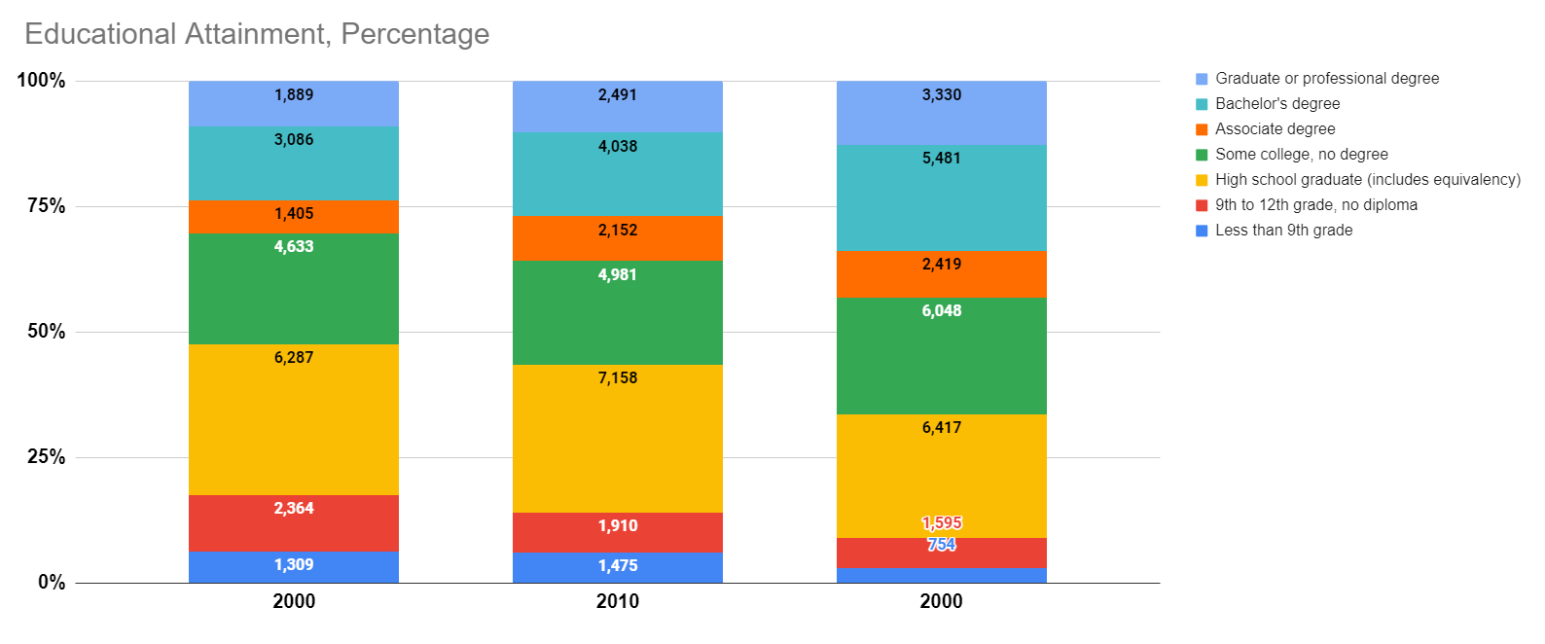
InfoGraphics 2050

Slide 9
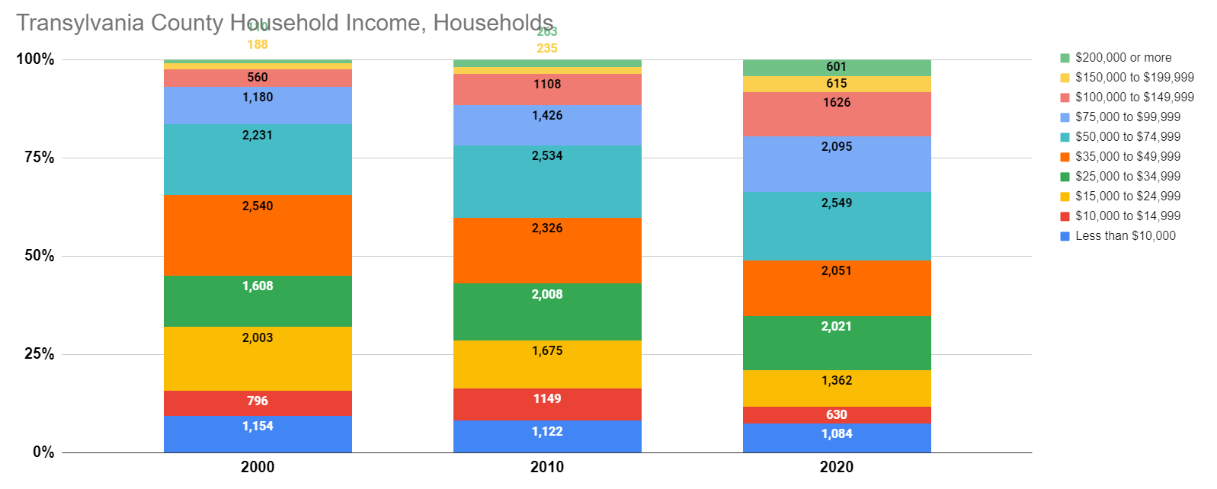
InfoGraphics 2050

Slide 10
Housing

Slide 11
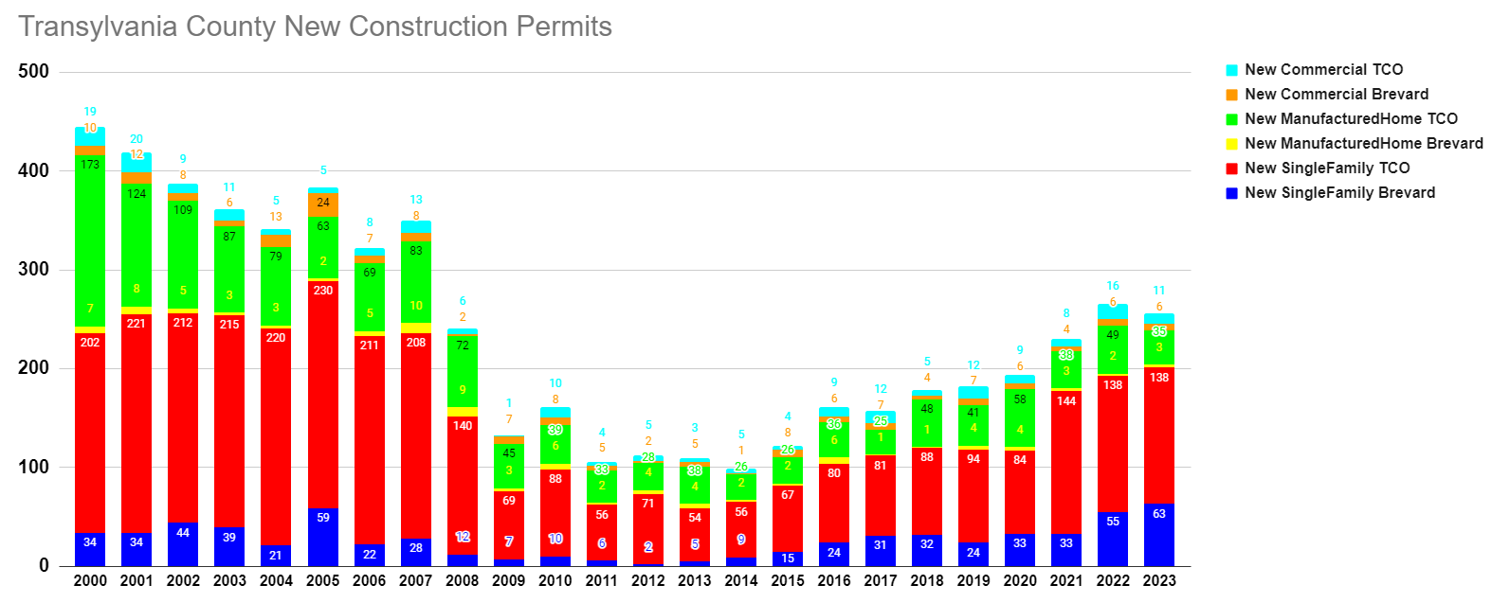
InfoGraphics 2050

Slide 12
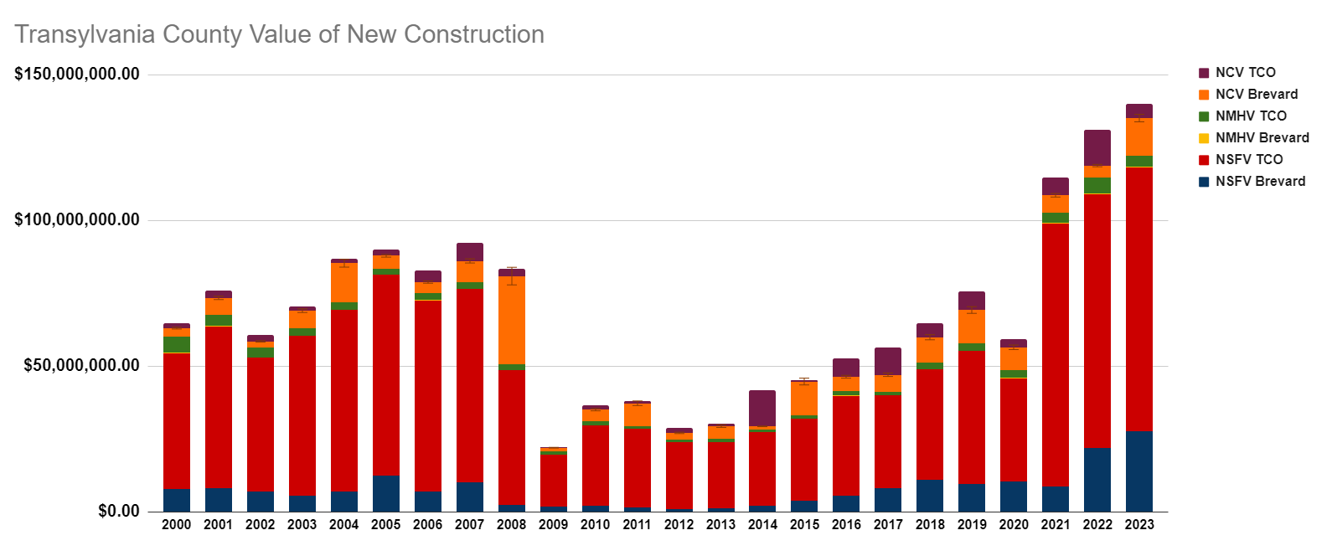
InfoGraphics 2050

Slide 13
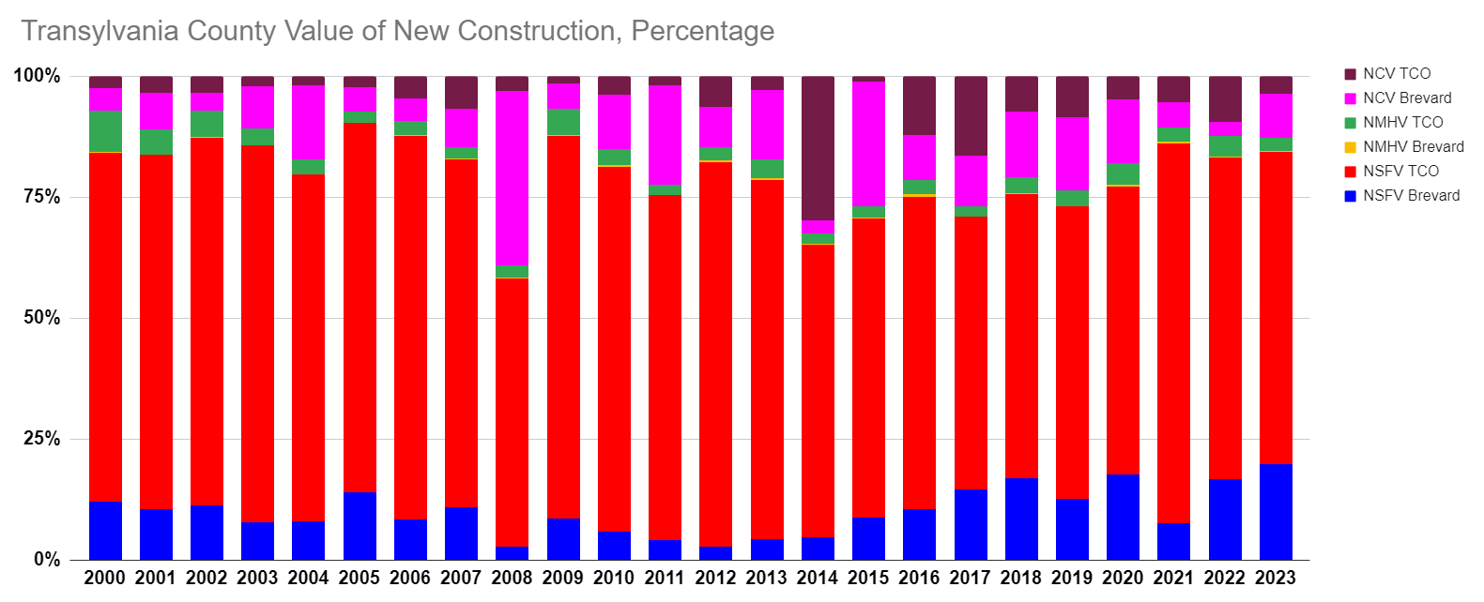
InfoGraphics 2050

Slide 14
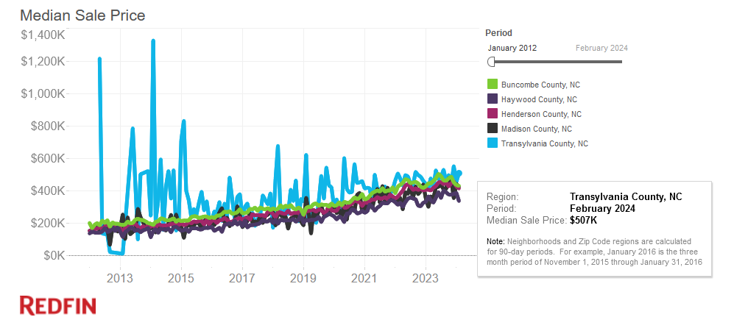
InfoGraphics 2050

Slide 15
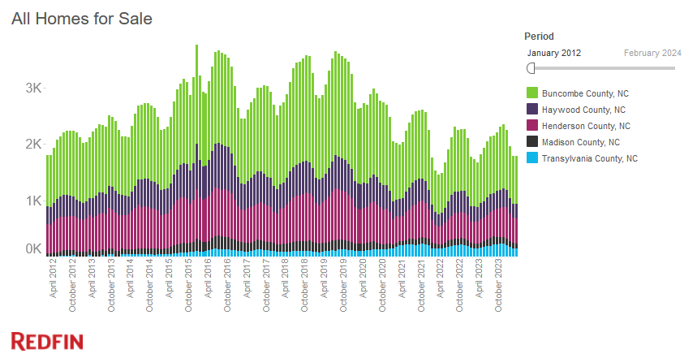
InfoGraphics 2050

Slide 16
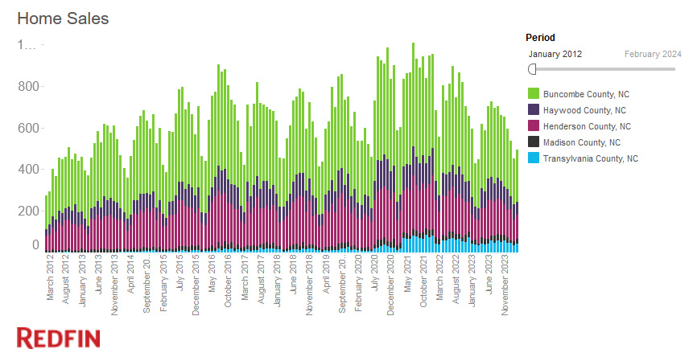
InfoGraphics 2050

Slide 17
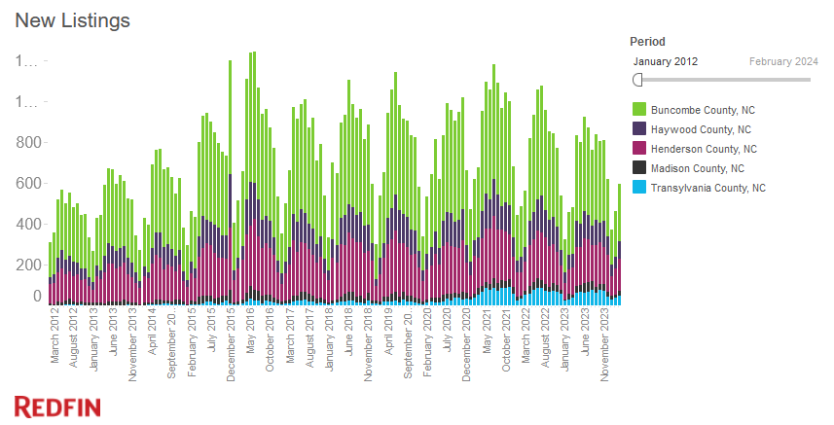
InfoGraphics 2050

Slide 18
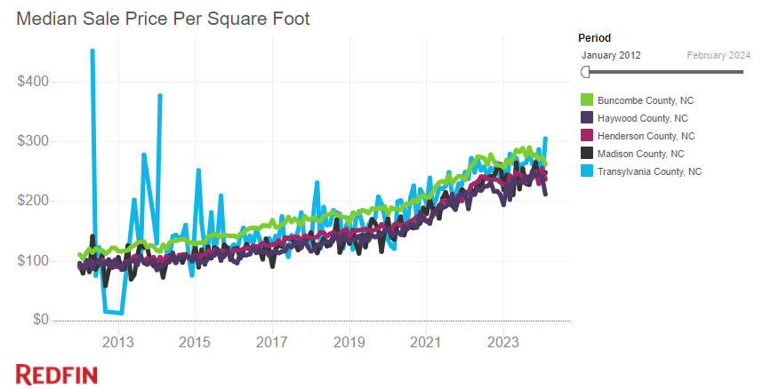
InfoGraphics 2050

Slide 19
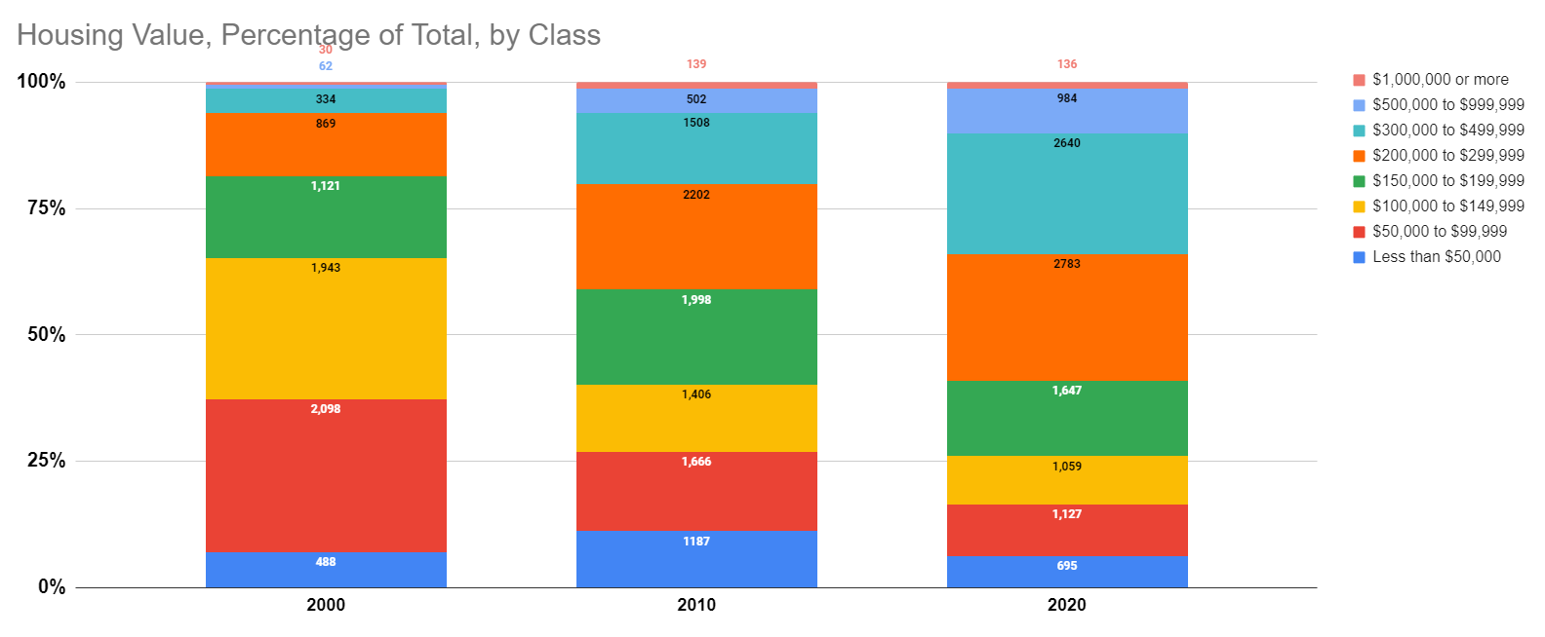
InfoGraphics 2050

Slide 20
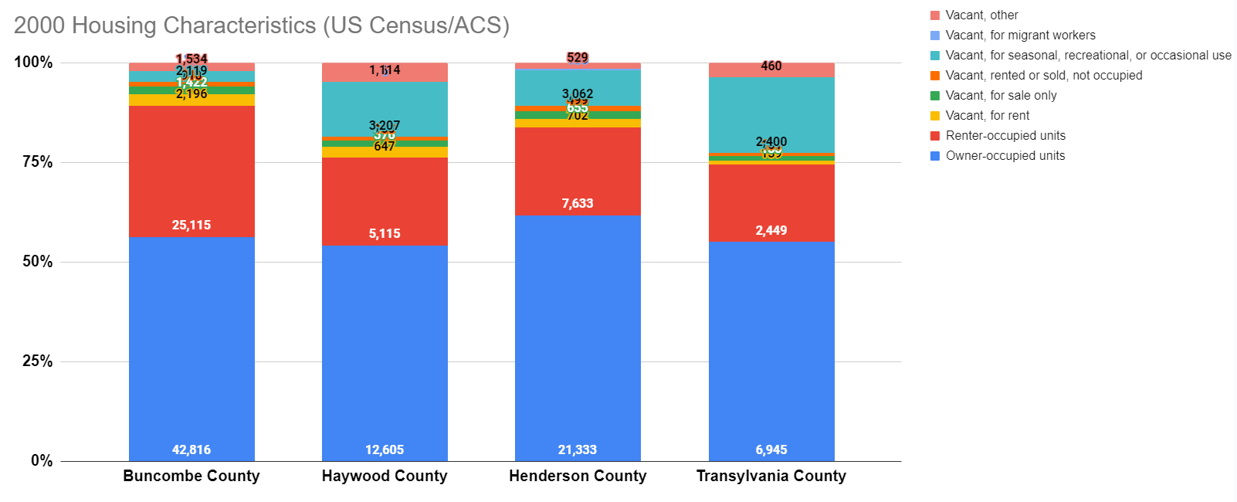
InfoGraphics 2050

Slide 21
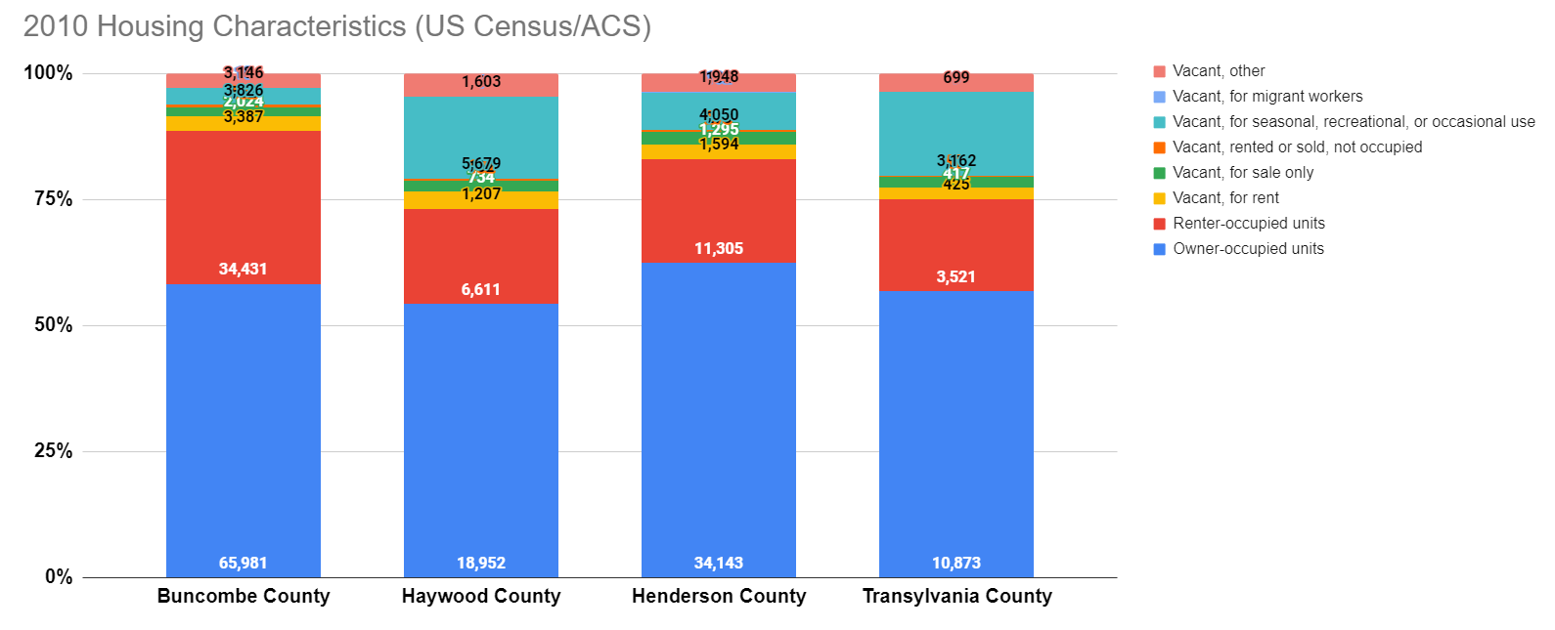
InfoGraphics 2050

Slide 22
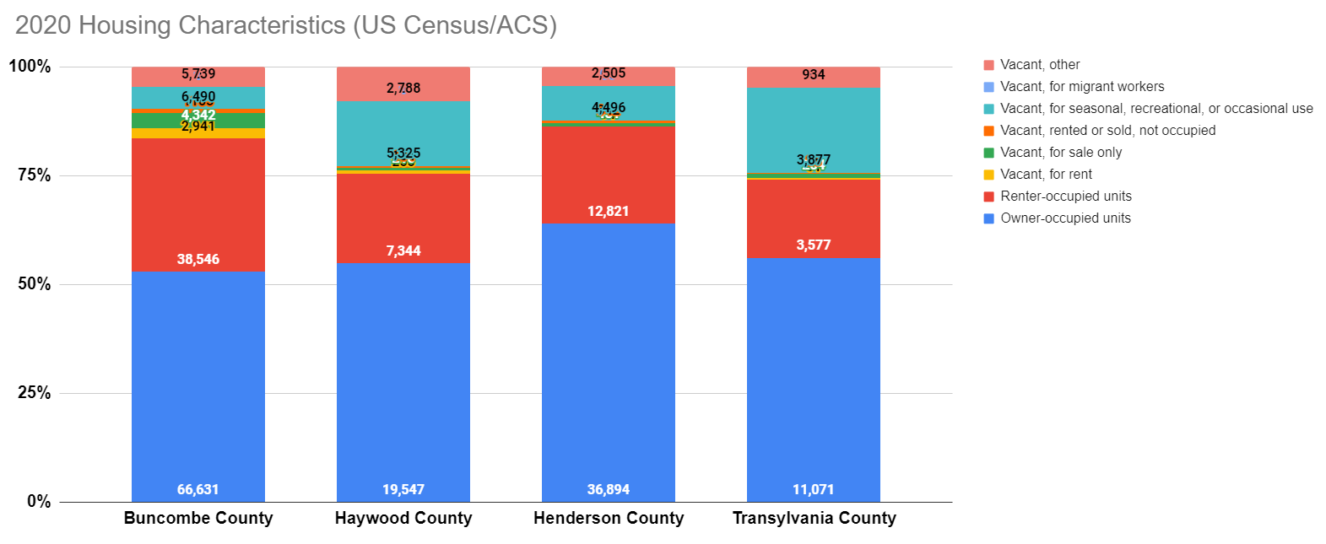
InfoGraphics 2050

Slide 23
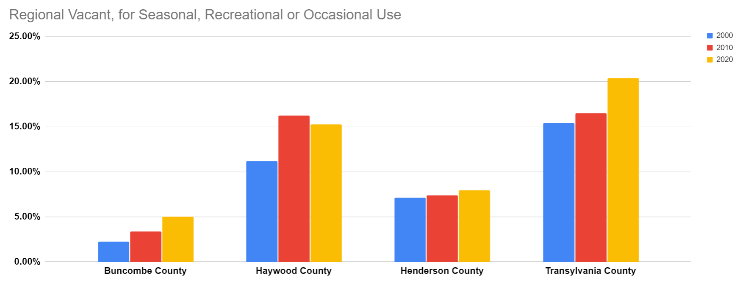
InfoGraphics 2050

Slide 24
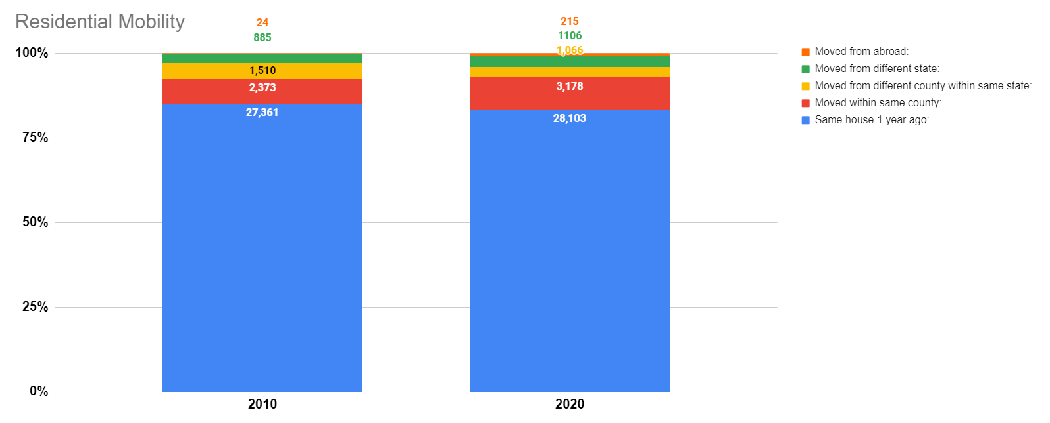
InfoGraphics 2050

Slide 25
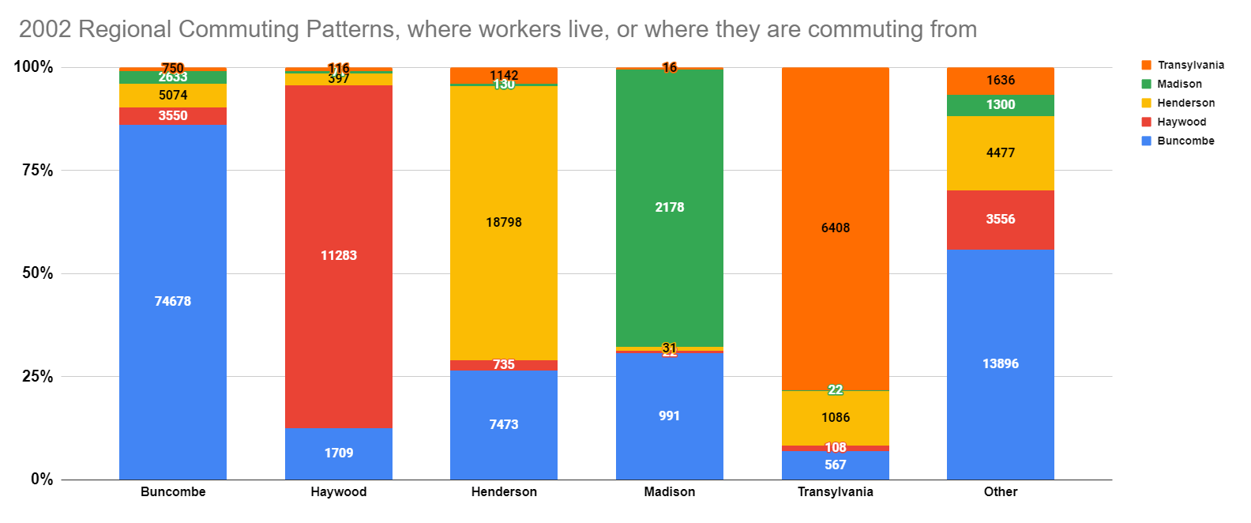
InfoGraphics 2050

Slide 26
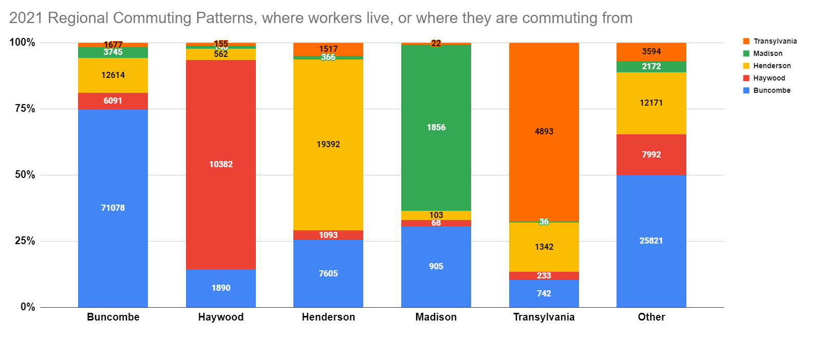
InfoGraphics 2050

Slide 27
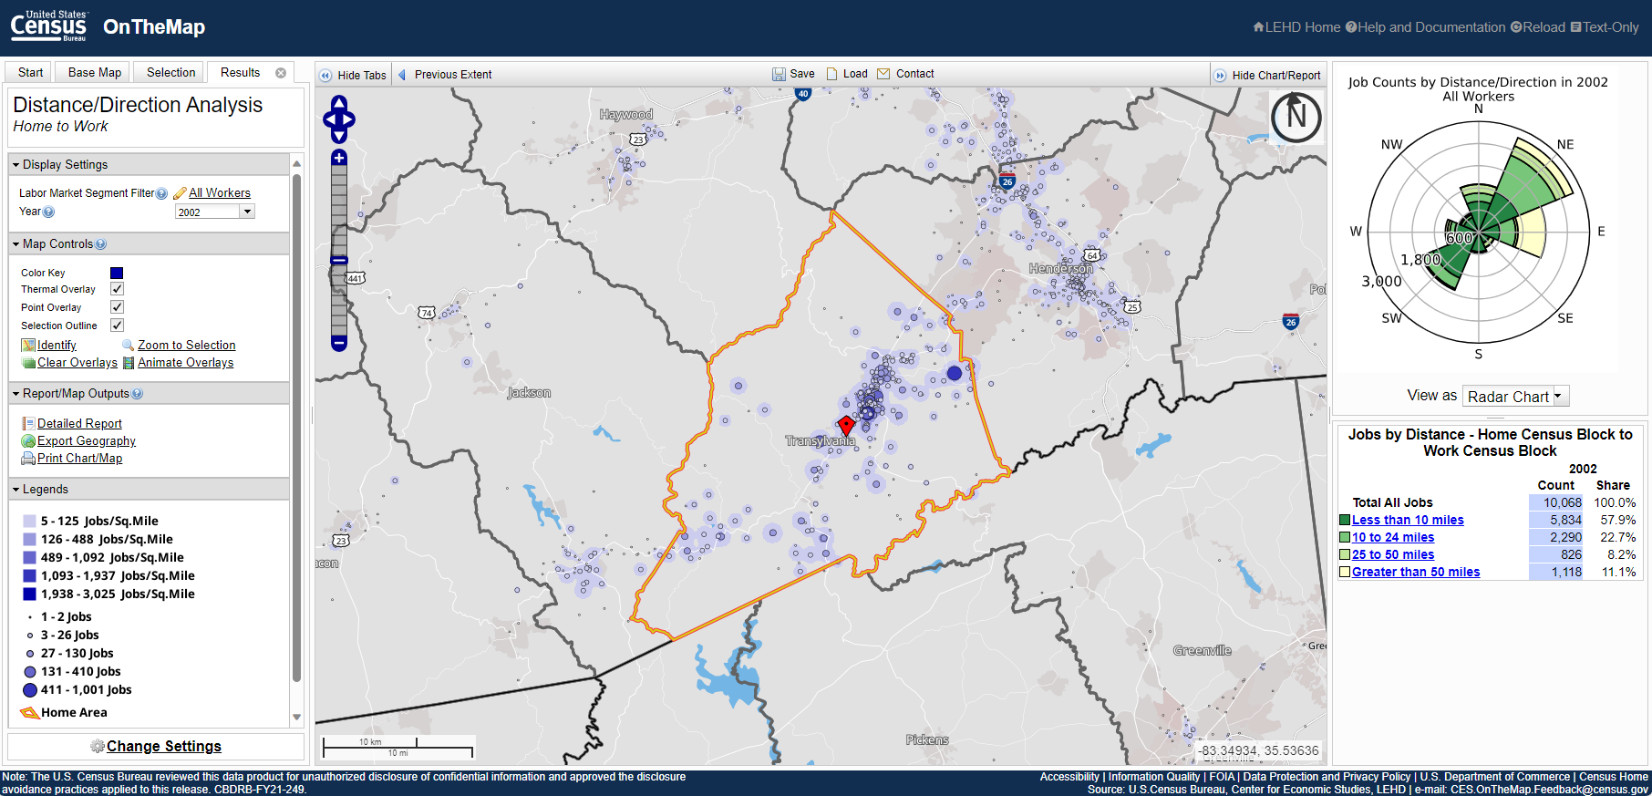
InfoGraphics 2050

Slide 28
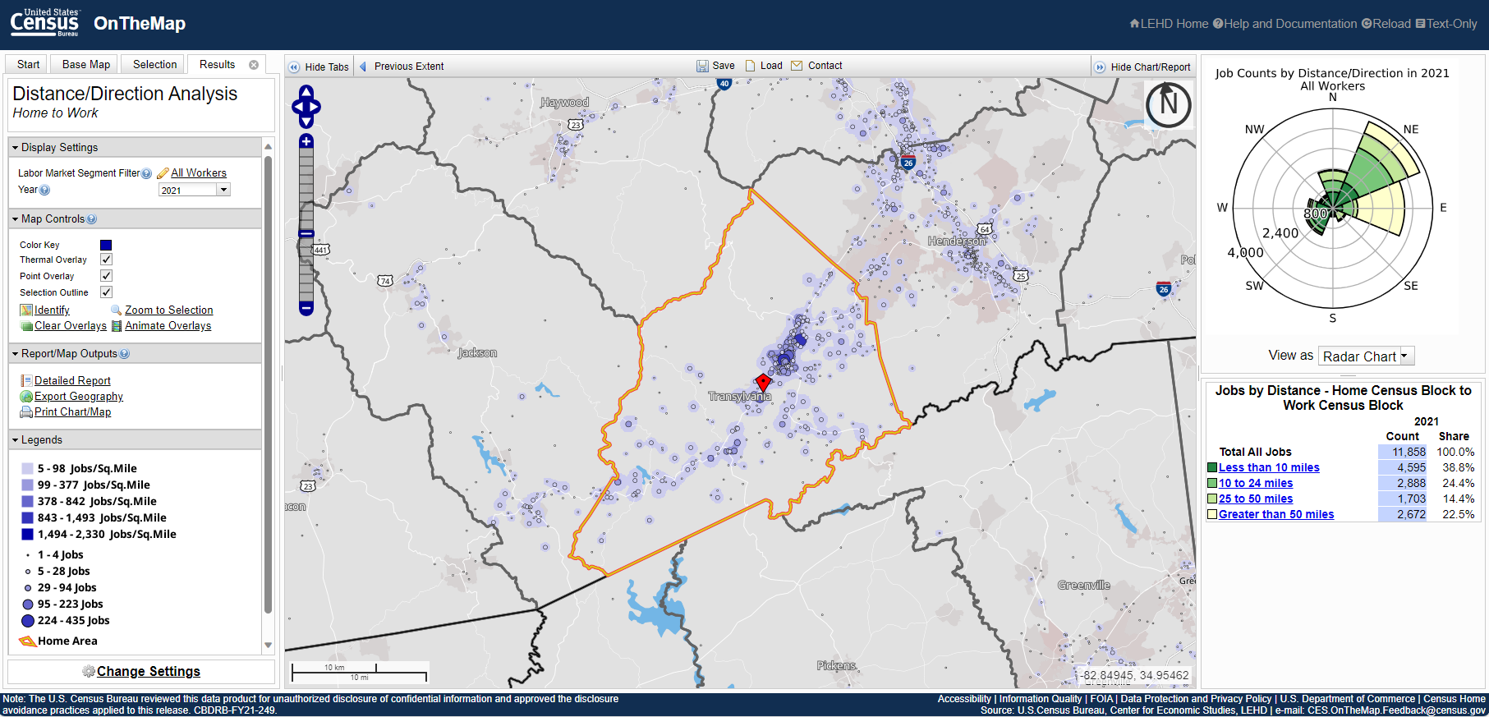
InfoGraphics 2050

Slide 29
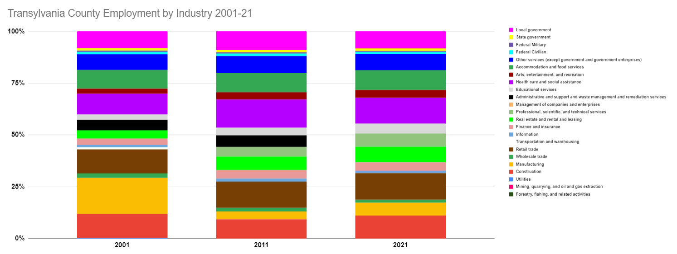
Economic Graphics 2050

Slide 30
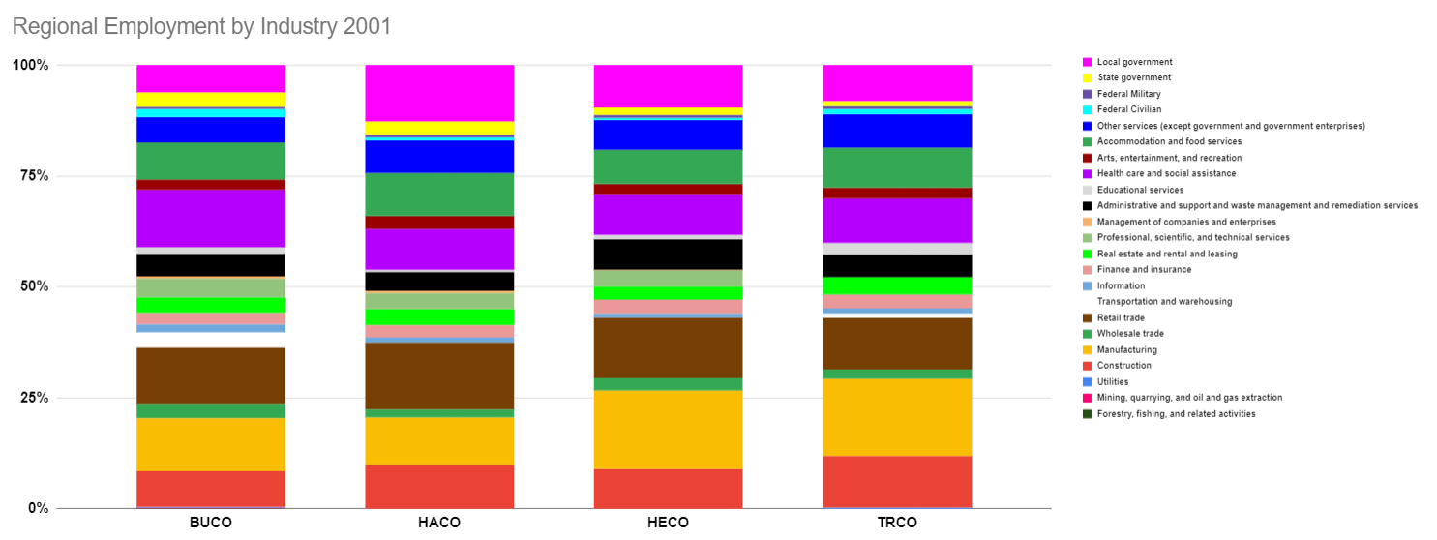
Economic Graphics 2050

Slide 31
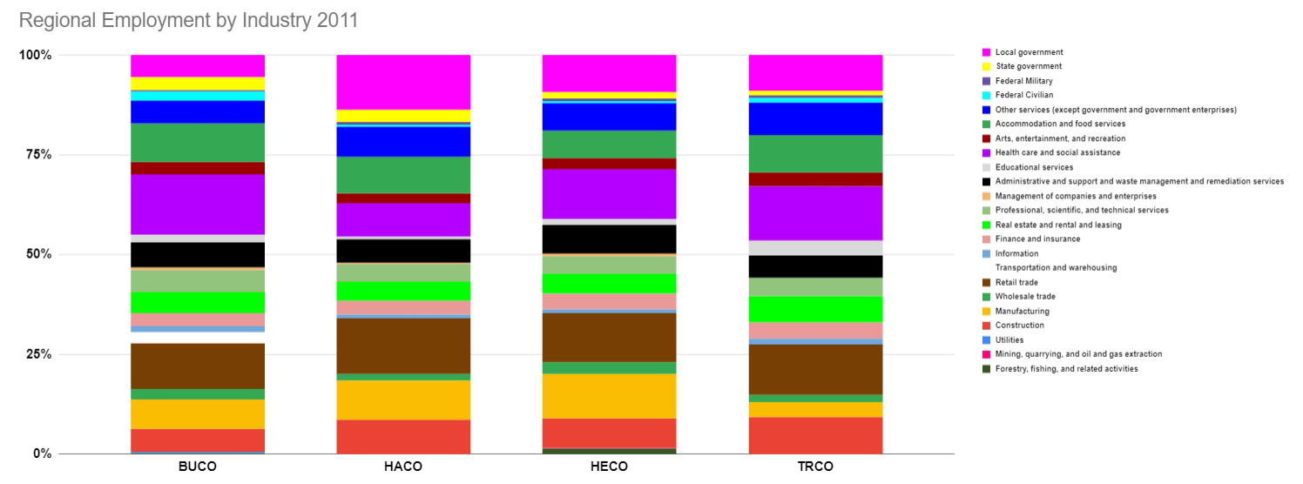
Economic Graphics 2050

Slide 32
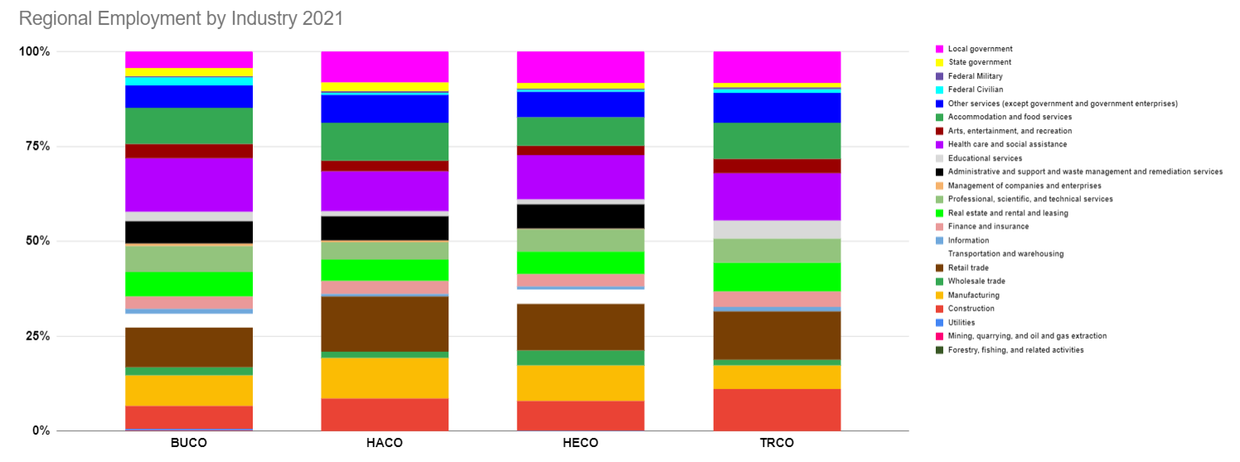
Economic Graphics 2050

Slide 33
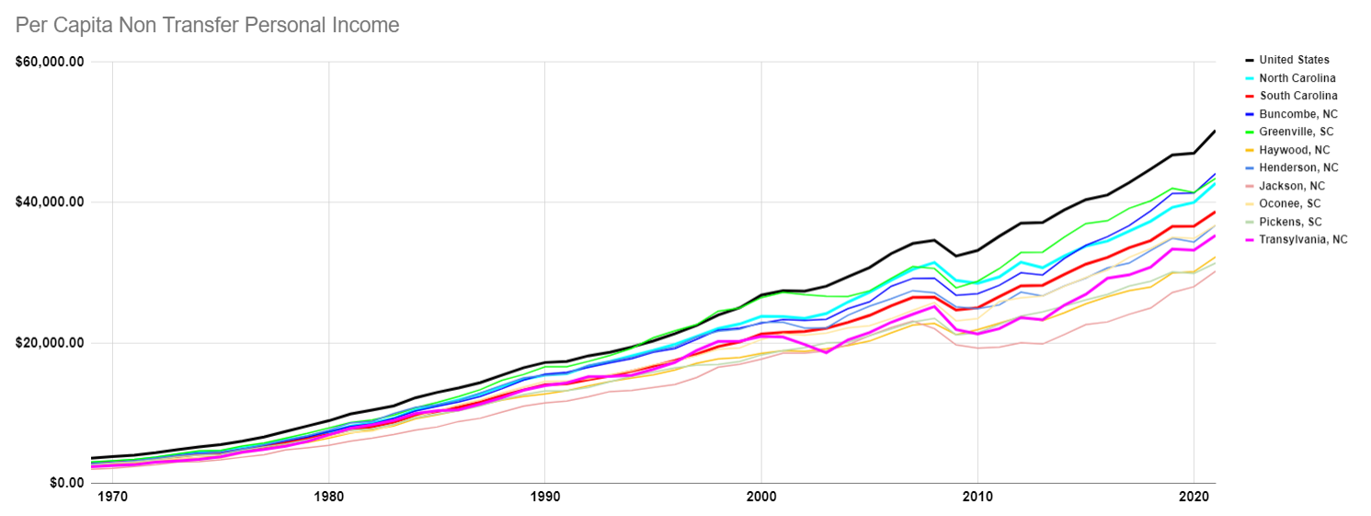
Economic Graphics 2050

Slide 34
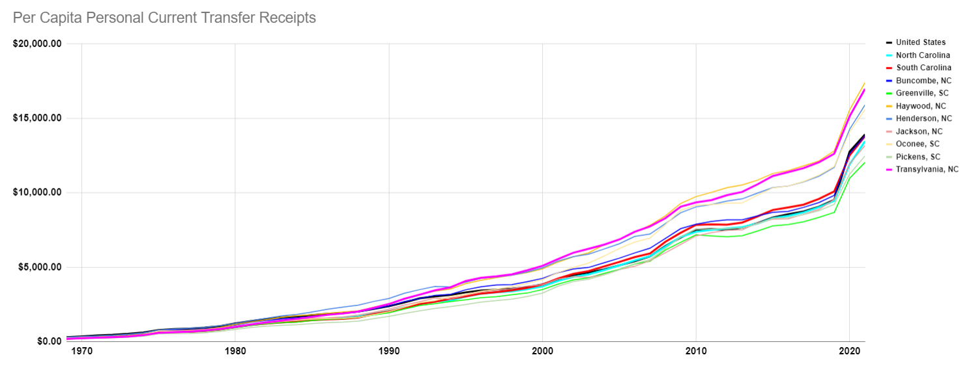
Economic Graphics 2050

Slide 35
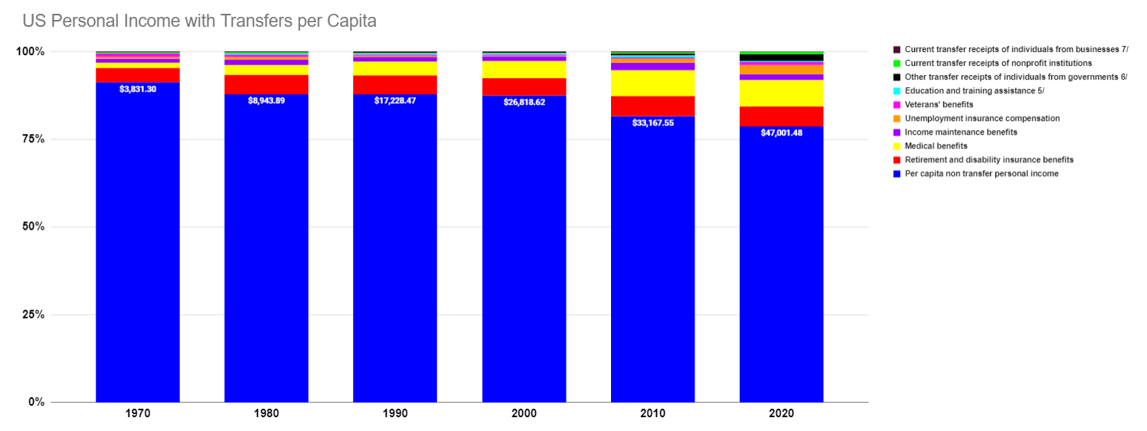
Economic Graphics 2050

Slide 36
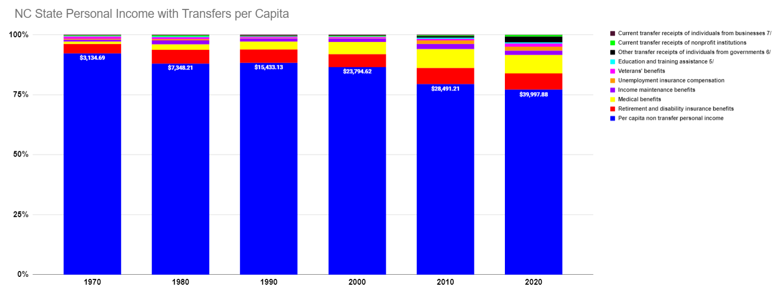
Economic Graphics 2050

Slide 37
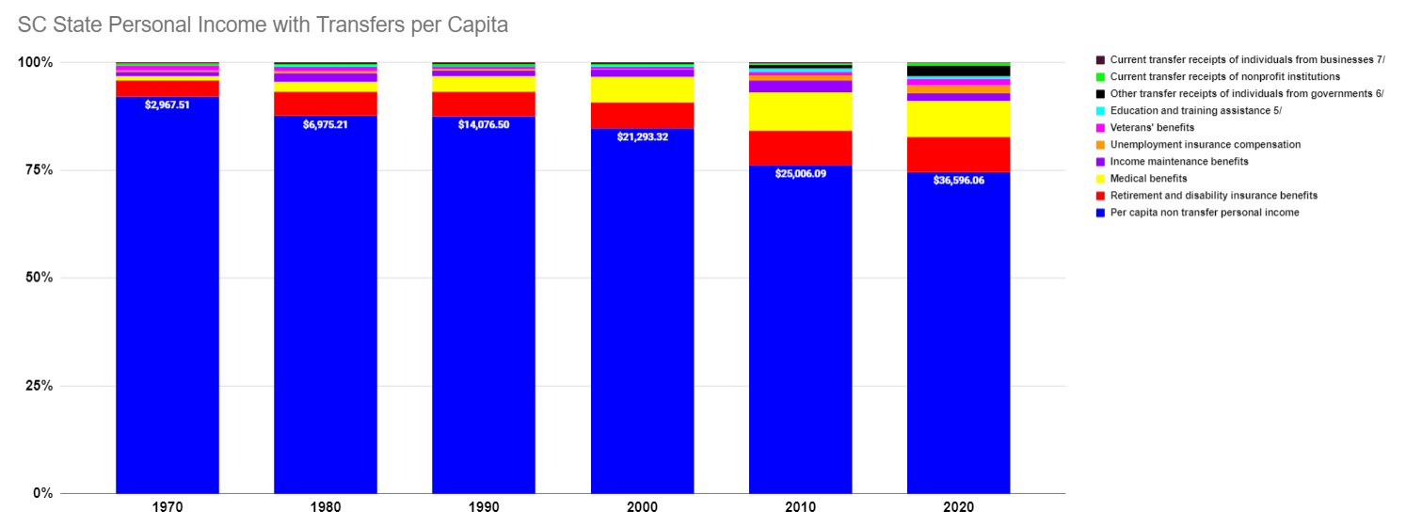
Economic Graphics 2050

Slide 38
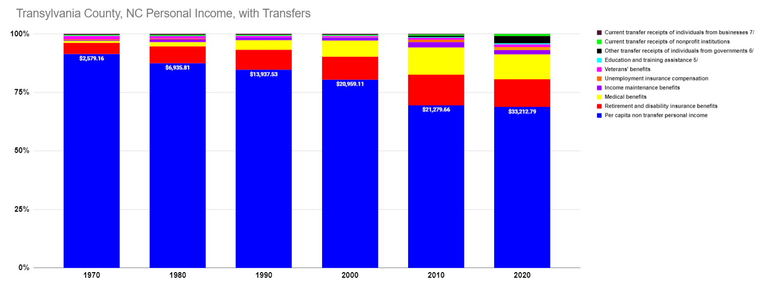
Economic Graphics 2050

Slide 39
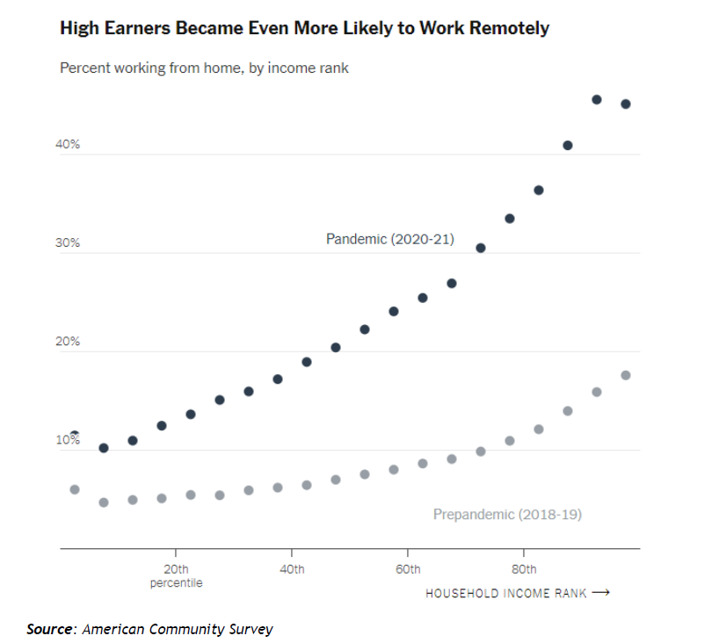
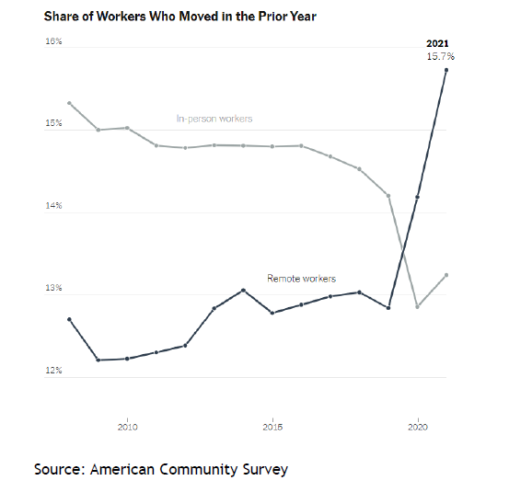
Economic Graphics 2050

Slide 40
Cultural

Slide 41
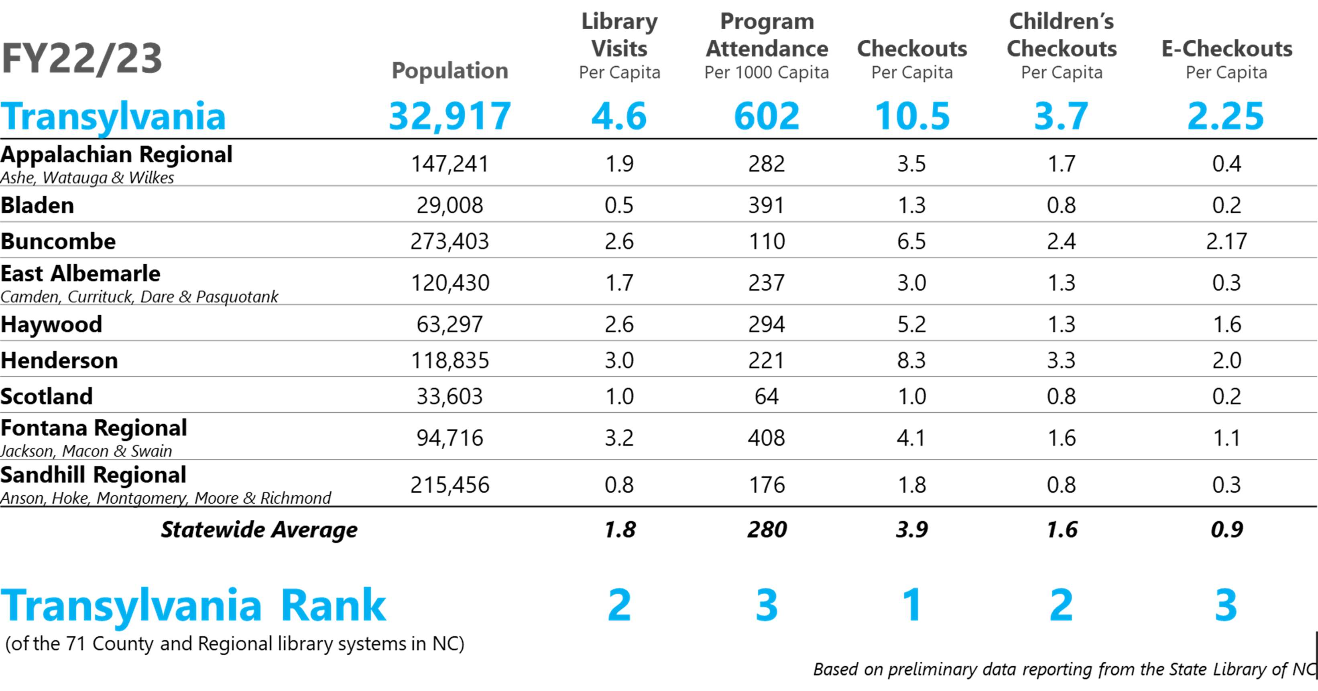
InfoGraphics 2050

Slide 42
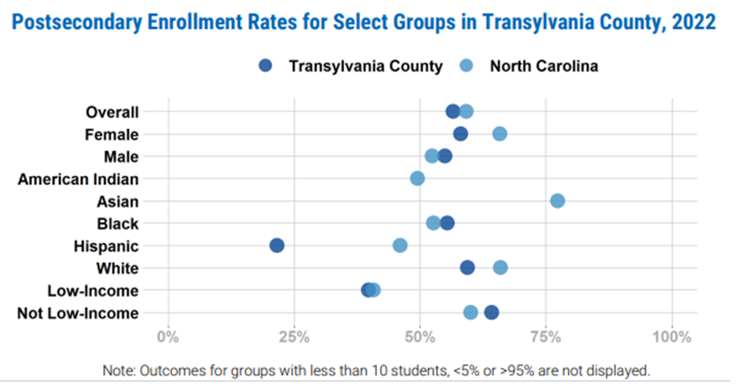
InfoGraphics 2050
Source: MyFutureNC

Slide 43
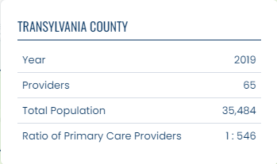
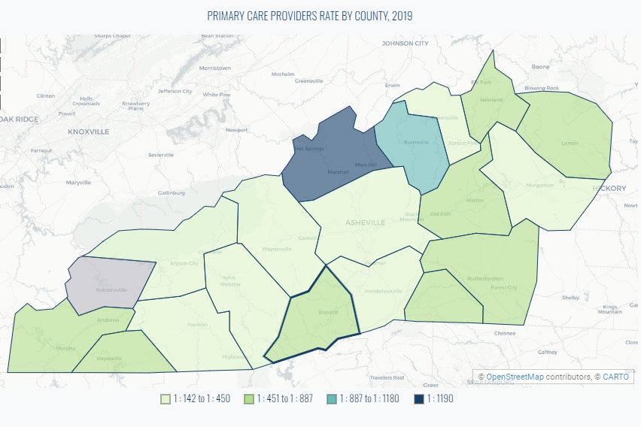
InfoGraphics 2050
https://healthycommunitiesnc.org/profile/geo/transylvania-county#primary-care-workforce-in-the-region

Slide 44
Source: Americans for the Arts: Arts & Economic Prosperity Study (FY22)
InfoGraphics 2050

Slide 45
Source: Americans for the Arts: Arts & Economic Prosperity Study (FY22)
InfoGraphics 2050

Slide 46
Source: Americans for the Arts: Arts & Economic Prosperity Study (FY22)
InfoGraphics 2050

Slide 47
Environment

Slide 48
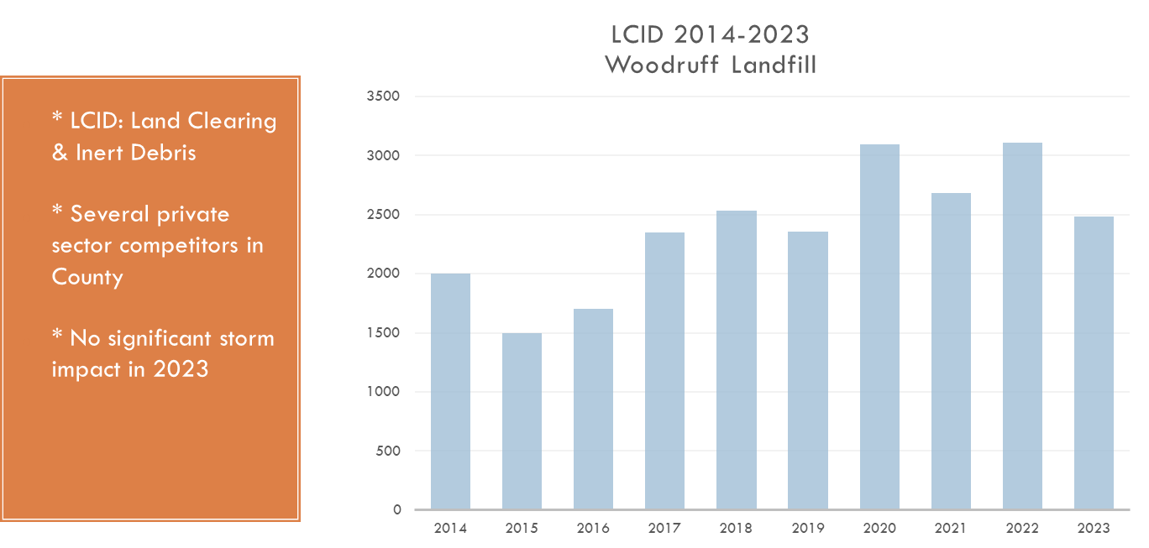
InfoGraphics 2050

Slide 49
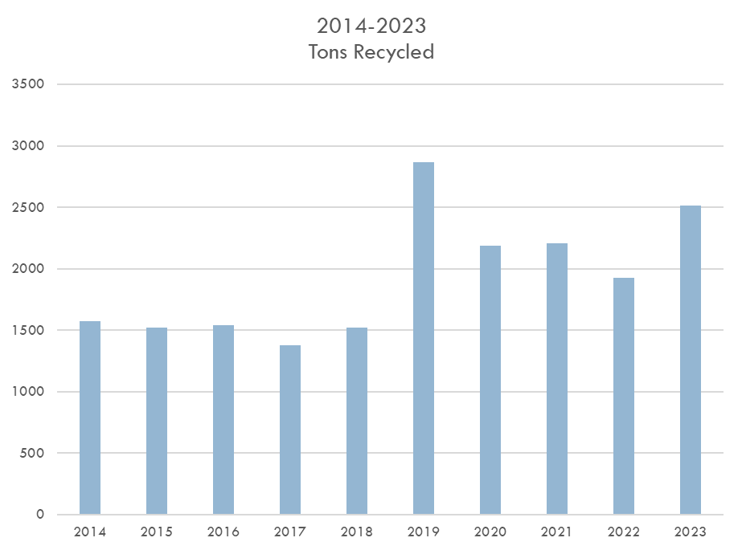
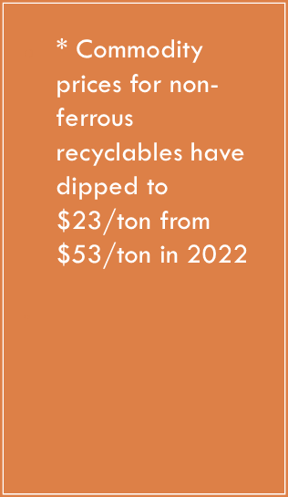
InfoGraphics 2050

Slide 50
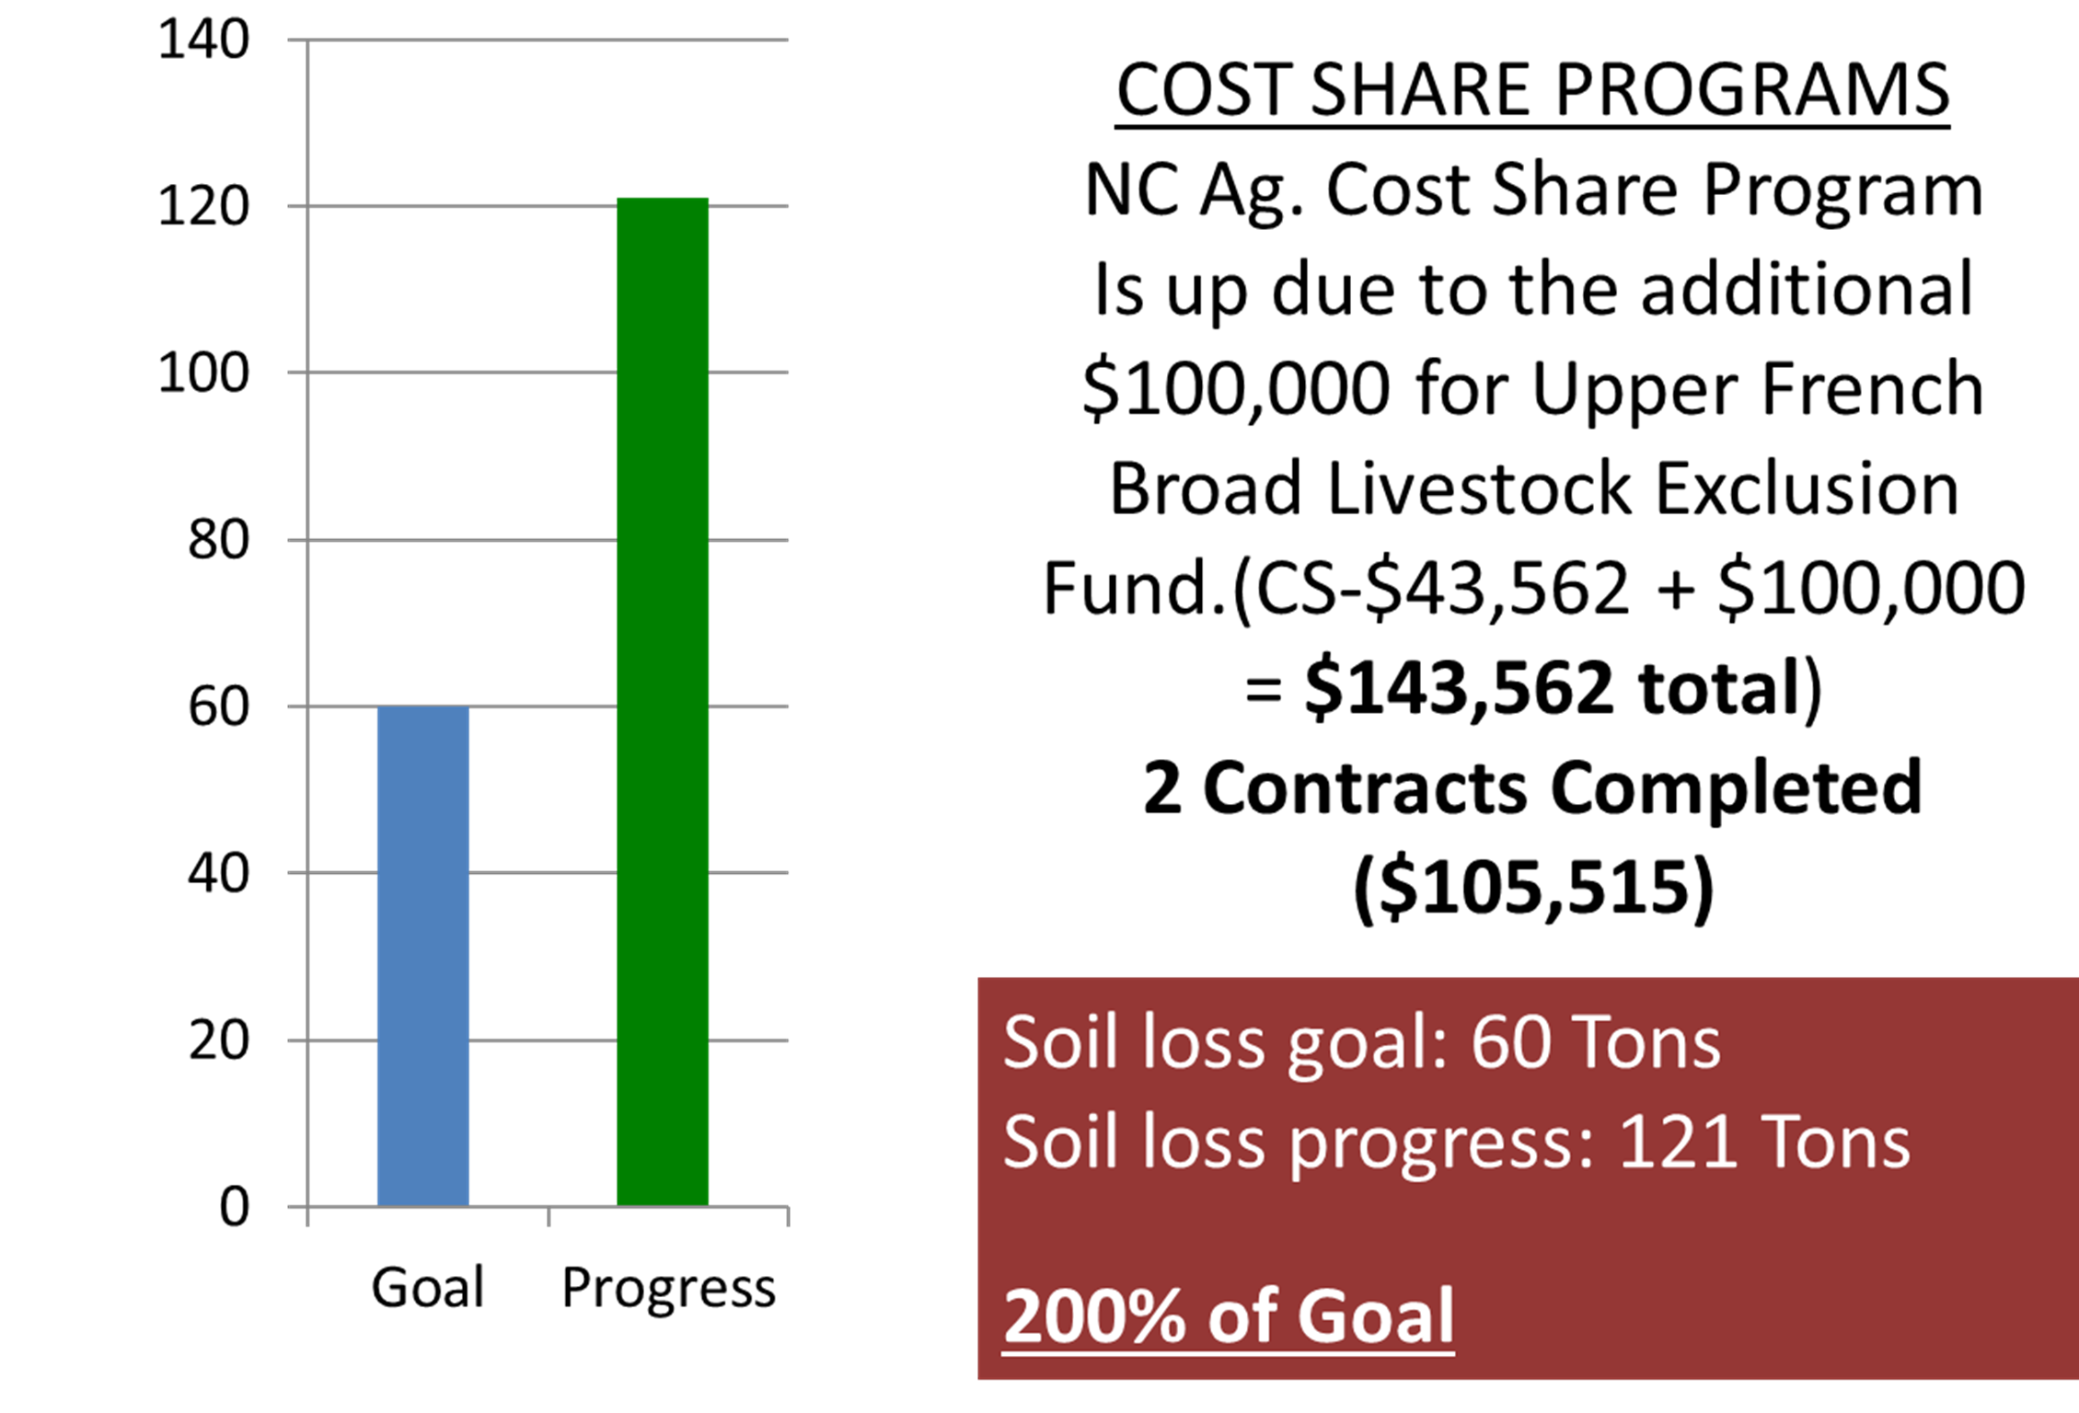
InfoGraphics 2050

Slide 51
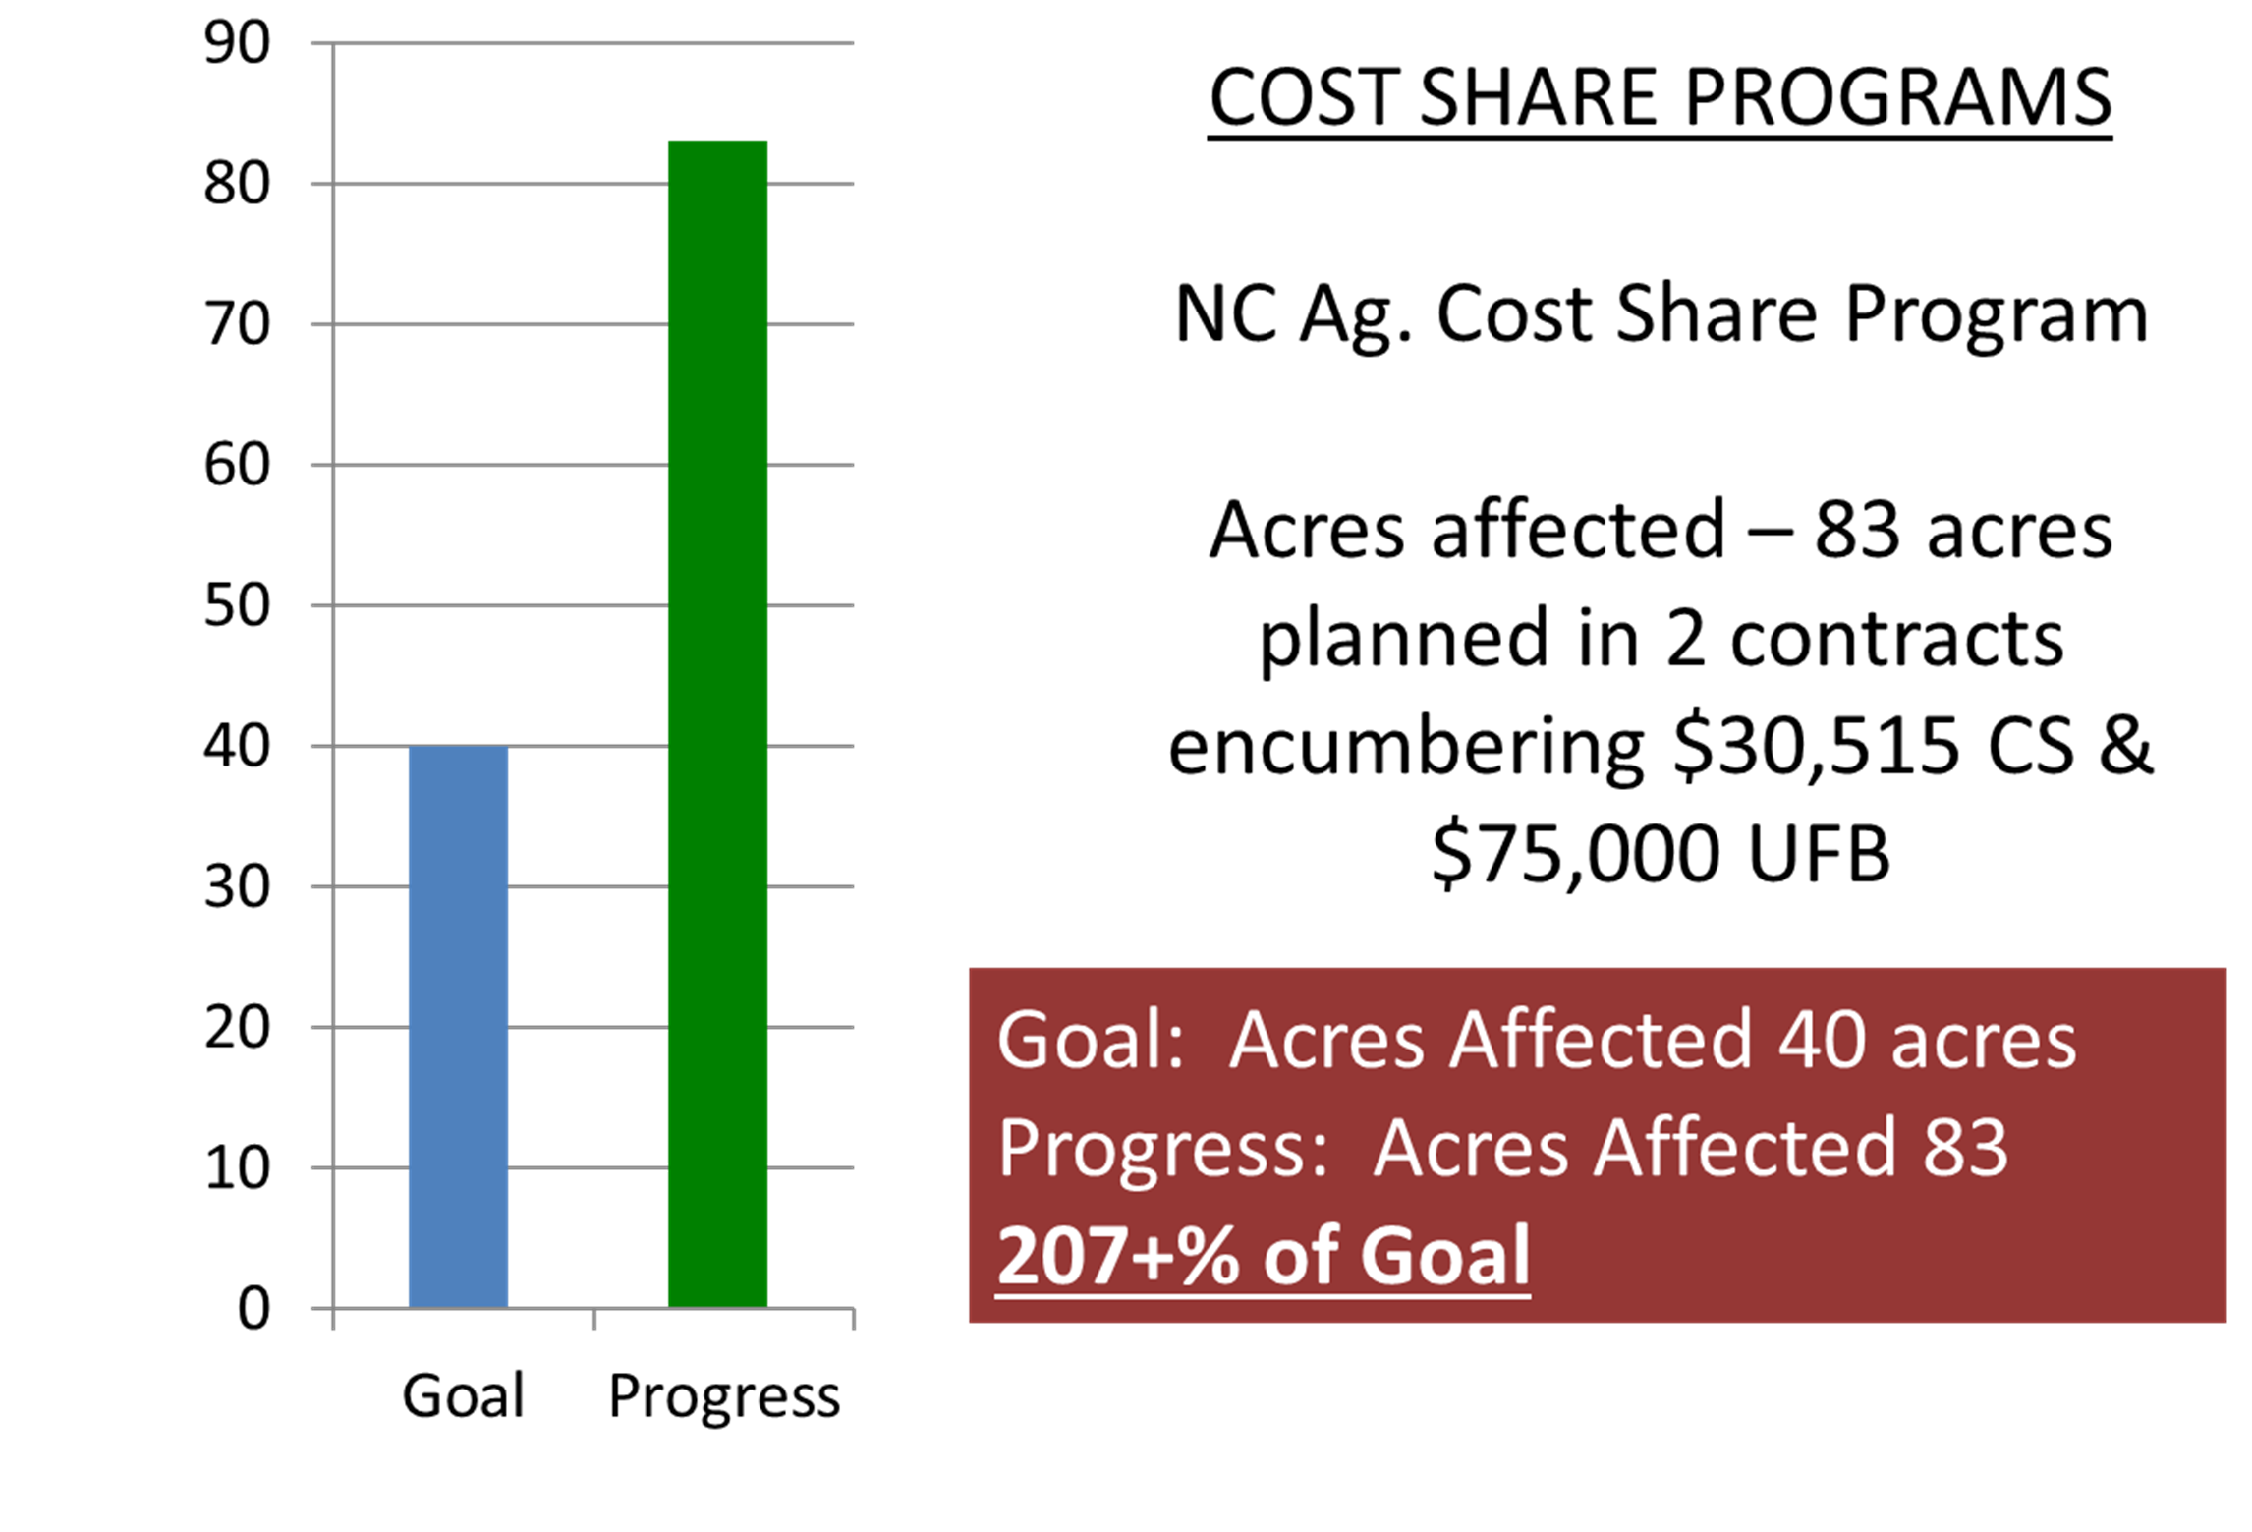
InfoGraphics 2050

Slide 52
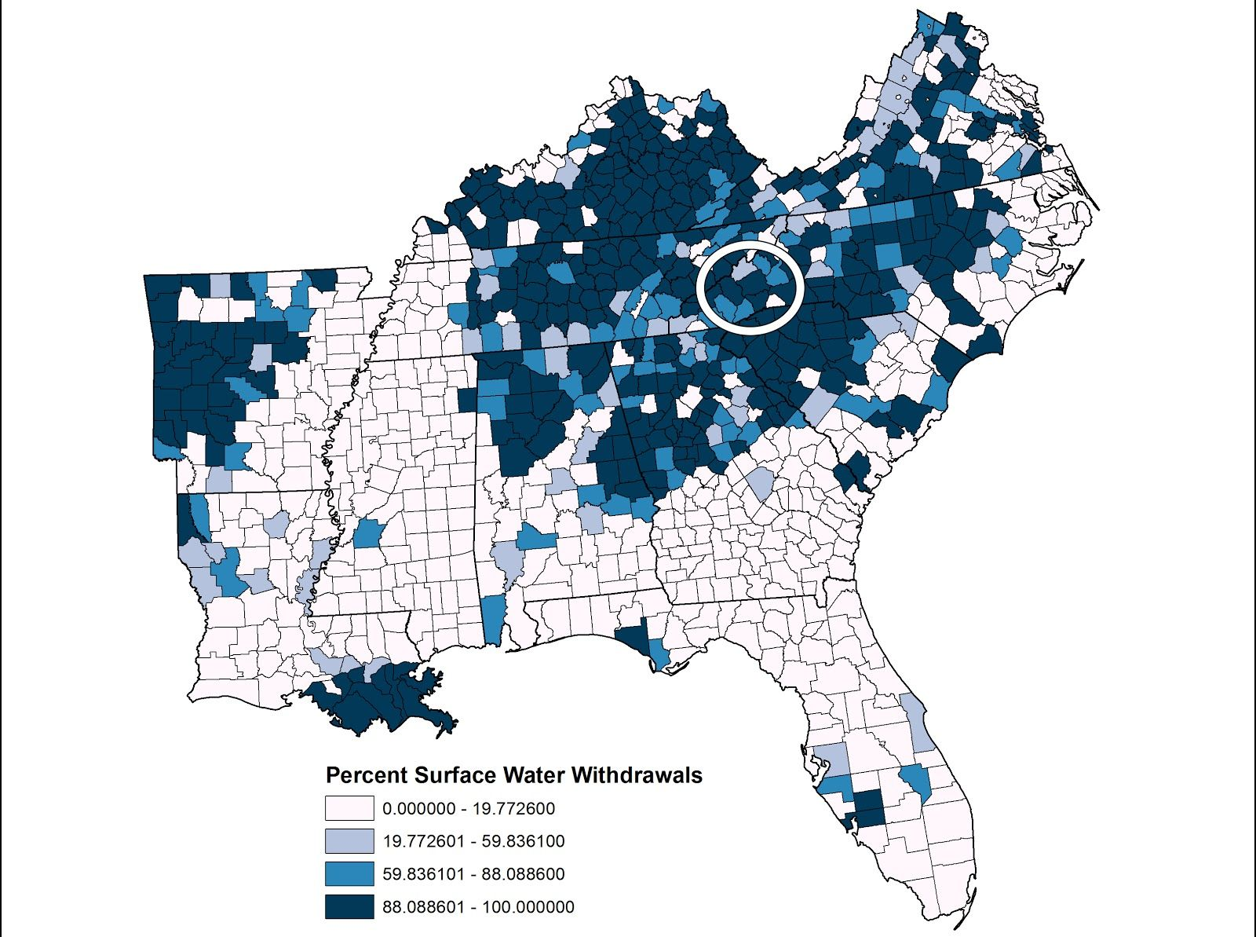
Source: Land of Sky Region Economic Resilience Exposure Analysis Phase I Report
InfoGraphics 2050

Slide 53
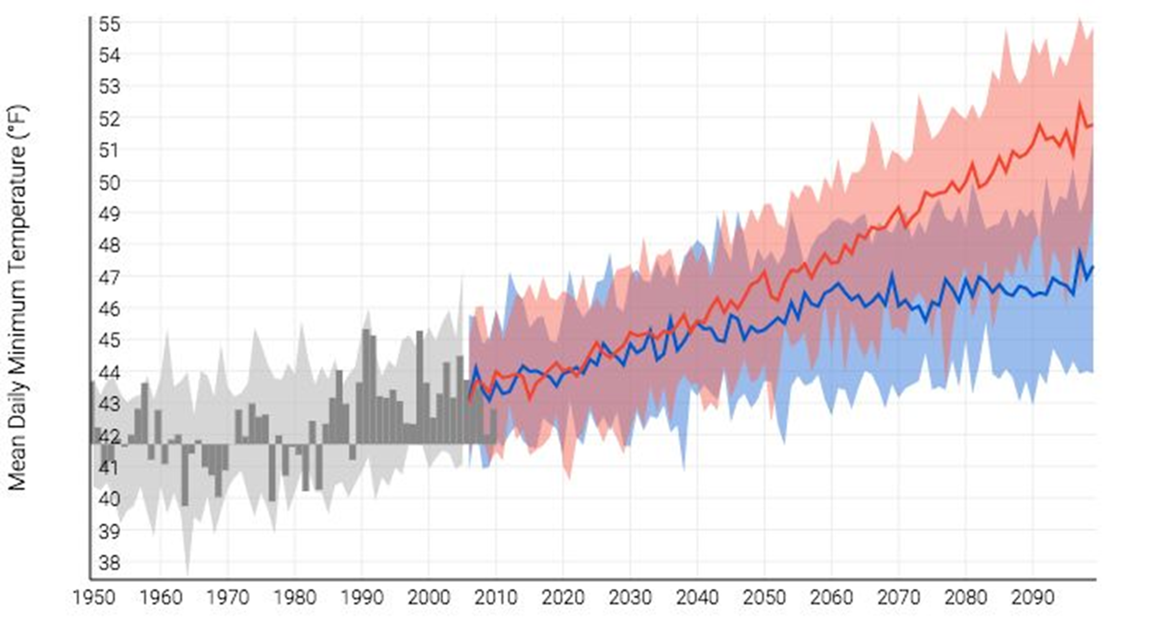
Source: Land of Sky Region Economic Resilience Exposure Analysis Phase I Report
InfoGraphics 2050

Slide 54
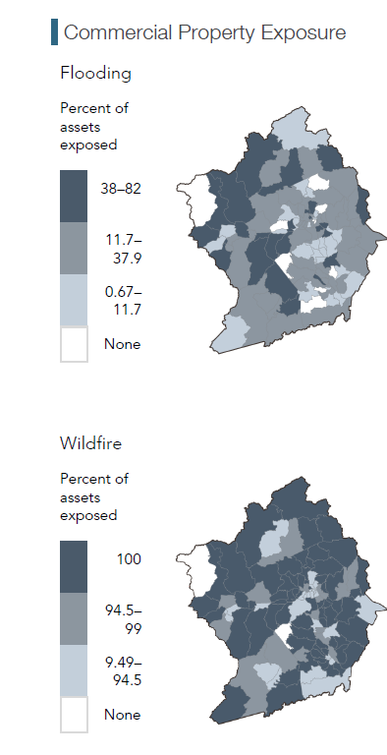
Source: Land of Sky Region Economic Resilience Exposure Analysis Phase II Report
(November 19)
InfoGraphics 2050

Slide 55
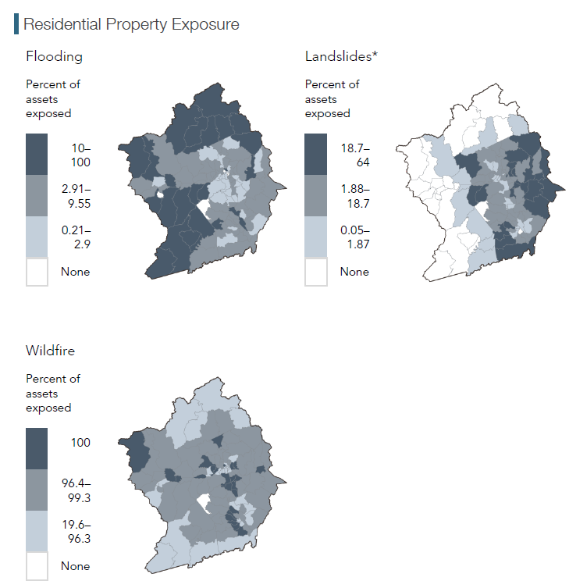
Source: Land of Sky Region Economic Resilience Exposure Analysis Phase II Report
(November 19)
InfoGraphics 2050

Slide 56
Source: Land of Sky Region Economic Resilience Exposure Analysis Phase II Report
(November 19)
InfoGraphics 2050

Slide 57
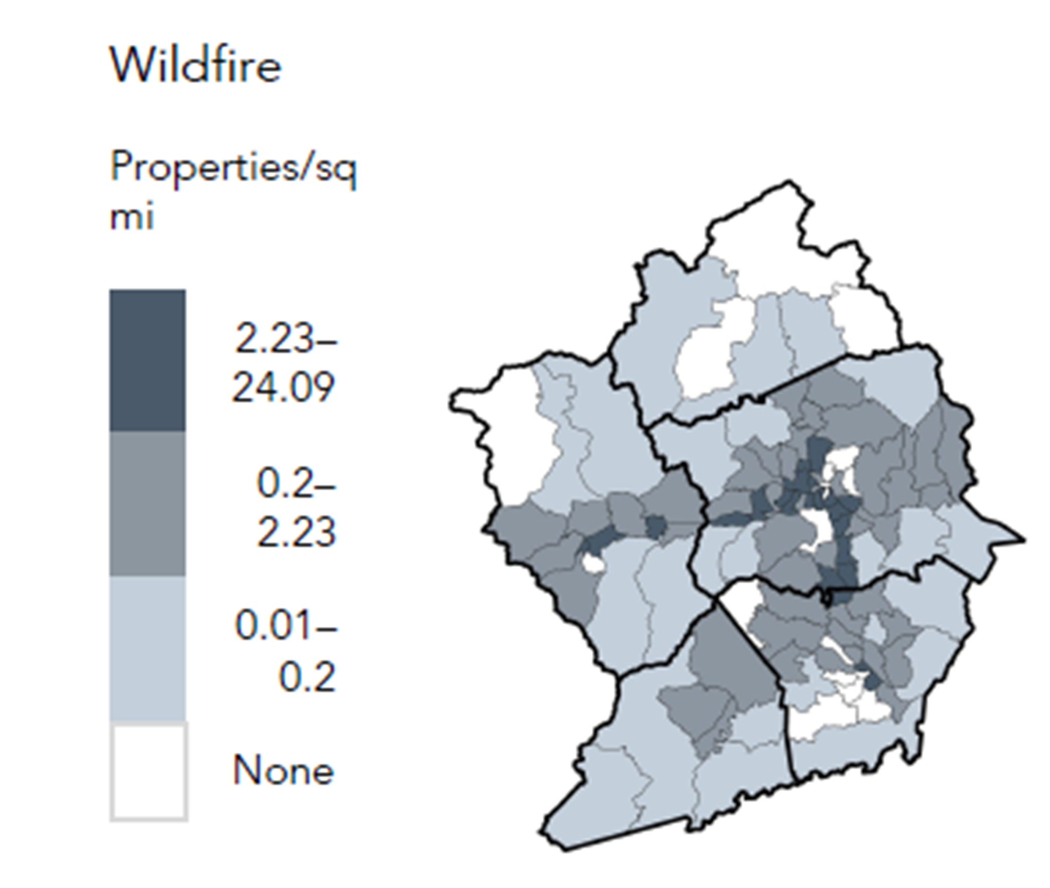
Source: Land of Sky Region Economic Resilience Exposure Analysis Phase I Report (June 2018)
InfoGraphics 2050

Slide 58
Source: Land of Sky Region Economic Resilience Exposure Analysis Phase I Report (June 2018)
InfoGraphics 2050

Slide 59
Health

Slide 60
Source: Robert Woods Foundation
InfoGraphics 2050

Slide 61
Transportation

Slide 62
InfoGraphics 2050

Slide 63
InfoGraphics 2050

Slide 64
French Broad MPO and Land of Sky Report for Transylvania County
InfoGraphics 2050

Slide 65
French Broad MPO and Land of Sky Report for Transylvania County
InfoGraphics 2050

Slide 66
French Broad MPO and Land of Sky Report for Transylvania County
InfoGraphics 2050

Slide 67
French Broad MPO and Land of Sky Report for Transylvania County
InfoGraphics 2050

Slide 68
InfoGraphics 2050

Slide 69
InfoGraphics 2050

Slide 70
InfoGraphics 2050

Slide 71
InfoGraphics 2050

Slide 72
InfoGraphics 2050

Slide 73
InfoGraphics 2050

Slide 74
InfoGraphics 2050

Slide 75
InfoGraphics 2050

Slide 76
InfoGraphics 2050

Slide 77
Land of Sky Resilience Exposure Analysis Phase I Report
June 2018
InfoGraphics 2050

Slide 78
2017 Transylvania County Bike Plan
InfoGraphics 2050

Slide 79
2023 City of Brevard Pedestrian and Bicycle Plan
InfoGraphics 2050

Slide 80
2017 Transylvania County Bike Plan
InfoGraphics 2050

Slide 81
What’s Missing?
InfoGraphics 2050

Slide 82
Branding & Marketing

Slide 83
Branding 2050

Slide 84
Branding 2050

Slide 85
Branding 2050

Slide 86
Branding 2050

Slide 87
Branding 2050

Slide 88
Branding 2050

Slide 89
Branding 2050

Slide 90
Branding 2050

Slide 91
Branding 2050

Slide 92
Thanks!

