Slide 1
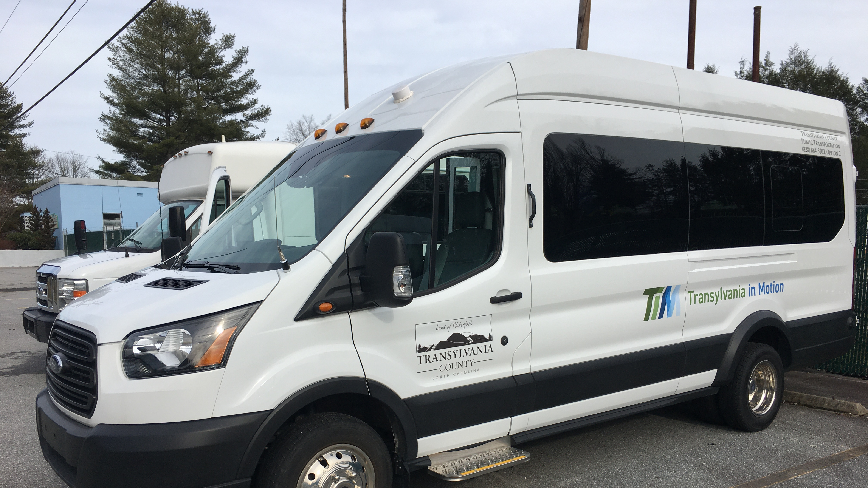
Transportation Advisory Board
May 8, 2024

Slide 2
I. Welcome

Slide 3
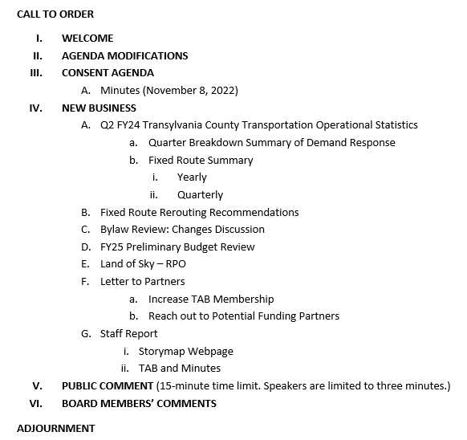
II. Agenda Modifications

Slide 4

III. Consent Agenda
February 14, 2024 Meeting Minutes

Slide 5
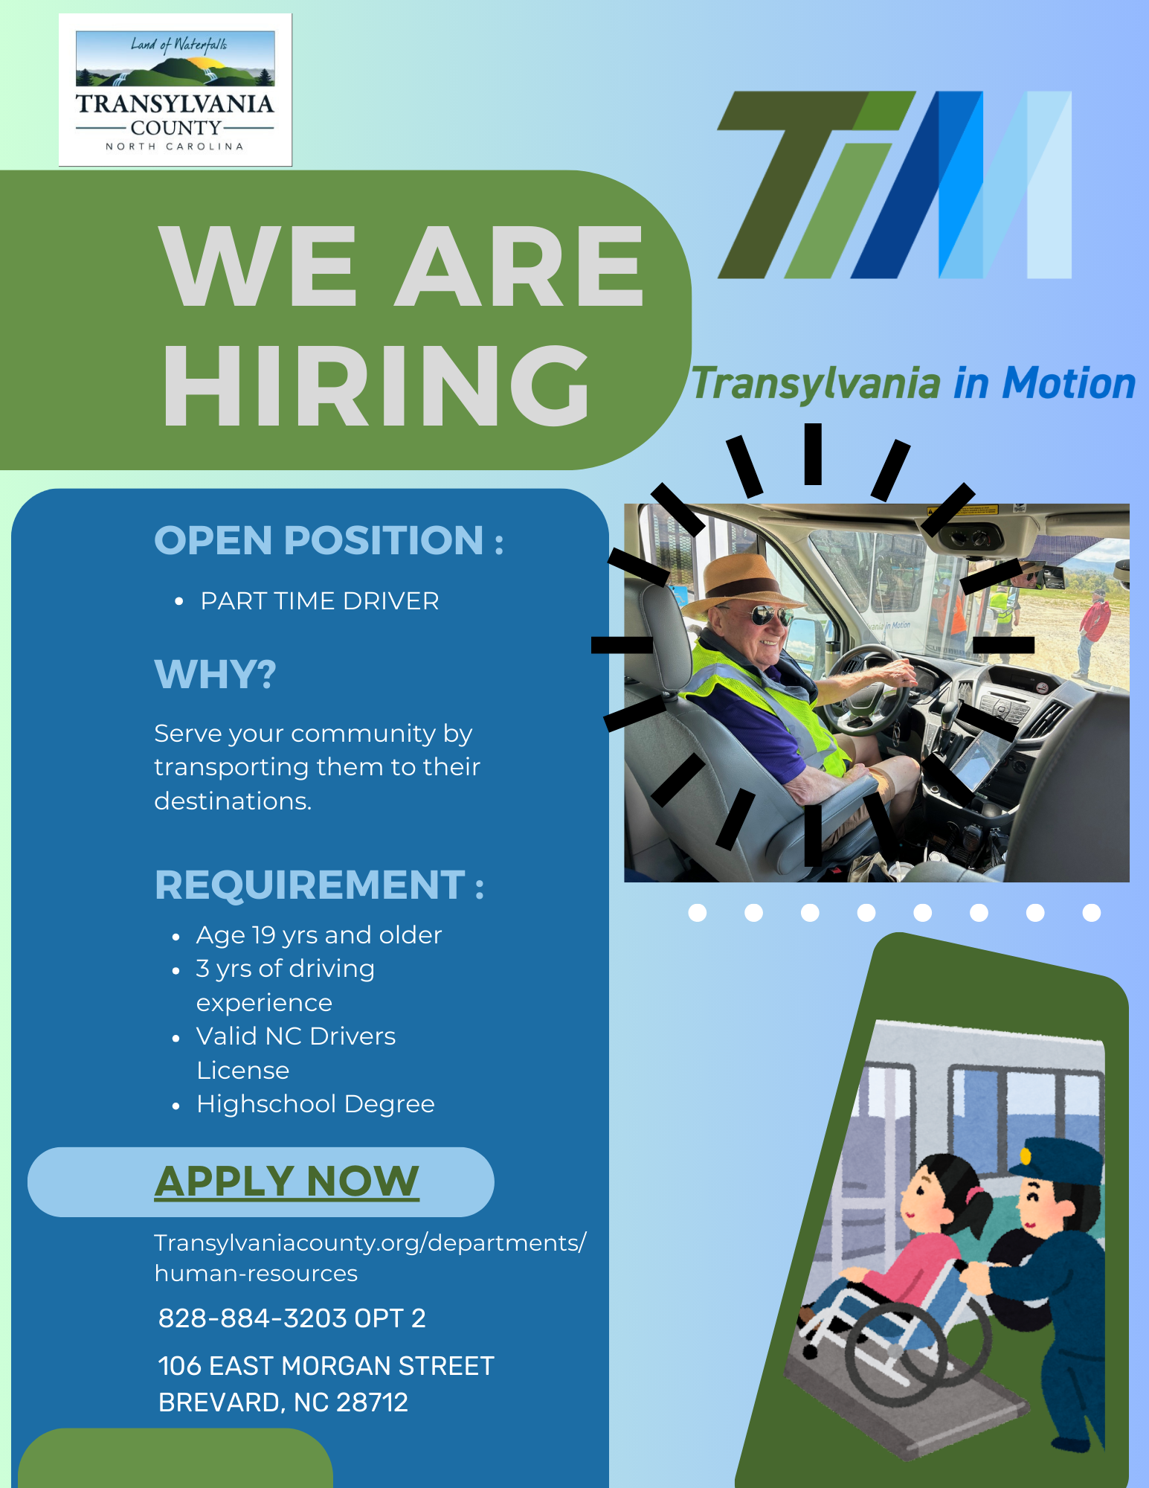
III-B. Transportation Updates
Budget Update
County Commissioners Approve Silver Squirrels!
Partnership with TC Library on Field Trips
Apple Country Fixed Route Observations

Slide 6
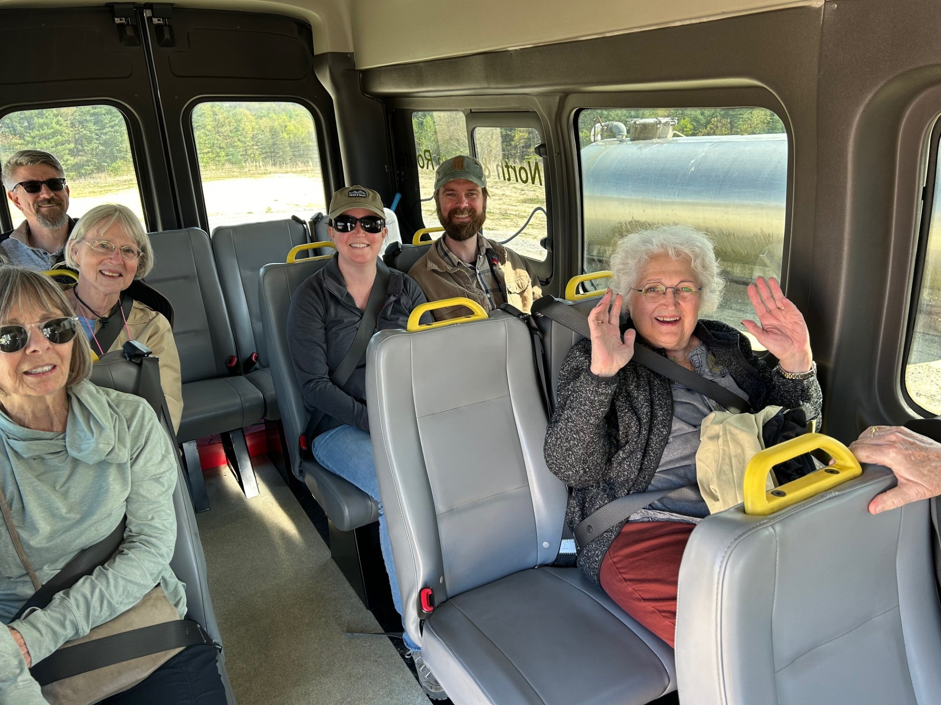
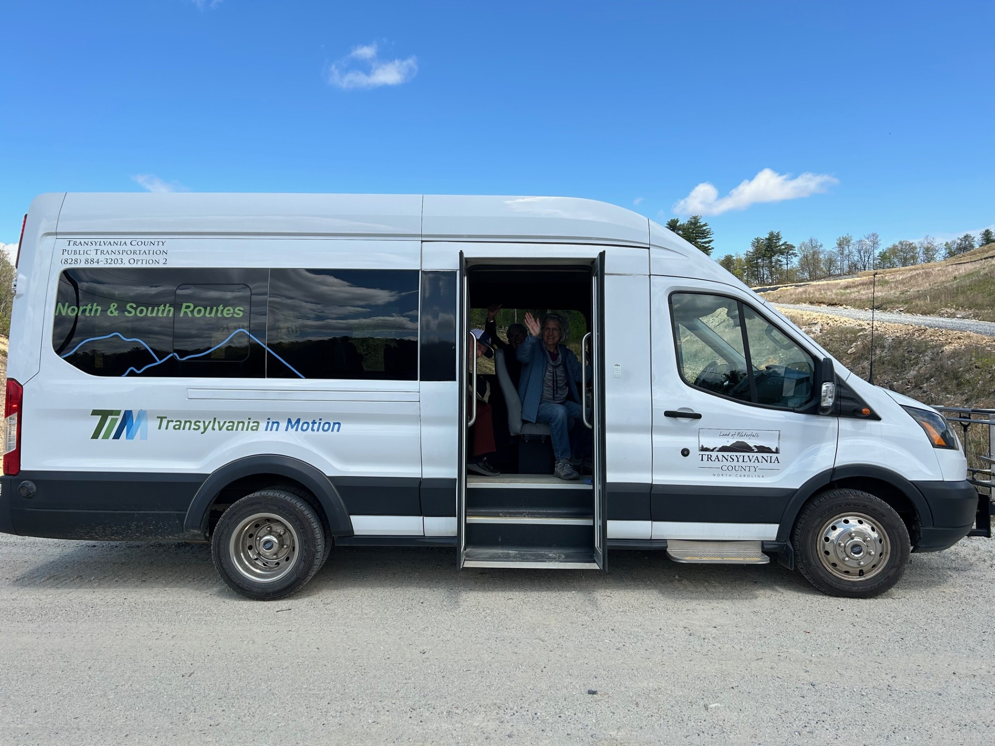
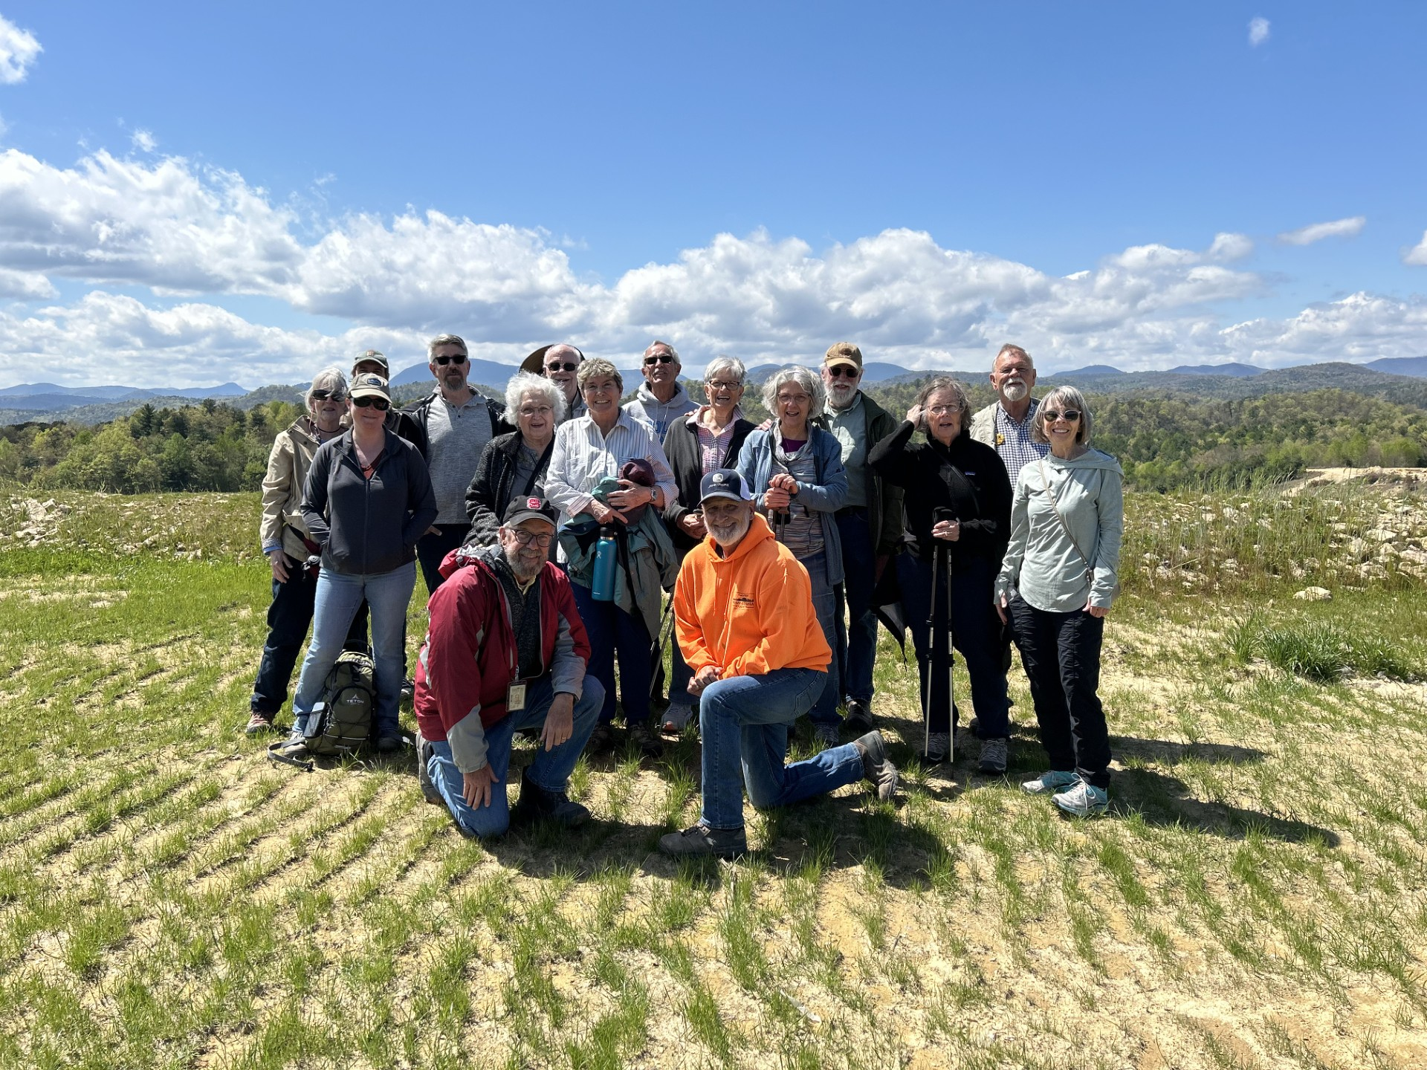
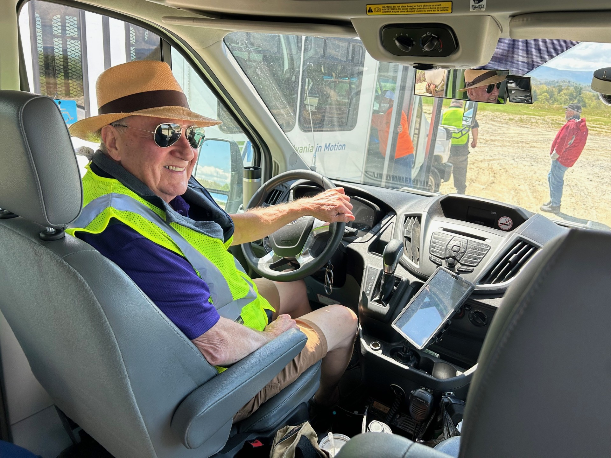
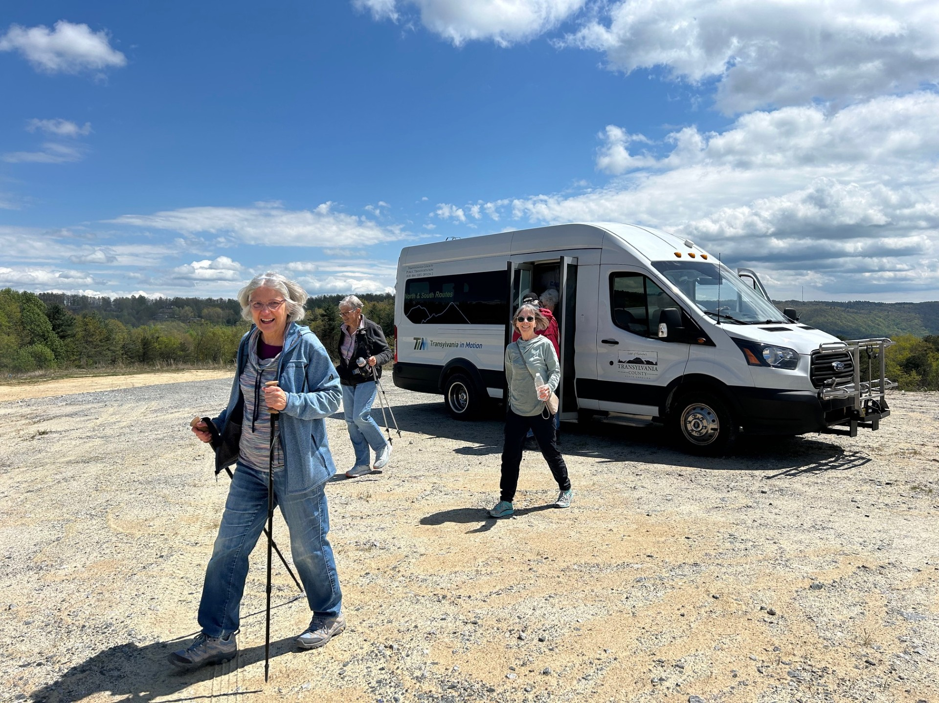
TC Library Field Trip
Bob
Substitute Driver

Slide 7
New Business

Slide 8
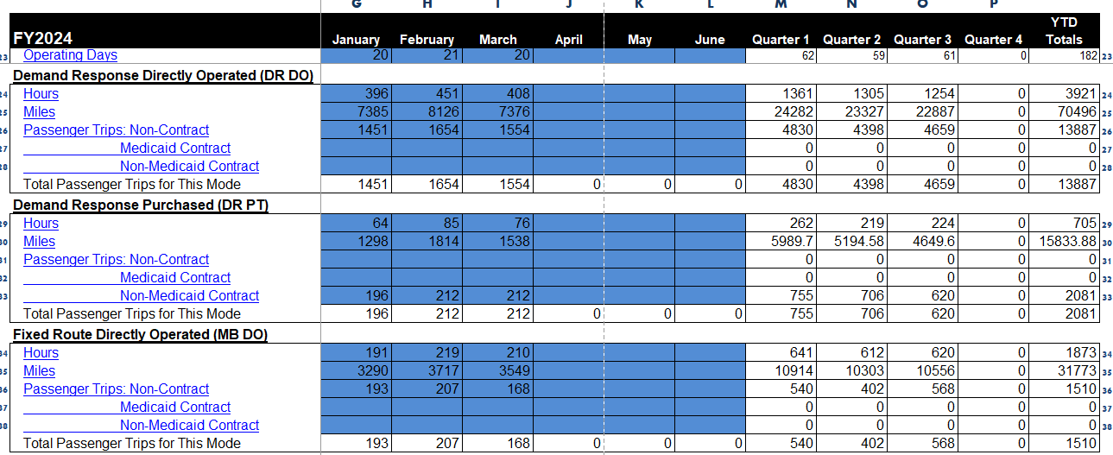
V-A. Q-3 FY24 Transportation Operational Statistics

Slide 9
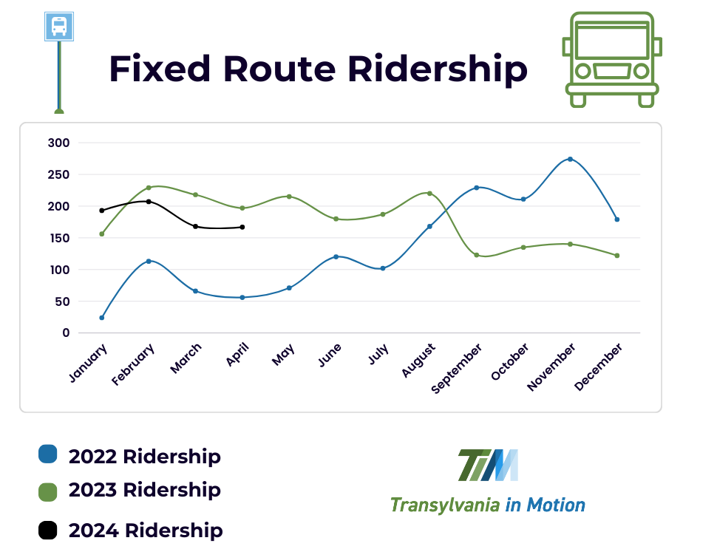
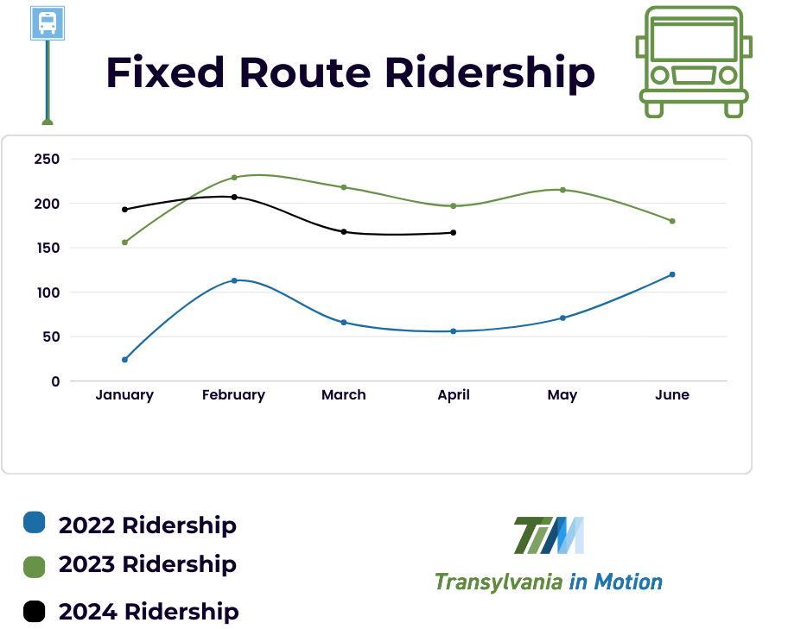
Fixed Route Yearly

Slide 10
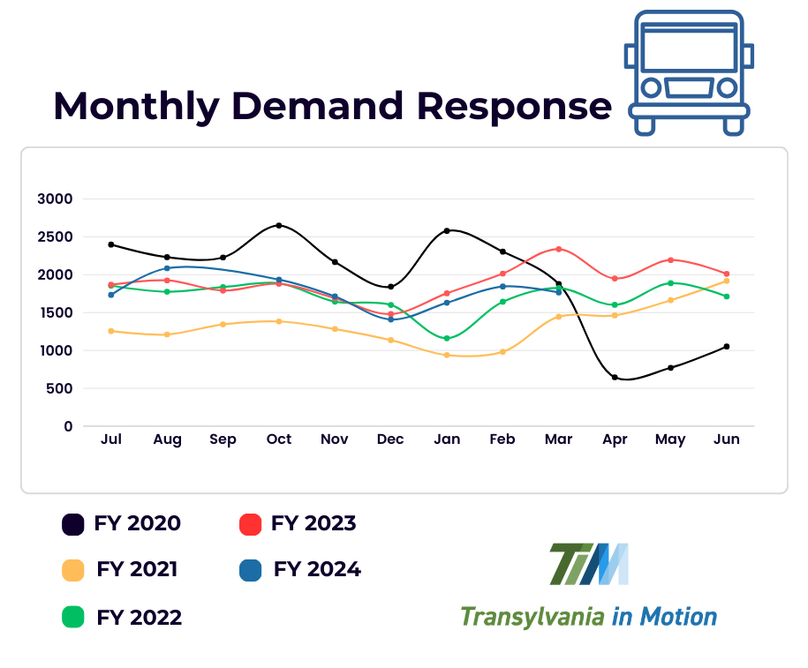
Demand Response

Slide 11
VI-B. Fixed Route Re-Routing

Slide 12
VI-B. Fixed Rerouting Recommendations
Staff has put together three options of Rerouting recommendations.
The next slide shows each option and the stop locations, it also includes the time it would take to get to each stop as well as the overall time of the route.
Some options show more stop locations but less time, since most of the stops are closer together.
Other options suggest a seasonal stop or one that would interest both residents and visitors to our county.

Slide 13
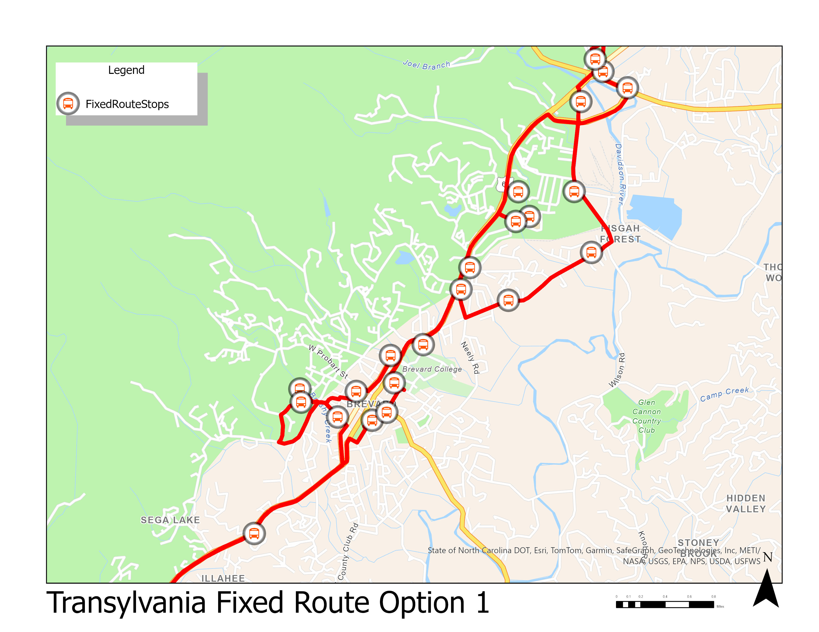

Slide 14
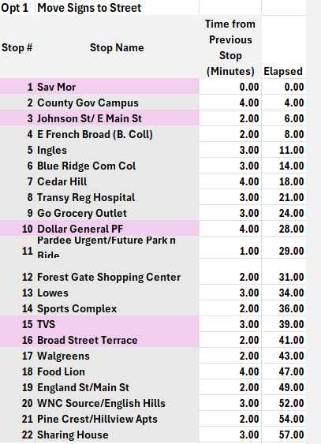


Slide 15
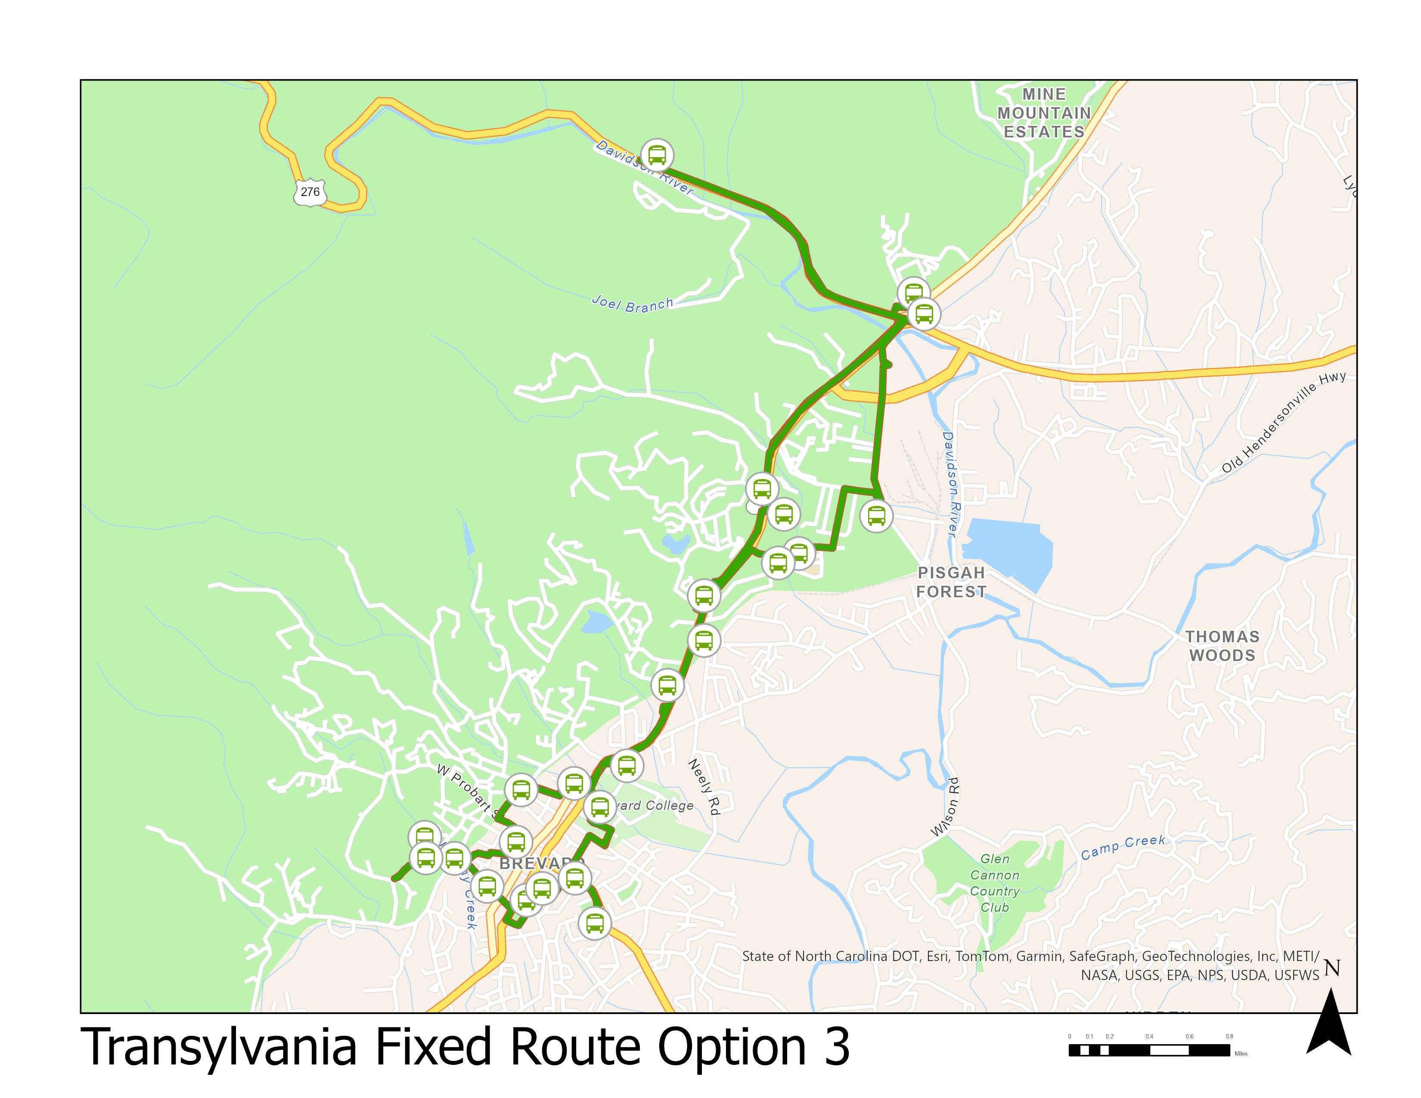

Legend
Opt 2 Stops
Opt 2 Route

Slide 16
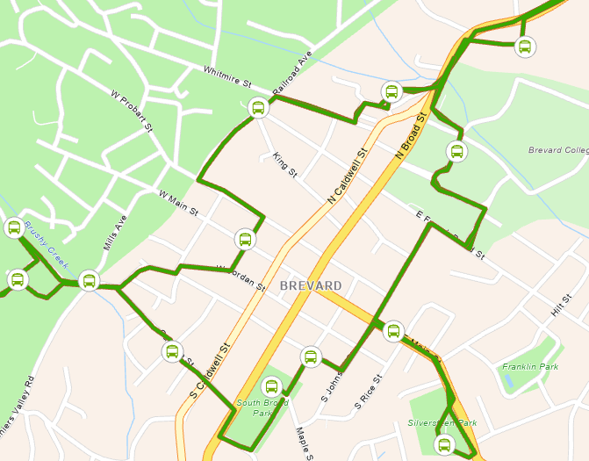
Legend
Opt 2 Stops
Opt 2 Route

Slide 17
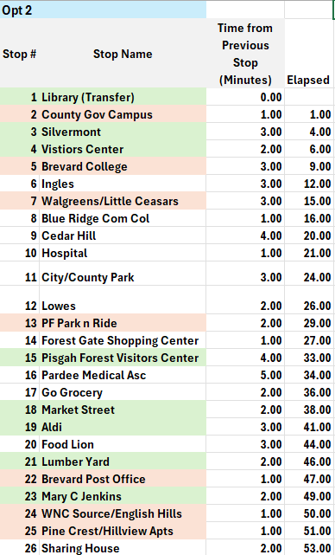

Slide 18
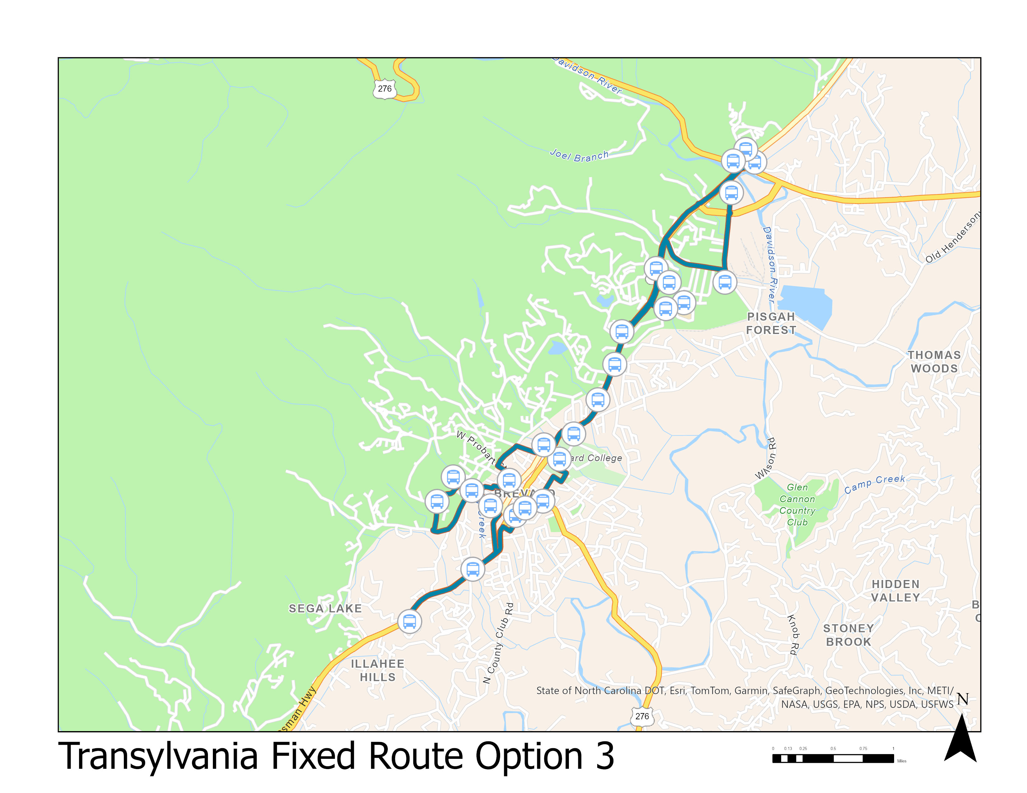
Legend
____ Opt 3 Stops
____ Opt 3 Route

Slide 19

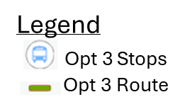
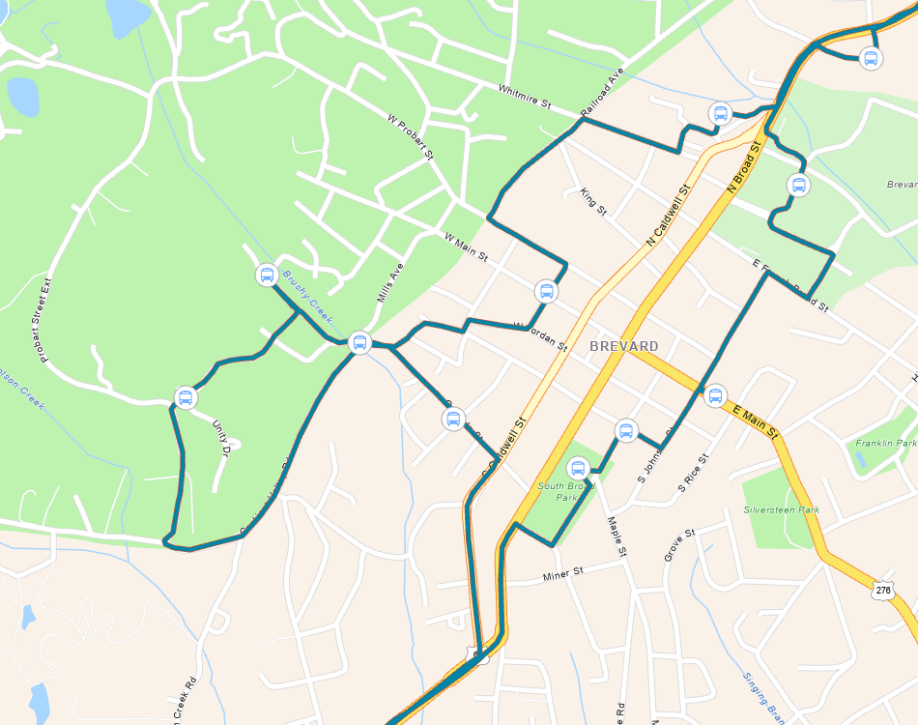

Slide 20
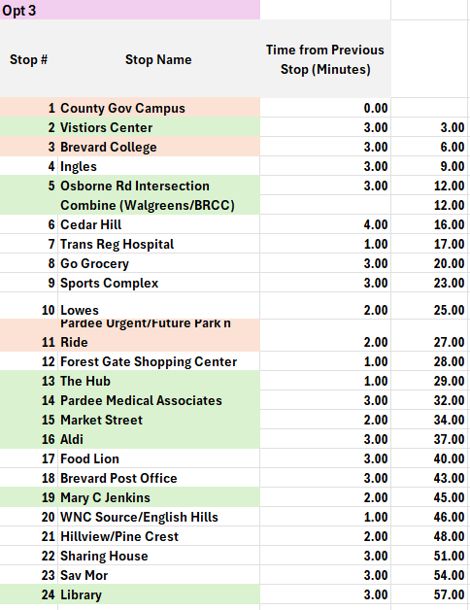

Slide 21
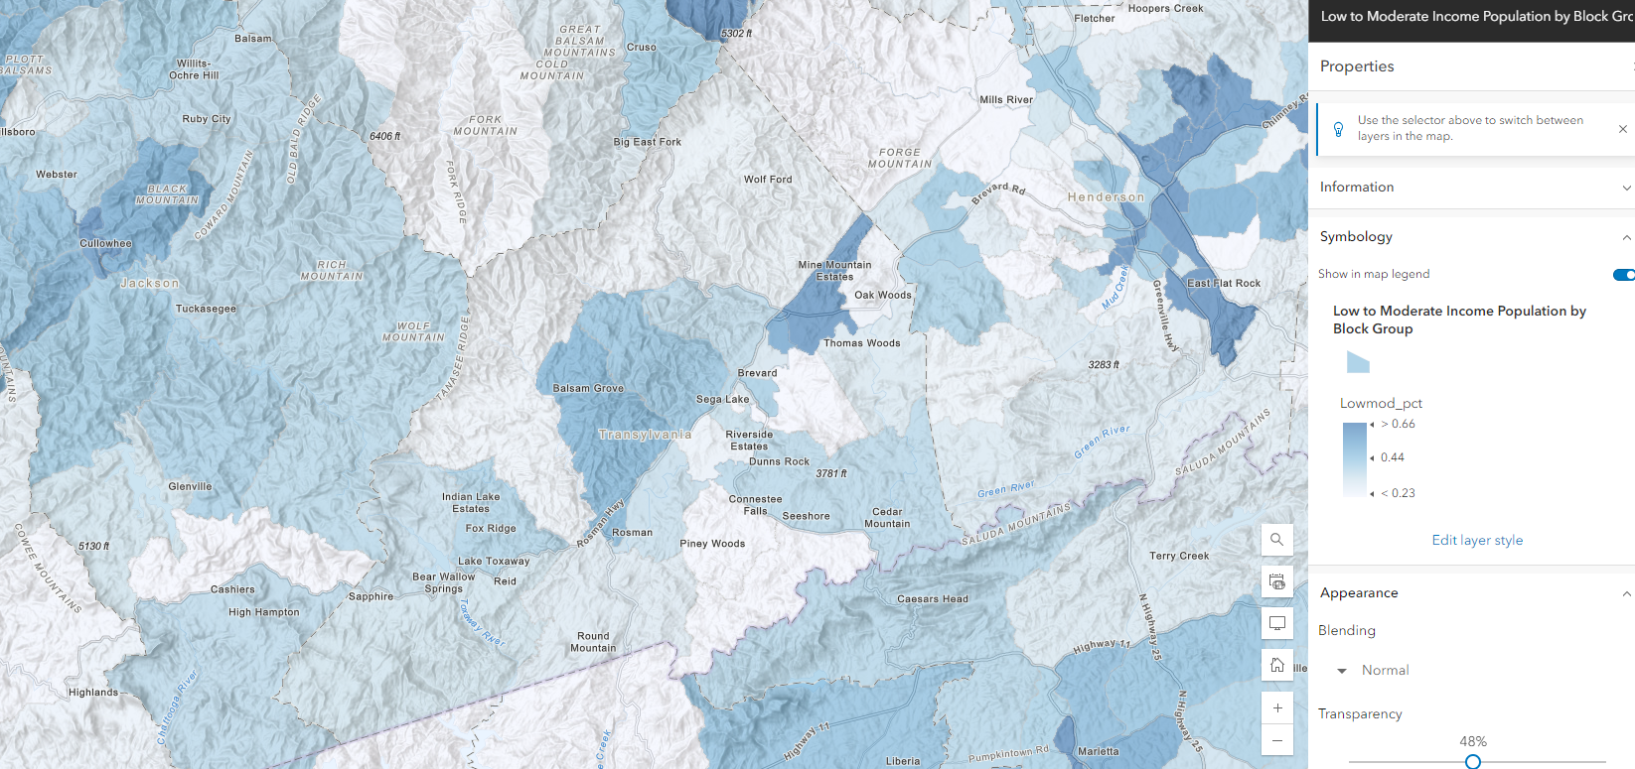
64% LMI
52% LMI

Slide 22
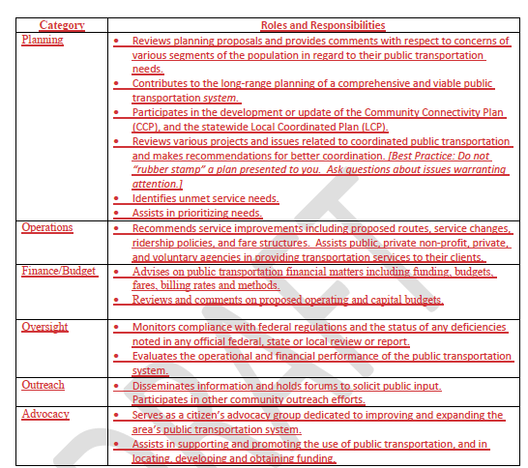
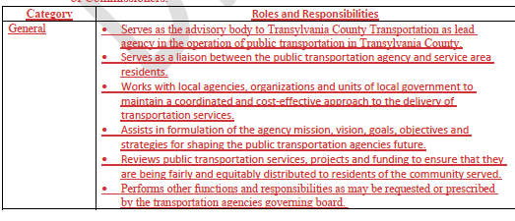
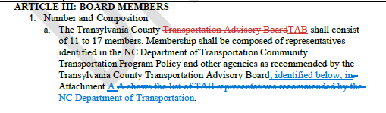
VI-C. Bylaw Review: Changes Discussion

Slide 23
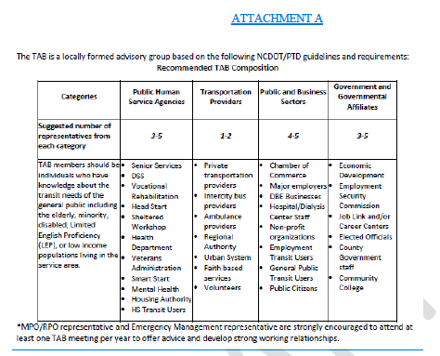


VI-C. Bylaw Review: Changes Discussion

Slide 24
VI-D. Land of Sky Update
Vicki Eastland

Slide 25
VI. Public Comment
15-Minute Time limit (speakers are held to three minutes)

Slide 26
VII. Board Members Comments

Slide 27
Thank you for attending
Next TAB meeting will be on August 14th at 2:00 PM, in the Large DSS Conference Room, 2nd Floor.

