Slide 1
Transylvania County
Planning Board Meeting | May 2024

Slide 2
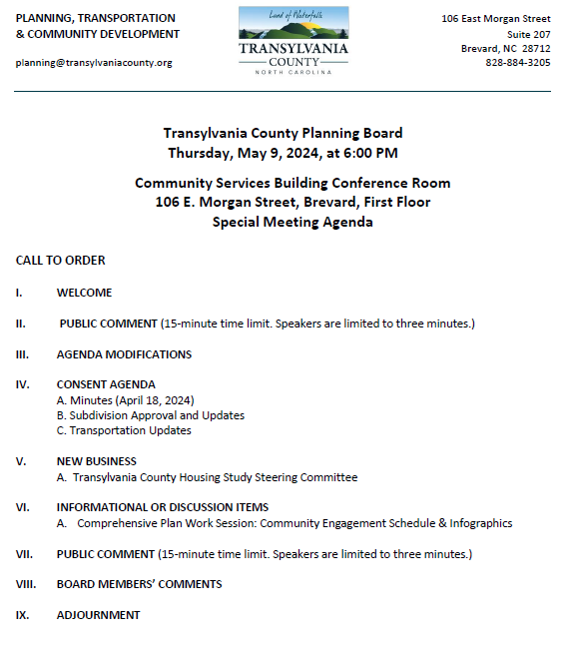
Transylvania County Planning Board

Slide 3
Public Comment

Slide 4
Agenda Modifications

Slide 5
Consent Agenda

Slide 6
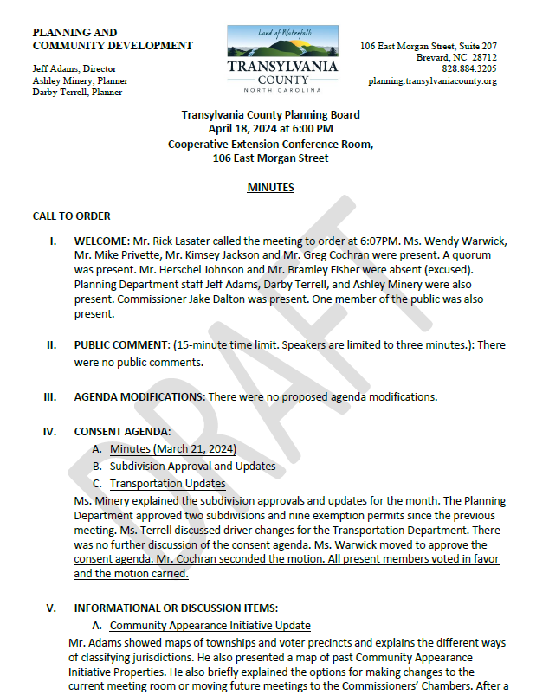
Minutes
March 21, 2024
Consent Agenda

Slide 7
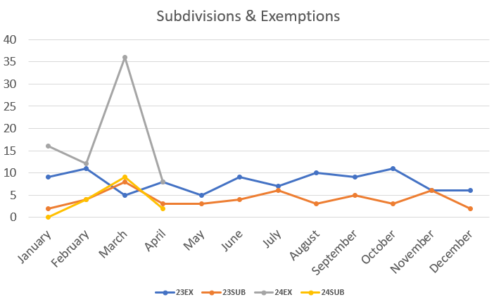
Subdivision Approval & Update
Consent Agenda

Slide 8
Transportation Update
Consent Agenda

Slide 9
Old Business

Slide 10
New Business

Slide 11
A. Transylvania County Housing Study Steering Committee

Slide 12
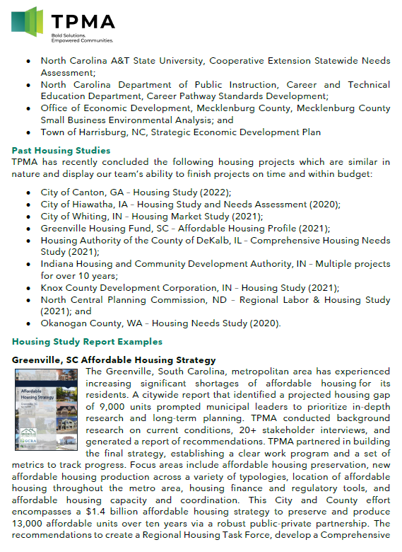
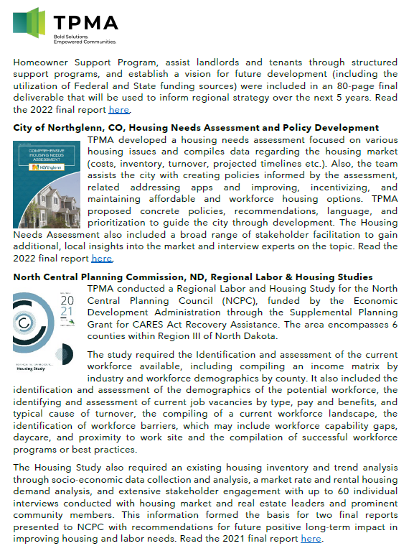
Housing Study

Slide 13
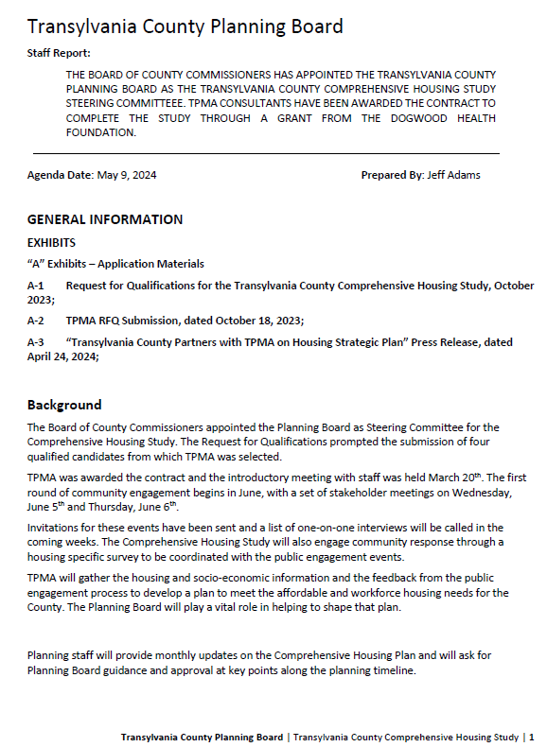
RFQ: Comprehensive Housing Study
Scope of Services:
Demographic Review
Economics
Inventory of Existing Housing Stock
Other Housing Issues
Recommendations
Housing Study

Slide 14
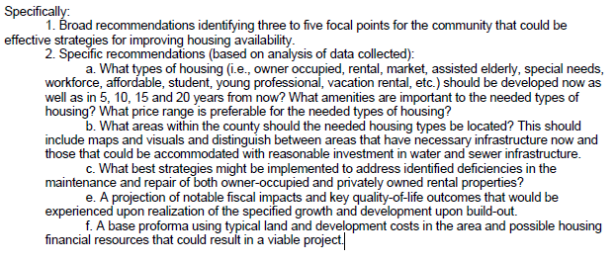
Housing Study

Slide 15
Task 1: Project Launch and Administration
Task 2: Demographic Analysis & Housing Analysis
Task 3: Community Engagement
Task 4: Housing Needs Analysis
Task 5: Housing Strategy & Implementation Roadmap
Housing Study

Slide 16
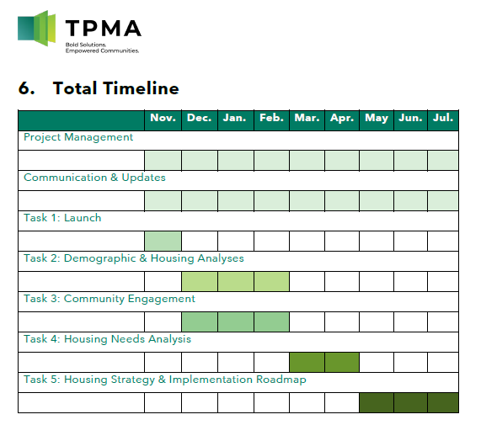
Housing Study

Slide 17
Informational & Discussion Items

Slide 18
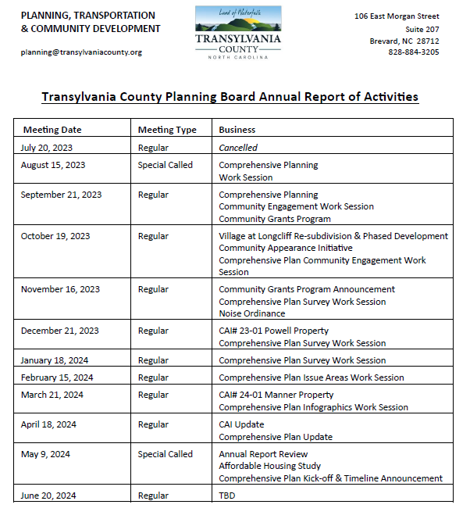
Annual Report
Informational & Discussion Items

Slide 19
B. Comprehensive Plan

Slide 20
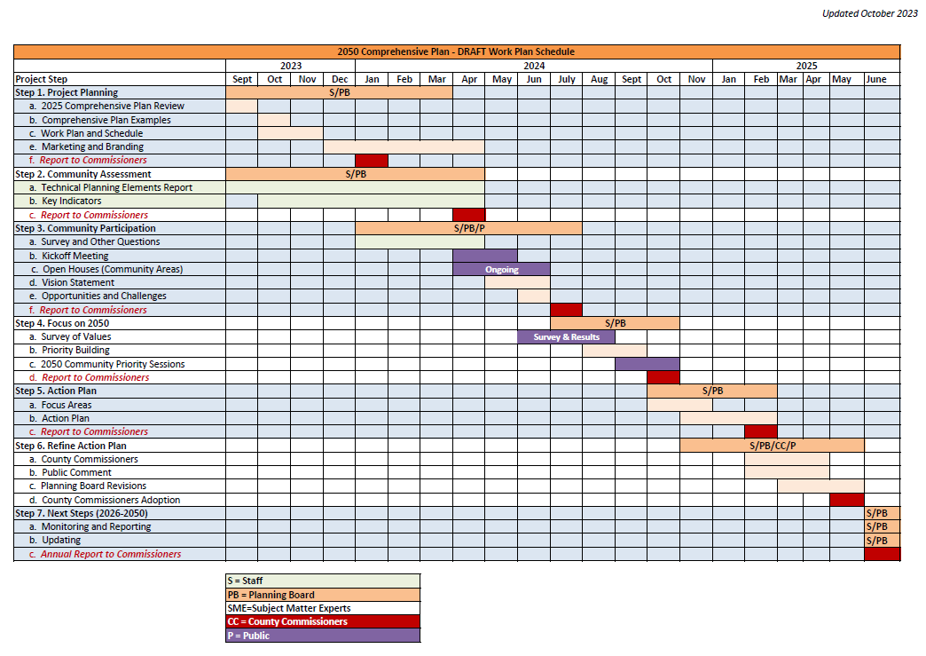
Comprehensive Plan: Outreach

Slide 22
Comprehensive Plan: Outreach

Slide 23
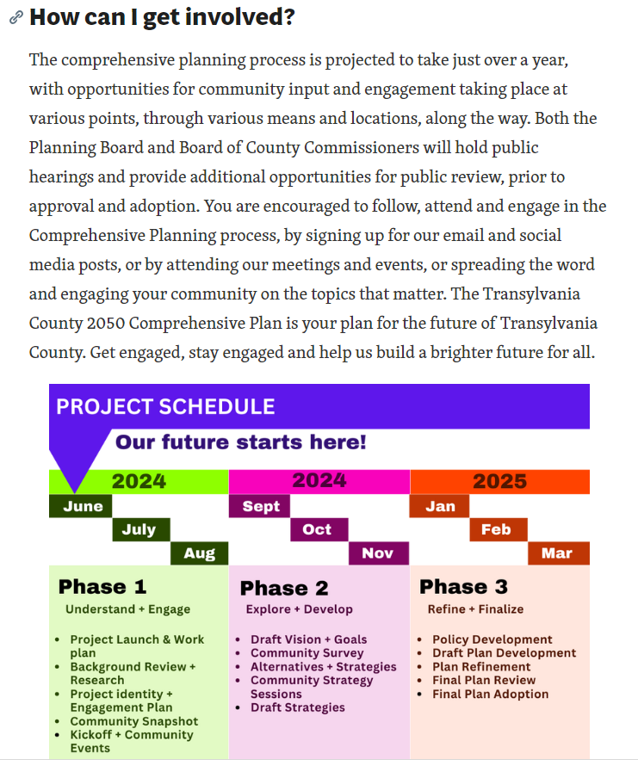
Comprehensive Plan: Outreach

Slide 24
Public Comment

Slide 25
Board Members’ Comments

Slide 26
Adjournment

