Slide 1
Transylvania County
Planning Board Meeting | August 2024

Slide 2
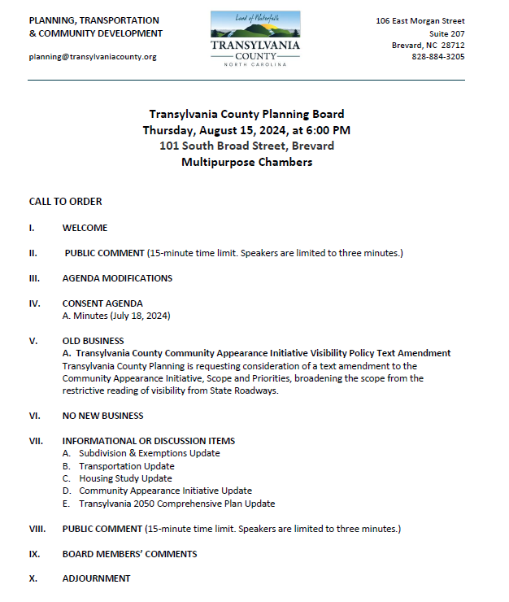
Transylvania County Planning Board

Slide 3
Public Comment

Slide 4
Agenda Modifications

Slide 5
Consent Agenda

Slide 6
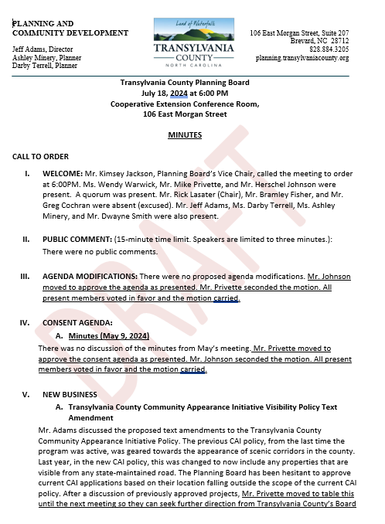
Minutes
July 18, 2024
Consent Agenda

Slide 7
Old Business

Slide 8
A. Community Appearance Initiative: Visibility Policy Text Amendment

Slide 9
Purpose
Consideration of proposed text amendment to the Transylvania County Community Appearance Initiative (CAI) Policy’s Scope and Priorities:
Current Language
Visibility Policy Text Amendment

Slide 10
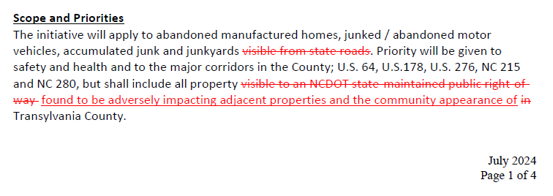
Proposed Language
Visibility Policy Text Amendment

Slide 11
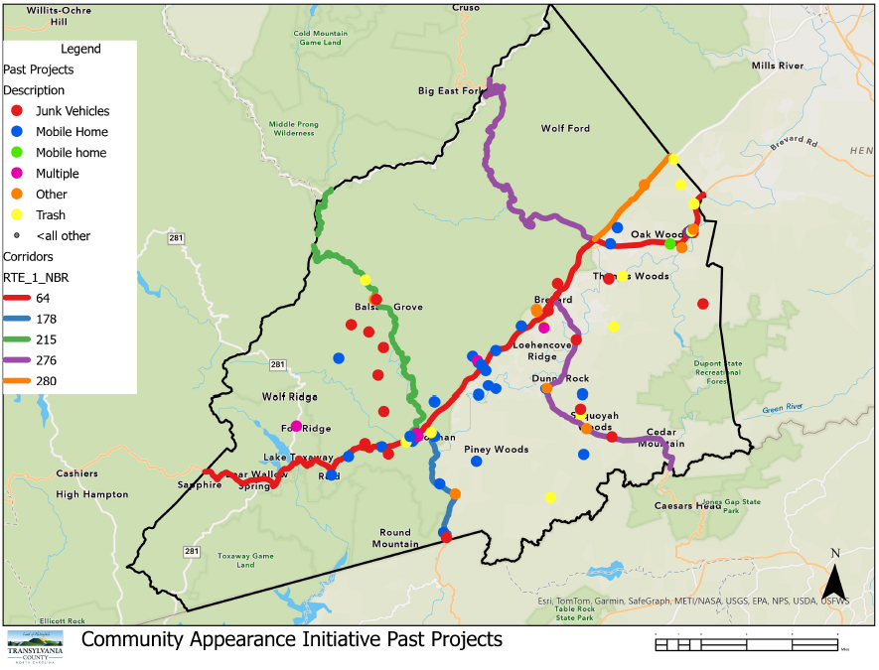
Previous CAI Cases
Visibility Policy Text Amendment

Slide 12
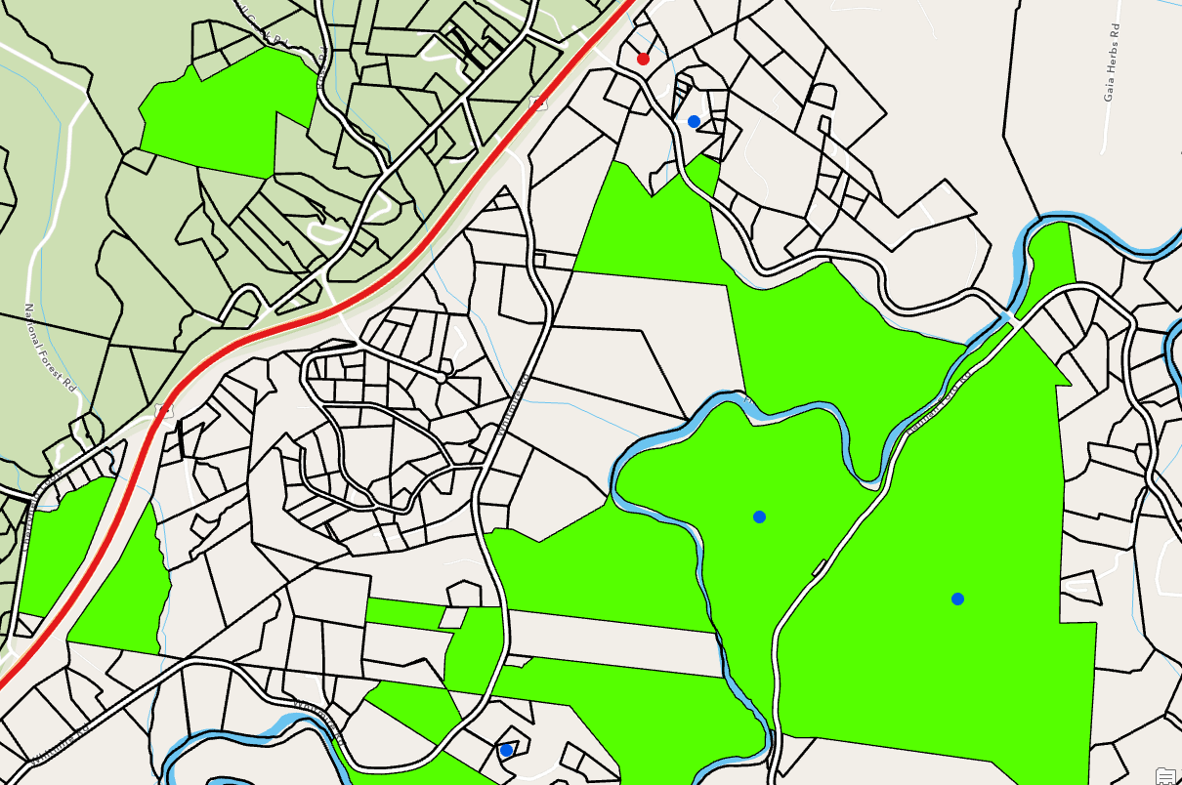
Hannah Ford Rd CAI Cases
Visibility Policy Text Amendment

Slide 13
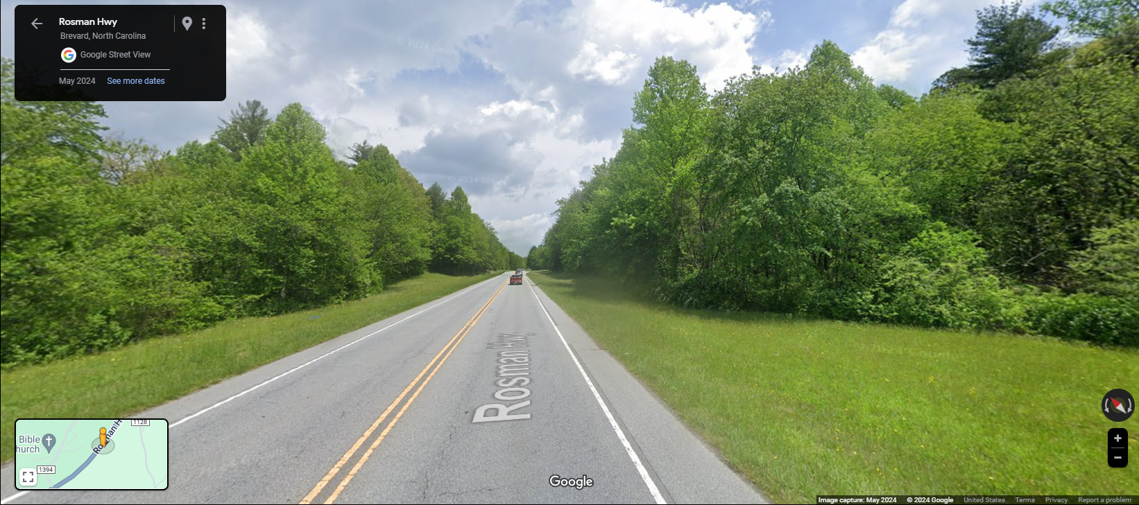
Hannah Ford Rd CAI Cases
Visibility Policy Text Amendment

Slide 14
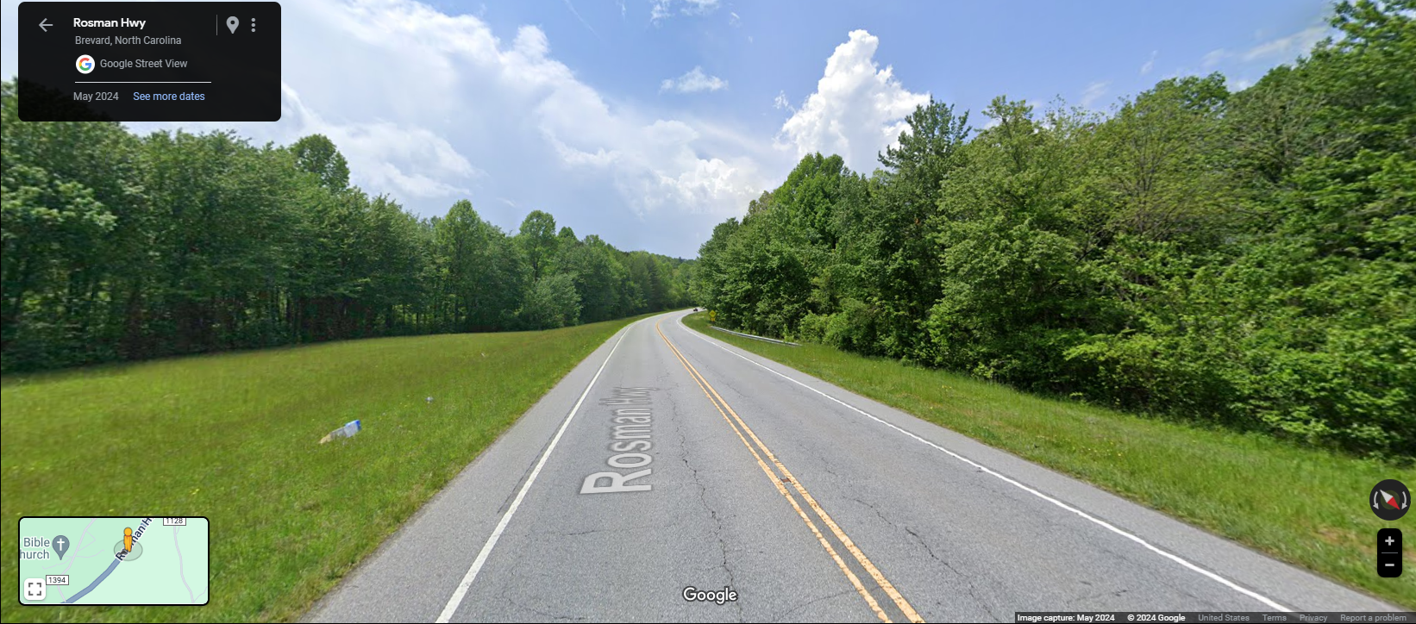
Hannah Ford Rd CAI Cases
Visibility Policy Text Amendment

Slide 15
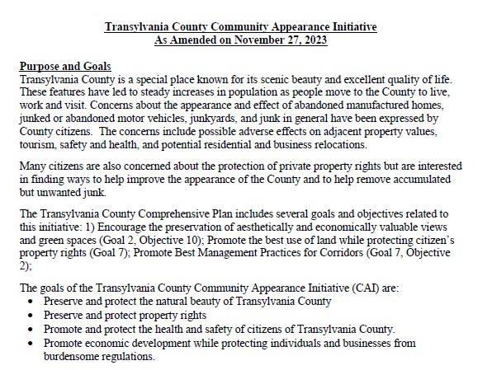
Goals
Visibility Policy Text Amendment

Slide 16
ReLaunch
Visibility Policy Text Amendment

Slide 17
Action
Visibility Policy Text Amendment

Slide 18
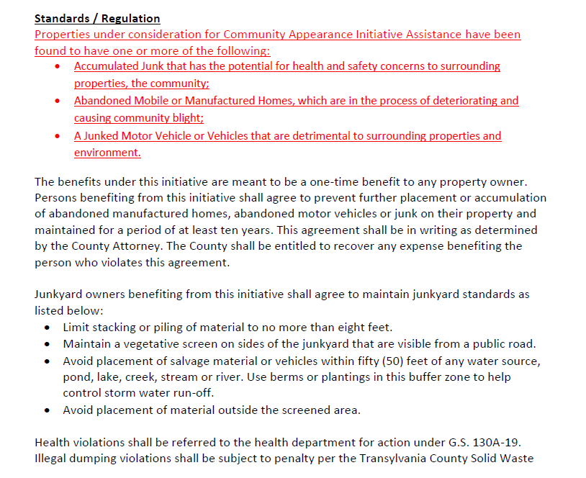
Action
Visibility Policy Text Amendment

Slide 19
New Business

Slide 20
Informational & Discussion Items

Slide 21
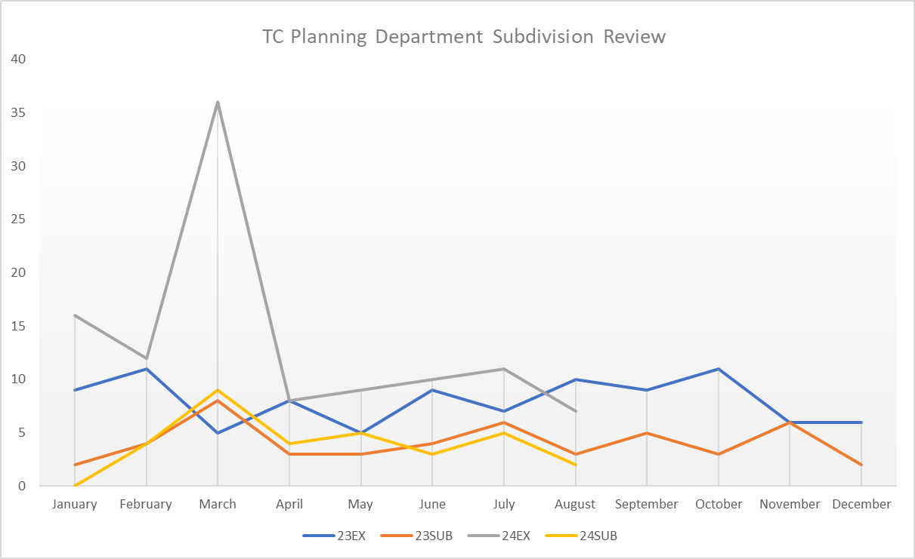
A. Subdivision Approval & Update
Subdivisions & Exemptions Update

Slide 22
B. Transportation Update
Transportation Update

Slide 23
B. Transportation Update
Transportation Update

Slide 24
C. Housing Study Update

Slide 25
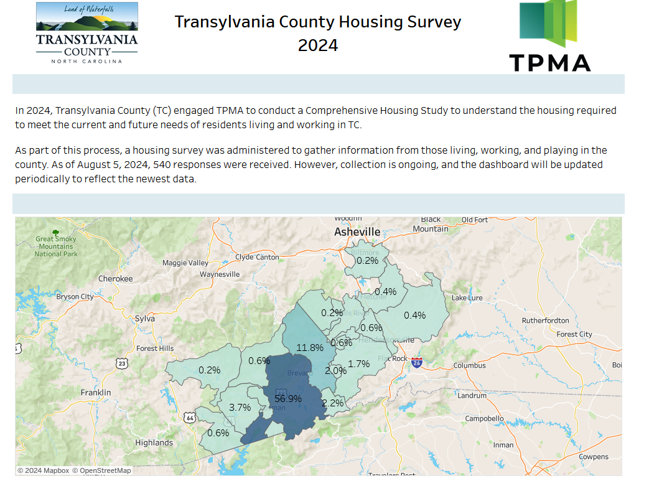
Housing Study Update

Slide 26
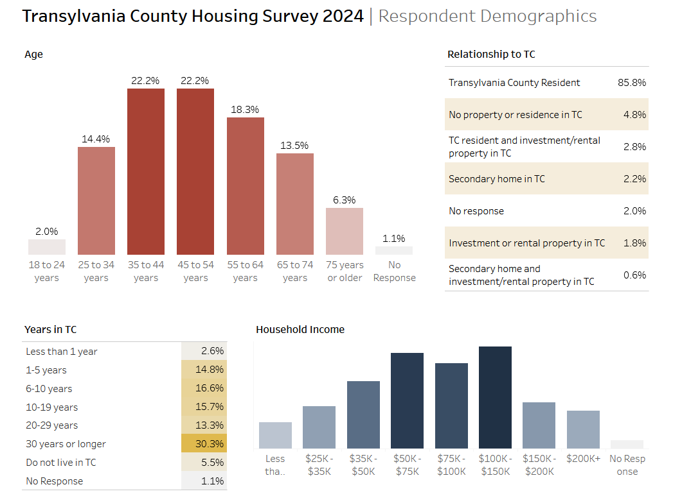
Housing Study Update

Slide 27
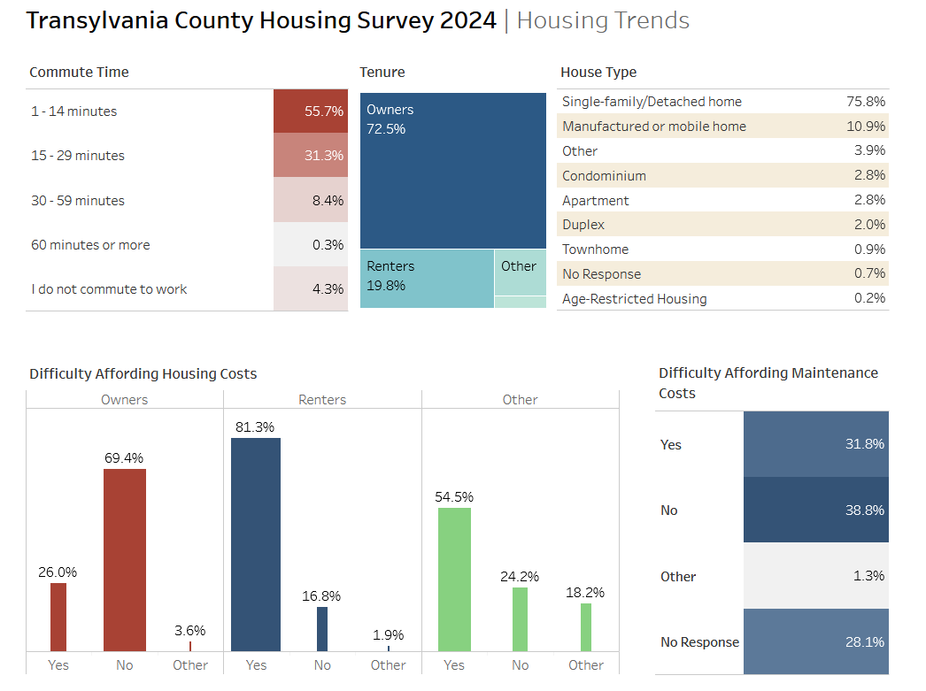
Housing Study Update

Slide 28
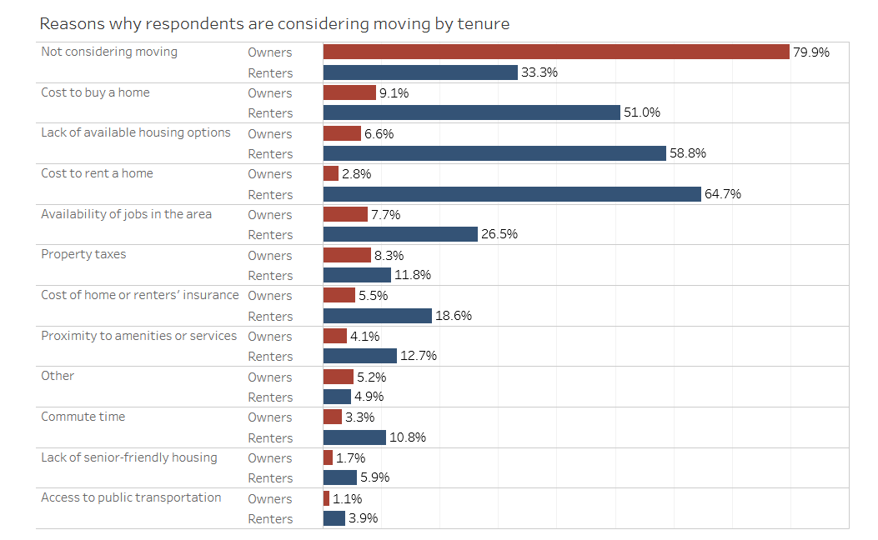
Housing Study Update

Slide 29
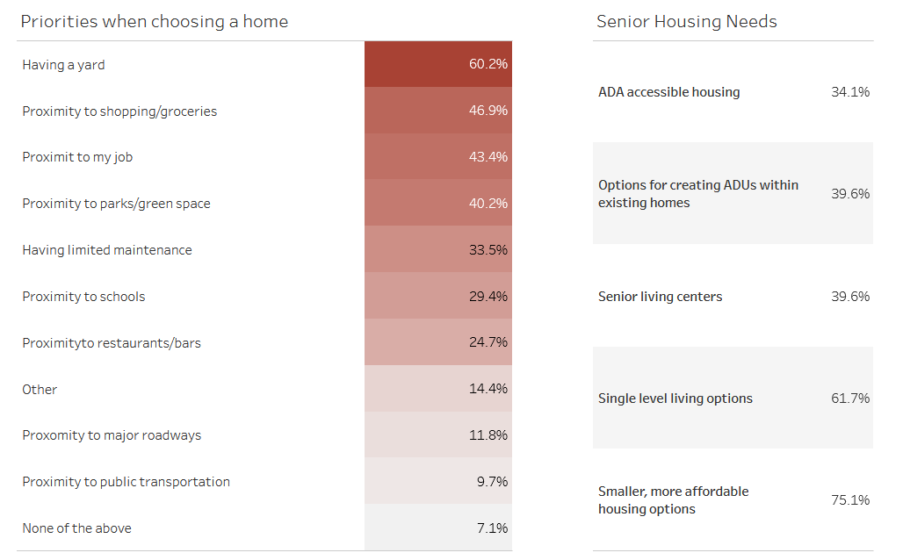
Housing Study Update

Slide 30
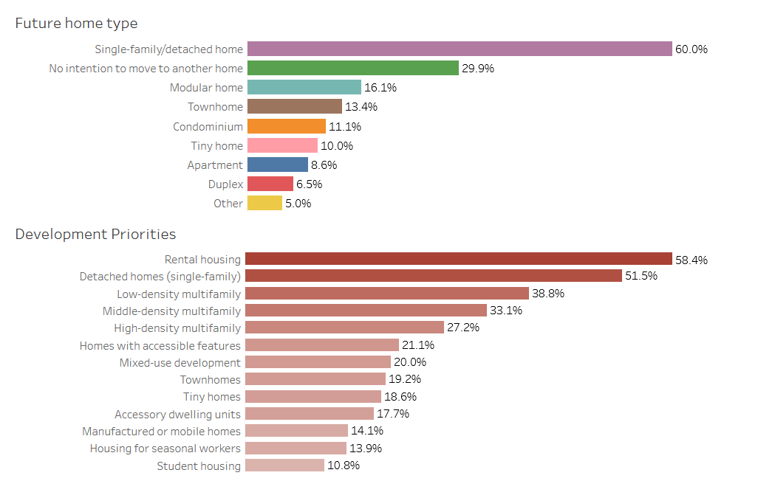
Housing Study Update

Slide 31
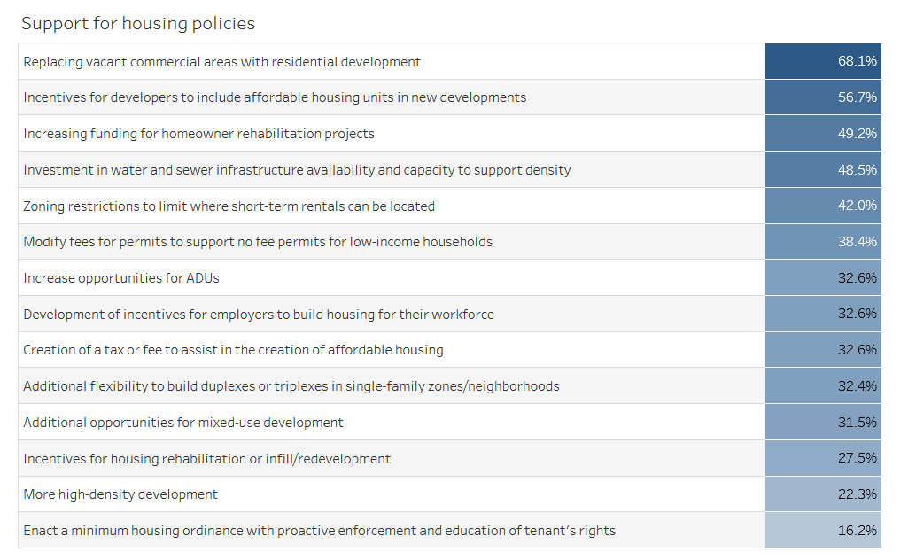
Housing Study Update

Slide 32
D. Community Appearance Initiative Update

Slide 33
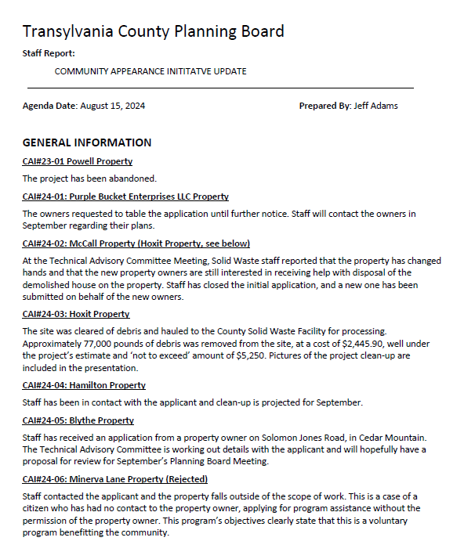
Staff Report
CAI Update

Slide 34
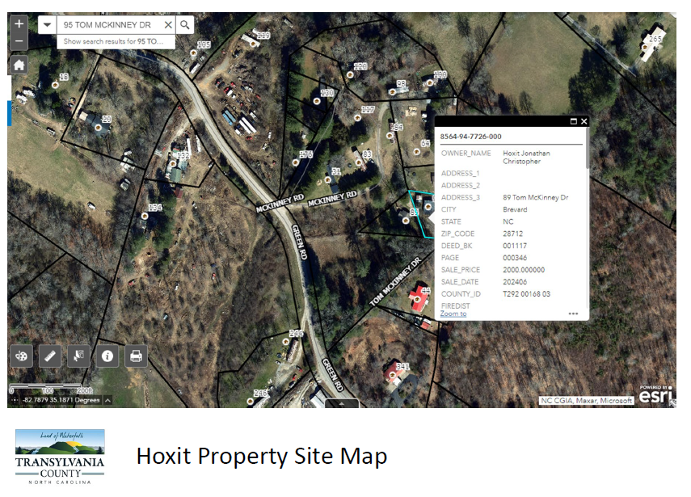
Staff Report
CAI# 24-03 Hoxit Update

Slide 35
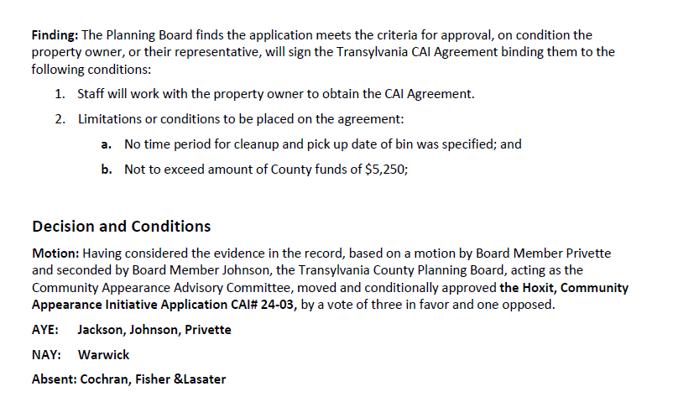
Staff Report
CAI Update

Slide 36
Staff Report
CAI Update

Slide 37
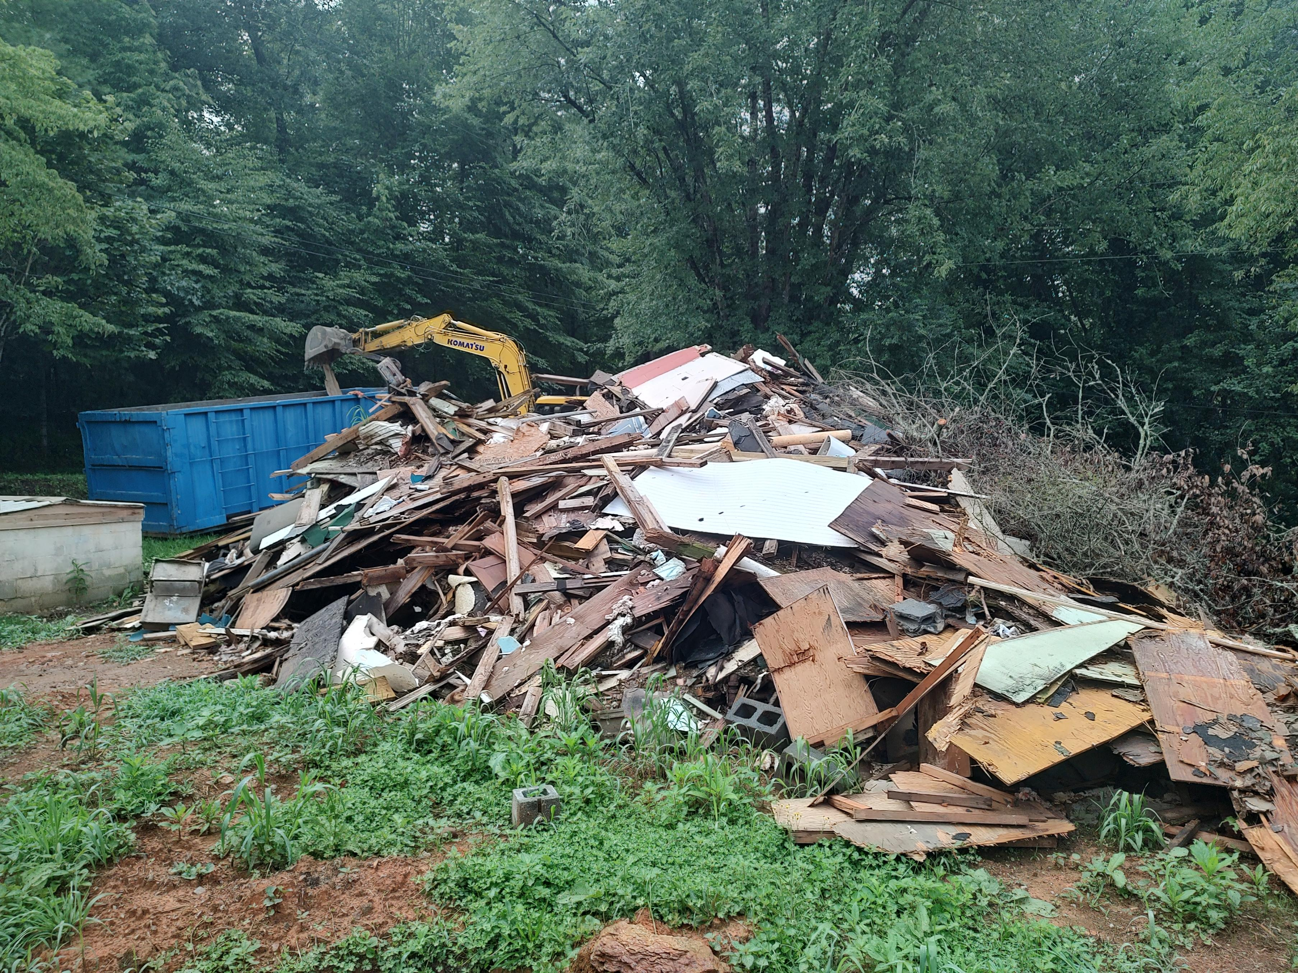
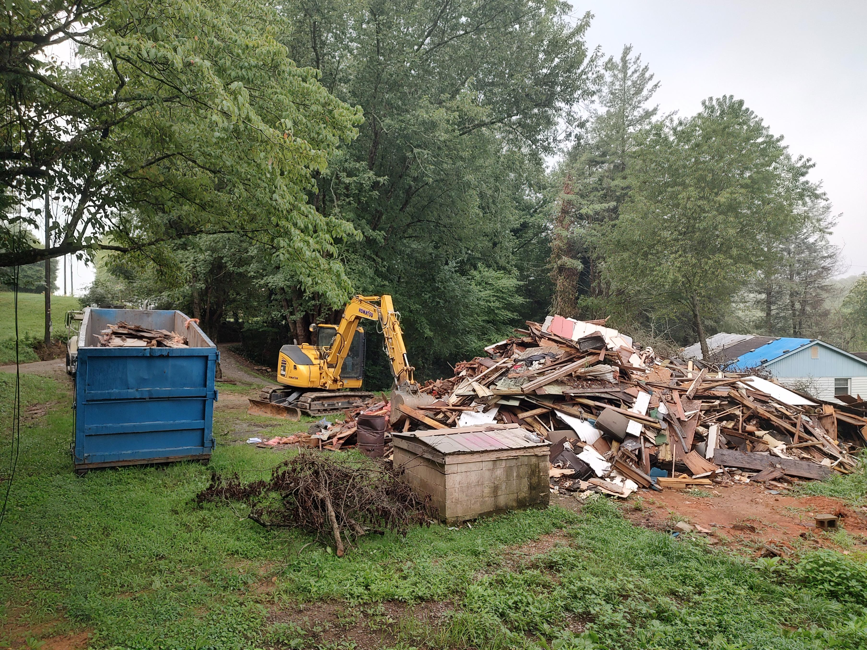
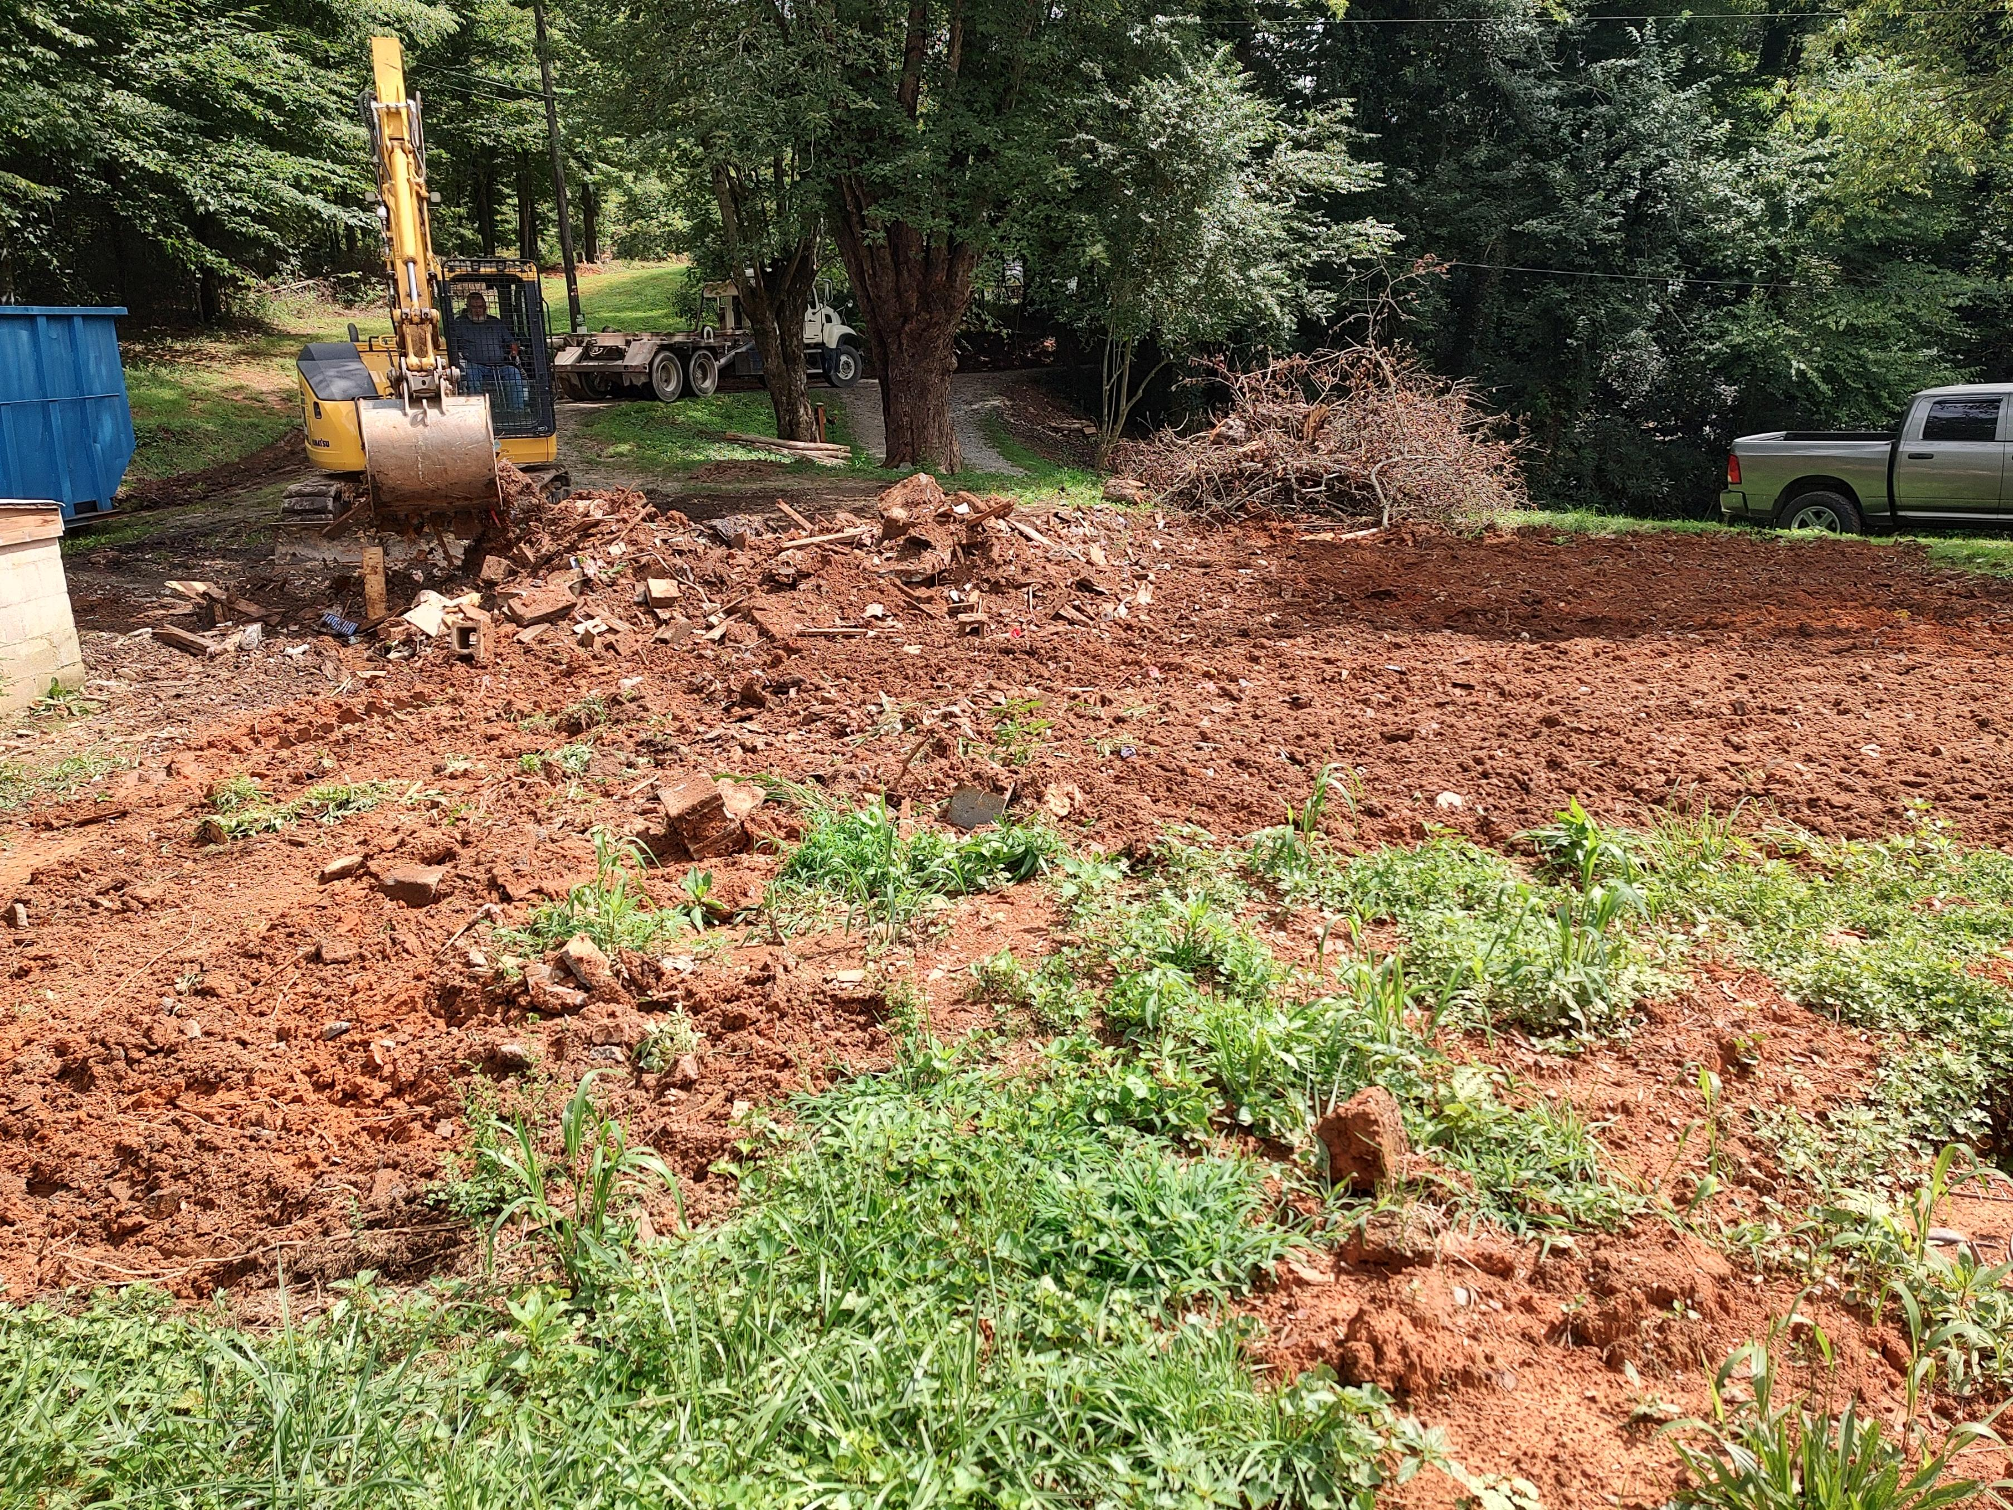
Staff Report
CAI# 24-03 Hoxit Update

Slide 38
D. Comprehensive Plan Update

Slide 39
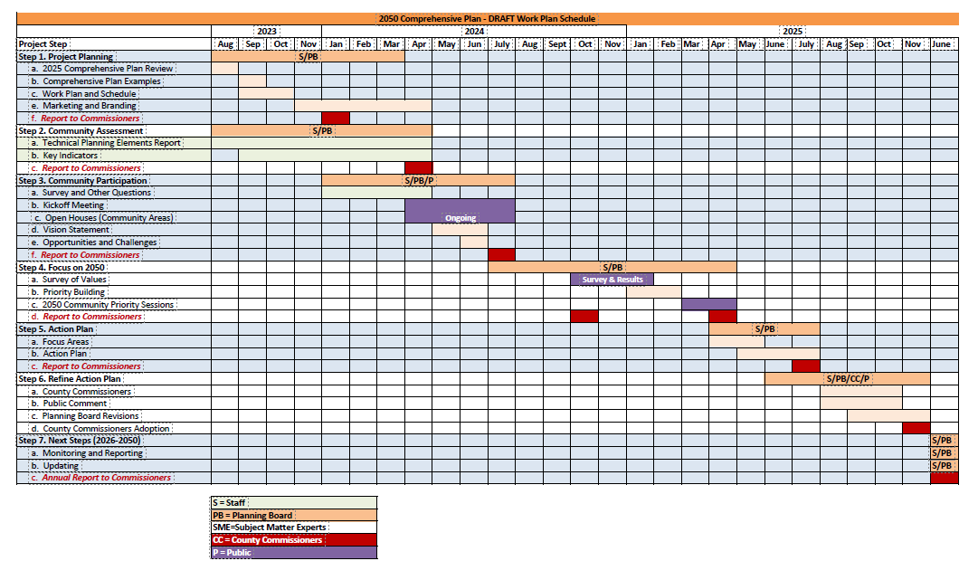
Comprehensive Plan: Outreach

Slide 41
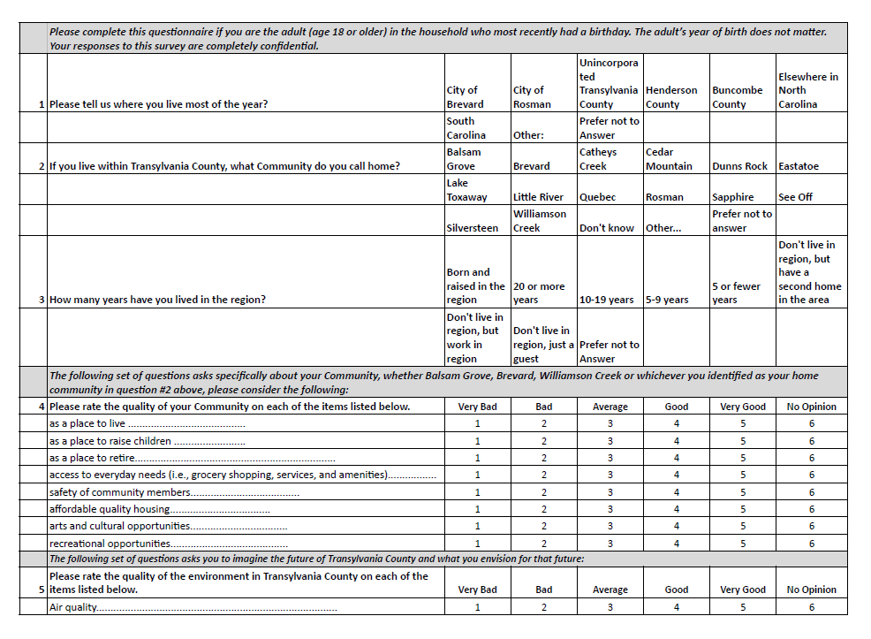
DRAFT
Comprehensive Plan: Survey

Slide 42
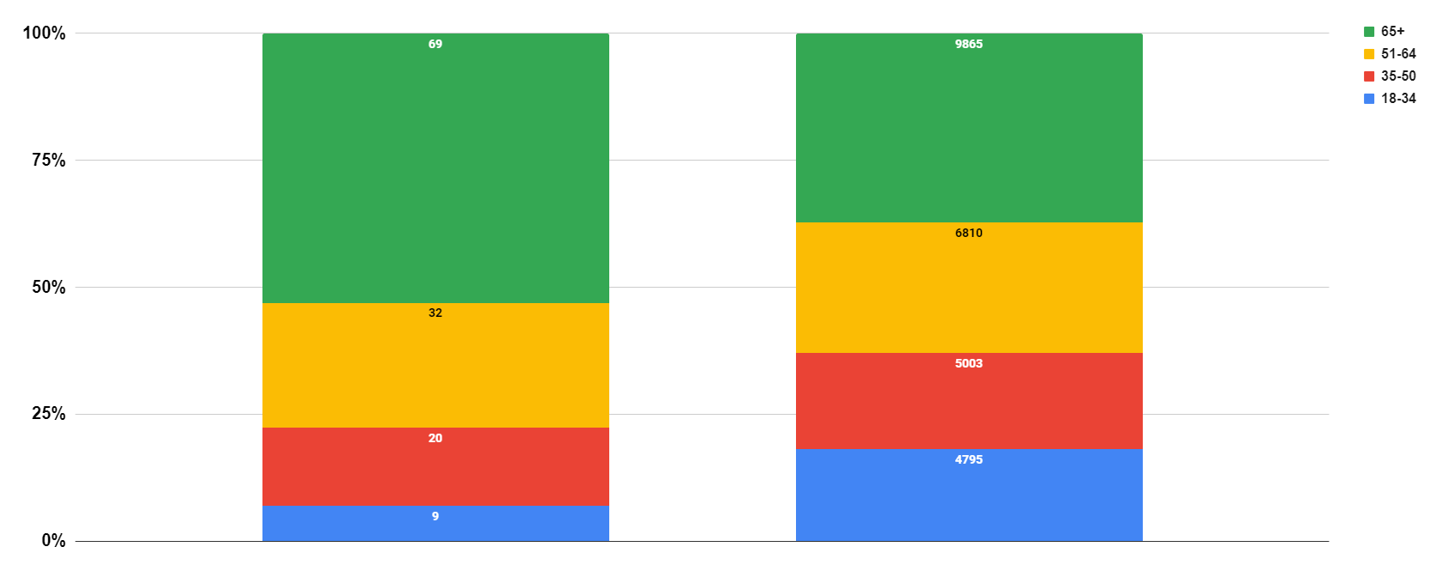
Survey Respondents
Transylvania County Population
2050 Field Journals: Age

Slide 43
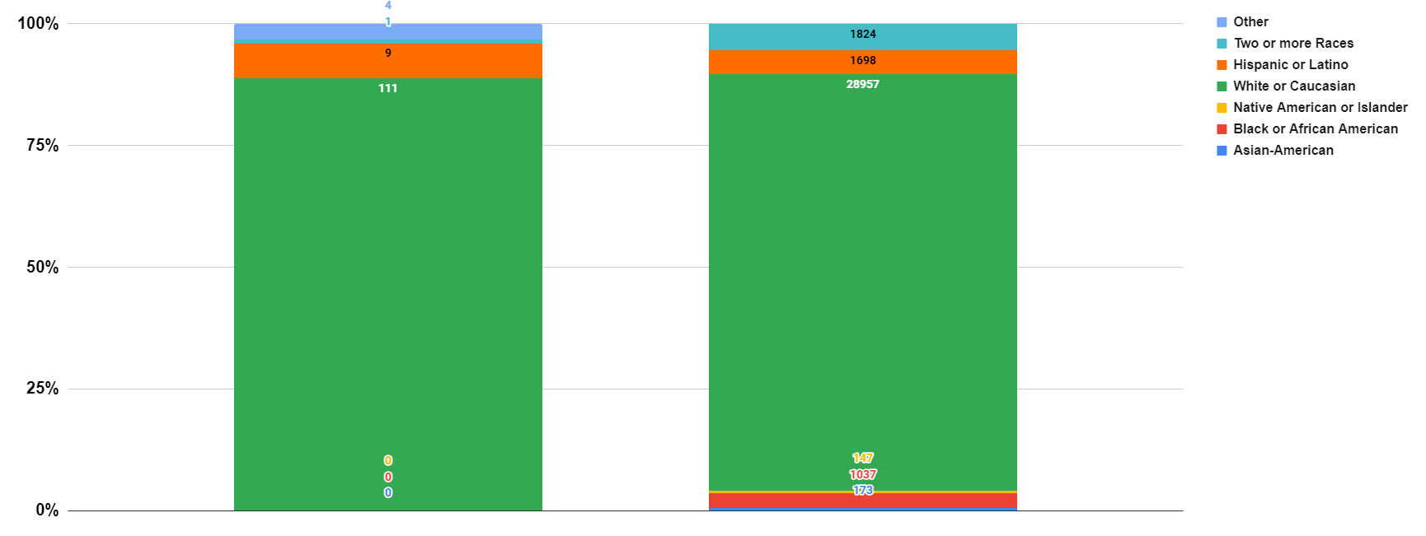
Survey Respondents
Transylvania County Population
2050 Field Journals: Race & Ethnicity

Slide 44
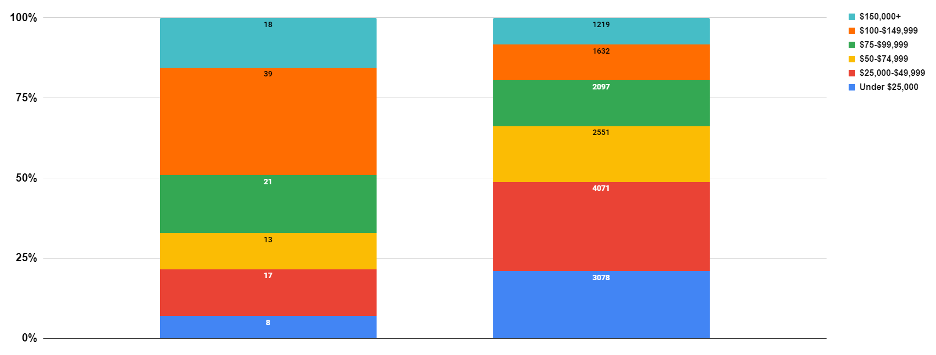
Survey Respondents
Transylvania County Population
2050 Field Journals: Income

Slide 45
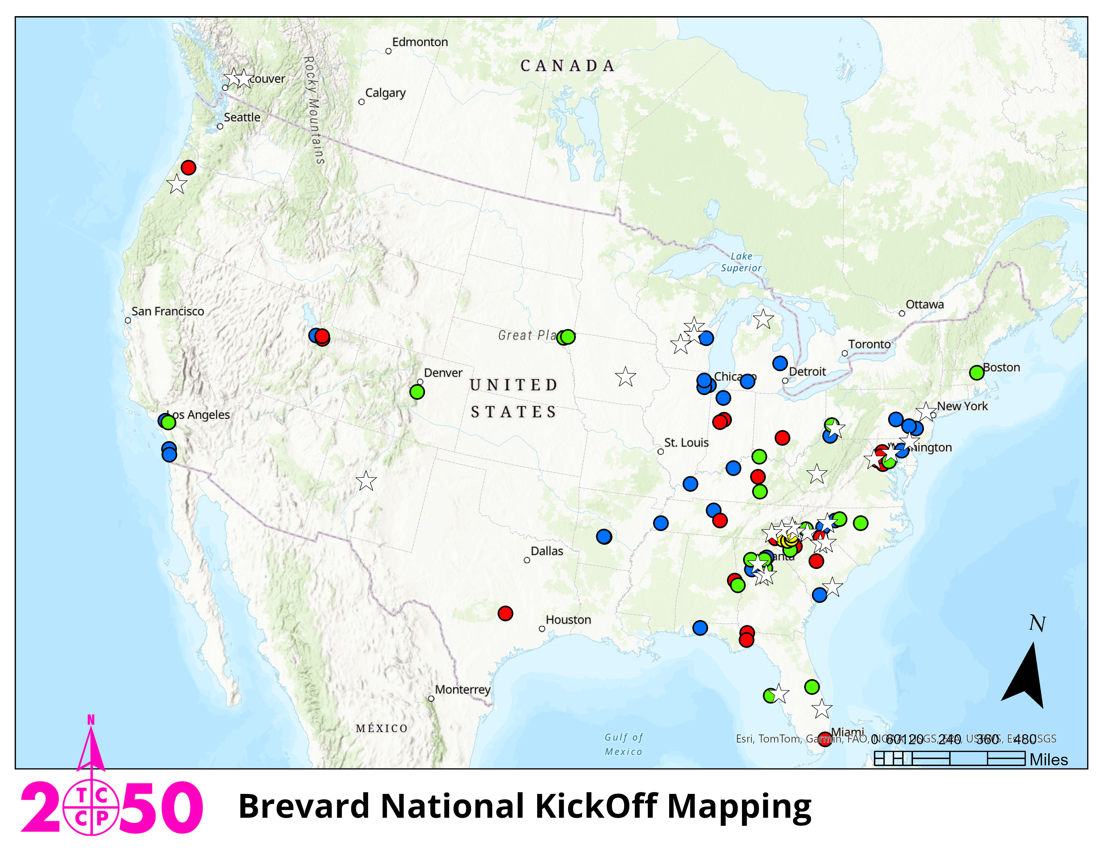
2050 Bucket Budgeting, by Event

Slide 46
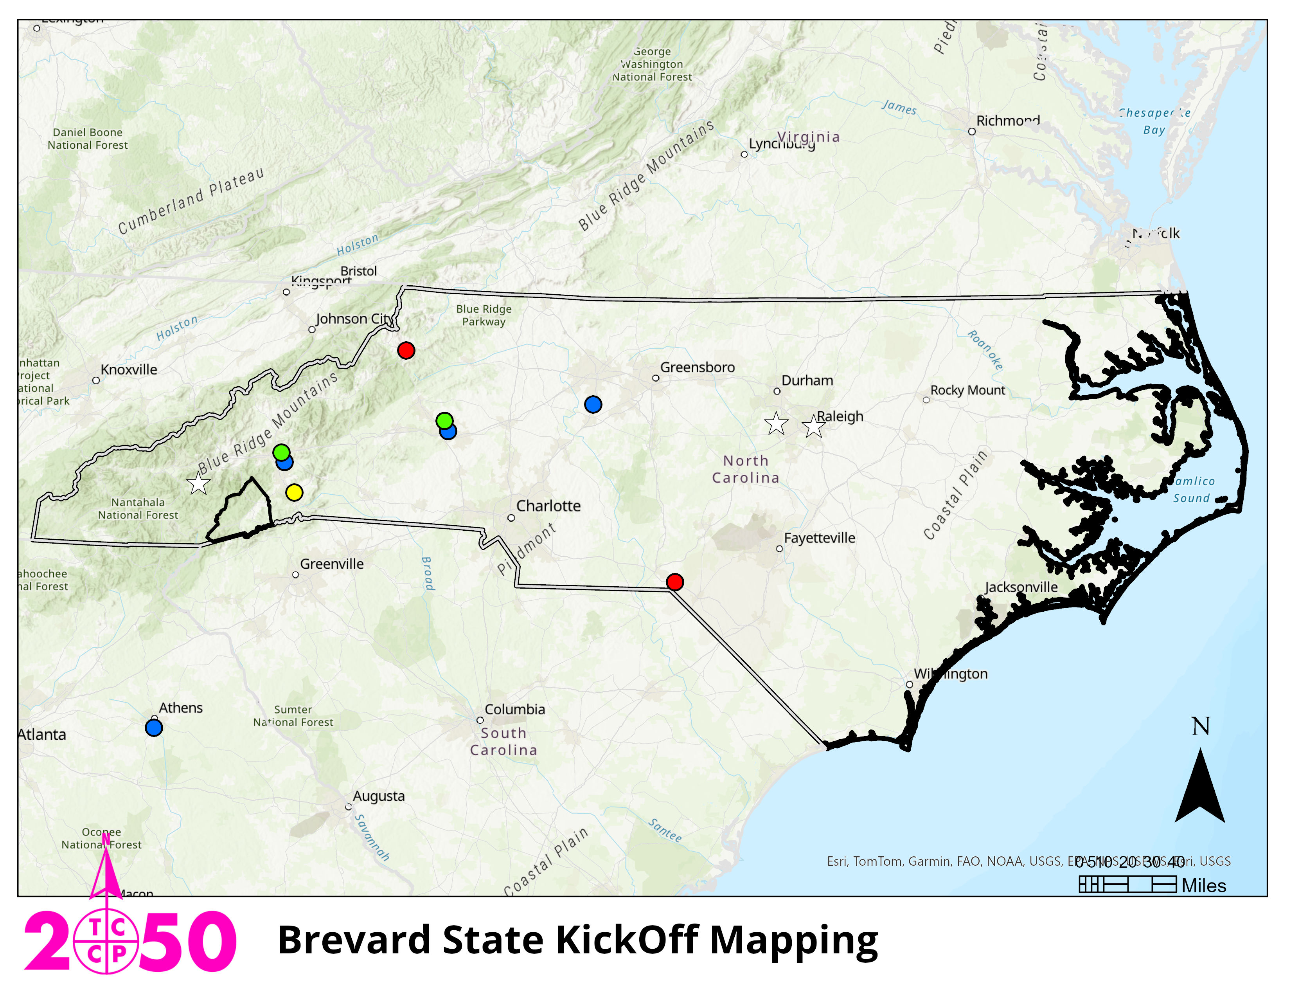
2050 Bucket Budgeting, by Event

Slide 47
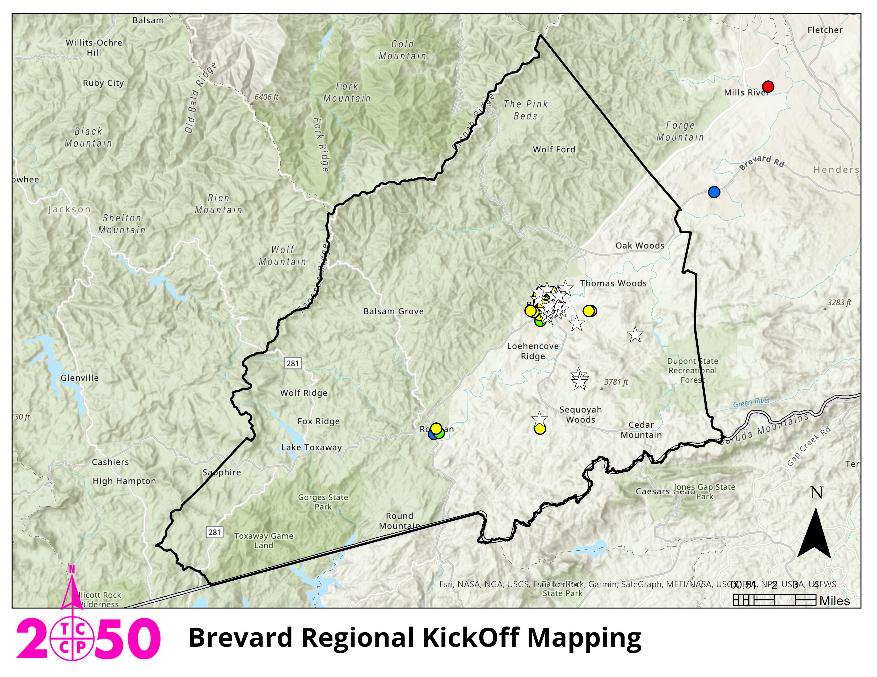
2050 Bucket Budgeting, by Event

Slide 48
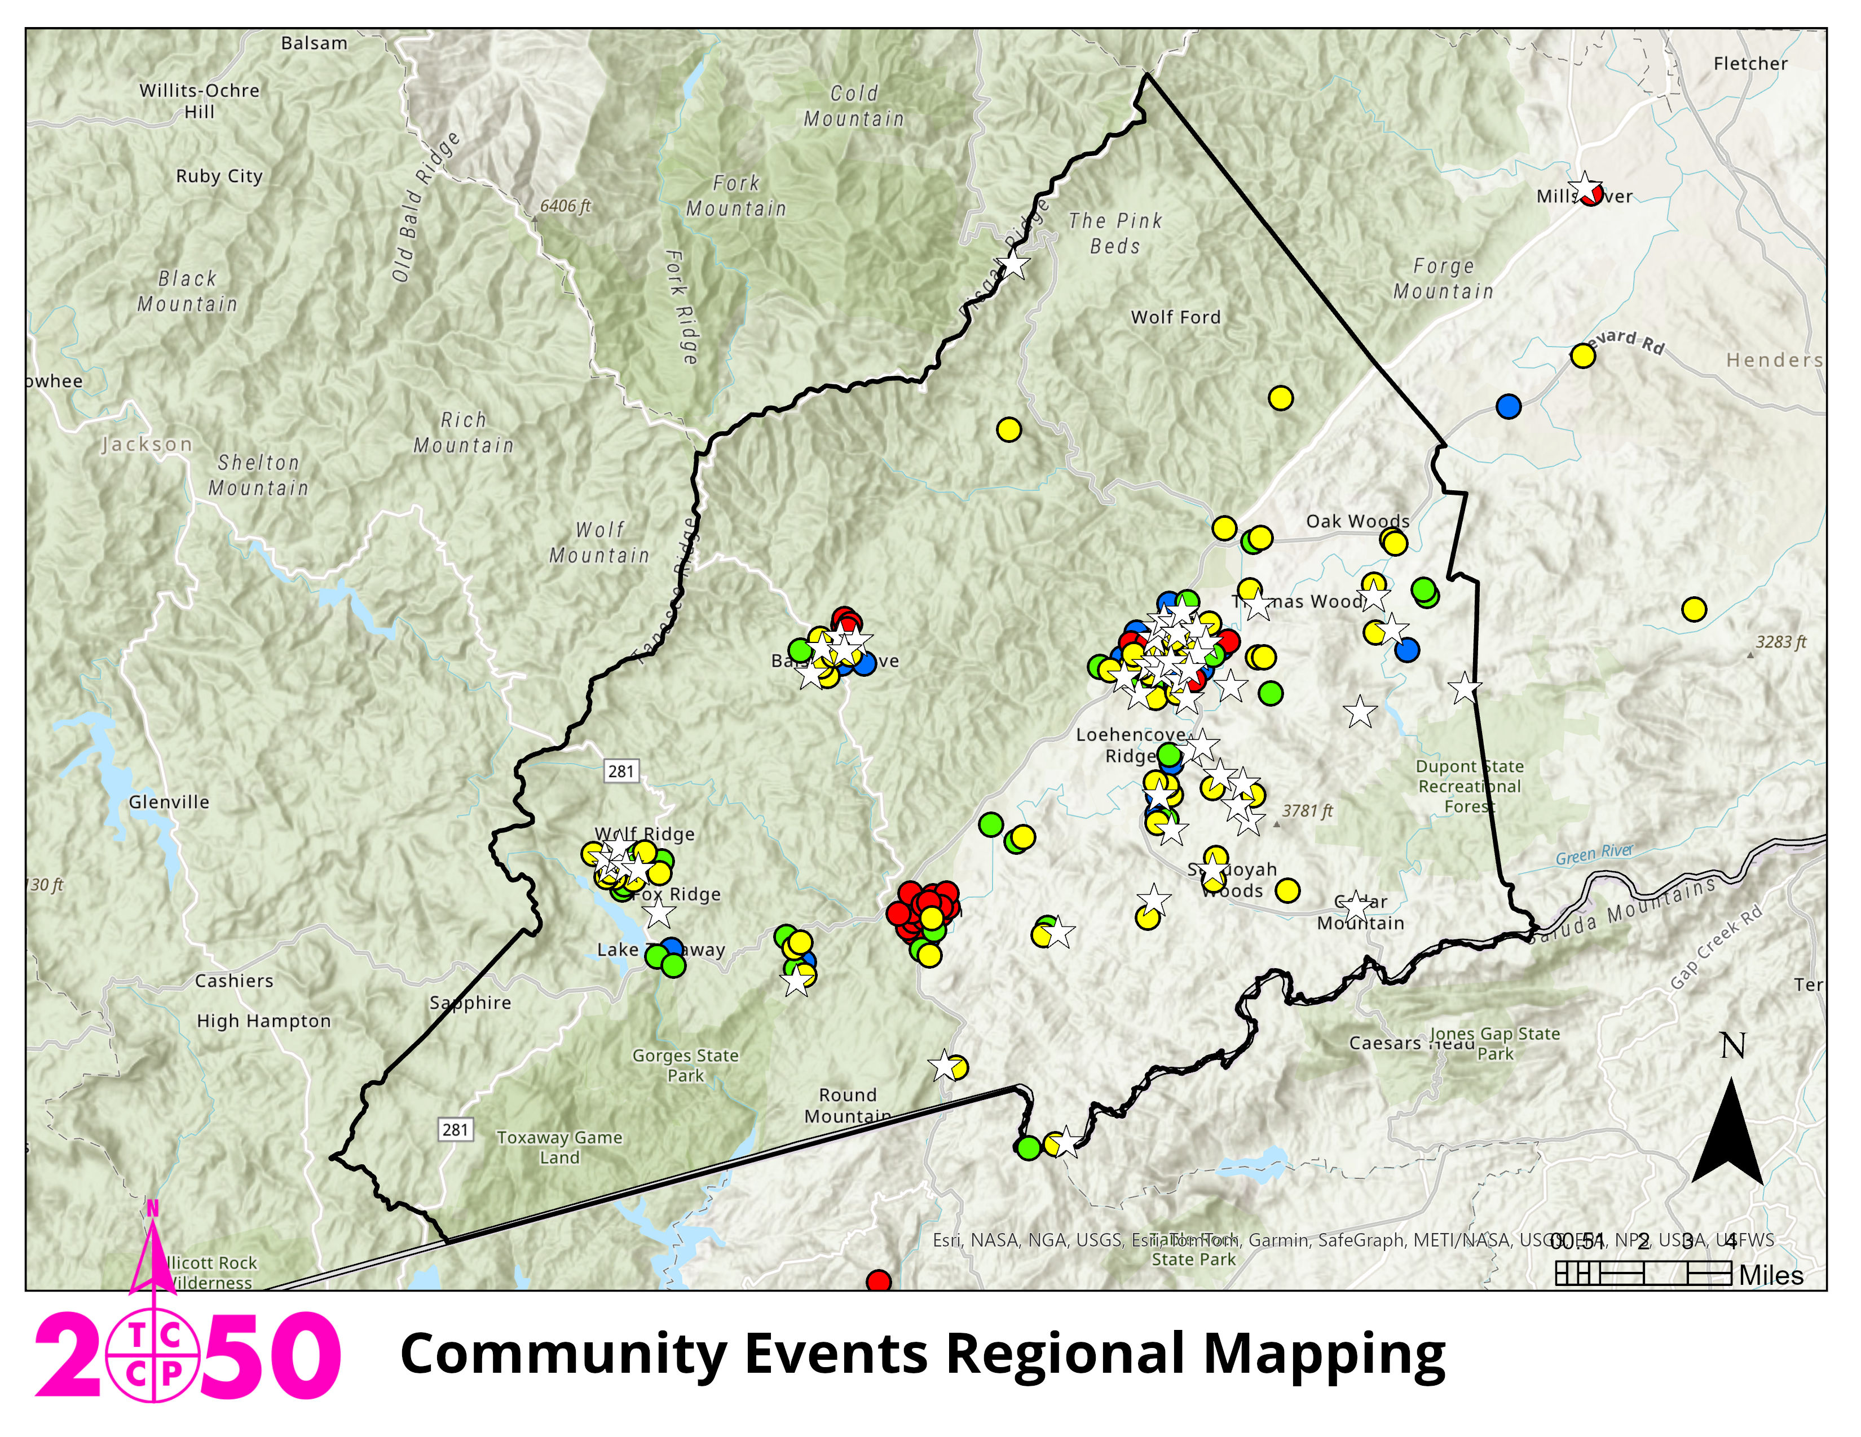
2050 Bucket Budgeting, by Event

Slide 49
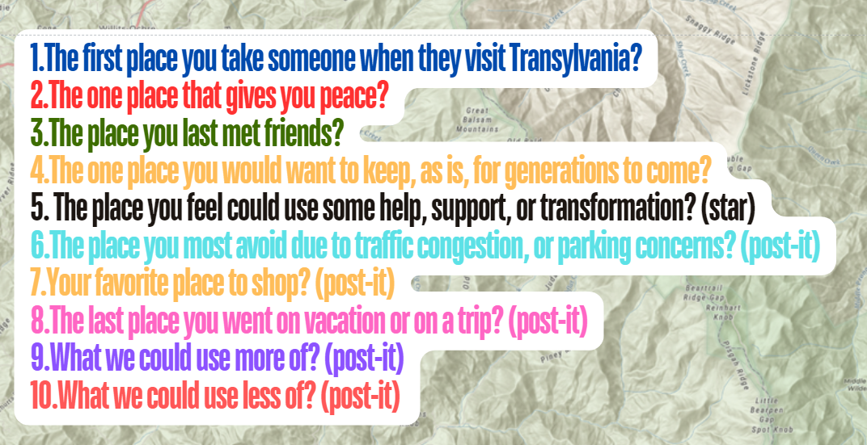
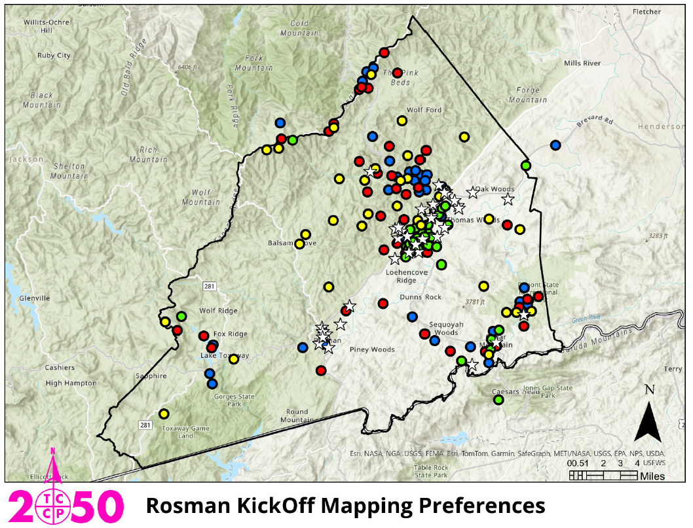
2050 Bucket Budgeting, by Event

Slide 50
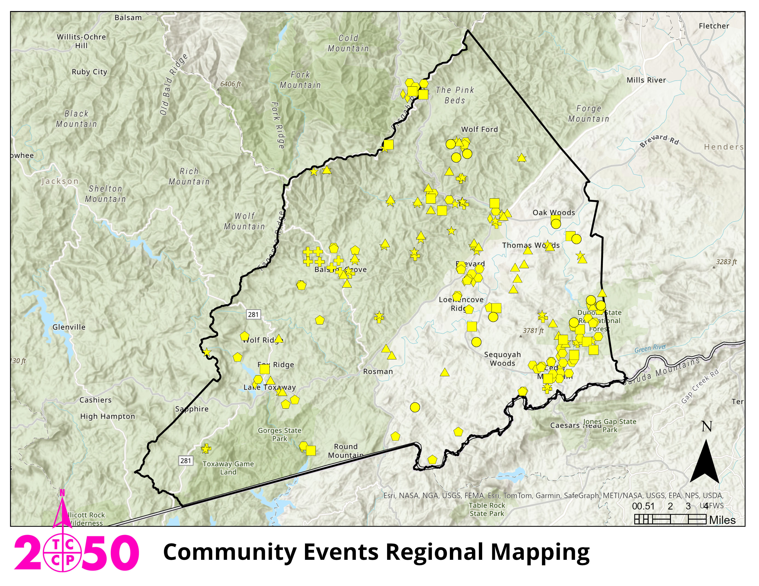
2050 Bucket Budgeting, by Event

Slide 51
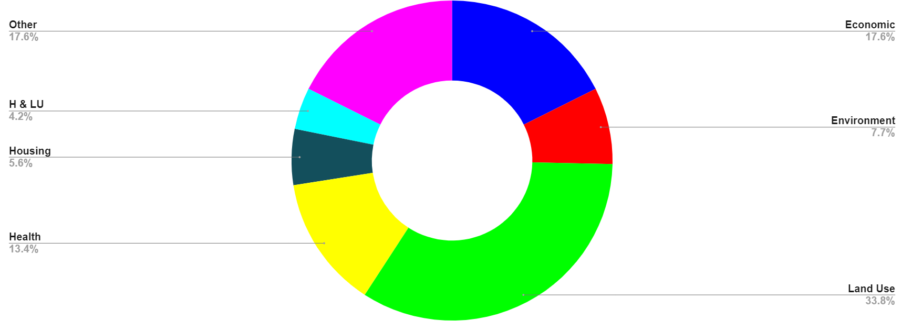
Knowing the goals and expectations from the current 2025 Comprehensive Plan, which goal is the most important you feel to carry forward to 2050?
2050 Field Journals: Which goal to carry forward?

Slide 52
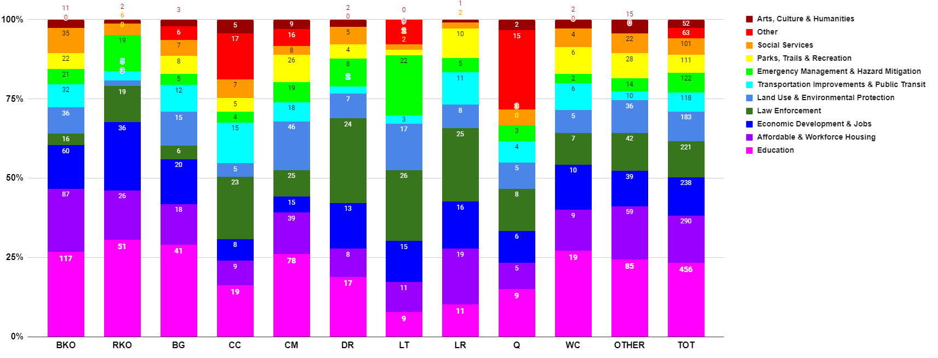
2050 Bucket Budgeting, by Event

Slide 53
Public Comment

Slide 54
Board Members’ Comments

Slide 55
Adjournment

