Slide 1
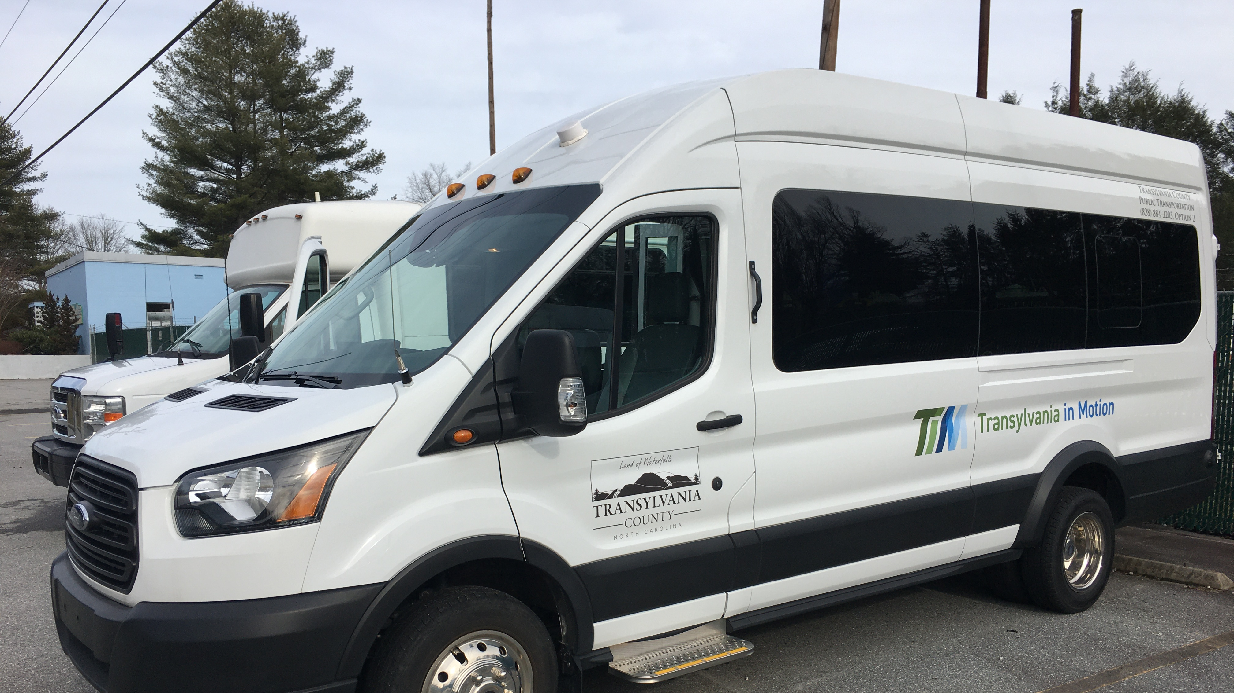
Transportation Advisory Board
February 14, 2023

Slide 2
I. Welcome

Slide 3
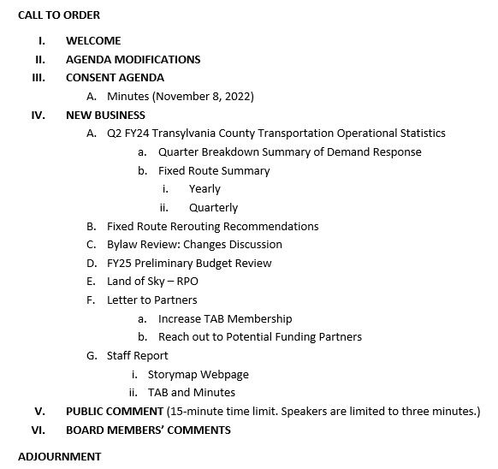
II. Agenda Modifications

Slide 4
III. Consent Agenda
August 9, 2023 Meeting Minutes

Slide 5
New Business

Slide 6
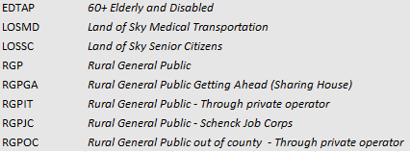
V-A. Q-2 FY24 Transportation Operational Statistics
 | 10/1/2023 - 12/31/2023 |  |  | 10/1/2022 - 12/31/2022
 | Pass Miles | Passengers |  | Pass Miles | Passengers
EDTAP | 1,532 | 540 |  | 3,274 | 1,120
LOSMD | 97 | 29 |  | 212 | 62
LOSSC | 2,424 | 424 |  | 4,596 | 848
RGP | 697 | 119 |  | 1,857 | 565
RGPGA | 0 | 0 |  | 24 | 22
RGPIT | 0 | 145 |  | 20 | 358
RGPJC
RGPOC | 0 | 0 |  | 0 | 8
RGPVC | 0 | 79 |  | 0 | 141
RGPVO | 0 | 8 |  | 0 | 42
RGP subtotal | 697 | 351 |  | 1,901 | 1,136
TCTVS
TVSED | 3,239 | 447 |  | 8,259 | 1,234
TVSGP | 1,040 | 144 |  | 843 | 117
TVS subtotal | 4,279 | 591 |  | 9,102 | 1,351
Overall total | 9,029 | 1,935 |  | 19,085 | 4,517
Revenue Report
Pass Miles: 9,009.15 less miles driven
Passengers: 2,585 less rides/riders
Reasons for drop:
Weather: delays and less travel
Holidays
Driver availability issues
Notes:
Each month, October- Carla, Jim (Scott started), Nov- Traci, Dec-Traci

Slide 7
Fixed Route Yearly

Slide 8
Demand Response

Slide 9
VI-B. Fixed Rerouting Recommendations

Slide 10
VI-C. Bylaw Review: Changes Discussion

Slide 11
VI-D. FY25 Preliminary Budget Review

Slide 12
VI-E. Land of Sky Update
Vicki Eastland

Slide 13
VI-F. Letter to Community Partners
Increase TAB Membership
Reach out to Potential Funding Partners

Slide 14
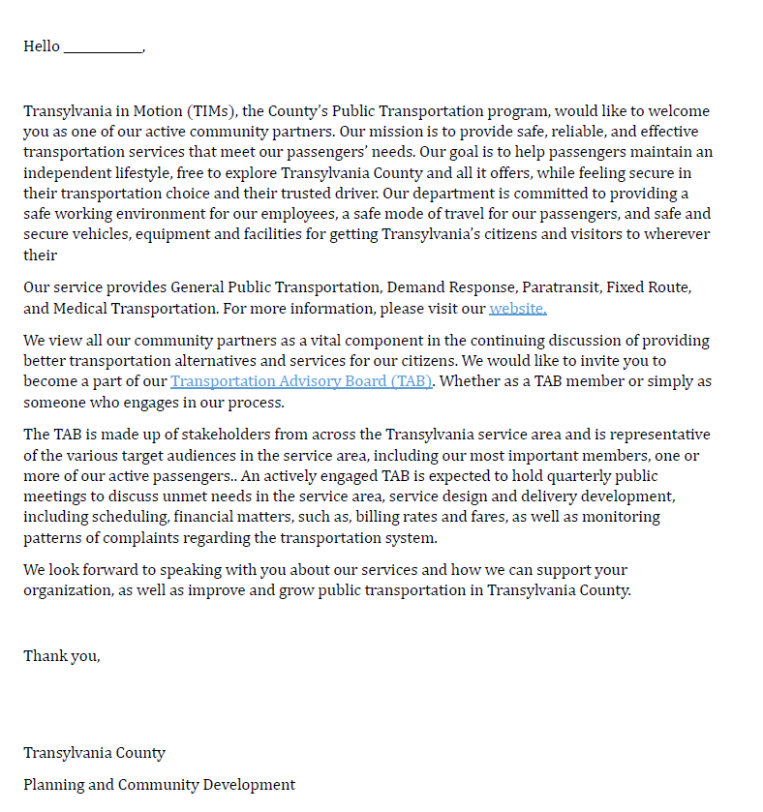

Slide 15
VI-D. Staff’s Report
Storymap Webpage for Transportation
TAB Members and Minutes for Website
HELP! We need Drivers!
Next TAB meeting will be on May 8th at 2:00 PM, in the Large DSS Conference Room, 2nd Floor.

Slide 16
VI. Public Comment
15-Minute Time limit (speakers are held to three minutes)

Slide 17
VII. Board Members Comments

Slide 18
Thank you for attending

