Slide 1


Transylvania County
Planning Board Meeting | November 2024

Slide 2
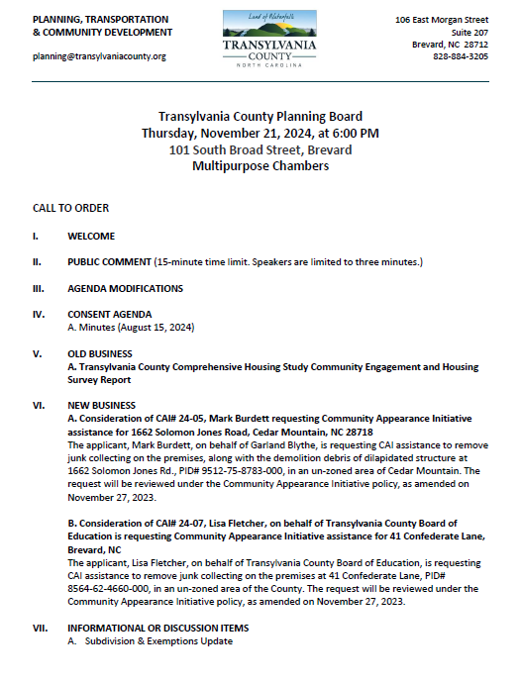
Transylvania County Planning Board

Slide 3
Public Comment

Slide 4
Agenda Modifications

Slide 5
Consent Agenda

Slide 6
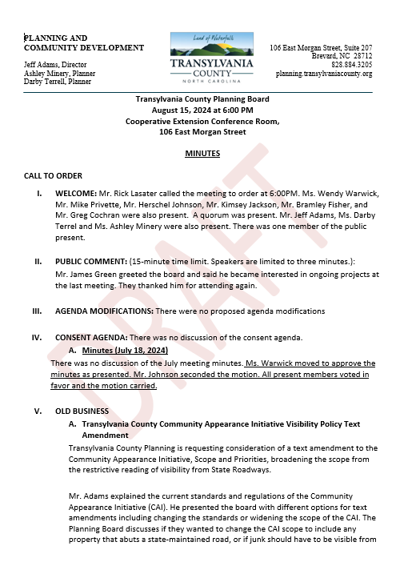
Minutes
August 15, 2024
Consent Agenda

Slide 7
Old Business

Slide 8
A. Transylvania County Comprehensive Housing
Study Community Engagement & Survey Report

Slide 9

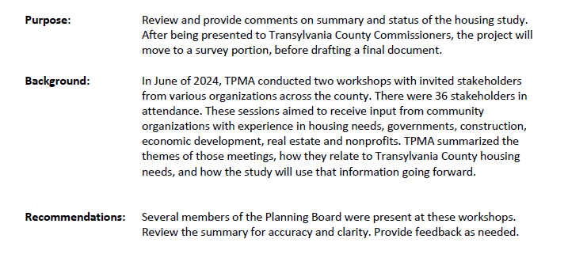
Housing Study Engagement Report

Slide 10
A. 2050 Comprehensive Plan Update
Kick-Off & Engagement Event Summary

Slide 11
B. 2050 Comprehensive Plan Update
Draft Community Survey

Slide 12
New Business

Slide 13
A. Burdett/Garland Blythe CAI# 24-05

Slide 14
Staff Report
Approved Expenditures:
CAI# 23-01 December 2023 FY23/24 $1,000
CAI# 24-03 July 2024 FY24/25 $5,250
CAI# 24-04 July 2024 FY24/25 $6,700
Actual Expenditures:
CAI# 24-03 July 2024 FY24/25 $2,445.90
FY 24/25 Available:
Budgeted $20,000.00
Approved $11,950.00
Expended + Pending $9,145.90
Pending Available $10,854.10
Community Appearance Initiative Expenditures

Slide 15
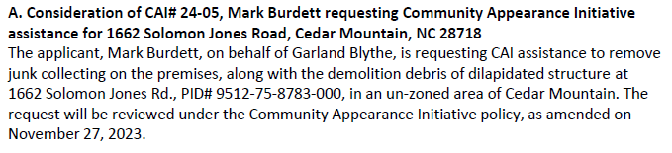
Staff Report
CAI# 24-05 Burdett

Slide 16
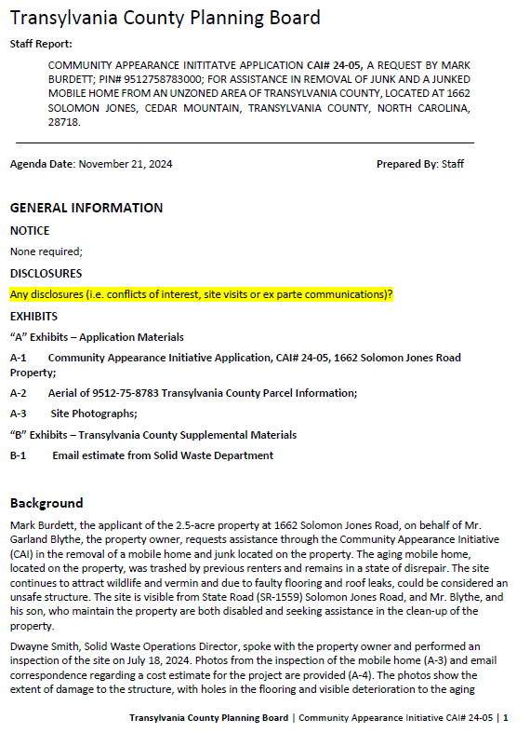
Staff Report
Background
1662 Solomon Jones Road (Garland Blythe: Owner)
2.5 Acre Property
Visible from Solomon Jones Road (SR-1559)
July 18, 2024, Site Visit
Aging mobile home, trashed and collected debris
Mr. Blythe and son, disabled, unable to attend to issue
CAI# 24-05 Burdett

Slide 17
Staff Report
CAI# 24-05 Burdett

Slide 18
Staff Report
CAI# 24-05 Burdett

Slide 19
Staff Report
CAI# 24-05 Burdett

Slide 20
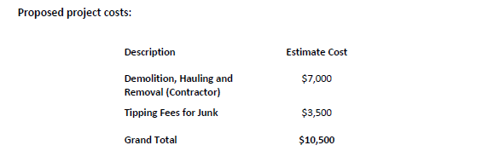

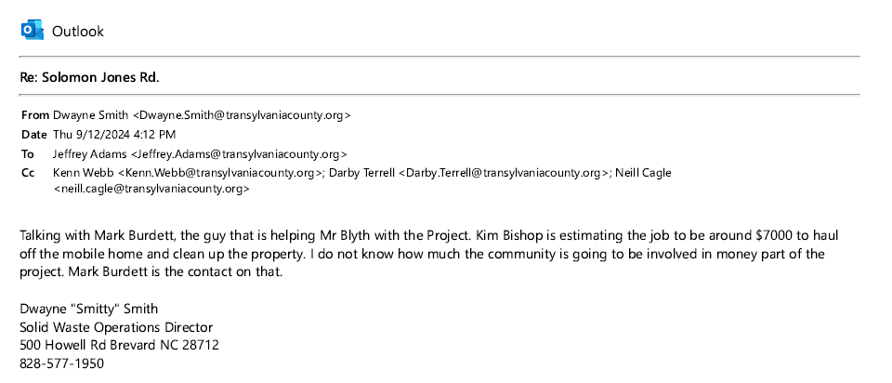
Staff Report
CAI# 24-05 Burdett

Slide 21
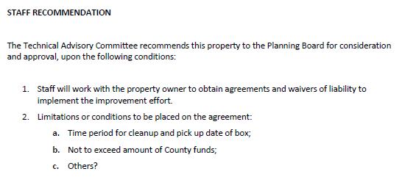

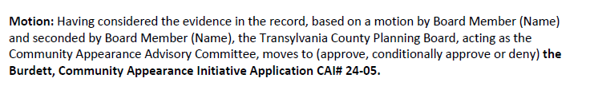
Staff Report
CAI# 24-05 Burdett

Slide 22
B. Fletcher/Transylvania County Board of Education CAI# 24-07

Slide 23
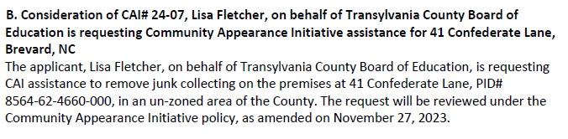
Staff Report
CAI# 24-07 Fletcher

Slide 24
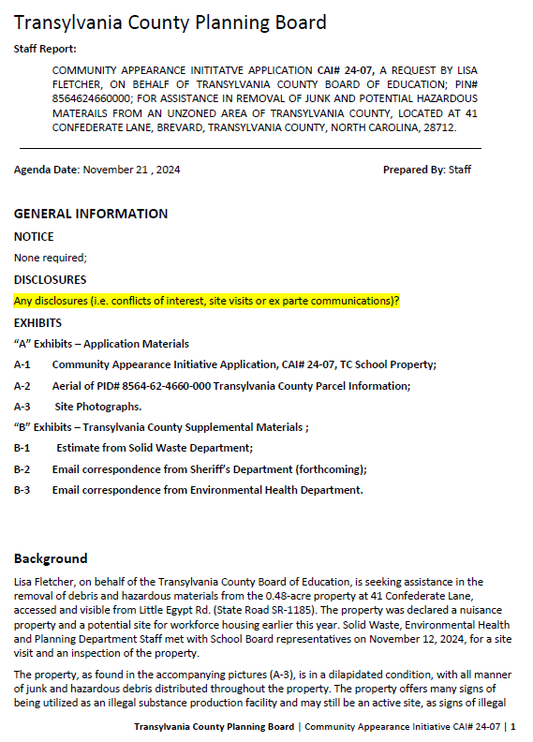
Staff Report
Background
41 Confederate Lane (Transylvania County Board of Education: Owner)
.48 Acre Property
Visible from Little Egypt (SR-1185)
November 12, 2024, Site Visit
Aging mobile home, trashed, junk collected, with hazard materials
Declared a nuisance property
Signs of illegal drug production and confirmed by Sheriff’s Department
Proposed site for Teacher and Workforce Housing
CAI# 24-07 Fletcher

Slide 25
Staff Report
CAI# 24-07 Fletcher

Slide 26
Staff Report
CAI# 24-07 Fletcher

Slide 27
Staff Report
CAI# 24-07 Fletcher

Slide 28
Staff Report
CAI# 24-07 Fletcher

Slide 29
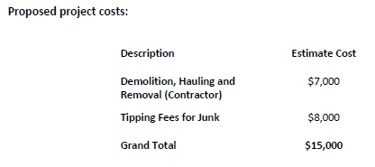
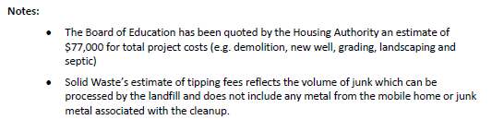
Staff Report
CAI# 24-07 Fletcher

Slide 30
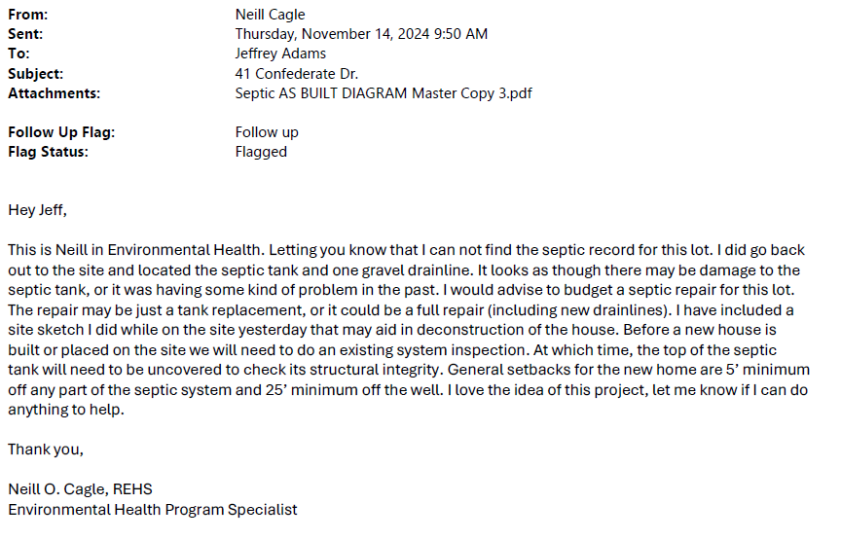
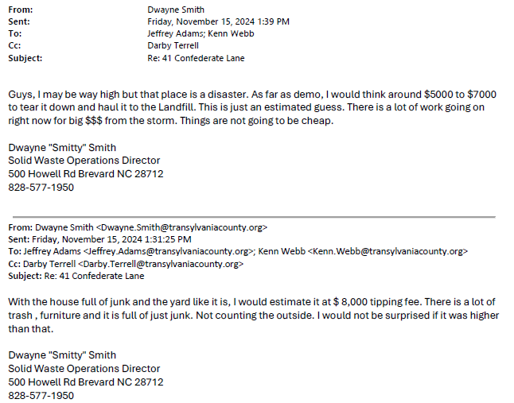
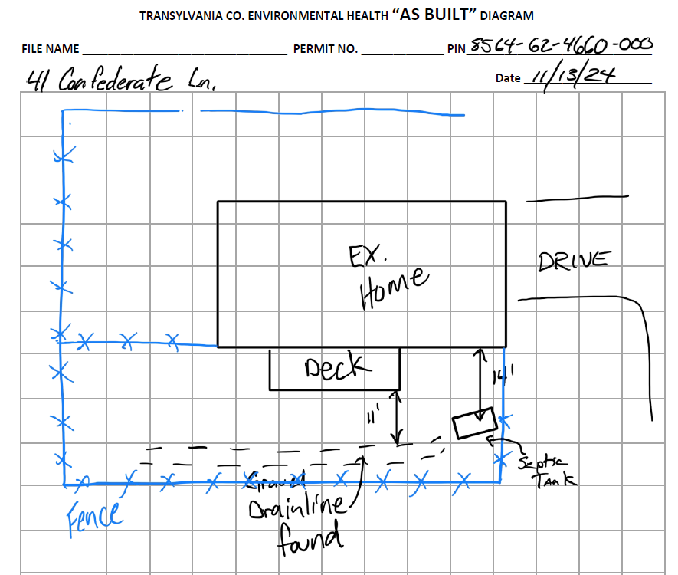
Staff Report
CAI# 24-07 Fletcher

Slide 31
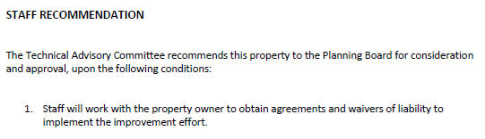
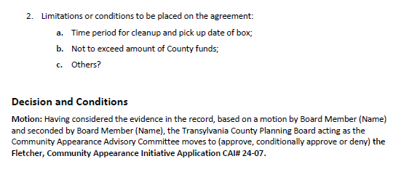
Staff Report
CAI# 24-07 Fletcher

Slide 32
Informational & Discussion Items

Slide 33
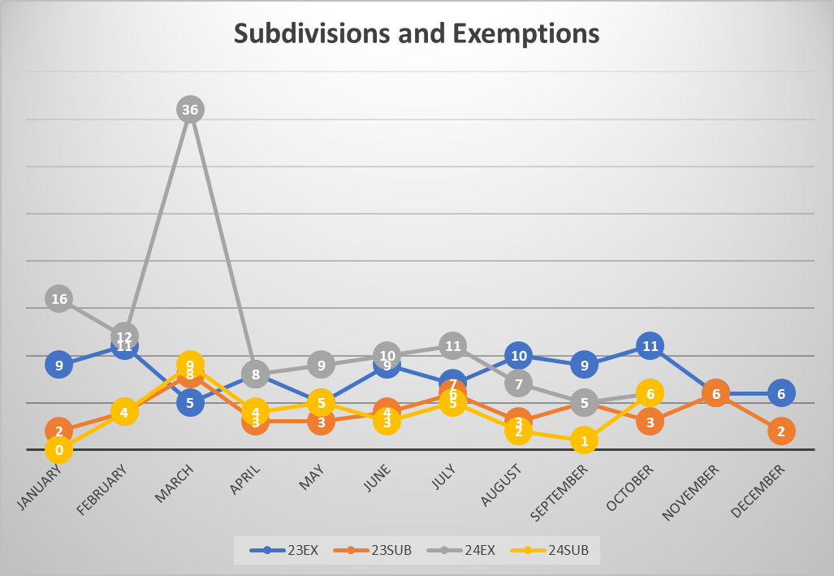
A. Subdivision Approval & Update
Subdivisions & Exemptions Update

Slide 34
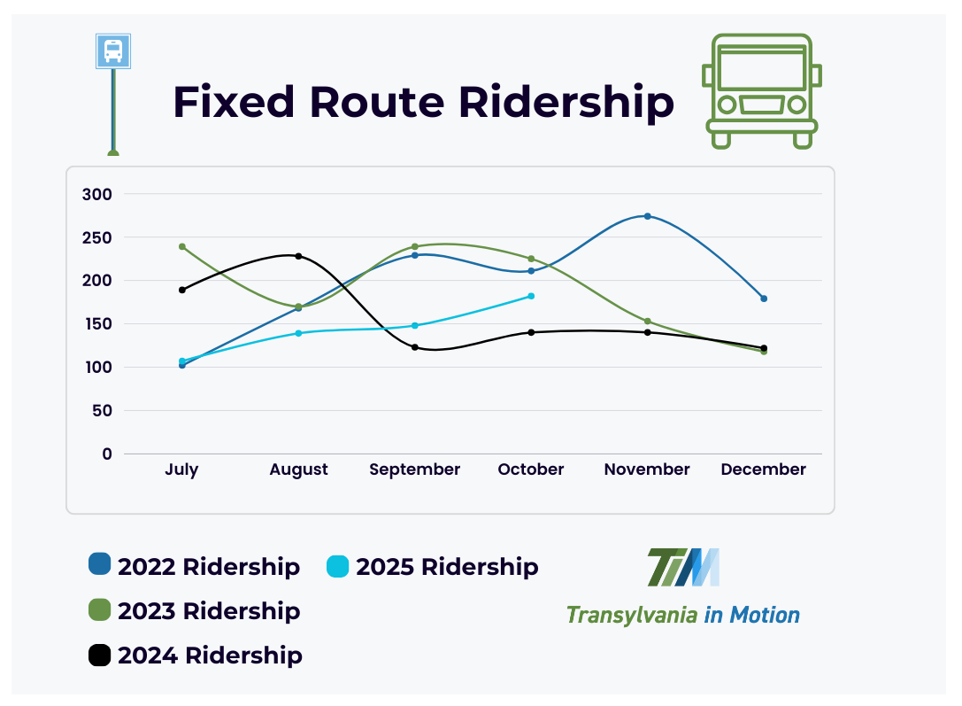
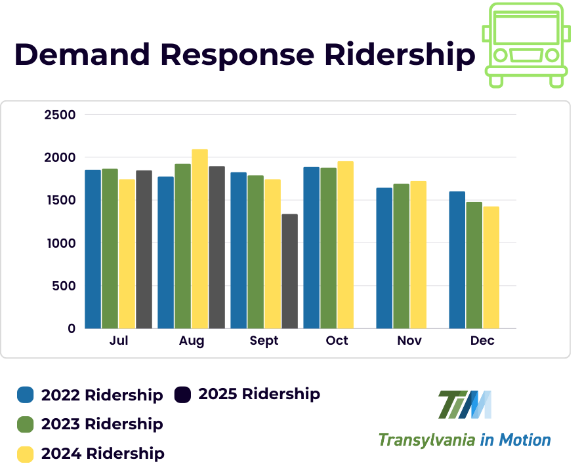
B. Transportation Update
Transportation Update

Slide 35
C. Housing Study Update

Slide 36
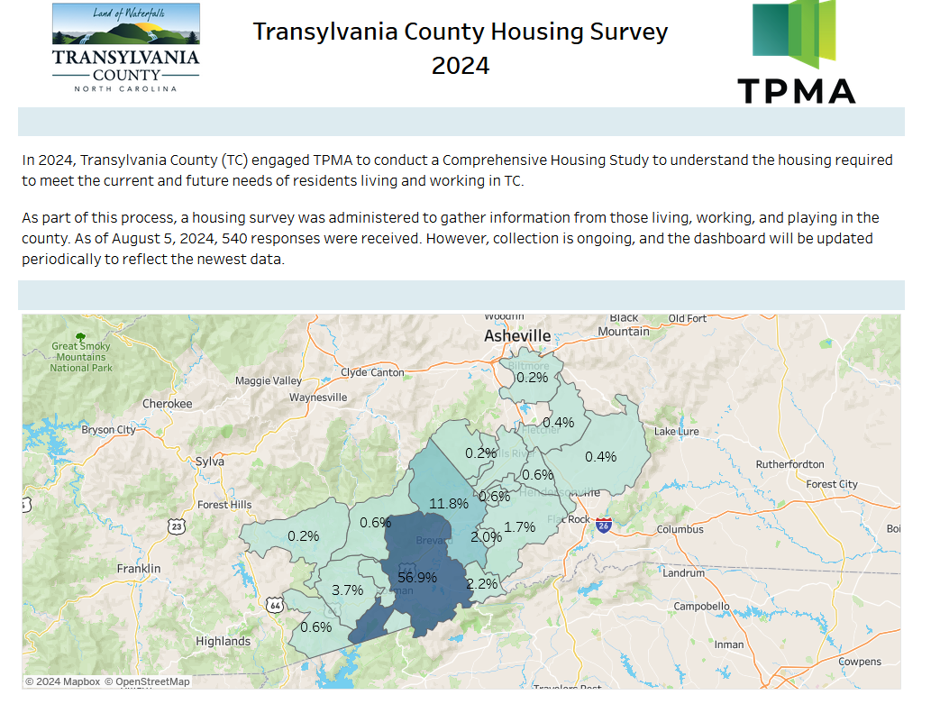
Housing Study Update

Slide 37
D. Community Appearance Initiative Update

Slide 38
CAI Update

Slide 39
CAI BUDGET
Approved Expenditures:
CAI# 23-01 December 2023 FY23/24 $1,000
CAI# 24-03 July 2024 FY24/25 $5,250
CAI# 24-04 July 2024 FY24/25 $6,700
Actual Expenditures:
CAI# 24-03 July 2024 FY24/25 $2,445.90
FY 24/25 Available:
Budgeted $20,000.00
Approved $11,950.00
Expended + Pending $9,145.90
Pending Available $10,854.10
CAI Update

Slide 40

D. Comprehensive Plan Update

Slide 41
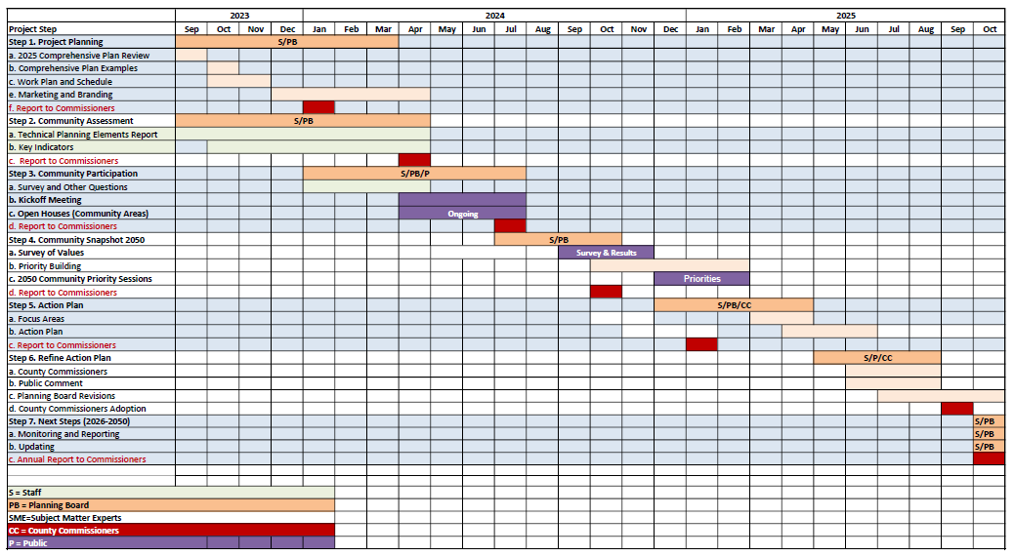

Comprehensive Plan: Outreach

Slide 42
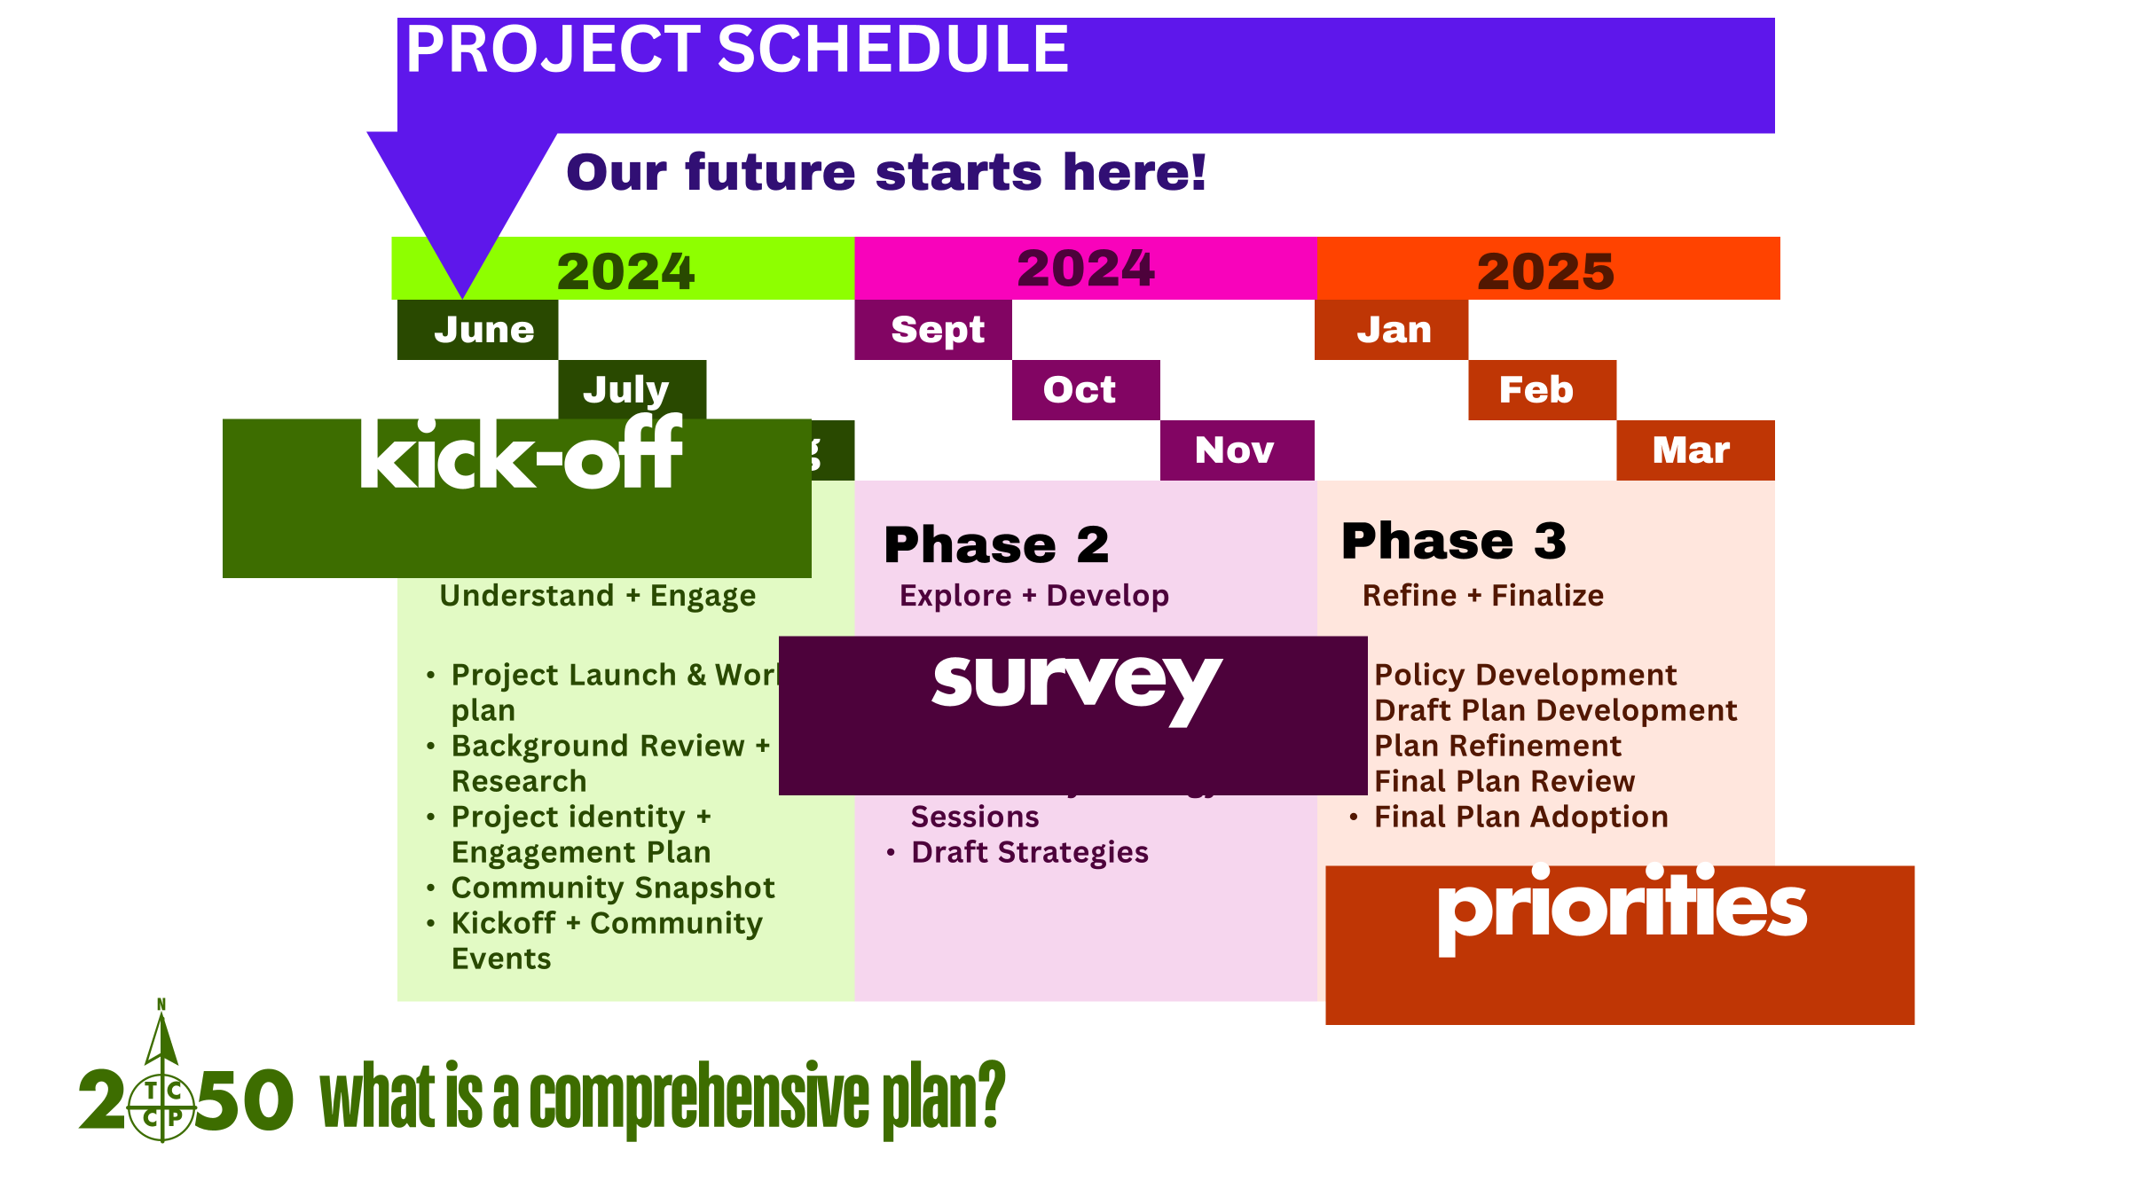

Slide 43
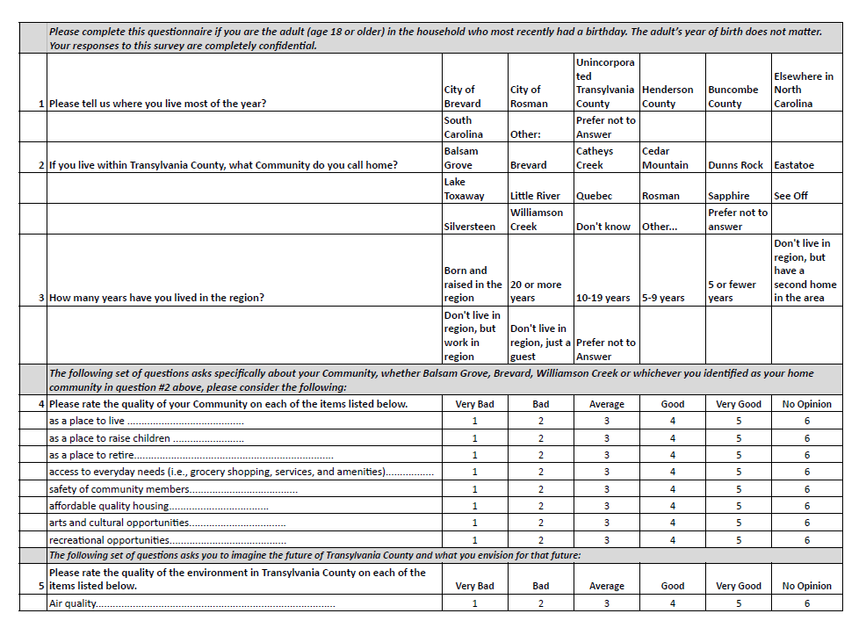
DRAFT
Comprehensive Plan: Survey

Slide 44
"Feedback loops are the engines of growth and change. They’re the mechanisms by which the output of a system influences its own input.
Complex systems often have many feedback loops, and it can be hard to appreciate how adjusting to feedback in one part of the system will affect the rest.
Using feedback loops as a mental model begins with noticing the feedback you give and respond to every day. The model also gives insight into the value of iterations in adjusting based on the feedback you receive. With this lens, you gain insight into where to direct system changes based on feedback and the pace at which you need to go to monitor the impacts.
Feedback loops are what make systems dynamic. Without feedback, a system just does the same thing over and over. Understand them, respect them, and use them wisely.”
— Source: The *Updated* Great Mental Models v3: Systems and Mathematics
Comprehensive Plan Update: Feedback Loops

Slide 45
Public Comment

Slide 46
Board Members’ Comments

Slide 47

Adjournment

