Slide 1


Transylvania County
Planning Board Meeting | December 2024

Slide 2
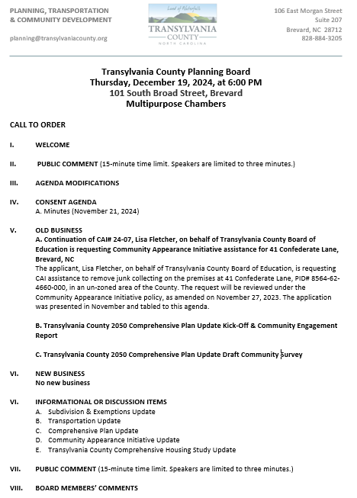
Transylvania County Planning Board

Slide 3
Public Comment

Slide 4
Agenda Modifications

Slide 5
Consent Agenda

Slide 6
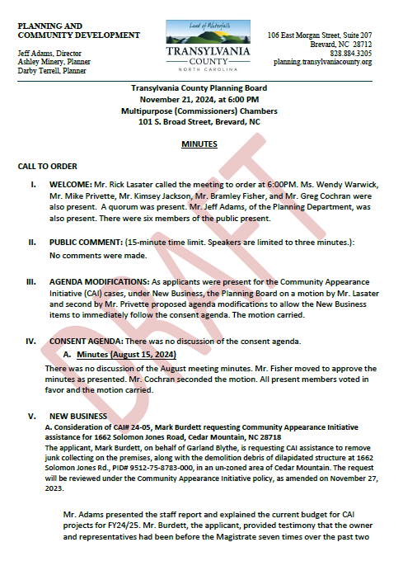
Minutes
November 21, 2024
Consent Agenda

Slide 7
Old Business

Slide 8
A. Fletcher/Transylvania County Board of Education CAI# 24-07

Slide 9
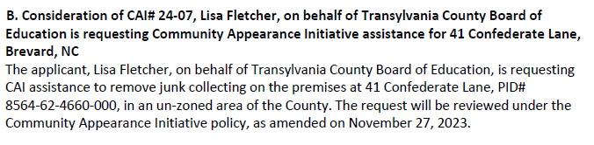
Staff Report
CAI# 24-07 Fletcher

Slide 10
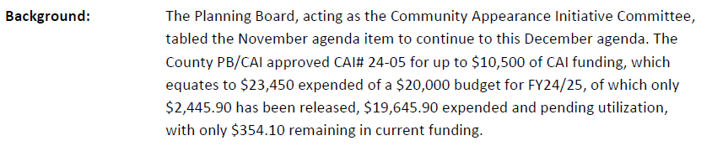
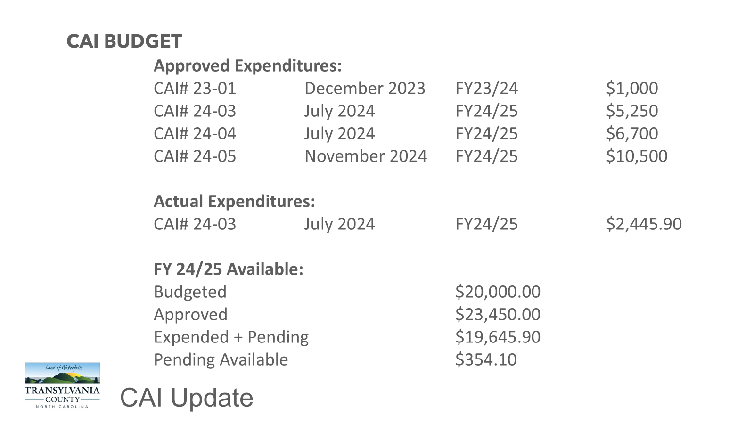
Memo
CAI# 24-07 Fletcher

Slide 11
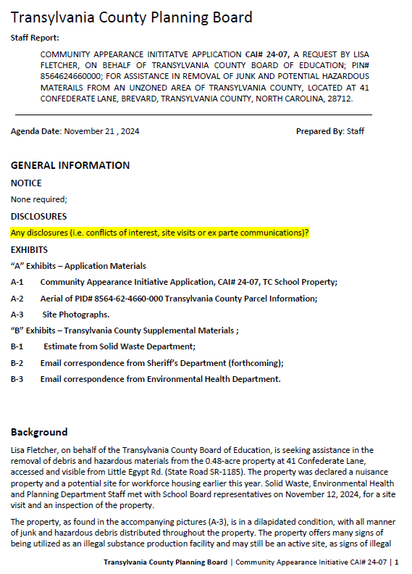
Staff Report
Background
41 Confederate Lane (Transylvania County Board of Education: Owner)
.48 Acre Property
Visible from Little Egypt (SR-1185)
November 12, 2024, Site Visit
Aging mobile home, trashed, junk collected, with hazard materials
Declared a nuisance property
Signs of illegal drug production and confirmed by Sheriff’s Department
Proposed site for Teacher and Workforce Housing
CAI# 24-07 Fletcher

Slide 12
Staff Report
CAI# 24-07 Fletcher

Slide 13
Staff Report
CAI# 24-07 Fletcher

Slide 14
Staff Report
CAI# 24-07 Fletcher

Slide 15
Staff Report
CAI# 24-07 Fletcher

Slide 16
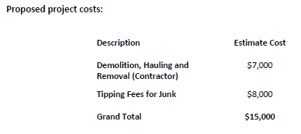
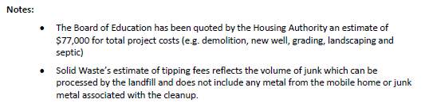
Staff Report
CAI# 24-07 Fletcher

Slide 17
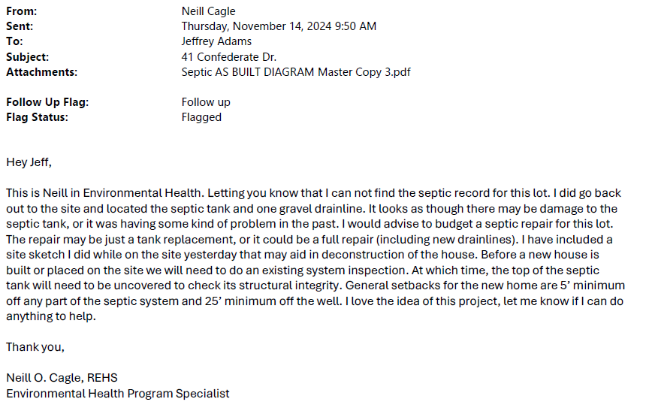
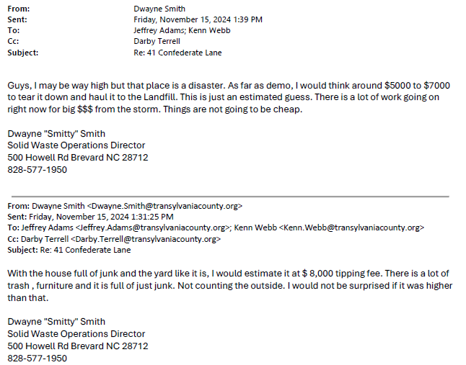
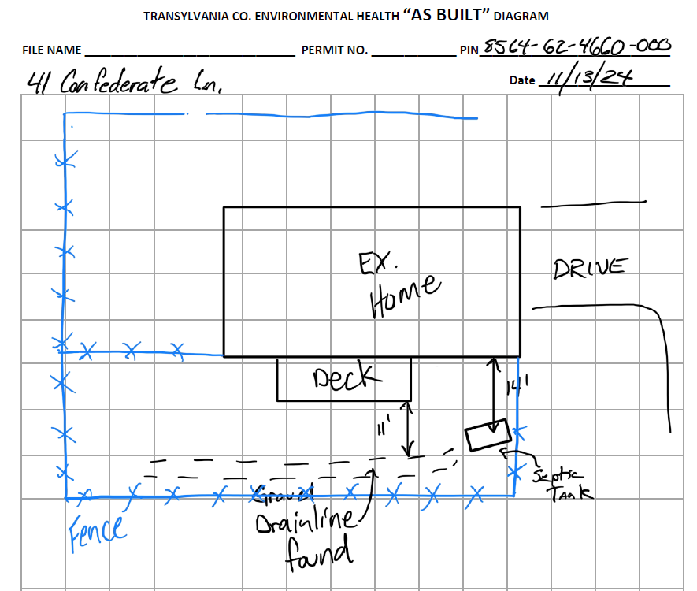
Staff Report
CAI# 24-07 Fletcher

Slide 18
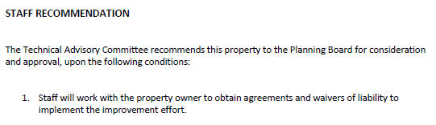
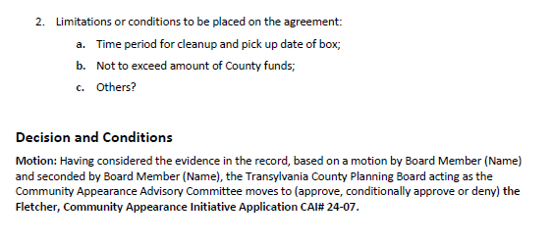
Staff Report
TABLED
CAI# 24-07 Fletcher

Slide 19


B. 2050 Comprehensive Plan Update
Kick-Off & Engagement Event Summary

Slide 20
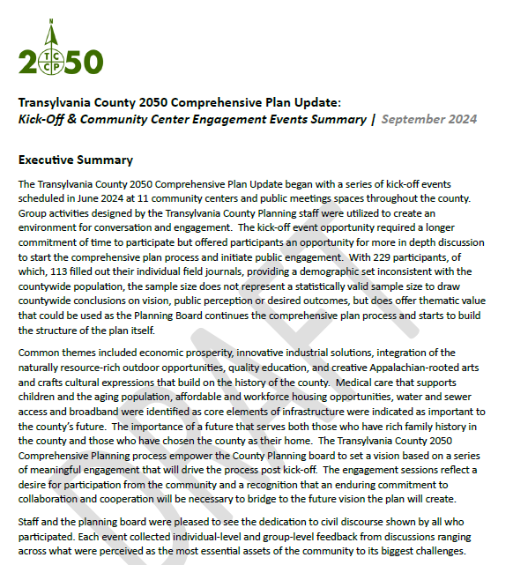
2050 Kick-Off Report

Slide 21
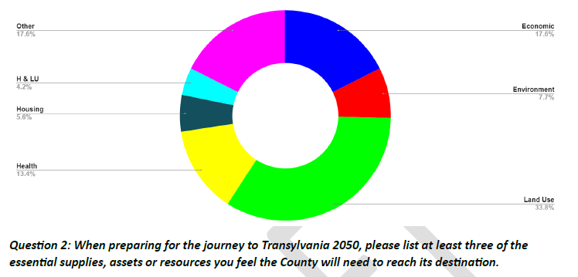
2050 Kick-Off Report

Slide 22
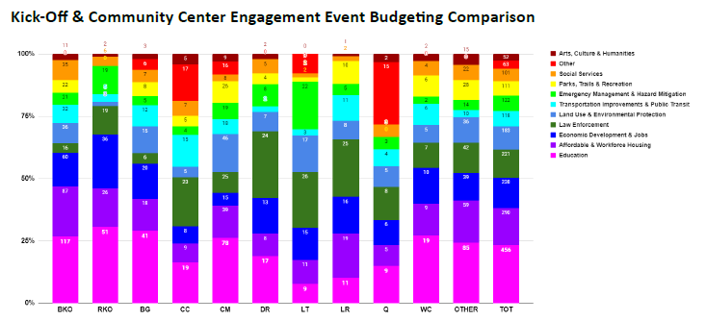
2050 Kick-Off Report

Slide 23
C. 2050 Comprehensive Plan Update
Draft Community Survey

Slide 24
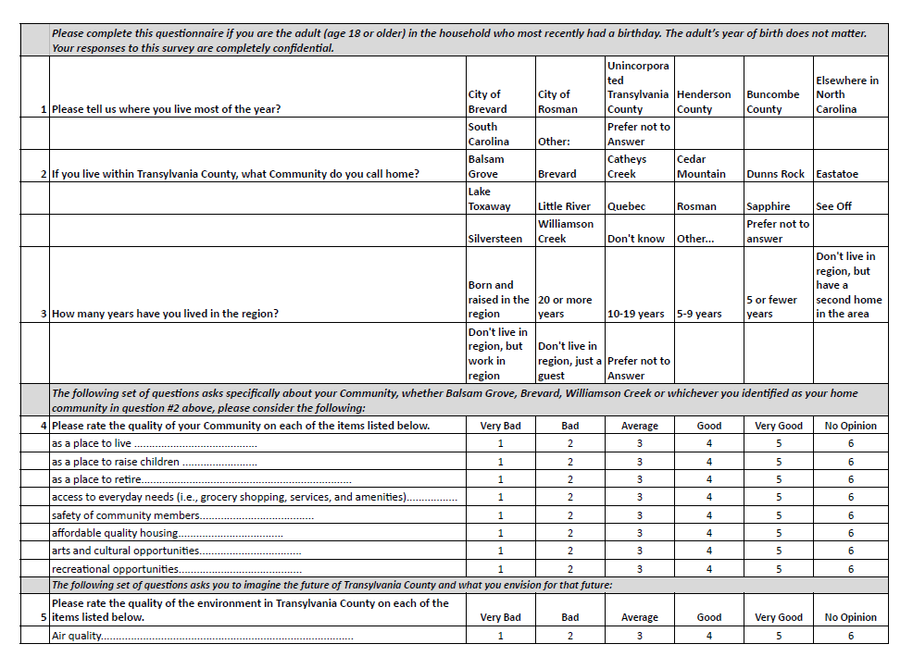
DRAFT
Comprehensive Plan: Survey

Slide 25
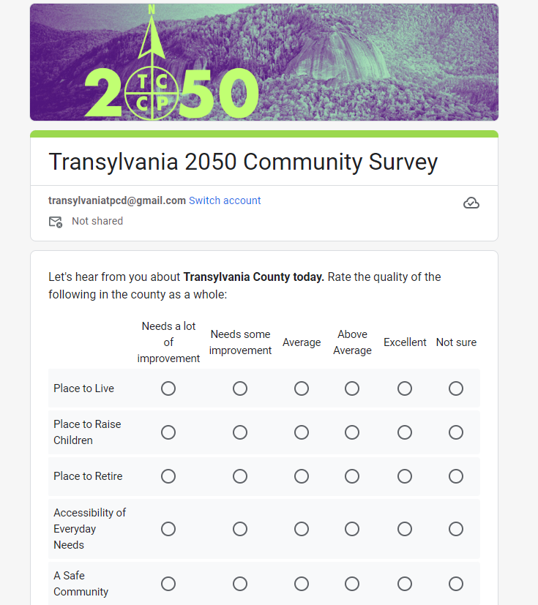
DRAFT
Comprehensive Plan: Survey

Slide 26
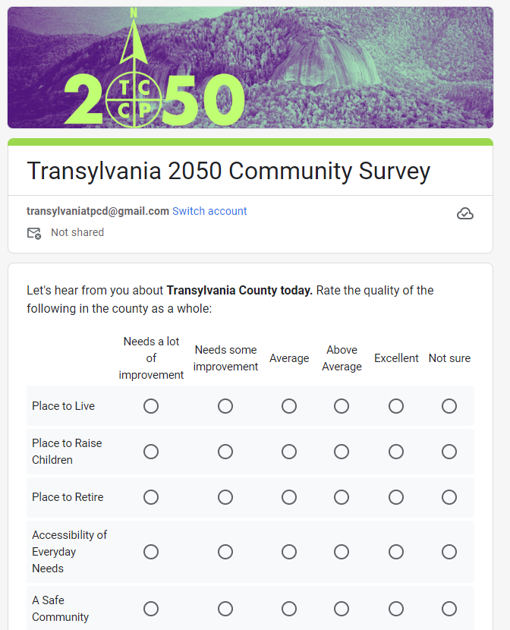
Shortened to six questions
48 responses requested
One qualitative assessment
One focused on transportation
One on participation
One on accessing information
One focusing on the future 2050
One on vision for 2050
With seven demographic questions
DRAFT
Draft Community Survey

Slide 27
No New Business

Slide 28
Informational & Discussion Items

Slide 29
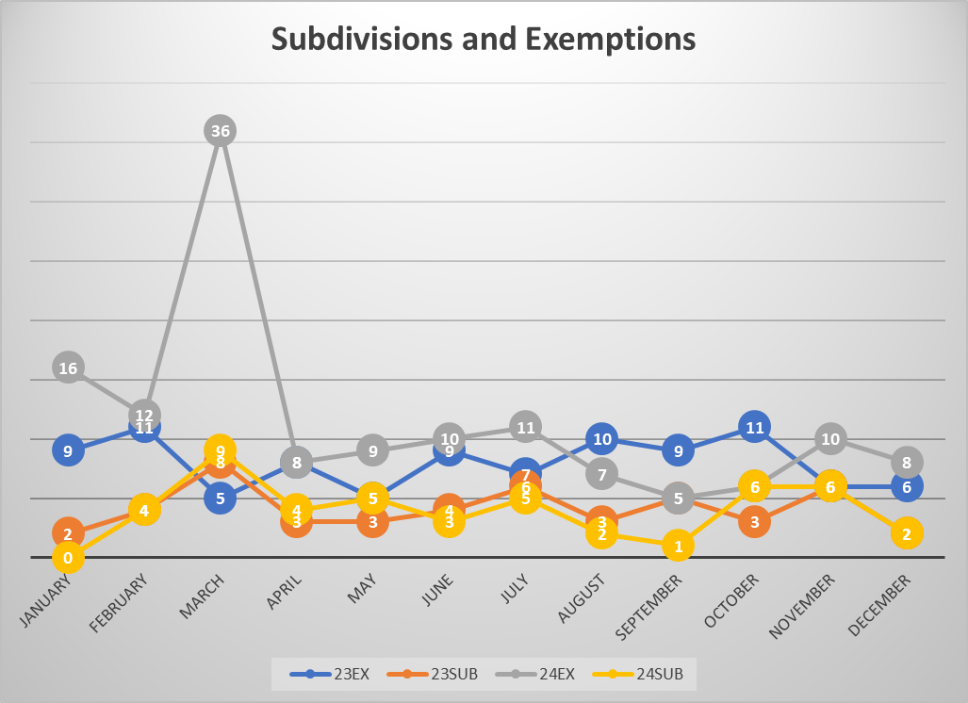
A. Subdivision Approval & Update
Subdivisions & Exemptions Update

Slide 30
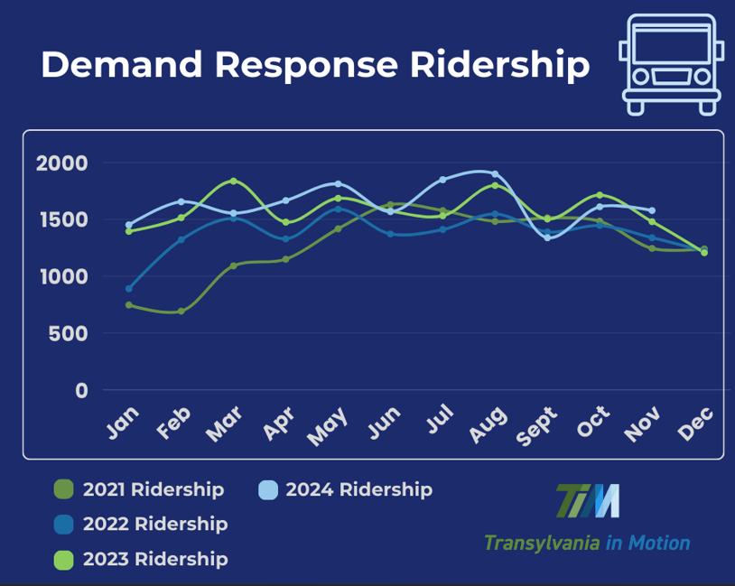
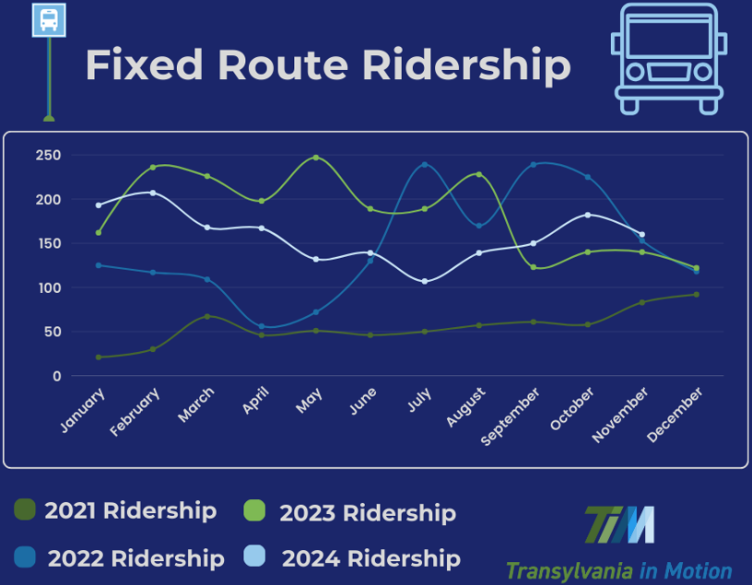
B. Transportation Update
Transportation Update

Slide 31

B. Transportation Update
Transportation Update

Slide 32
C. Housing Study Update

Slide 33
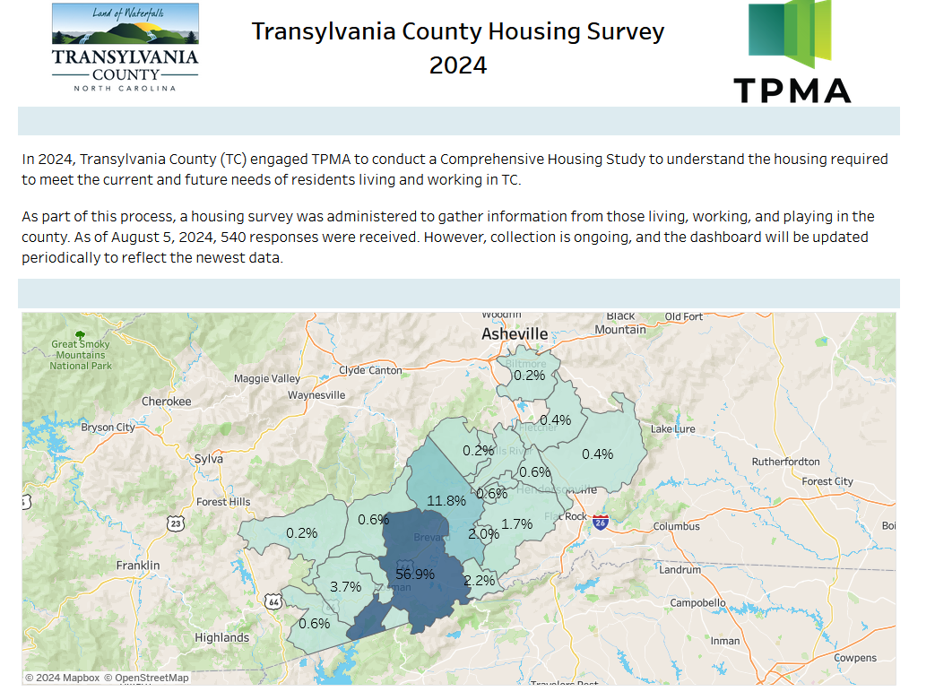
Housing Study Update

Slide 34
D. Community Appearance Initiative Update

Slide 35
CAI BUDGET
Approved Expenditures:
CAI# 23-01 December 2023 FY23/24 $1,000
CAI# 24-03 July 2024 FY24/25 $5,250
CAI# 24-04 July 2024 FY24/25 $6,700
CAI# 24-05 November 2024 FY24/25 $10,500
Actual Expenditures:
CAI# 24-03 July 2024 FY24/25 $2,445.90
FY 24/25 Available:
Budgeted $20,000.00
Approved $23,450.00
Expended + Pending $19,645.90
Pending Available $354.10
CAI Update

Slide 36

D. Comprehensive Plan Update

Slide 37
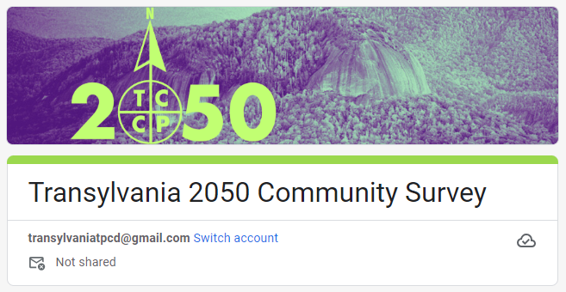

Slide 38

PROJECT SCHEDULE
Our future starts here!
2024
2024/25
2025
June
Dec
June
kick-off
July
Jan
July
Aug
Feb
Aug
Phase 1
Phase 2
Phase 3
Understand + Engage
  Project Launch & Work plan
  Background Review + Research
  Project identity + Engagement Plan
  Community Snapshot
  Kickoff + Community Events
Explore + Develop
  Draft Vision + Goals
  Community Survey
  Alternatives + Strategies
  Community Strategy Sessions
  Draft Strategies
Refine + Finalize
  Policy Development
  Draft Plan Development
  Plan Refinement
  Final Plan Review
  Final Plan Adoption
survey
priorities
what is a comprehensive plan?

Slide 39
"Feedback loops are the engines of growth and change. They’re the mechanisms by which the output of a system influences its own input.
Complex systems often have many feedback loops, and it can be hard to appreciate how adjusting to feedback in one part of the system will affect the rest.
Using feedback loops as a mental model begins with noticing the feedback you give and respond to every day. The model also gives insight into the value of iterations in adjusting based on the feedback you receive. With this lens, you gain insight into where to direct system changes based on feedback and the pace at which you need to go to monitor the impacts.
Feedback loops are what make systems dynamic. Without feedback, a system just does the same thing over and over. Understand them, respect them, and use them wisely.”
— Source: The *Updated* Great Mental Models v3: Systems and Mathematics
Comprehensive Plan Update: Feedback Loops

Slide 40
Public Comment

Slide 41
Board Members’ Comments

Slide 42

Adjournment

