Slide 1


Transylvania County
Planning Board Meeting | January 2025

Slide 2
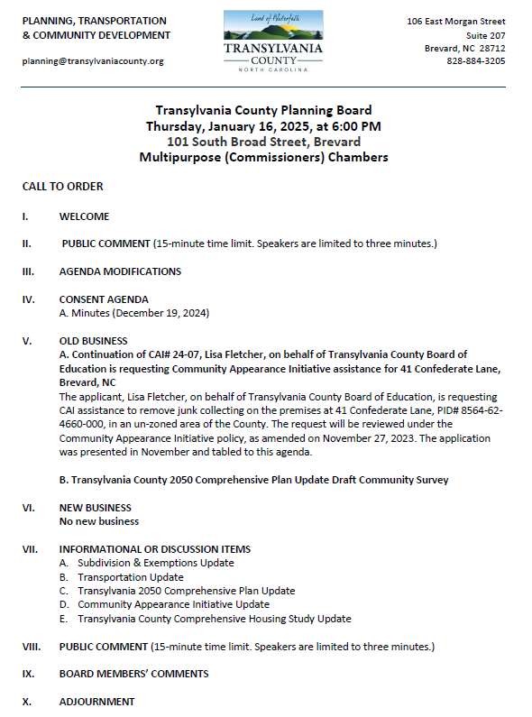
Transylvania County Planning Board

Slide 3
Public Comment

Slide 4
Agenda Modifications

Slide 5
Consent Agenda

Slide 6
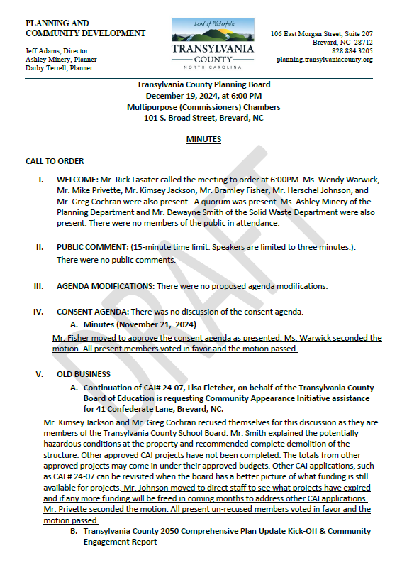
Minutes
December 19, 2024
Consent Agenda

Slide 7
Old Business

Slide 8
A. Fletcher/Transylvania County Board of Education CAI# 24-07

Slide 9
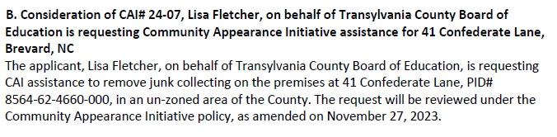
Staff Report
CAI# 24-07 Fletcher

Slide 10
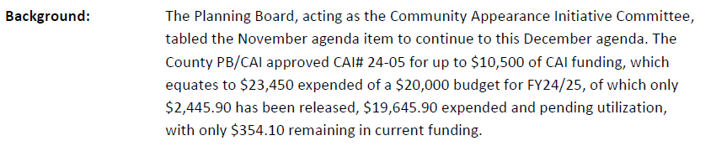
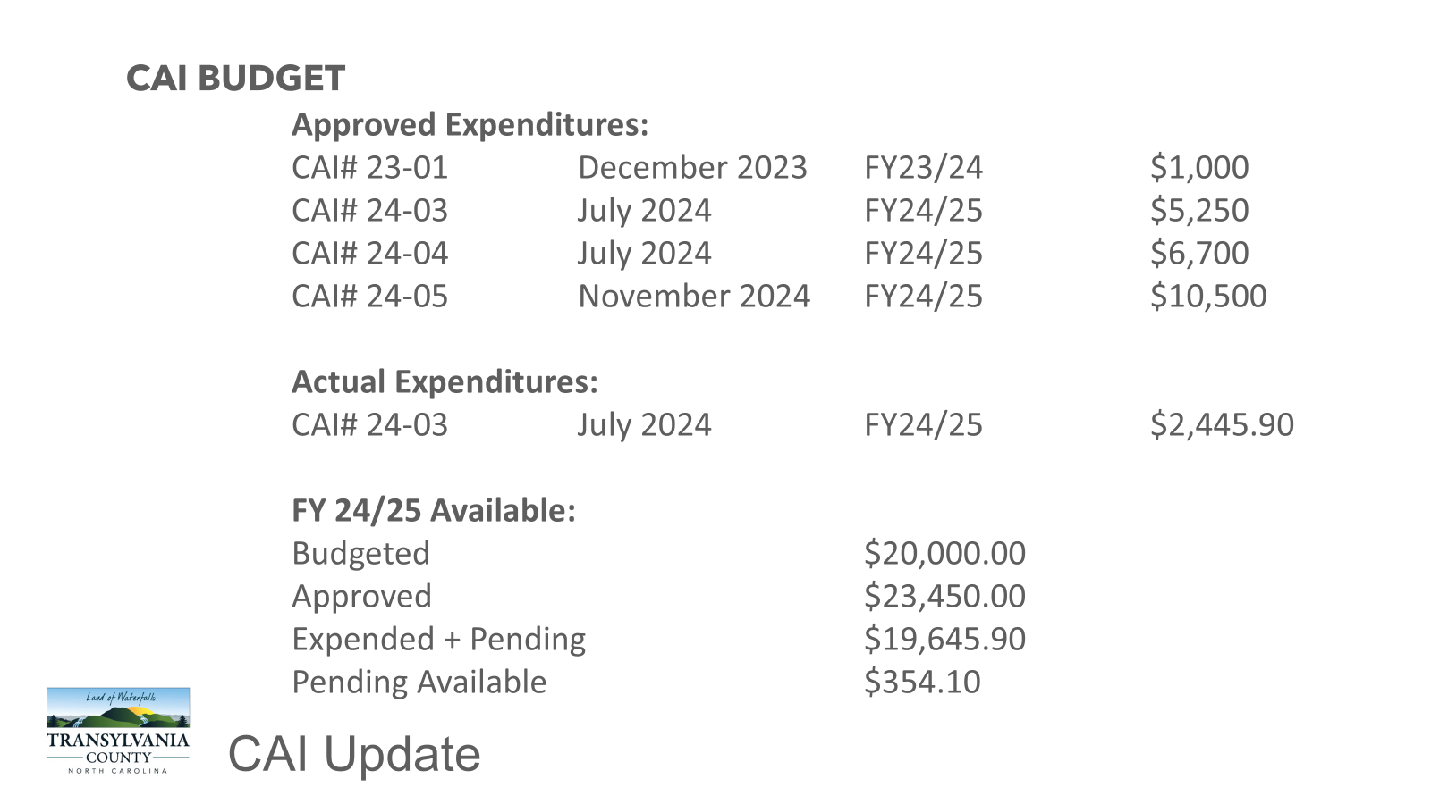
Memo
CAI# 24-07 Fletcher

Slide 11
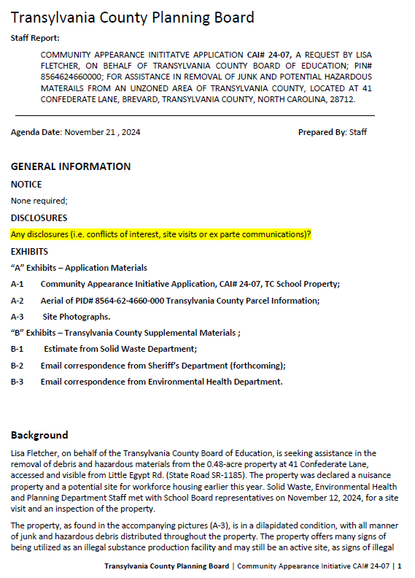
Staff Report
Background
41 Confederate Lane (Transylvania County Board of Education: Owner)
.48 Acre Property
Visible from Little Egypt (SR-1185)
November 12, 2024, Site Visit
Aging mobile home, trashed, junk collected, with hazard materials
Declared a nuisance property
Signs of illegal drug production and confirmed by Sheriff’s Department
Proposed site for Teacher and Workforce Housing
CAI# 24-07 Fletcher

Slide 12
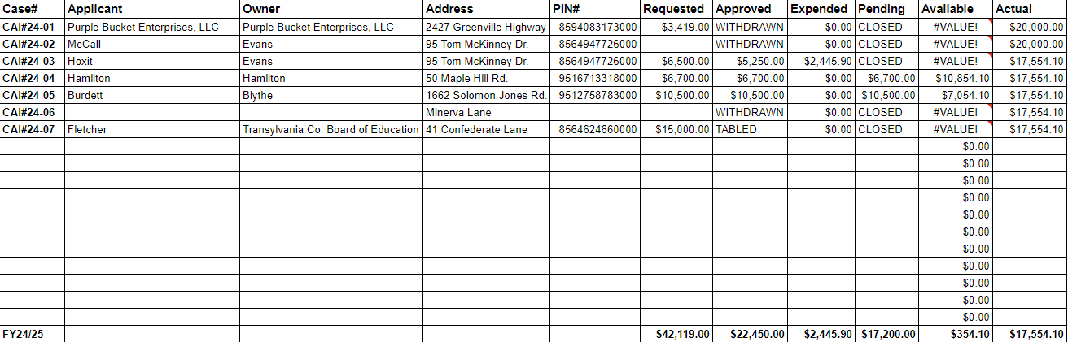
CAI BUDGET
CAI Update

Slide 13
Staff Report
CAI# 24-07 Fletcher

Slide 14
Staff Report
CAI# 24-07 Fletcher

Slide 15
Staff Report
CAI# 24-07 Fletcher

Slide 16
Staff Report
CAI# 24-07 Fletcher

Slide 17
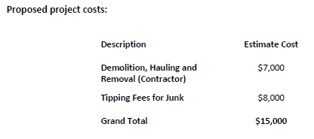
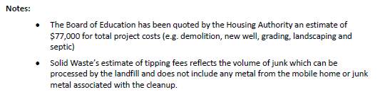
Staff Report
CAI# 24-07 Fletcher

Slide 18
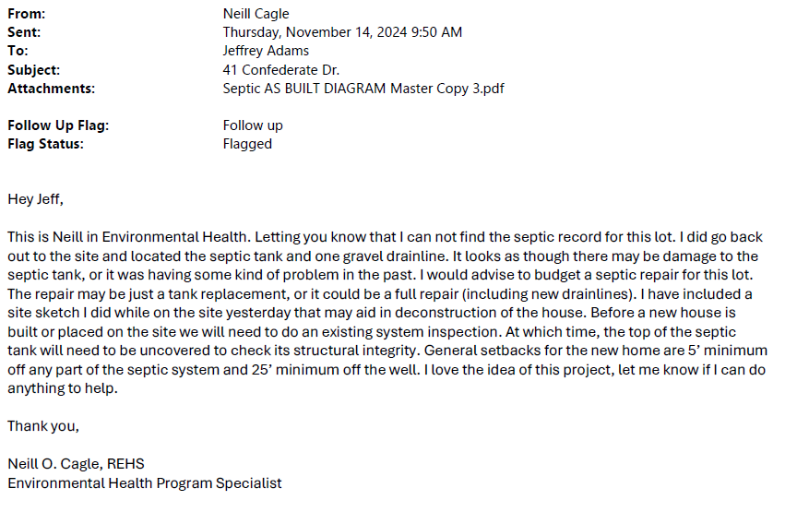
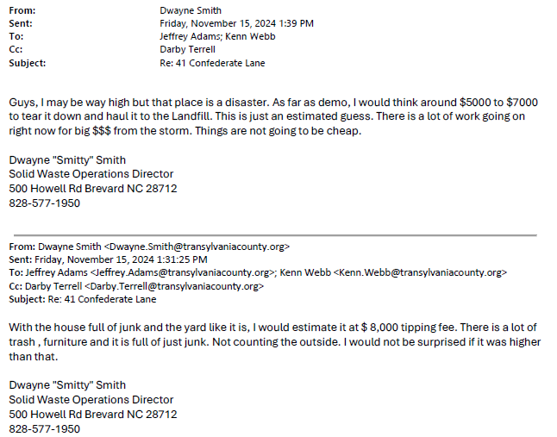
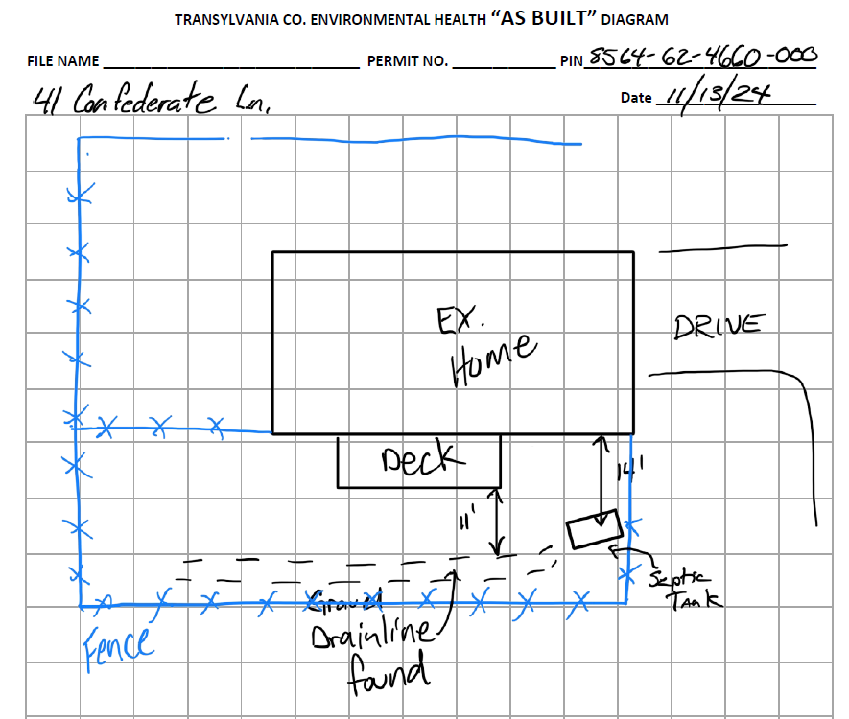
Staff Report
CAI# 24-07 Fletcher

Slide 19
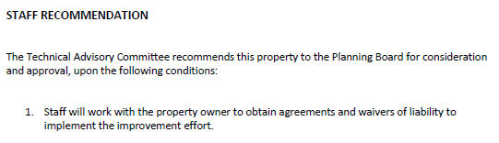
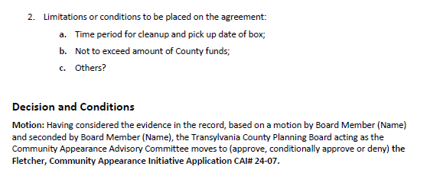
Staff Report
TABLED
CAI# 24-07 Fletcher

Slide 20


B. 2050 Comprehensive Plan Update
DRAFT Community Survey

Slide 21
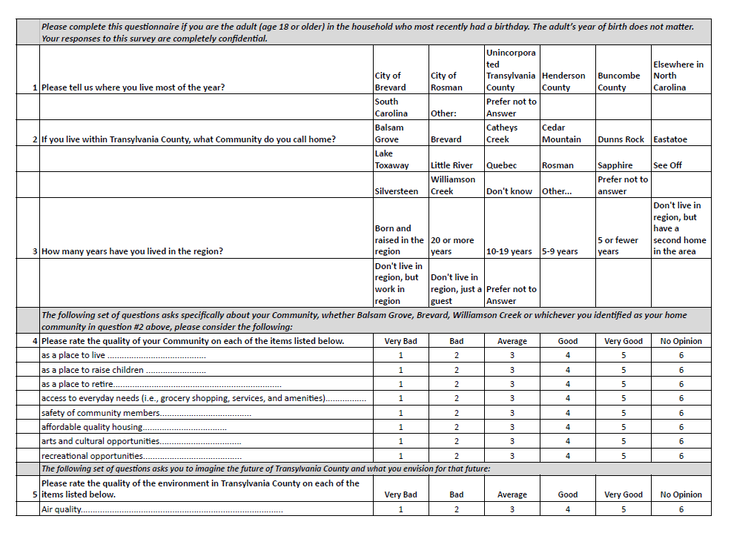
DRAFT
Comprehensive Plan: Survey

Slide 22
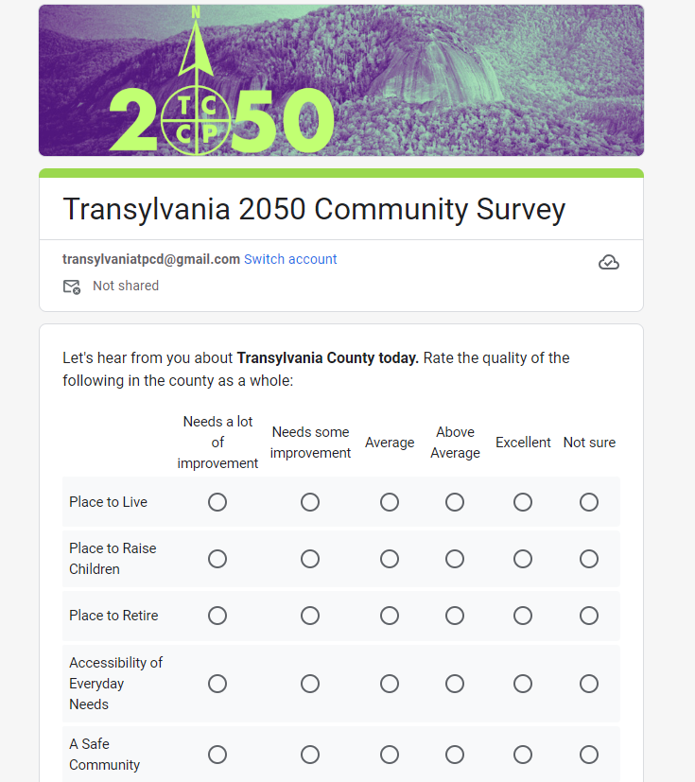
DRAFT
Comprehensive Plan: Survey

Slide 23
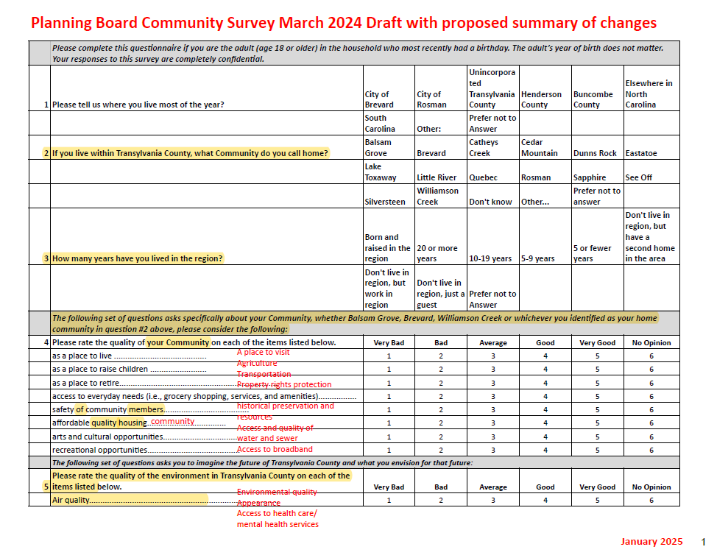
Comprehensive Plan: Survey

Slide 24
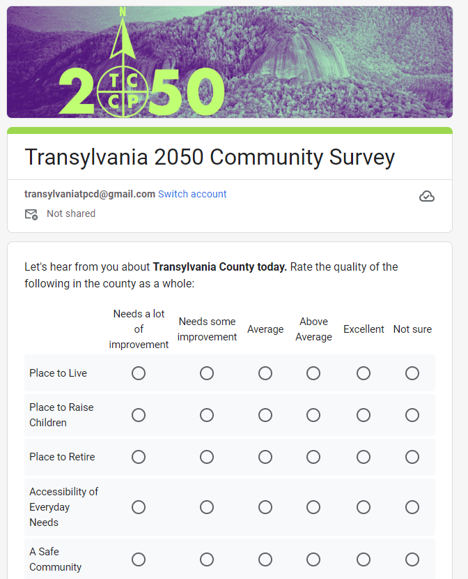
Shortened to six questions
48 responses requested
One qualitative assessment
One focused on transportation
One on participation
One on accessing information
One focusing on the future 2050
One on vision for 2050
With seven demographic questions
Draft Community Survey

Slide 25
No New Business

Slide 26
Informational & Discussion Items

Slide 27
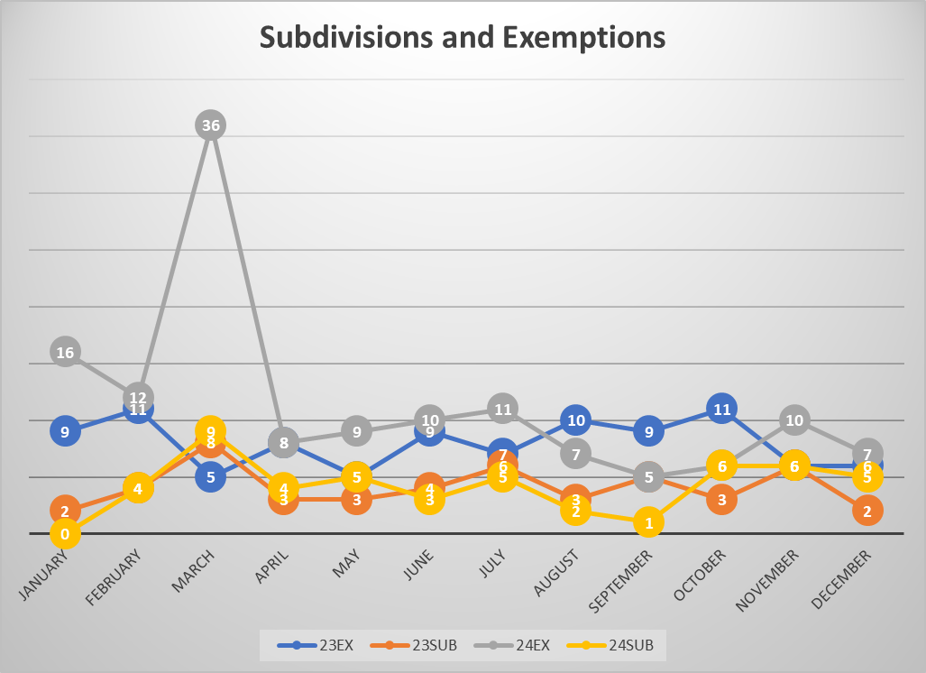
A. Subdivision Approval & Update
Subdivisions & Exemptions Update
Notes:
December 2024- 7 Exemptions and 5 Subdivisions

Slide 28
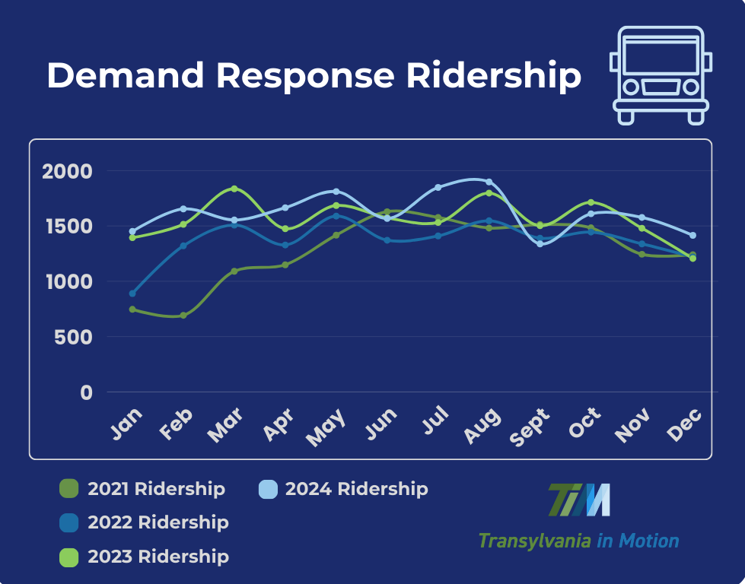
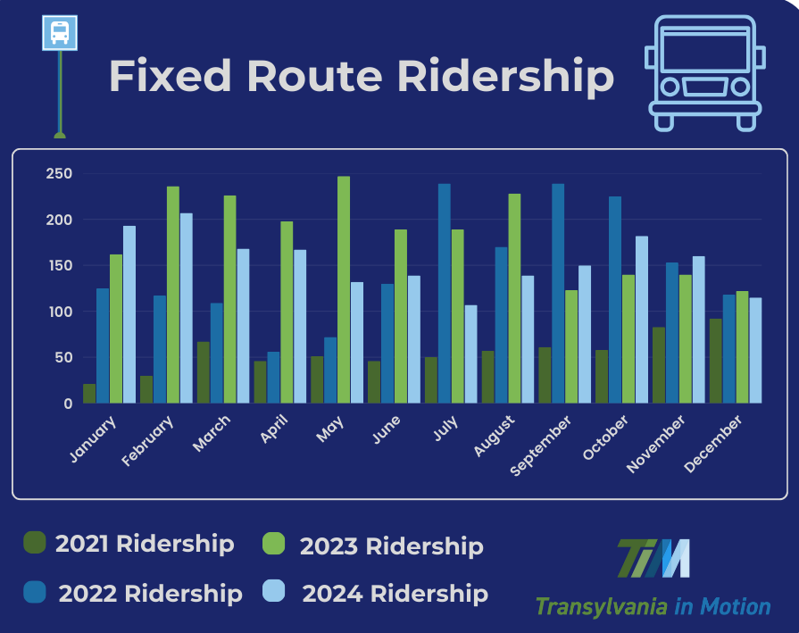
B. Transportation Update
DR: Total Rides= 21,413 (Year), Avg per Month: 1,616
FR: Total Rides= 3,883 (Year), Avg per Month: 155
Transportation Update

Slide 29

B. Transportation Update
Transportation Update

Slide 30
C. Housing Study Update

Slide 31
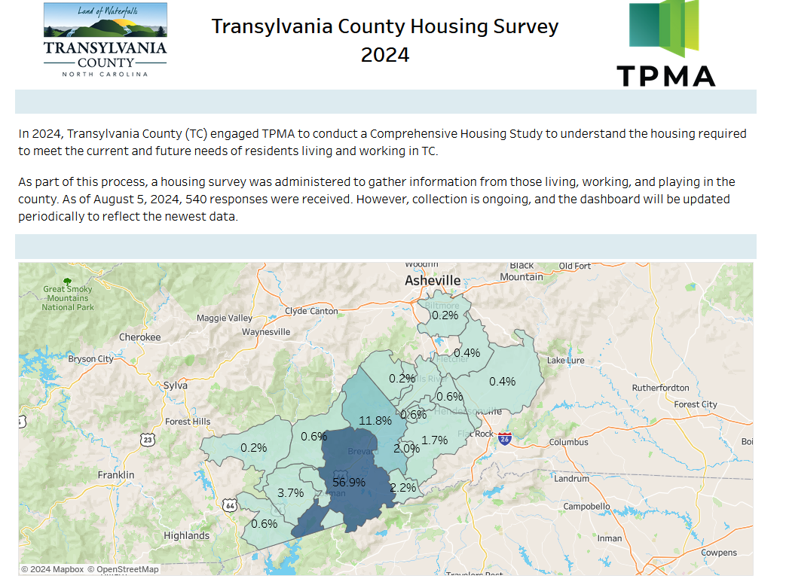
Housing Study Update

Slide 32
D. Community Appearance Initiative Update

Slide 34
CAI BUDGET
CAI Update

Slide 35

D. Comprehensive Plan Update

Slide 36
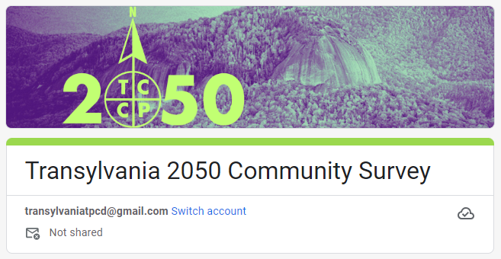

Slide 37

PROJECT SCHEDULE
Our future starts here!
2024
2024/25
2025
June
Feb
Aug
kick-off
July
Mar
Sep
Aug
Apr
Oct
Phase 1
Phase 2
Phase 3
Understand + Engage
  Project Launch & Work plan
  Background Review + Research
  Project identity + Engagement Plan
  Community Snapshot
  Kickoff + Community Events
Explore + Develop
  Draft Vision + Goals
  Community Survey
  Alternatives + Strategies
  Community Strategy Sessions
  Draft Strategies
Refine + Finalize
  Policy Development
  Draft Plan Development
  Plan Refinement
  Final Plan Review
  Final Plan Adoption
survey
priorities
what is a comprehensive plan?

Slide 38
"Feedback loops are the engines of growth and change. They’re the mechanisms by which the output of a system influences its own input.
Complex systems often have many feedback loops, and it can be hard to appreciate how adjusting to feedback in one part of the system will affect the rest.
Using feedback loops as a mental model begins with noticing the feedback you give and respond to every day. The model also gives insight into the value of iterations in adjusting based on the feedback you receive. With this lens, you gain insight into where to direct system changes based on feedback and the pace at which you need to go to monitor the impacts.
Feedback loops are what make systems dynamic. Without feedback, a system just does the same thing over and over. Understand them, respect them, and use them wisely.”
— Source: The *Updated* Great Mental Models v3: Systems and Mathematics
Comprehensive Plan Update: Feedback Loops

Slide 39
Public Comment

Slide 40
Board Members’ Comments

Slide 41

Adjournment

