Slide 1


Transylvania County
Planning Board Meeting | February 2025

Slide 2
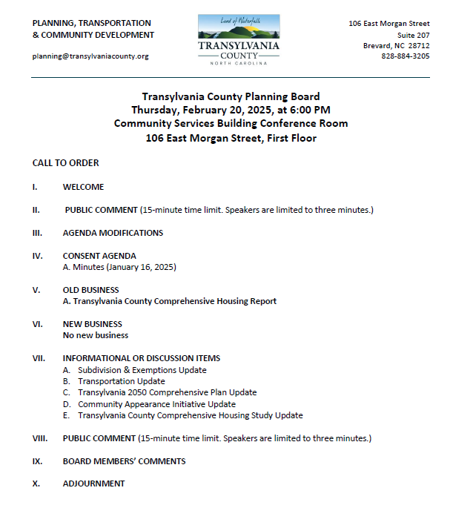
Transylvania County Planning Board

Slide 3
Public Comment

Slide 4
Agenda Modifications

Slide 5
Consent Agenda

Slide 6
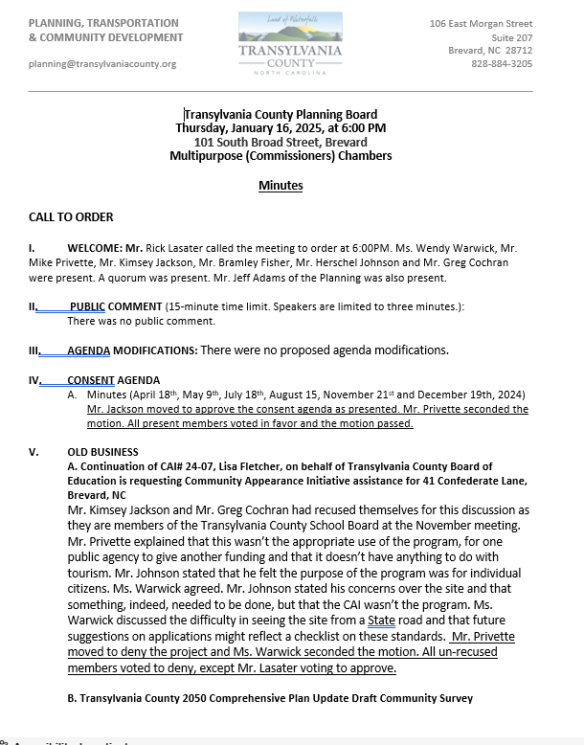
Minutes
January 16, 2025
Consent Agenda

Slide 7
Old Business

Slide 8
A. Transylvania County Housing Report:
Draft Summary of Data & Research

Slide 9

Memo:
Housing Report

Slide 10
A. Fletcher/Transylvania County Board of Education CAI# 24-07

Slide 11
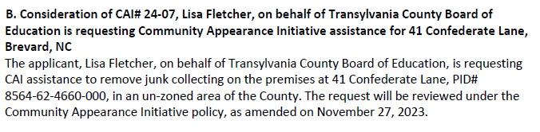
Staff Report
CAI# 24-07 Fletcher

Slide 12
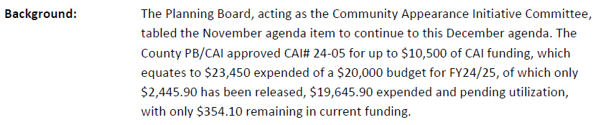
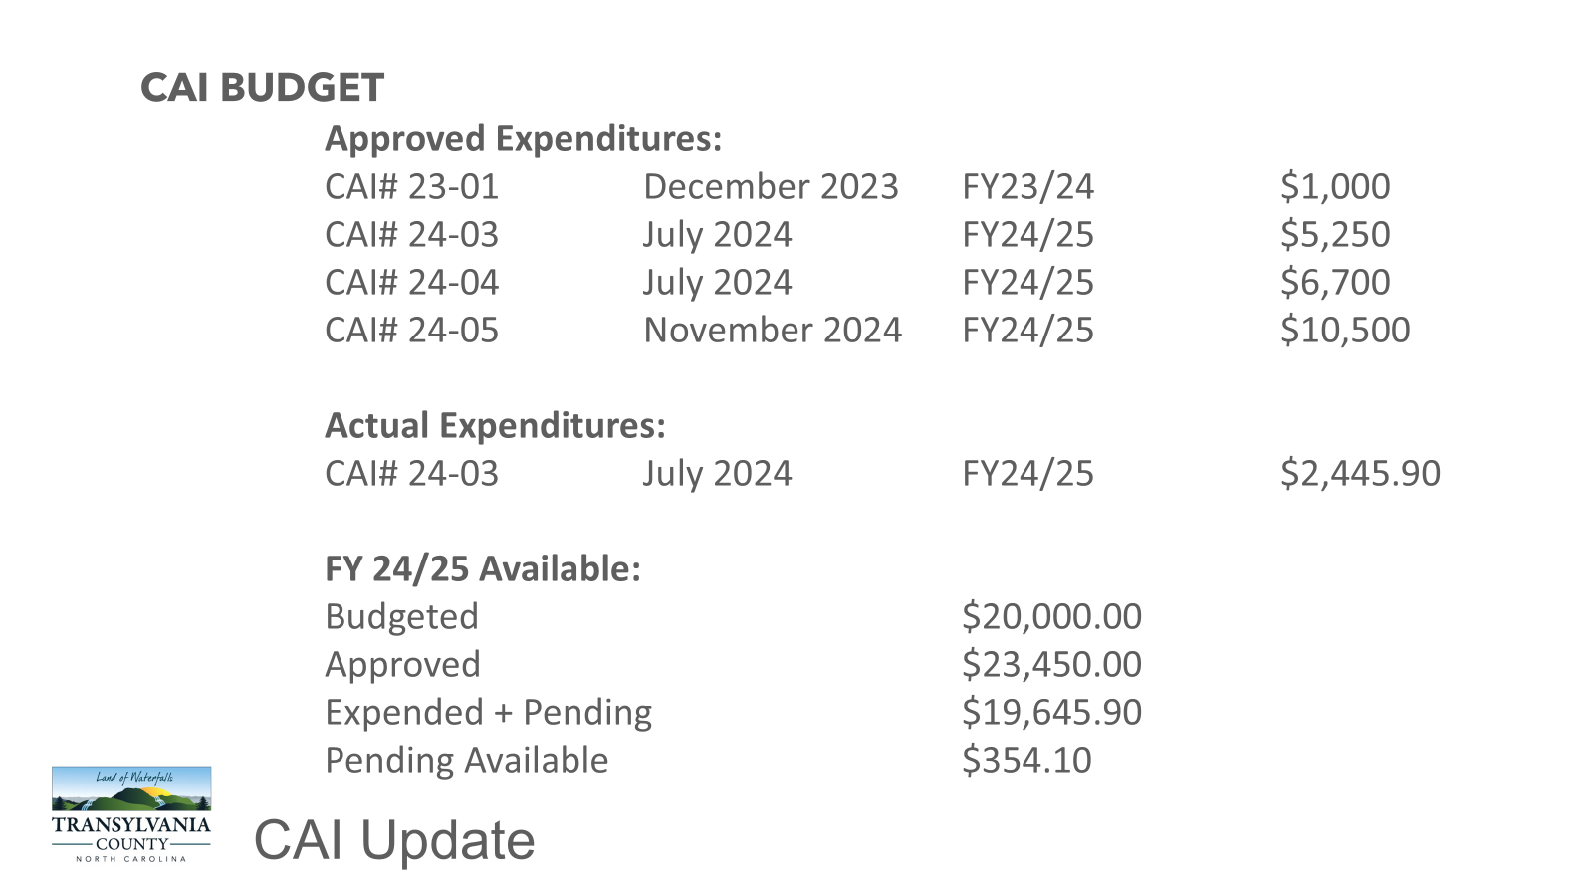
Memo
CAI# 24-07 Fletcher

Slide 13
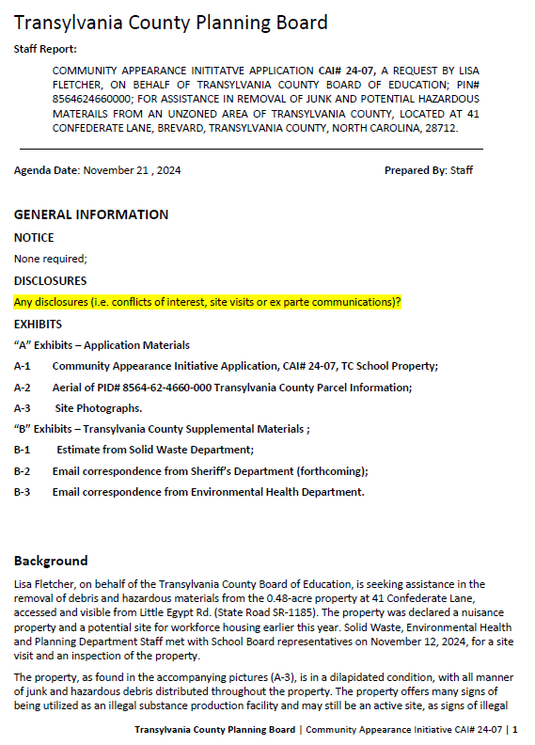
Staff Report
Background
41 Confederate Lane (Transylvania County Board of Education: Owner)
.48 Acre Property
Visible from Little Egypt (SR-1185)
November 12, 2024, Site Visit
Aging mobile home, trashed, junk collected, with hazard materials
Declared a nuisance property
Signs of illegal drug production and confirmed by Sheriff’s Department
Proposed site for Teacher and Workforce Housing
CAI# 24-07 Fletcher

Slide 14
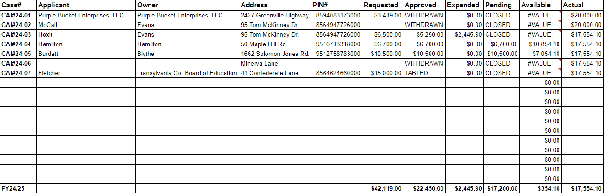
CAI BUDGET
CAI Update

Slide 15
Staff Report
CAI# 24-07 Fletcher

Slide 16
Staff Report
CAI# 24-07 Fletcher

Slide 17
Staff Report
CAI# 24-07 Fletcher

Slide 18
Staff Report
CAI# 24-07 Fletcher

Slide 19
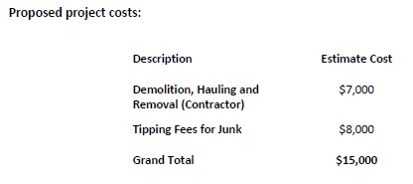
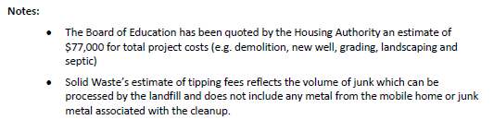
Staff Report
CAI# 24-07 Fletcher

Slide 20
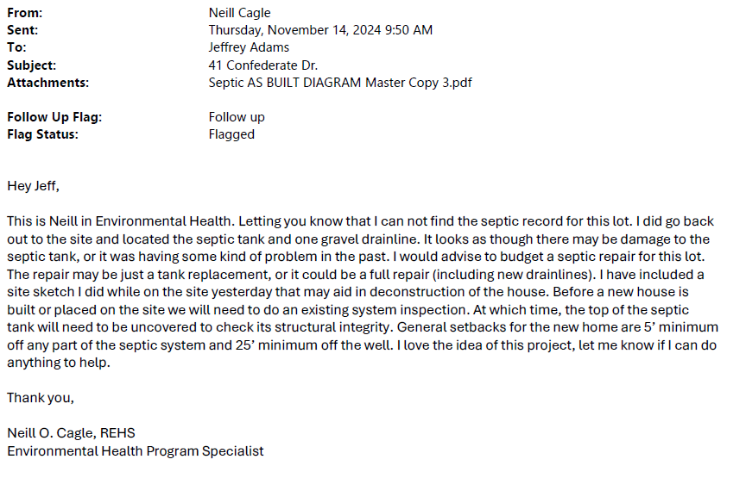
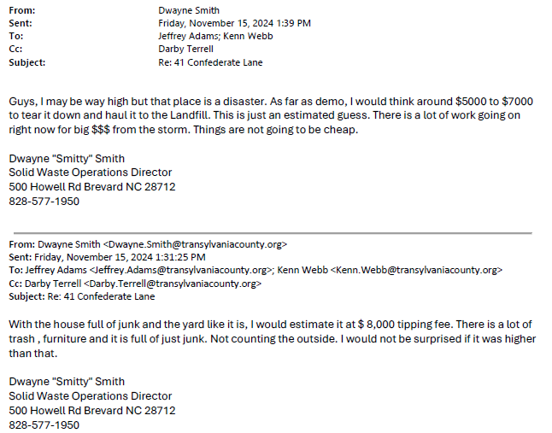
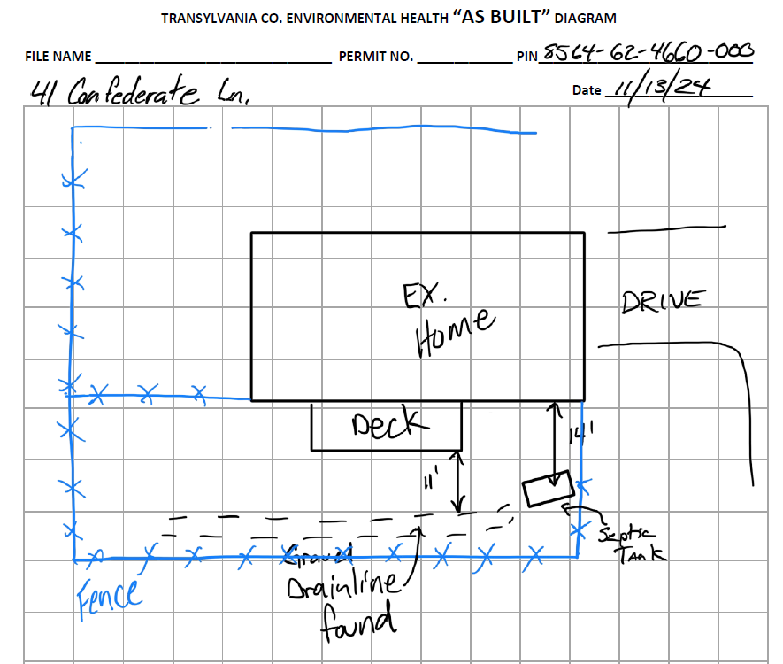
Staff Report
CAI# 24-07 Fletcher

Slide 21
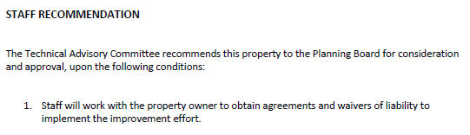
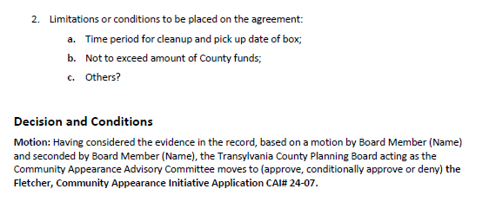
Staff Report
TABLED
CAI# 24-07 Fletcher

Slide 22


B. 2050 Comprehensive Plan Update
DRAFT Community Survey

Slide 23
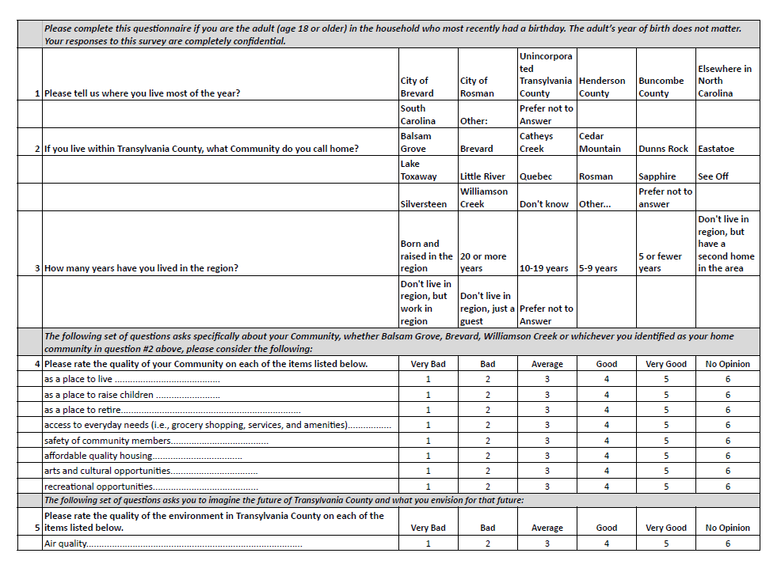
DRAFT
Comprehensive Plan: Survey

Slide 24
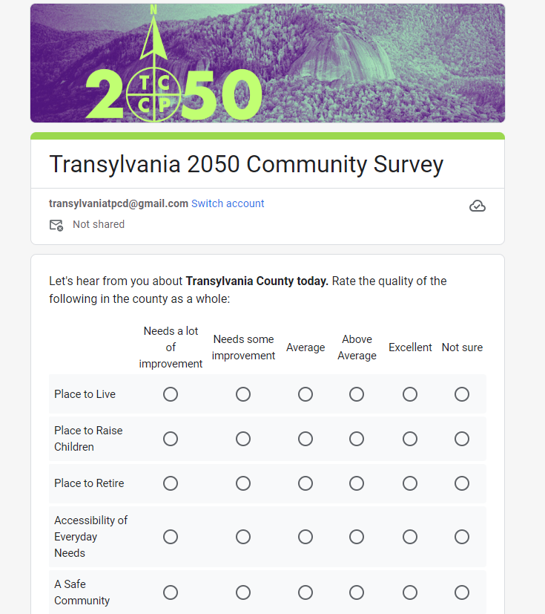
DRAFT
Comprehensive Plan: Survey

Slide 25
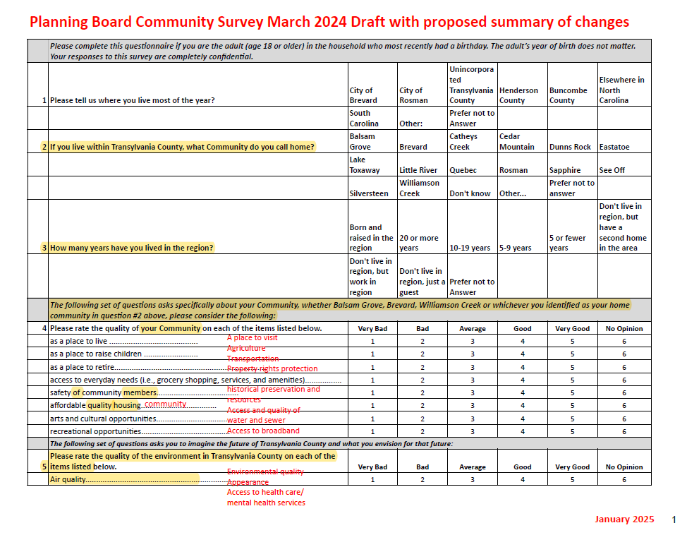
Comprehensive Plan: Survey

Slide 26
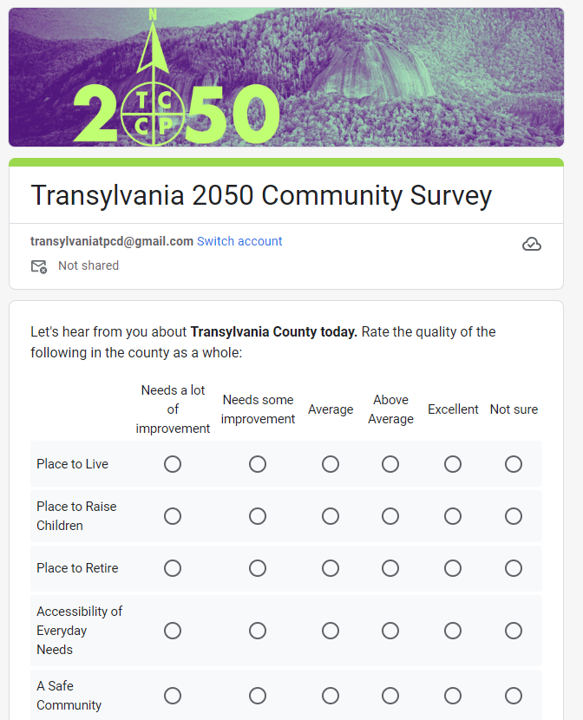
Shortened to six questions
48 responses requested
One qualitative assessment
One focused on transportation
One on participation
One on accessing information
One focusing on the future 2050
One on vision for 2050
With seven demographic questions
Draft Community Survey

Slide 27
No New Business

Slide 28
Informational & Discussion Items

Slide 29
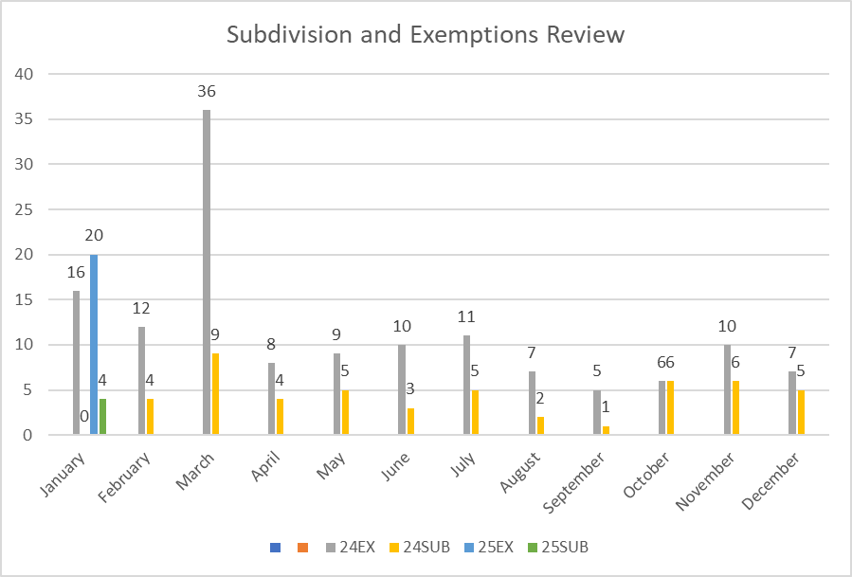
A. Subdivision Approval & Update
Subdivisions & Exemptions Update
Notes:
December 2024- 7 Exemptions and 5 Subdivisions

Slide 30
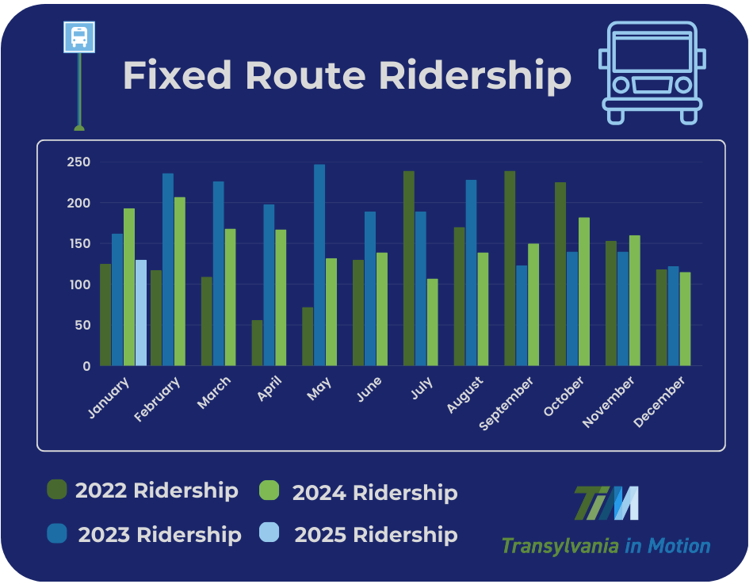
B. Transportation Update
FR January Numbers:
2022- 125 riders
2023- 162 riders
2024- 193 riders
2025- 130 riders
Transportation Update

Slide 31
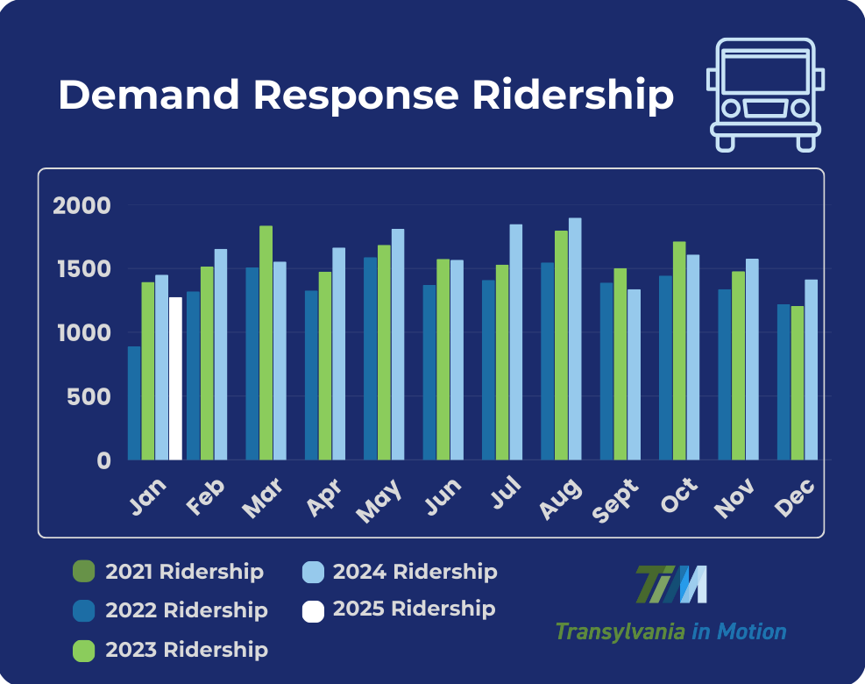
B. Transportation Update
DR January Numbers:
2022- 889 trips
2023- 1396 trips
2024- 1451 trips
2025- 1275 trips
Transportation Update

Slide 32

B. Transportation Update
Last Chance to Take the Survey!
Transportation Update

Slide 33
C. Community Appearance Initiative Update

Slide 34
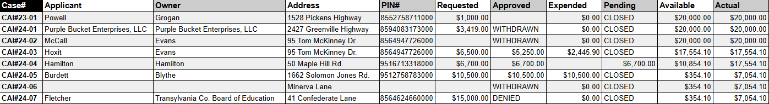
CAI BUDGET
CAI Update

Slide 35

C. Comprehensive Plan Update

Slide 36
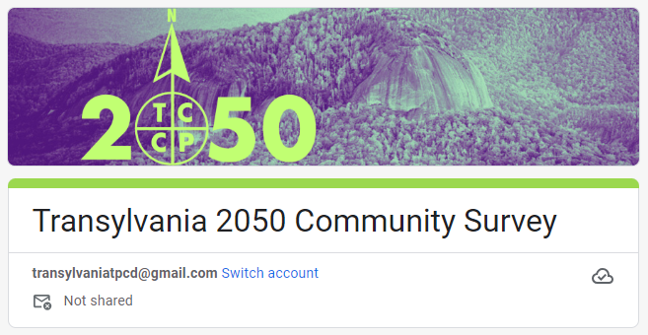

Slide 37

PROJECT SCHEDULE
Our future starts here!
2024
2024/25
2025
June
Feb
Aug
kick-off
July
Mar
Sep
Aug
Apr
Oct
Phase 1
Phase 2
Phase 3
Understand + Engage
  Project Launch & Work plan
  Background Review + Research
  Project identity + Engagement Plan
  Community Snapshot
  Kickoff + Community Events
Explore + Develop
  Draft Vision + Goals
  Community Survey
  Alternatives + Strategies
  Community Strategy Sessions
  Draft Strategies
Refine + Finalize
  Policy Development
  Draft Plan Development
  Plan Refinement
  Final Plan Review
  Final Plan Adoption
survey
priorities
what is a comprehensive plan?

Slide 38
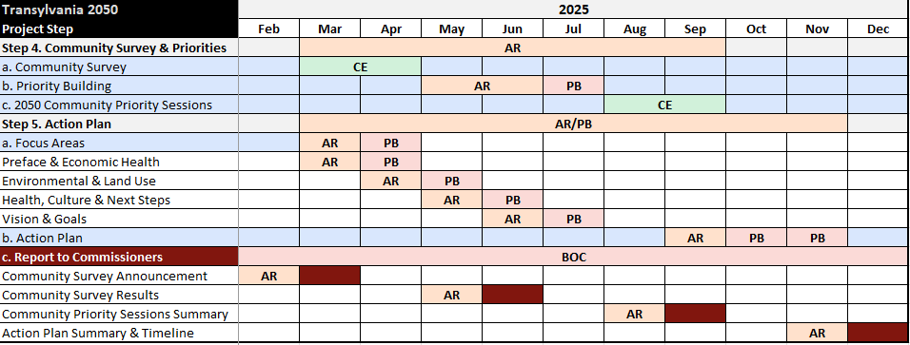
Timeline

Slide 39
"Feedback loops are the engines of growth and change. They’re the mechanisms by which the output of a system influences its own input.
Complex systems often have many feedback loops, and it can be hard to appreciate how adjusting to feedback in one part of the system will affect the rest.
Using feedback loops as a mental model begins with noticing the feedback you give and respond to every day. The model also gives insight into the value of iterations in adjusting based on the feedback you receive. With this lens, you gain insight into where to direct system changes based on feedback and the pace at which you need to go to monitor the impacts.
Feedback loops are what make systems dynamic. Without feedback, a system just does the same thing over and over. Understand them, respect them, and use them wisely.”
— Source: The *Updated* Great Mental Models v3: Systems and Mathematics
Comprehensive Plan Update: Feedback Loops

Slide 40
D. Housing Study Update

Slide 41
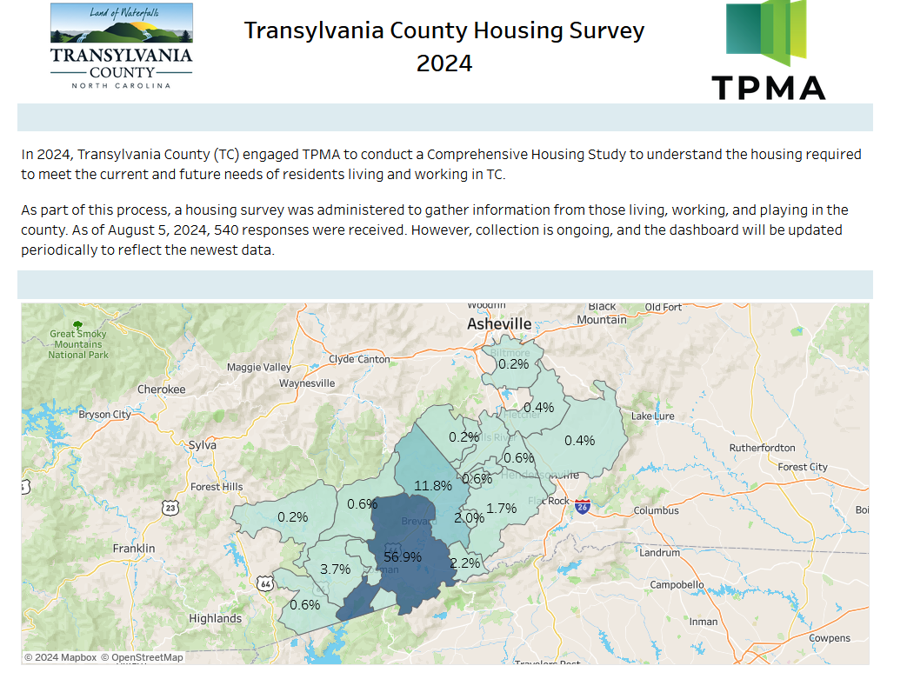
Housing Study Update

Slide 42
Public Comment

Slide 43
Board Members’ Comments

Slide 44

Adjournment

