Slide 1
Transylvania County's Transportation Advisory Committee
Special Meeting
February 12, 2025 at 6:00 PM
County Commissioners Chamber at 101 South Broad Street, Brevard NC 28712

Slide 2
Agenda
Welcome
I
Public that is interested in speaking, please sign in at the front, thank you.
Public Comment
II
Consent Agenda
IV
Presentation
V
Old Business
VI

Slide 3
Public Comment
15-minute time limit
For those who wish to speak, please sign in on the sheet at the front.
Each speaker is limited to 3 minutes
​

Slide 4
3 Minutes
2 Minutes
1 Minute
30 Seconds
Time Complete
Please end comments
Thank you!

Slide 5
Consent Agenda
Minutes (July 9,2024)

Slide 6
Presentation
By Troy Wilson, NCDOT District Engineer, Division 14, District I

Slide 7
V. Old Business
Comprehensive Transportation Plan (CTP)
A
Vicki Eastland, Land of Sky RPO or Daniel Sellers, NCDOT
B
NCDOT Current Projects Update
Steve Williams, Division 14 Planning and Troy Wilson, District 1 Engineer
LOSRPO Updates
C
Vicki Eastland, LOSRPO
Transit Ridership: Yearly Numbers
D
Darby Terrell, Planner

Slide 8
V-A. Comp. Transportation Plan Update
Update from Vicki Eastland on the current progress of the Comprehensive Transportation Plan for Transylvania County.
Draft is being revised after receiving input from Land of Sky RPO feedback.
Next Step: Finished Draft will be sent to TAC for review

Slide 9
V-B. NCDOT Current Project Updates
Steve Williams, NCDOT, Division 14 Planning and Troy Wilson, NCDOT, Division 14, District 1 Engineer..
This is a routine update will provide the committee status updates for transportation projects that are already funded or are already under construction as they pertain to Transylvania County.

Slide 10
Quick Update on NCDOT Projects
Route/TIP # | Description | Completion Date | Completion %
US 64: R-57941, U-5104 | Caldwell St near Bracken Ln to US 64 near Brevard Academy | 6/25/23 *Revised Date: 10/21/2023 | 84%
US 64:R-5799 | Intersection of US-64/US-276 and US 280 (Asheville Hwy) | 5/14/2027 | 27%
US 64 | Resurfacing on Rosman Hwy and various secondary routes throughout TC | 10/15/2023 | 85%
SR-1309 | Bridge (#63) over West Fork of French Broad River on Silversteen Road | 5/15/2025 | 91%
SR-1615/HA-002 | Mountain Industrial Drive Road Extension in Jennings Industrial Park | 10/19/2024 | 86%
US 276: EB-5858 | Pedestrian Bridge across Davidson River | 4/11/2025 | 72%

Slide 11
Project ID | Description | ROW ACQ Begins | Let Date
BN-0011 | Multi-use Path (Eastatoe Trail) from Cashiers Valley Road to US 64 |  | 12/23/2025*
BP14.R012 | Replace B-5972 over tributary to Tucker Creek on Tanasee Gap Rd (SR 1324) | 11/13/2026* | 1/23/2029*
BP14.R022 | Replace Bridge #11 on Solomon Jones Rd (SR 1559) over Walker Creek | 2/11/2024 | 2/8/2028*
BP14.R039 | Replace Bridge over French Broad River on Old Turnpike Rd | 11/11/2024 | 11/11/2031*
BR-0252 | Replace Timber Bridges: Bridge over Walker Creek on Haskell Jones Rd, Bridge over Richland Creek on Homer McCall Rd, Bridge over Shoal Creek on Babb Rd | 1/30/2024 | 12/15/2024
HB-0026 | Replace Bridge Over French Broad River on Everett Rd | 5/15/2024 | 10/19/2027
EB-6037B | Ecusta Rail Trail | 9/30/2021 | FY 2026
R-5763 | Upgrade roadway: Wilson Road from Old US 64 to US 276 | 3/21/2022 | 9/16/2025
R-5800 | US 64 from US 276, Fortune Cove Rd to Caldwell Street. Construct median and access control measures. | 3/1/2023 | 10/20/2026
R-5865 | Widening to 3-lanes to include Bicycle lanes on US 276 from US 64 to Avery Creek Trail Head | 1/1/2040 | 1/1/2040
R-5882 | Improving Intersection of US 64/Broad St, US 64 BUS/Caldwell St, N. Country Club Rd | 7/21/2028 | PE Only
R-5919 | Modernize Roadway of US 178/East Main Street at Main Street in Rosman to Middlefork Off-site Parking | 10/12/2028 | PE Only
HF-0004 | US 276, Install guardrail from Sliding Rock to Proposed off-site parking, construct sidewalk |  | 9/22/2026
HS-2414G | Install Rectangle Rapid Flashing Beacon with Actuated crosswalk lighting |  | 6/10/2025
HS-2414H | Install Rumble strips with 6-inch-long life pavement markings, near US 64 mile marker 5 until mile marker 13 and mile marker 31 near Brevard. |  | 2/25/2025
HN-0031 | Intersection improvement at US 276 and Cascade Lake Road | 9/23/2025 | 9/22/2026

Slide 12
V-C. LOSRPO Updates
Vicki Eastland, Land of Sky RPO
This is a routine update for the committee to stay informed on the status of future transportation projects and NCDOT funding statuses as it pertains to Transylvania County.

Slide 13
V-D. Transit Trips: Yearly Numbers
This is a routine update for the committee to stay informed on the status of the Transit/Transportation system provided by Transylvania County.
Still not having an average of over 10 passengers a day for the Fixed Route. We are doing a Survey to adjust the stops and receive feedback from the Public.
The Demand Response this year beat most of the previous year's numbers. The ridership is still in the process of bouncing back from not only the storm but the Epidemic 4 years ago.

Slide 14
V-D. Transit Trips: Fixed Route
2024 Year

Slide 15
V-D. Transit Trips: Yearly Numbers
2024

Slide 16
Public Comment
15-minute time limit
For those who wish to speak, please sign in on the sheet at the front.
Each speaker is limited to 3 minutes
​

Slide 17
Board Member Comments

Slide 18
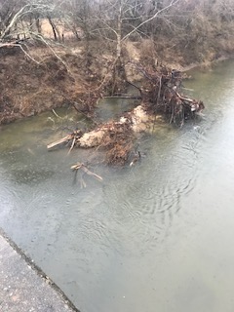
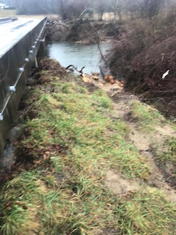
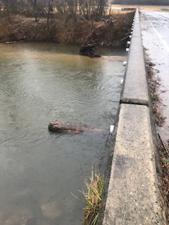
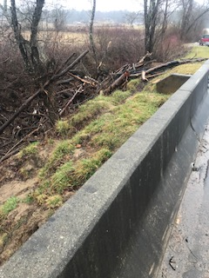
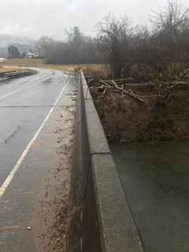
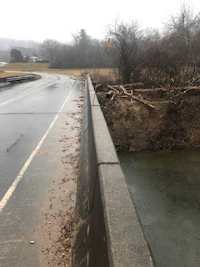

Slide 19
Thank you

