Slide 1
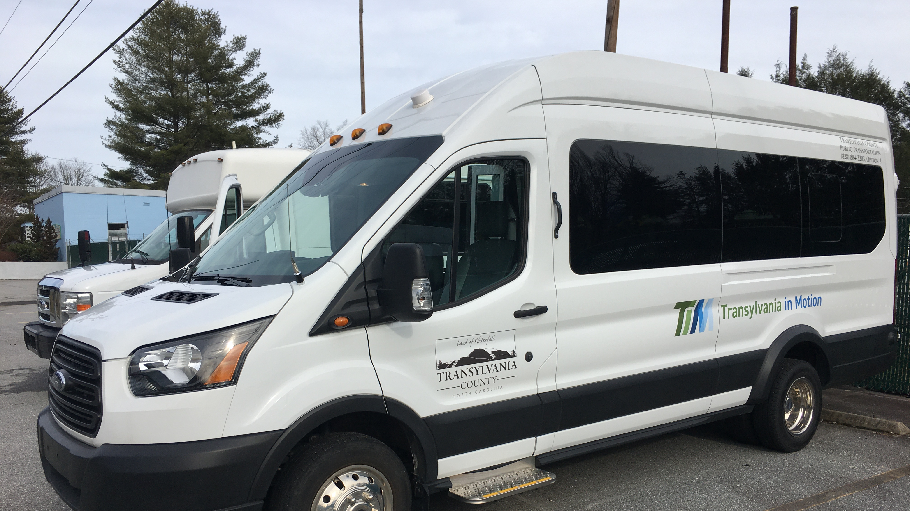
Transportation Advisory Board
February 12, 2025

Slide 2
I. Welcome

Slide 3
II. Agenda Modifications
None?

Slide 4

III. Consent Agenda
November 13, 2025 Meeting Minutes

Slide 5
VI. Q2 FY25 Operational Statistics

Slide 6
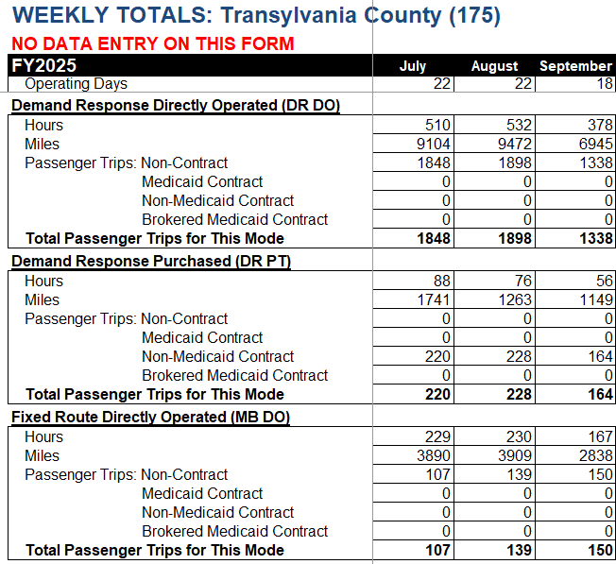

V-A. Q2 FY25 Transportation Operational Statistics
Higher than FY24
DR Van Riders
Cab Riders
FR Van Riders

Slide 7
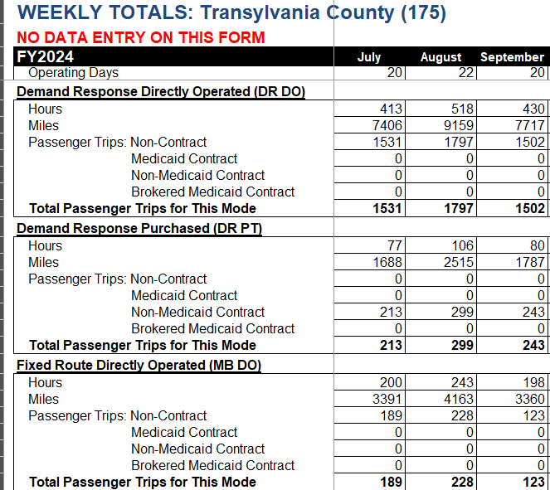

Q2 FY24 Transportation Operational Statistics
DR Van Riders
Cab Riders
Higher than FY25
FR Van Riders

Slide 8
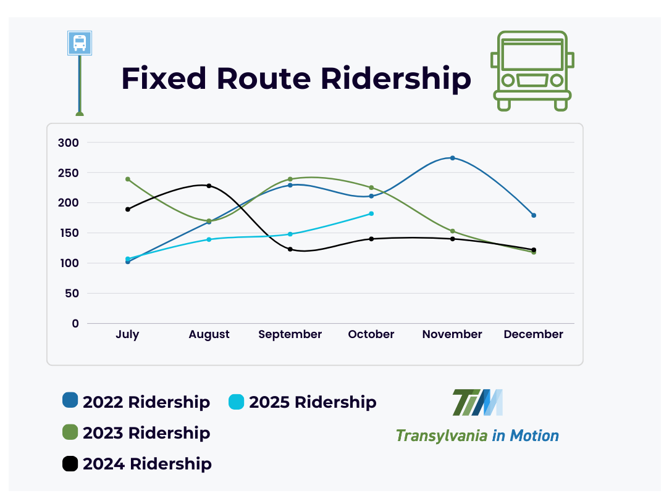
Fixed Route
Monthly

Slide 9
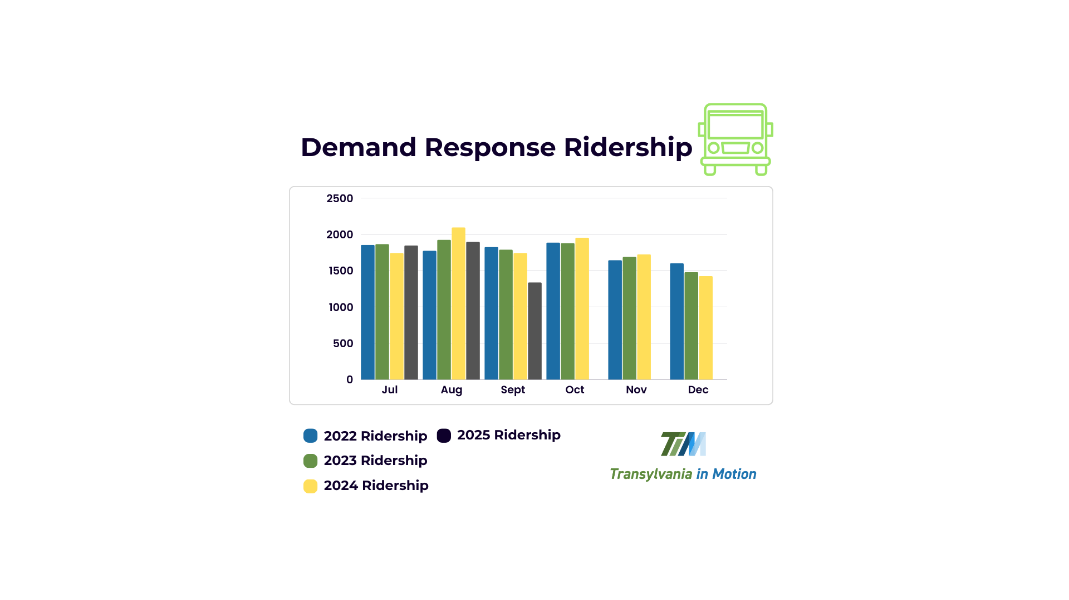
Demand Response

Slide 10
VI-B. Fixed Route Survey Update

Slide 11


As of February 6th, 75 responses
VI-B. Fixed Rerouting Summary

Slide 12
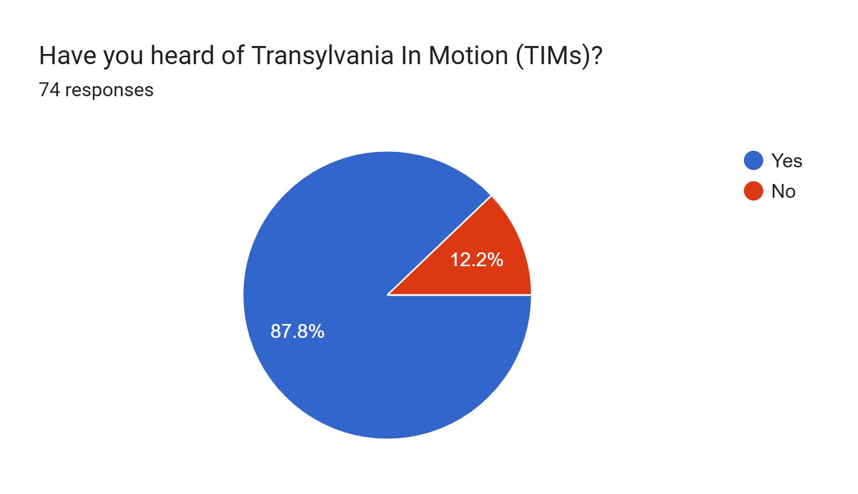
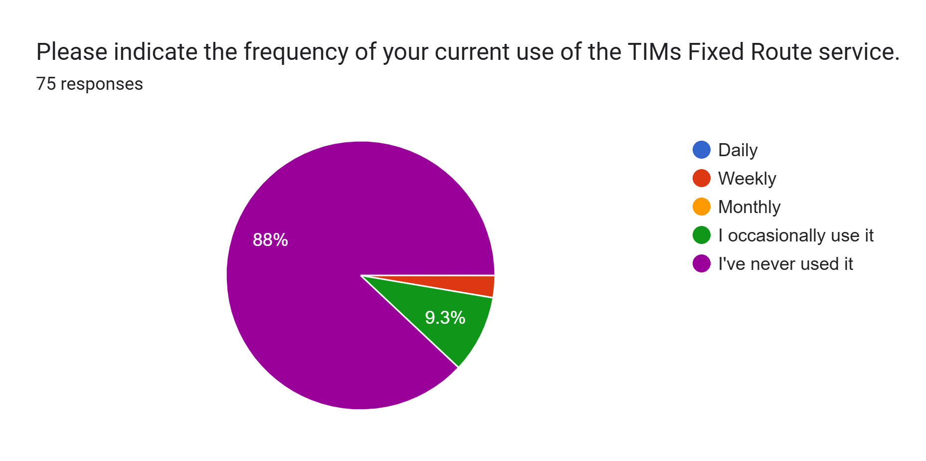
VI-B. Fixed Rerouting Summary

Slide 13
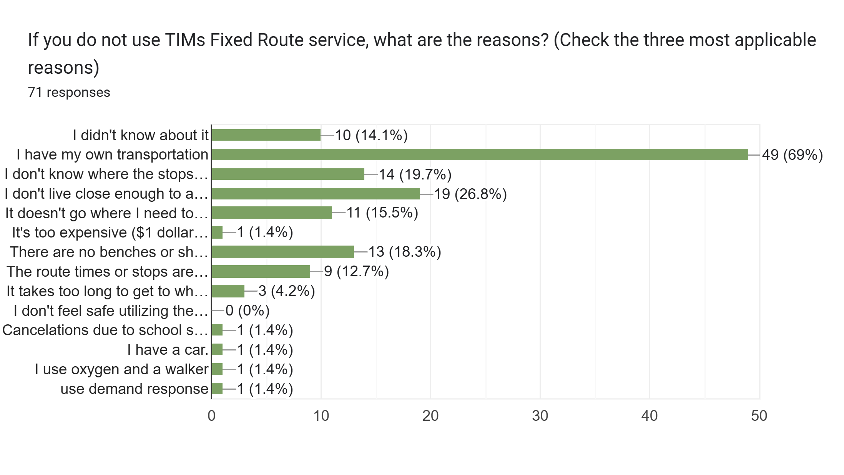
VI-B. Fixed Rerouting Summary

Slide 14
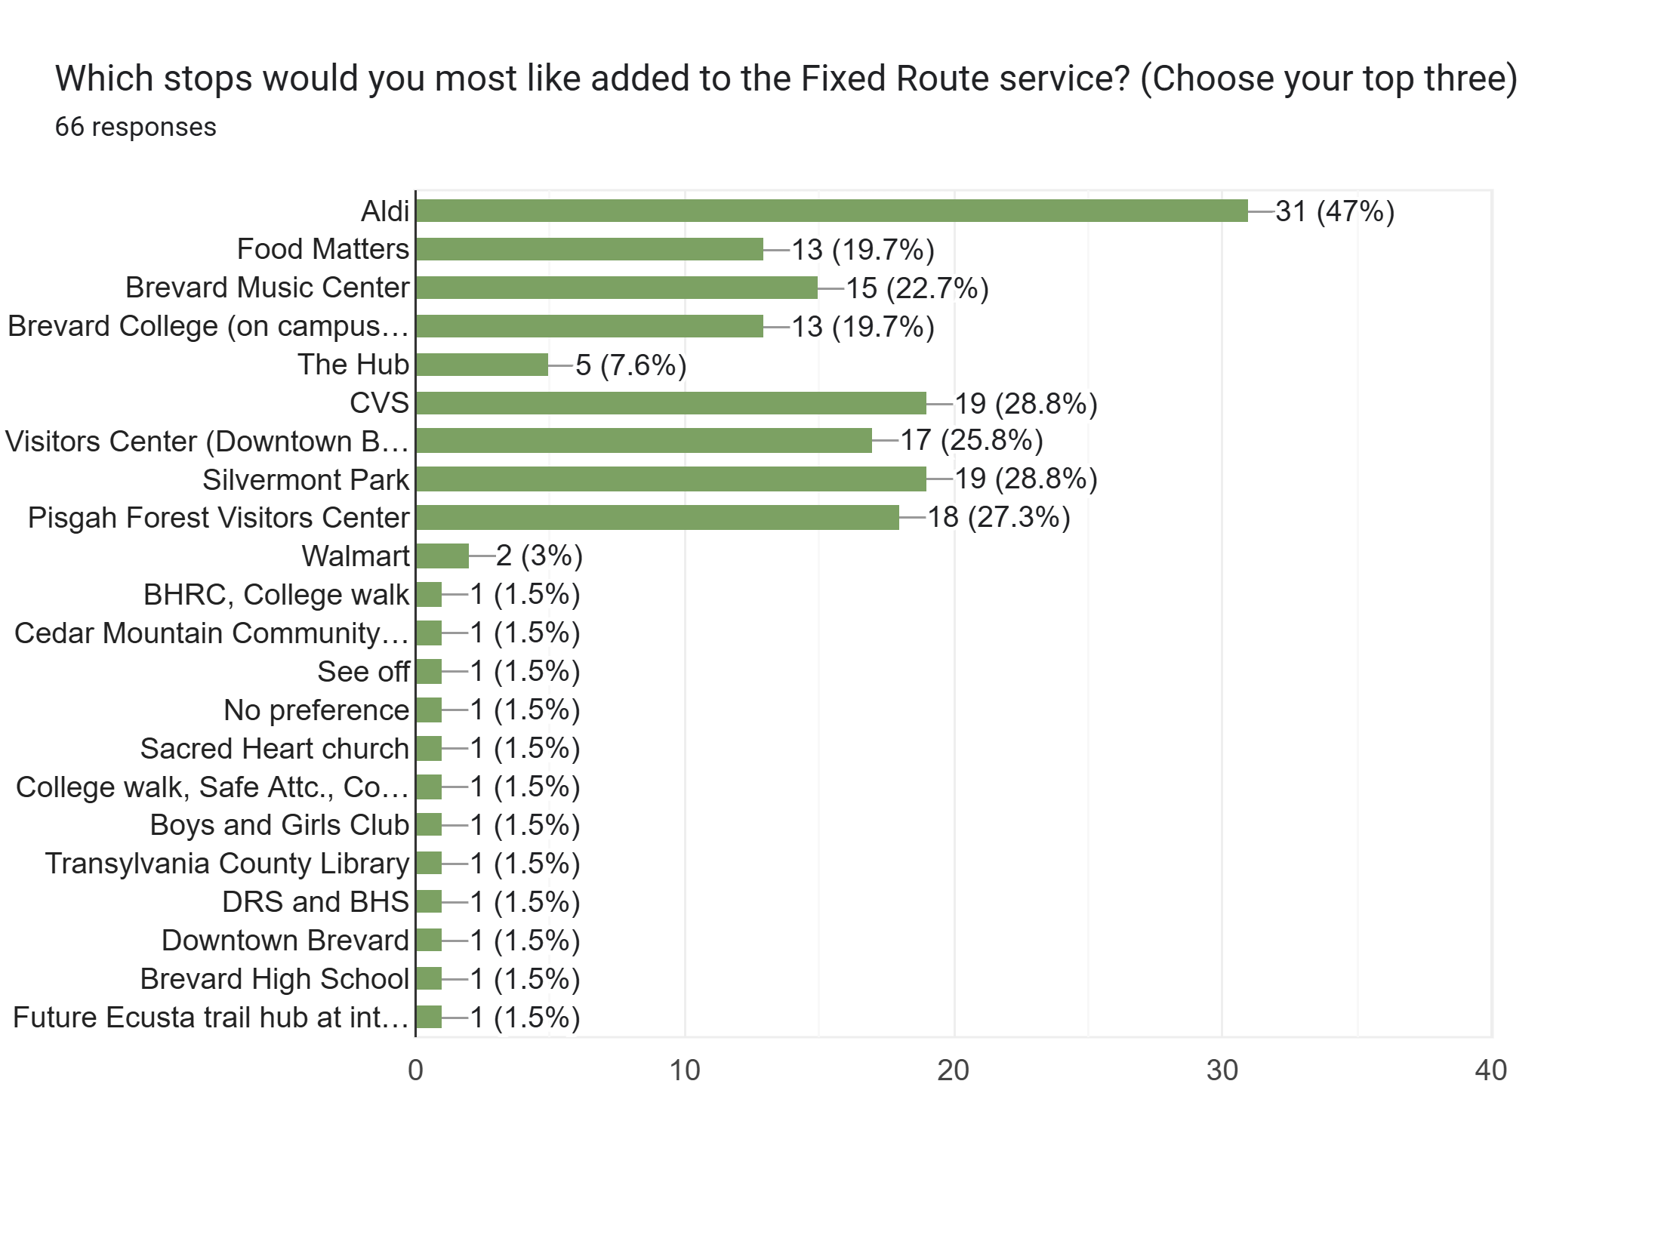
VI-B. Fixed Rerouting Summary

Slide 15
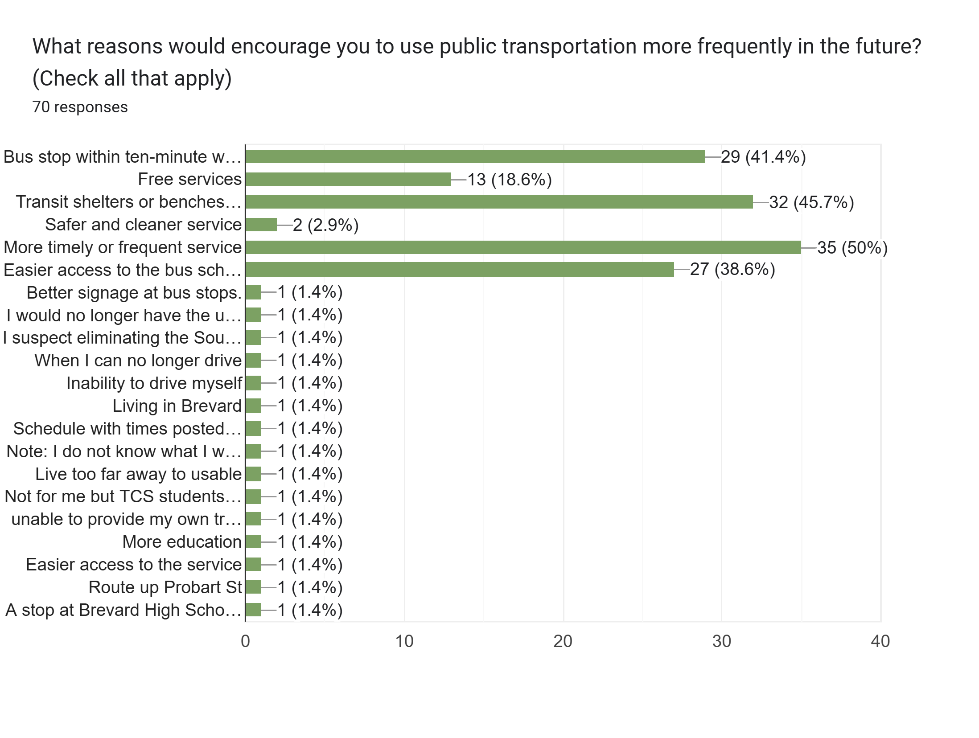
VI-B. Fixed Rerouting Summary

Slide 16
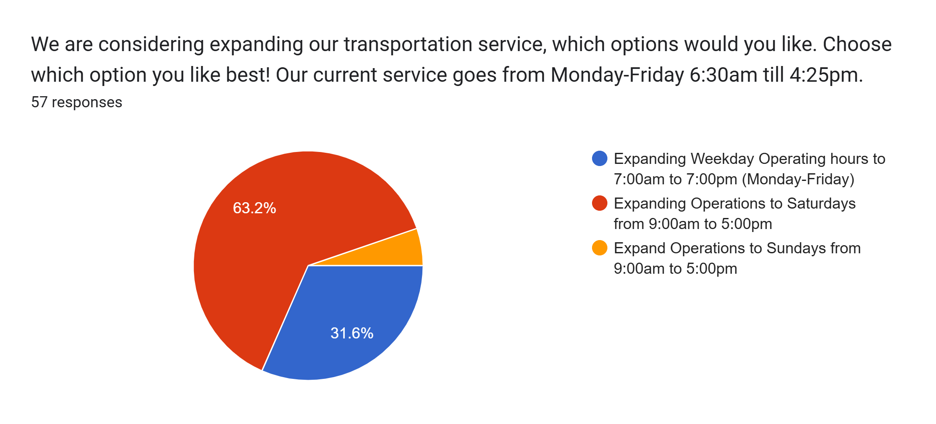
VI-B. Fixed Rerouting Summary

Slide 17
VI-B. Fixed Rerouting Summary
What would be some improvements to the Fixed Route that you would recommend?
Better communication about what is offered. Do you have a brochure? How do you accommodate the handicapped? Micro-transit sounds interesting. What is the cab service?
Expanding Operations to Saturdays from 9am-5pm;
Add visible signs and shelters at the stops. Expand the hours to include evenings and weekends;
Better advertising of stop times;
Able to get on and off with one card;
Having the fixed route tied to the school cancellations make the service pretty much worthless to me, and I suspect many others that would like to use it to get to/from work;
Additional routes e.g. up 276 and I'd love the schedule to integrate live with google so I can see when the bus is coming;
I would recommend a stop at the Davidson River Campground and offer service into town. Consider offering service for performances at Brevard College and Brevard Music Center with transportation after the events (late evening service). I think you'd get a lot more ridership;
Eliminate low rider stops, England St, Go Grocery, Lowe’s, TVS, WCCA;
Make College Walk a stop;

Slide 18
IV-C. Land of Sky RPO Update
Vicki Eastland

Slide 19
IV-D. Transportation Updates
Silver Squirrel Update: Following Slides
Marketing Update: Used Radio ads in November, Advertised the Department twice in the T-Times, Sent out Flyers for Fixed Route Survey to School System, TVS, and Boards.
Newsletter: Decided to start promoting the Department more through Seasonal Newsletter to give a quarterly update that is sent out with pieces discussing our drivers or needs. The first one was out in December for the Winter update. The next one will be in the Spring.

Slide 20
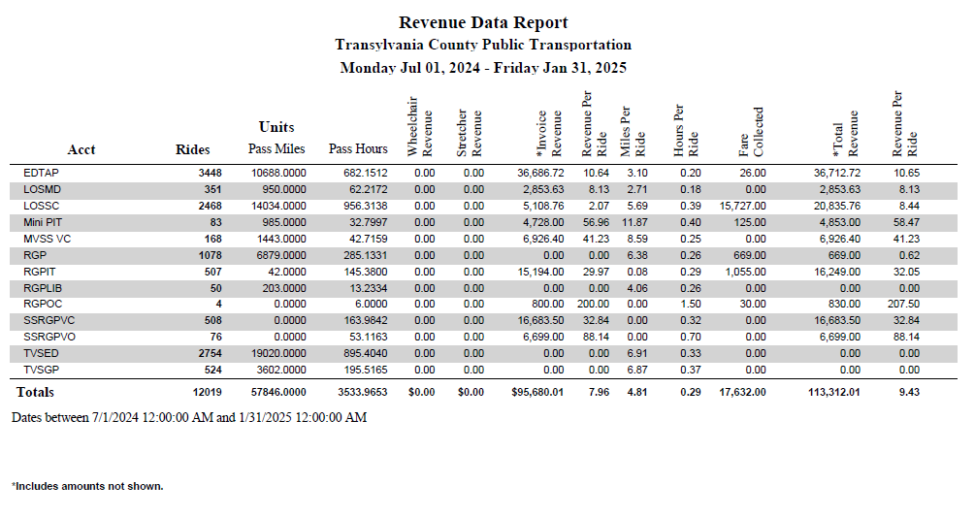
VI-D. Silver Squirrel Update
752 Rides
(6% of Total Rides) $6,400 in senior savings

Slide 21
VI-D. Pisgah Health Update
251 Rides
(2% of Total Rides) $11,654 in service savings

Slide 22
New Business

Slide 23
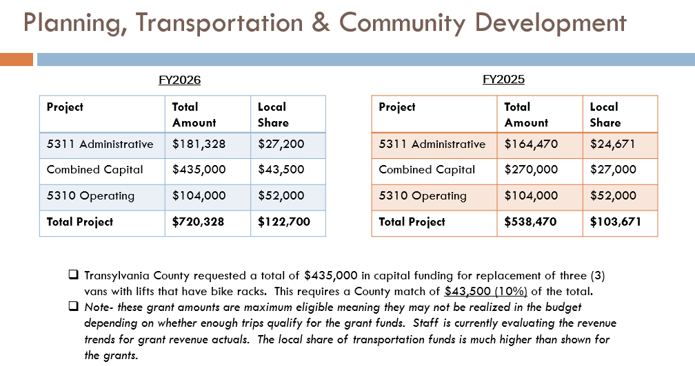
VII-A. 5310 Operating Application Review Discussion

Slide 24
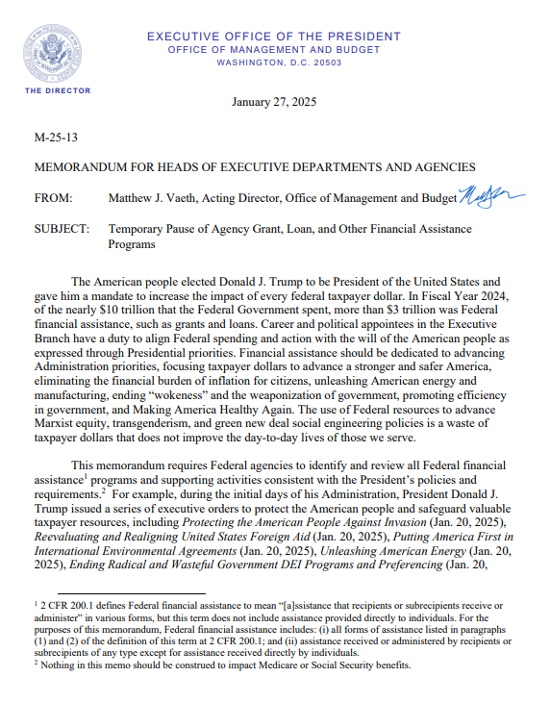
VII-A. 5310 Operating Application Review Discussion
TRANSPORTATION REVENUE
PROGRAM FY25 Budget FY25 Actual RunningAVG FY26 Proposed
5311 Transportation ($139,800) ($28,700) ($90,000) ($100,000)
5310 Operating Revenues ($52,000) ($8,800) ($16,000) ($20,000)
ROAP EDTAP ($58,700) ($55,600) ($71,400) ($70,200)
EMPL ($8,400) ($9,400) ($10,900) ($9,400)
ROAP RGP ($83,000) ($66,000) ($86,000) ($76,900)
5311 Capital ($270,000) ($.00) NA ($391,500)
Misc. Transit Grants ($12,000) ($12,000) NA ($10,000)

Slide 25
VI. Public Comment
15-Minute Time limit (speakers are held to three minutes)

Slide 26
VII. Board Members Comments

Slide 27
Thank you for attending
Next TAB meeting will be on May 14, 2025, in the Large DSS Conference Room, 2nd Floor.

