Slide 1
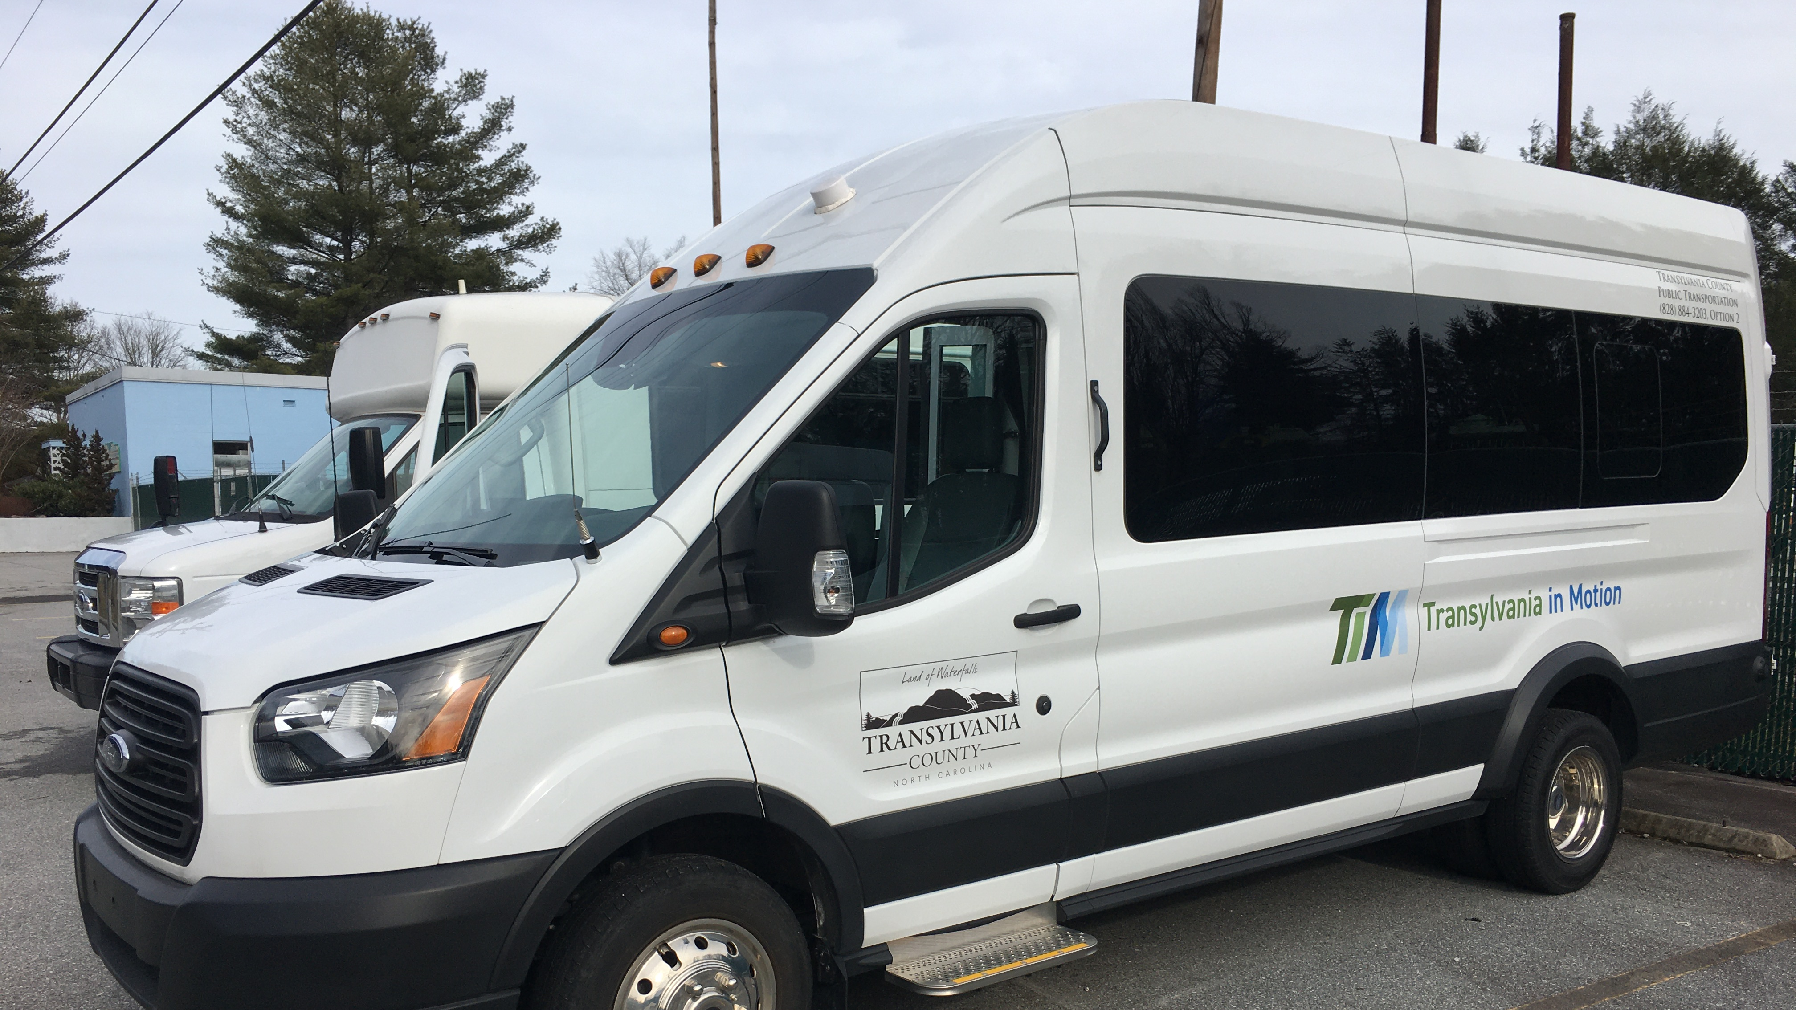
Transportation Advisory Board
May 14, 2025

Slide 2
I. Welcome

Slide 3
II. Agenda Modifications
Staff has None

Slide 4
III. Consent Agenda
February 12, 2025 Meeting Minutes

Slide 5
IV. Q3 FY25 Operational Statistics

Slide 6
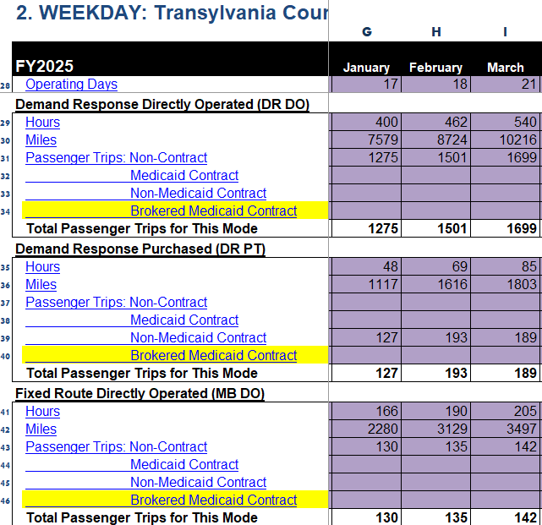
IV-A. Q-3 FY25 Transportation Operational Statistics
Lower than FY24
DR Van Riders
Cab Riders
FR Van Riders

Slide 7
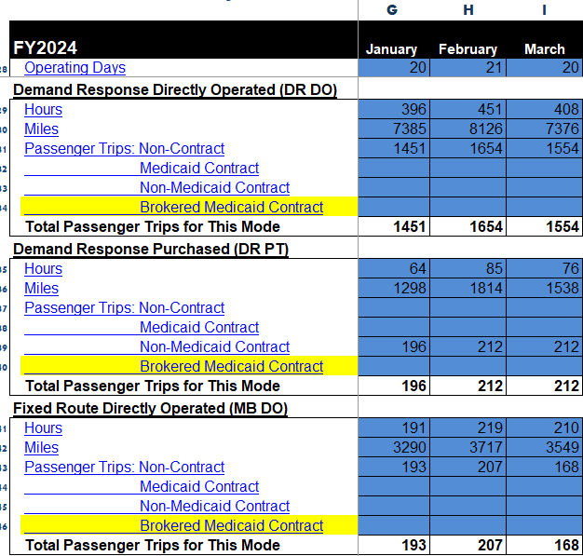
Q-3 FY24 Transportation Operational Statistics
Higher than FY25
DR Van Riders
Cab Riders
FR Van Riders

Slide 8
Fixed Route Monthly
The Fixed Route this year keeps coming in lower than the previous two years.
Though in April (beginning of Qtr. 4) the rides difference was only 3. (2025 165 riders, 2024 167 riders)
We are hoping the increase from April Continues into the warmer months.

Slide 9
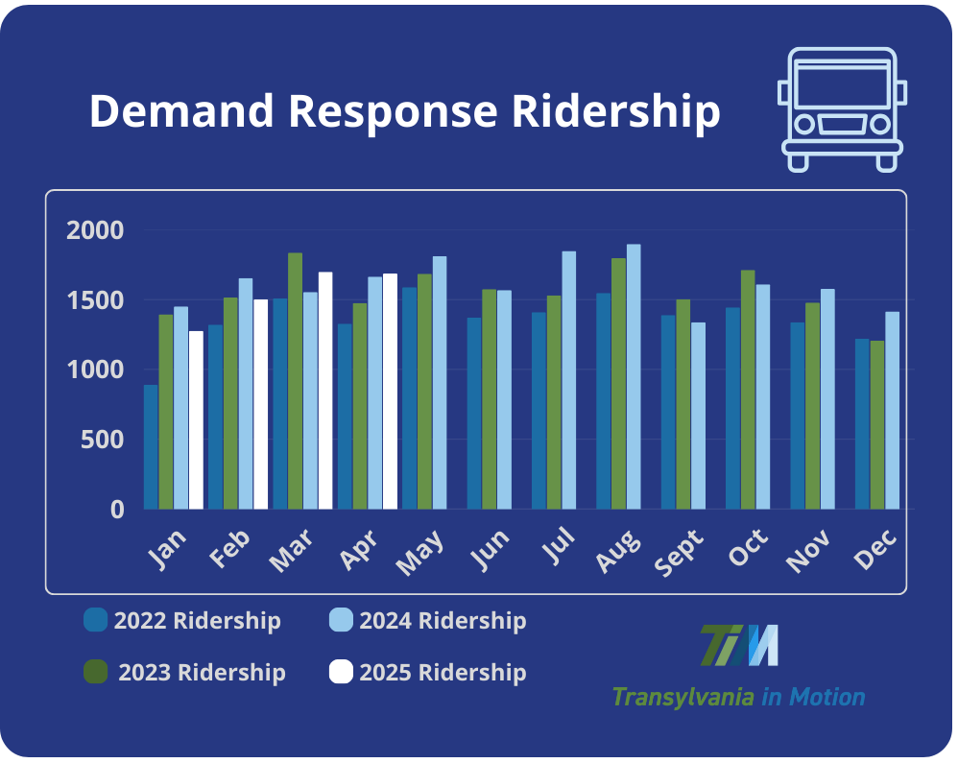
Demand Response
While on the Demand Response side there was a drop for the first two months in Qtr. 3.
The last month in March, it surpassed all but 2023, ridership/trip numbers.
Though the start of Qtr. 4 (April) shows the continued increase, with the ridership/trip's numbers coming in as best in the last 4 years. (2025 1687, 2024 1665).
This is slightly down from the March numbers which came in around 1699.

Slide 10
VI-B. Fixed Route Re-Routing Update

Slide 11
Stop Statistics

Slide 12
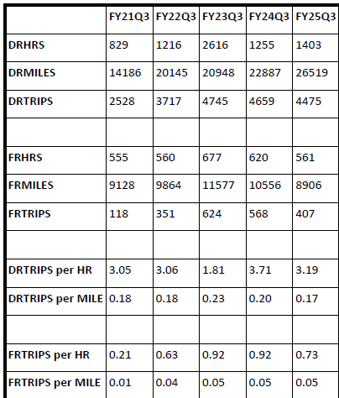
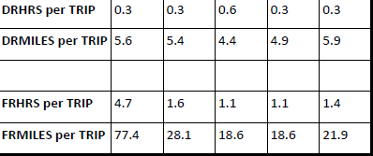

Slide 13
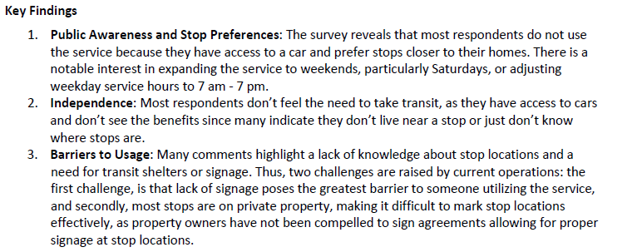
Second Survey Analysis

Slide 14
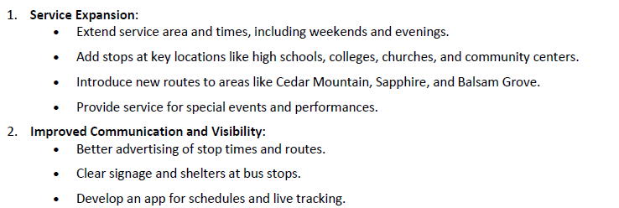
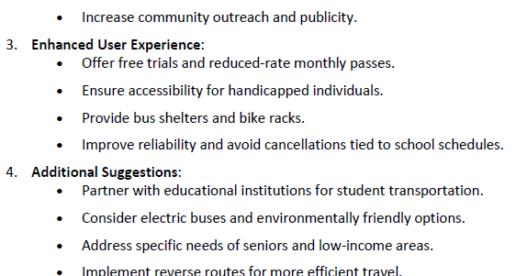
Second Survey Comments Summarized

Slide 15
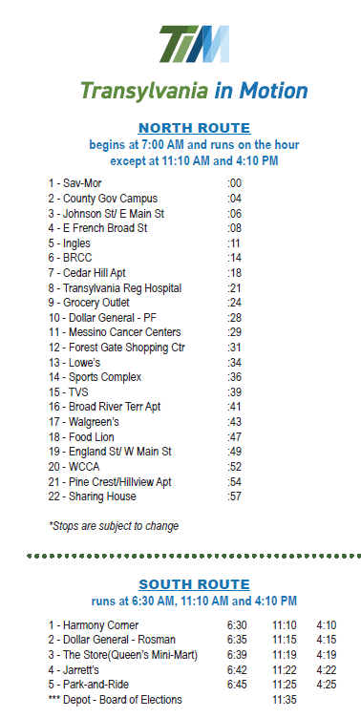
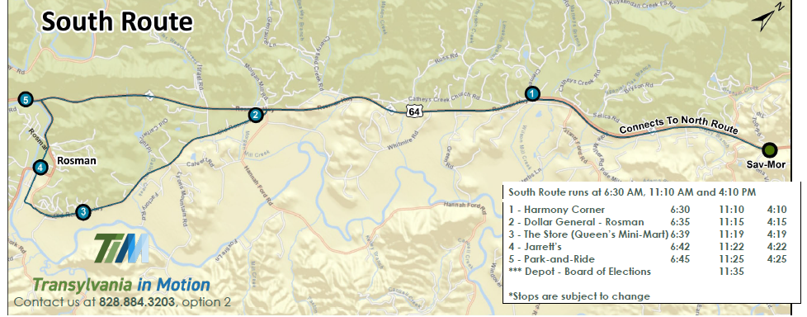

Slide 16
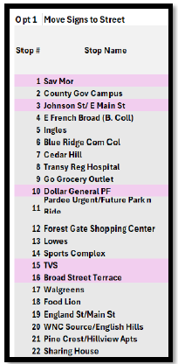
Re-Routing Options

Slide 17
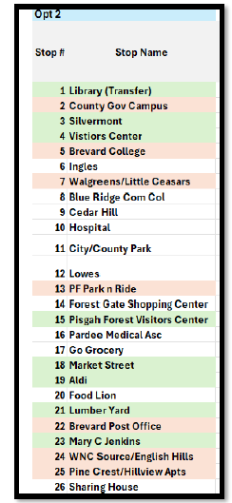
Re-Routing Options

Slide 18
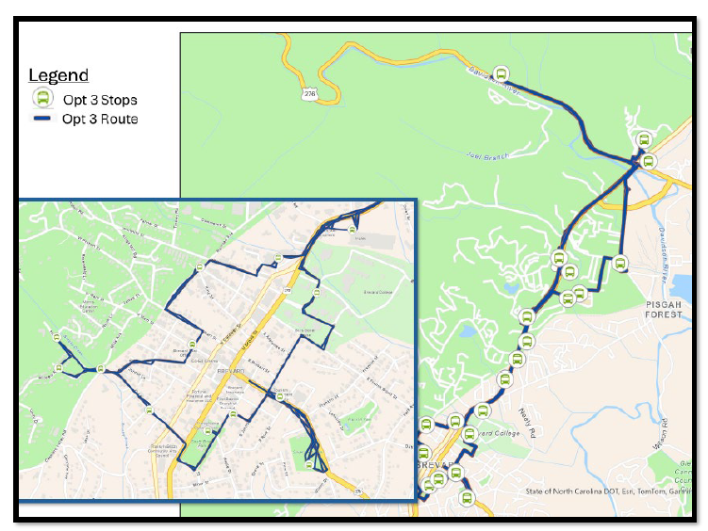

Slide 19
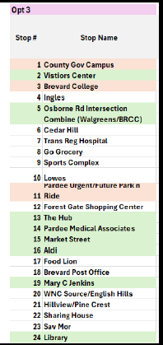
Re-Routing Options

Slide 20
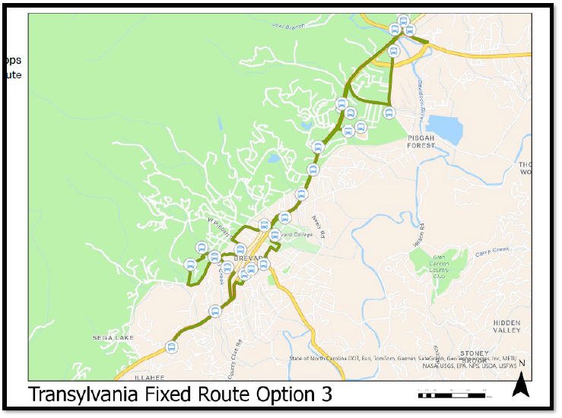

Slide 21
VI-C. Land of Sky RPO Update
Vicki Eastland

Slide 22
IV-D. Transportation Updates
Silver Squirrel Update

Slide 23
VI. Public Comment
15-Minute Time limit (speakers are held to three minutes)

Slide 24
VII. Board Members Comments

Slide 25
Thank you for attending
Next TAB meeting will be on August 16, 2025, in the Large DSS Conference Room, 2nd Floor.

