Slide 1
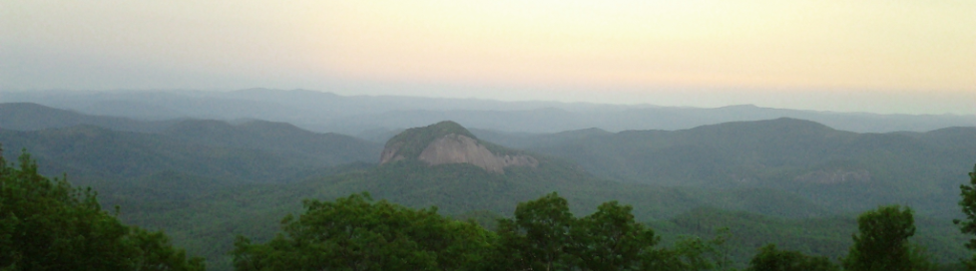

Transylvania County
Planning Board Meeting | April 2025

Slide 2
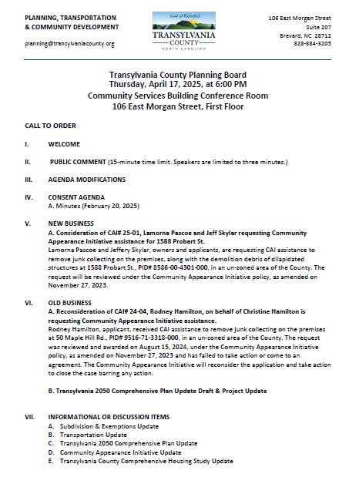
Transylvania County Planning Board

Slide 3
Public Comment

Slide 4
Agenda Modifications

Slide 5
Consent Agenda

Slide 6
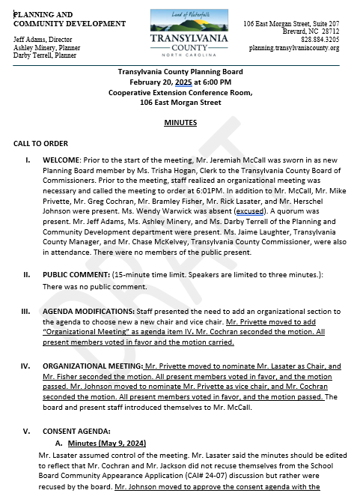
Minutes
February 20, 2025
Consent Agenda

Slide 7
New Business

Slide 8
A. CAI# 25-01, Pascoe & Skylar
1588 Probart St.

Slide 9
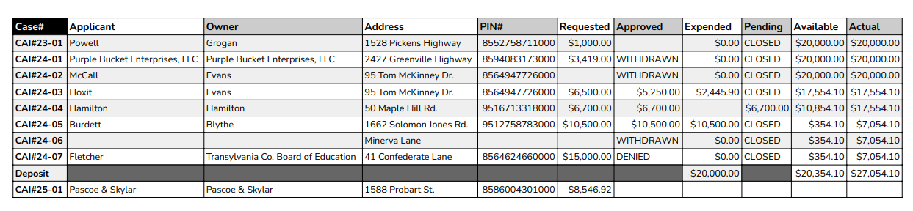
CAI BUDGET
CAI Update

Slide 10
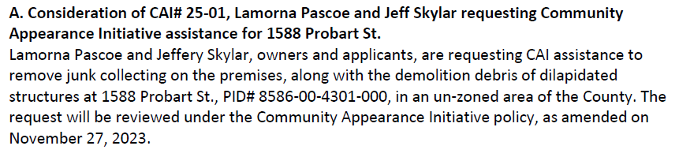
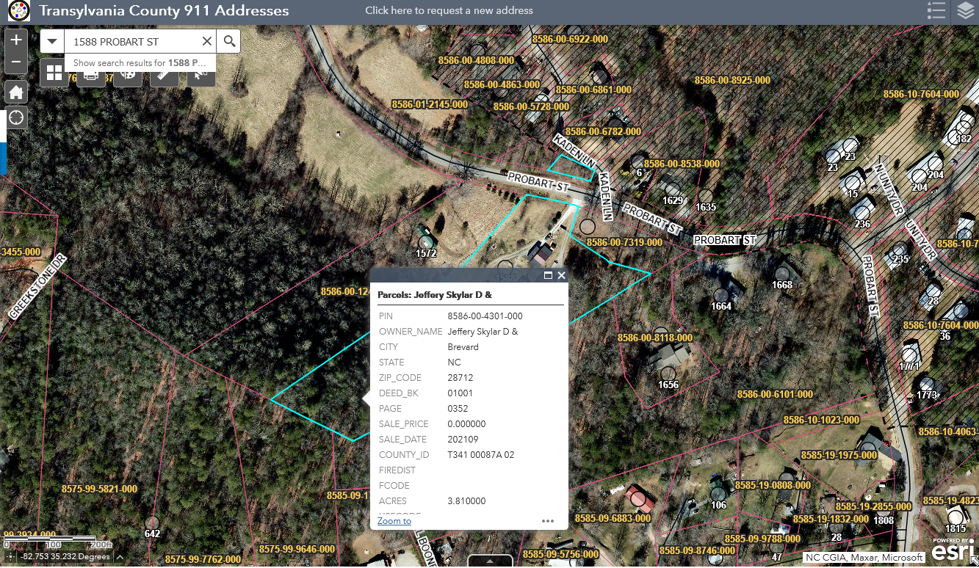
Staff Report
CAI# 25-01 Pascoe & Skylar

Slide 11
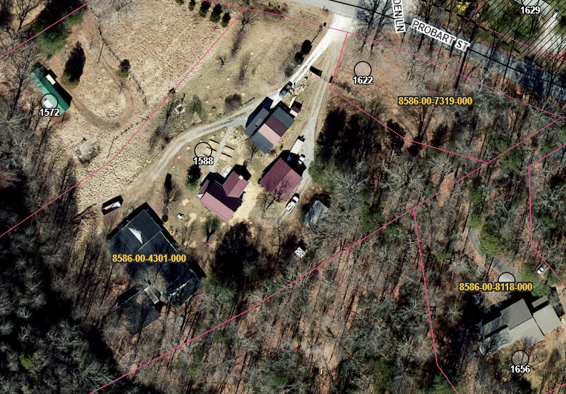
Staff Report
CAI# 25-01 Pascoe & Skylar

Slide 12
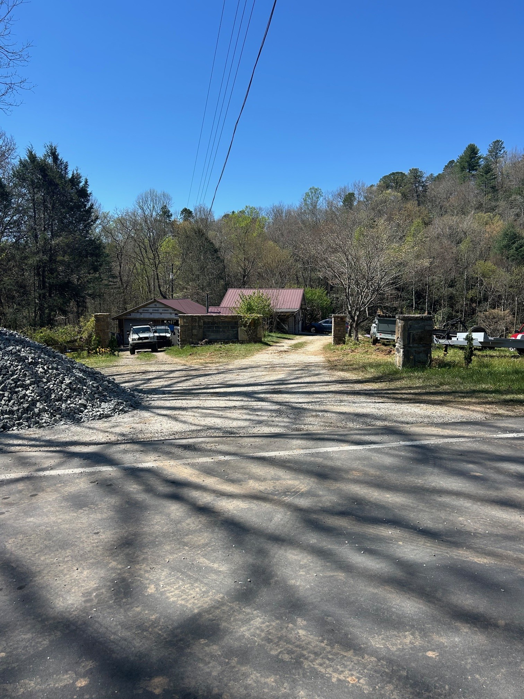
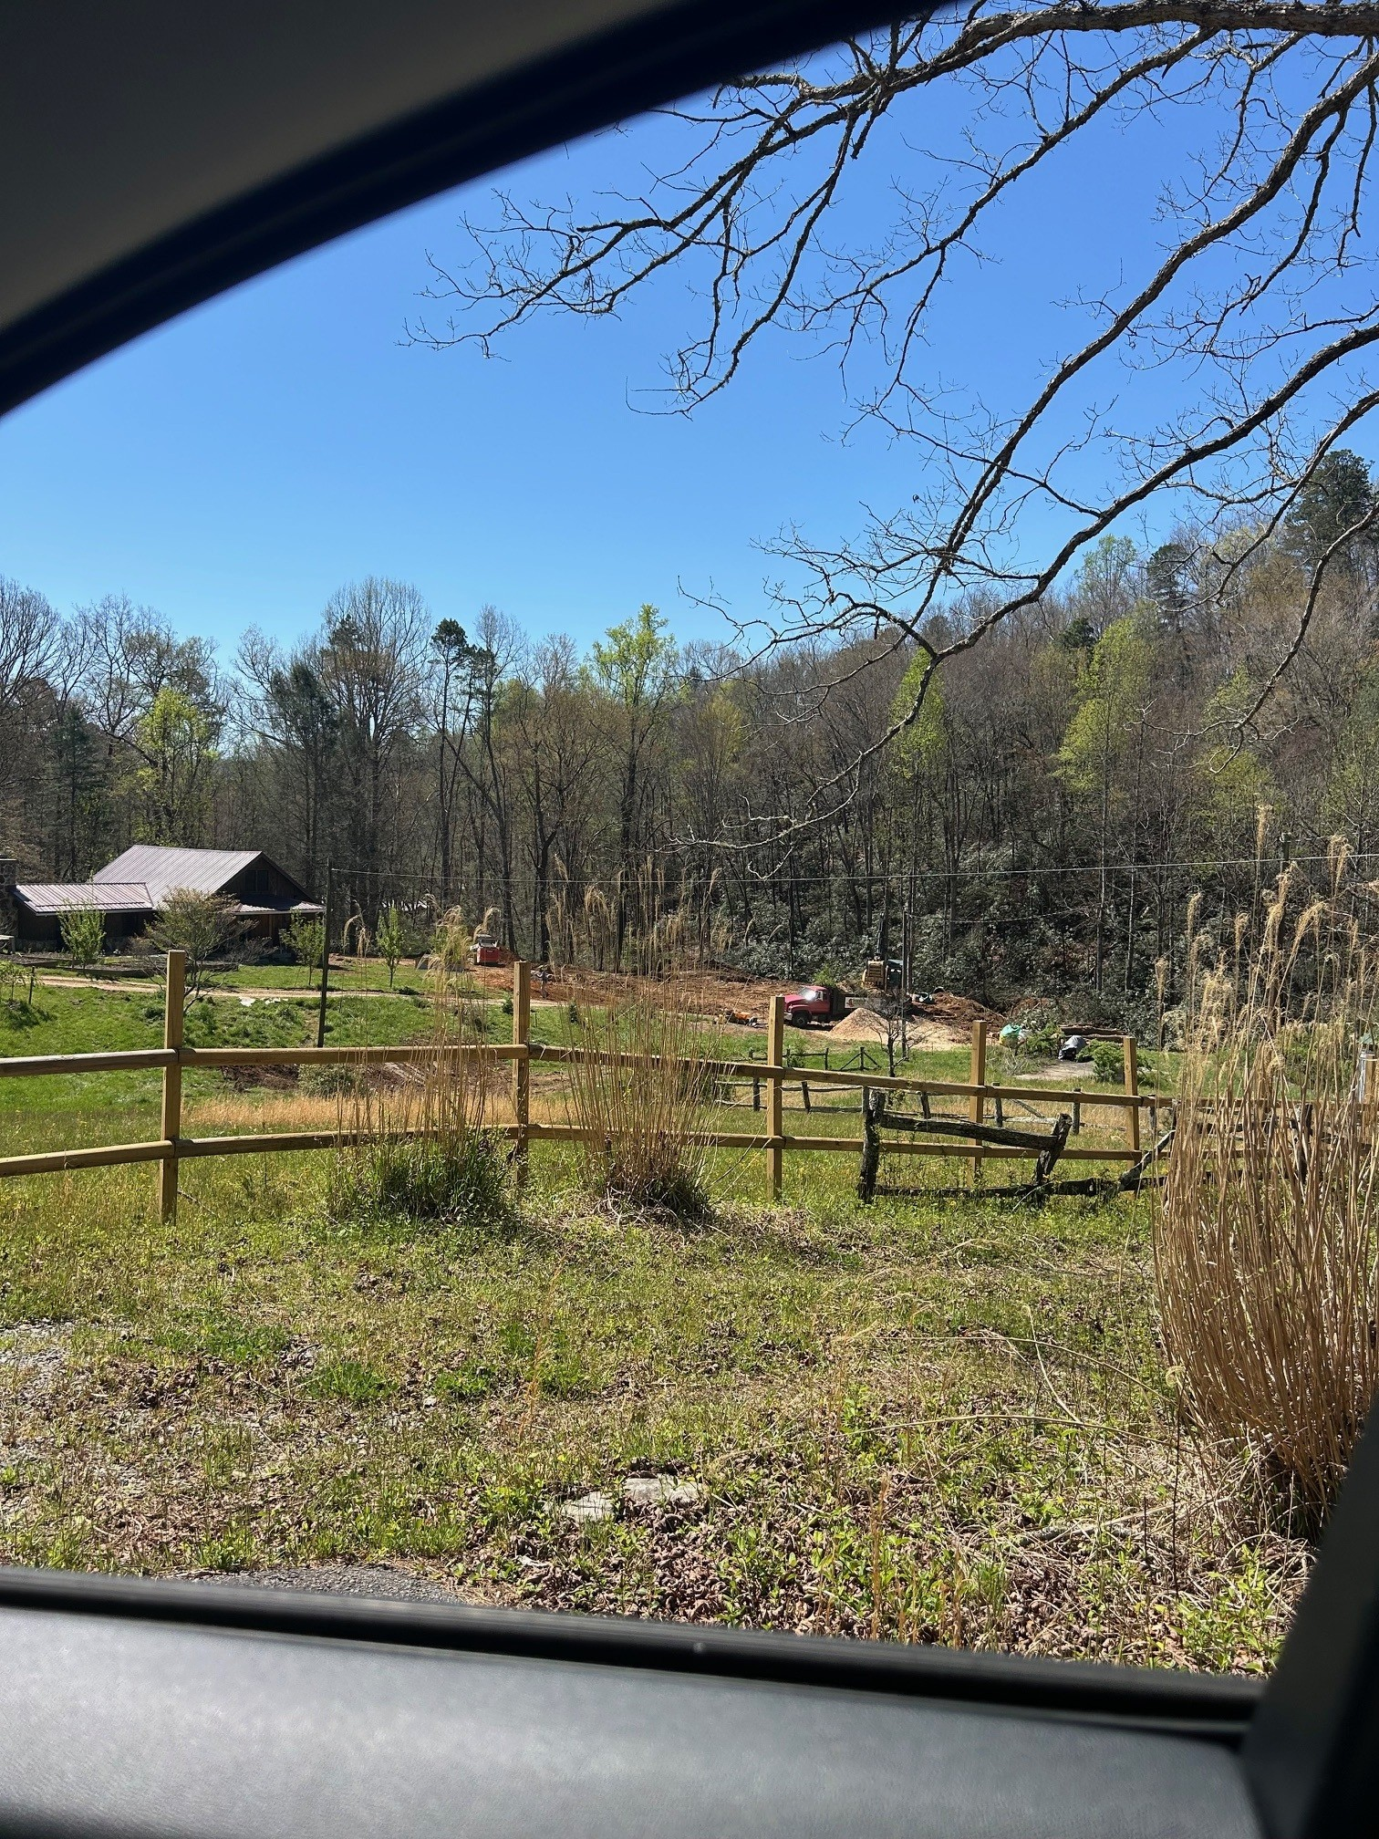
Staff Report
CAI# 25-01 Pascoe & Skylar

Slide 13
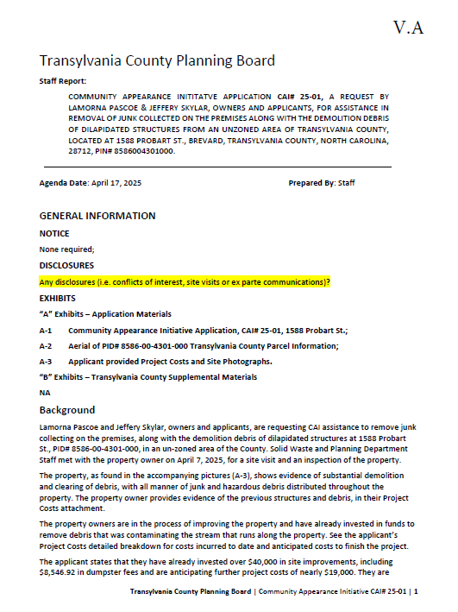
Staff Report
Background
1588 Probart St.
.48 Acre Property
Visible from Probart St. (SR-1348)
April 7th, Site Visit
Demolished structures, embedded trashed and junk collected, possible hazardous materials
Applicant has invested over $40,000 in site clean-up
Projected costs, additional $19,000
Including over $8,000 in dumpster fees
CAI# 25-01 Pascoe & Skylar

Slide 14
Staff Report
CAI# 25-01 Pascoe & Skylar

Slide 15
Staff Report
CAI# 25-01 Pascoe & Skylar

Slide 16
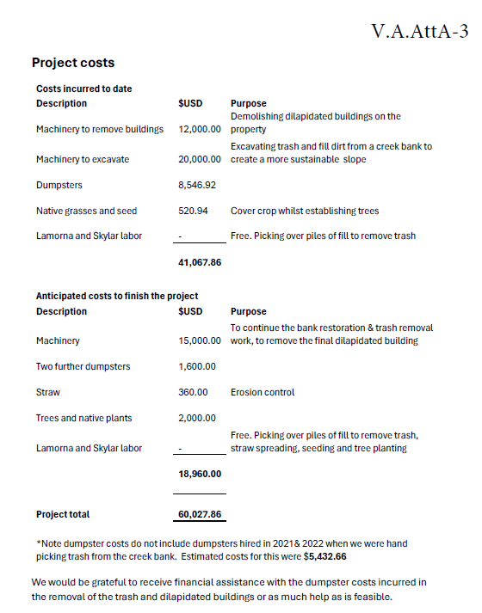
Staff Report
CAI# 25-01 Pascoe & Skylar

Slide 17
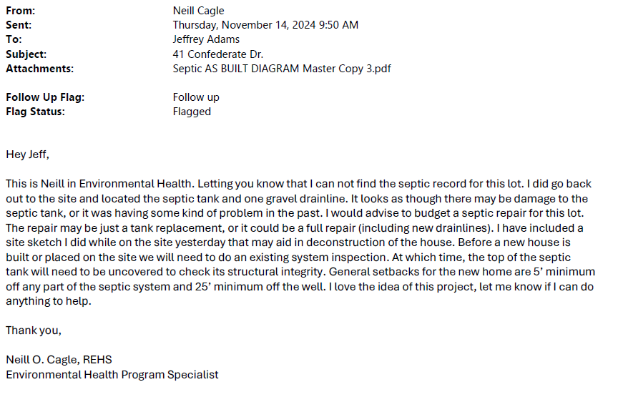
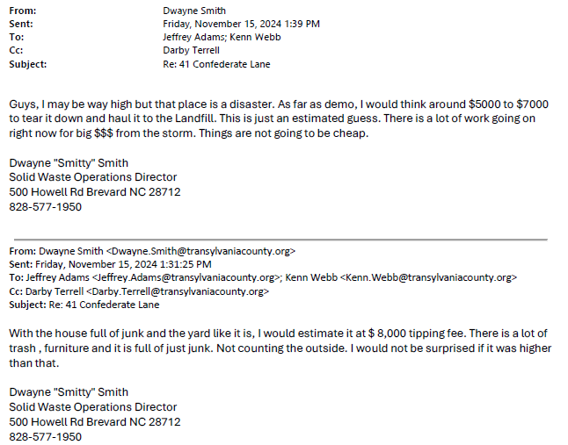
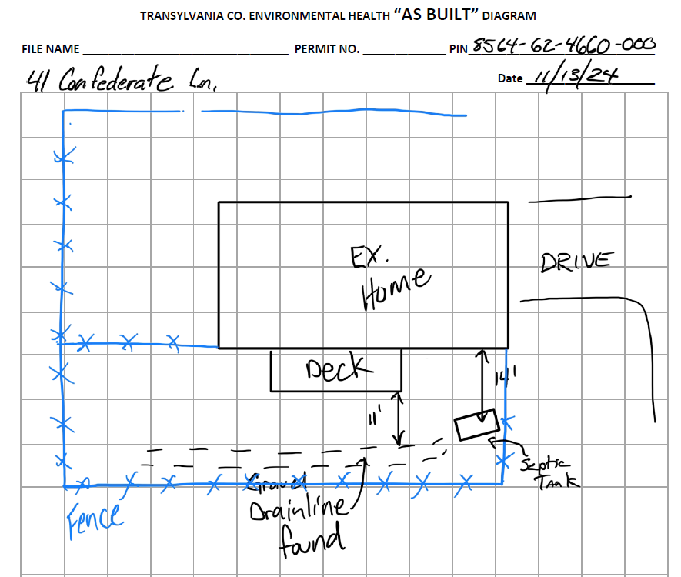
Staff Report
CAI# 24-07 Fletcher

Slide 18
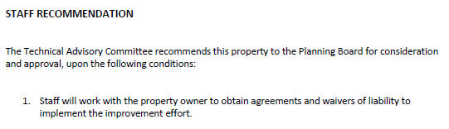
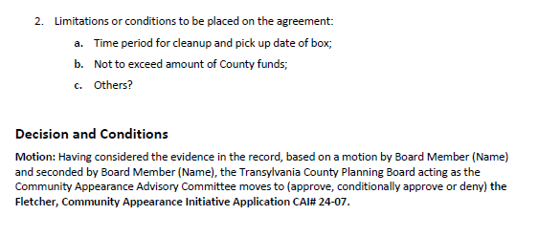
Staff Report
TABLED
CAI# 24-07 Fletcher

Slide 19
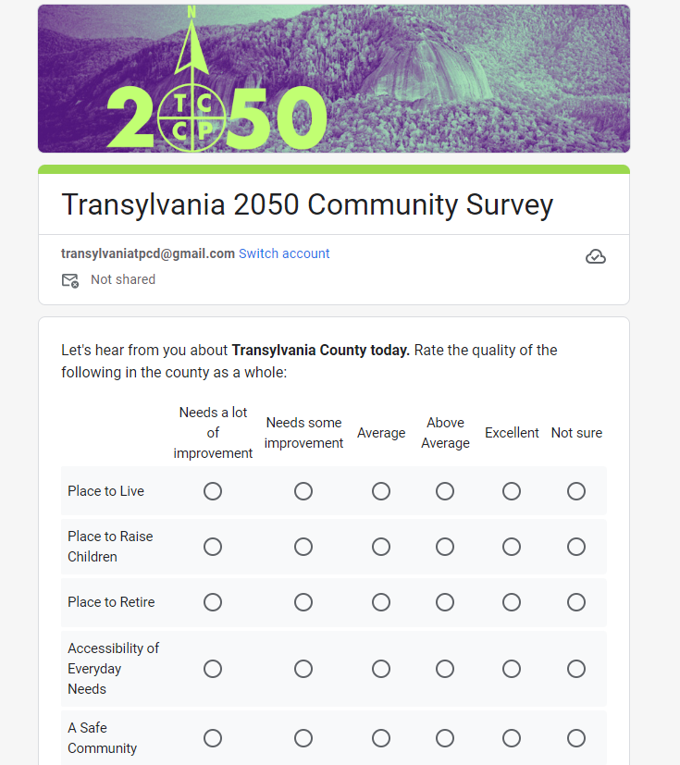

DRAFT
Comprehensive Plan: Survey

Slide 20
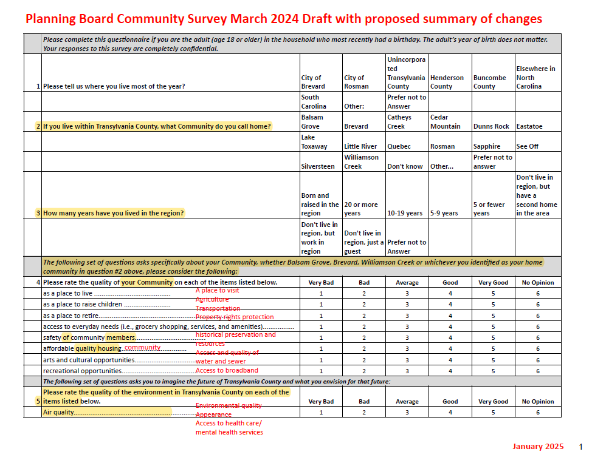
Comprehensive Plan: Survey

Slide 21
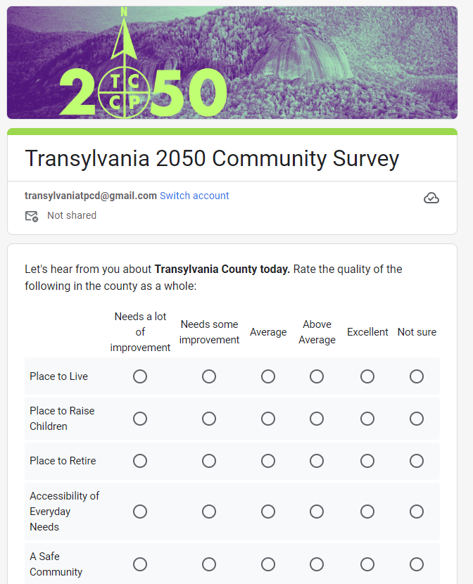
Shortened to six questions
48 responses requested
One qualitative assessment
One focused on transportation
One on participation
One on accessing information
One focusing on the future 2050
One on vision for 2050
With seven demographic questions
Draft Community Survey

Slide 22
Old Business

Slide 23
A. Reconsideration of Hamilton CAI# 24-04

Slide 24

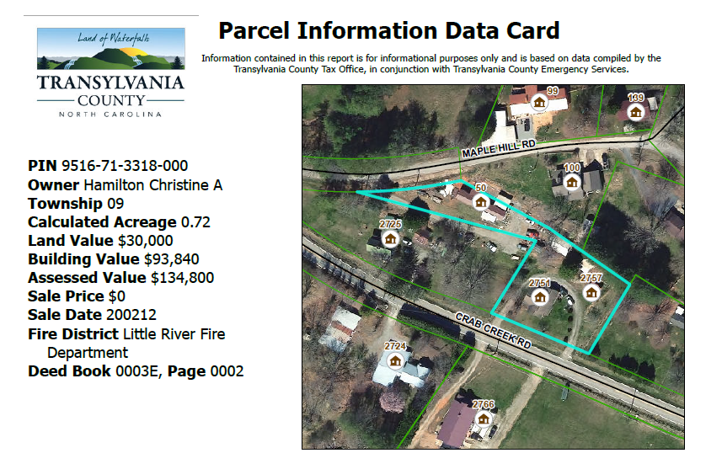
Staff Report
CAI# 24-04 Hamilton

Slide 25
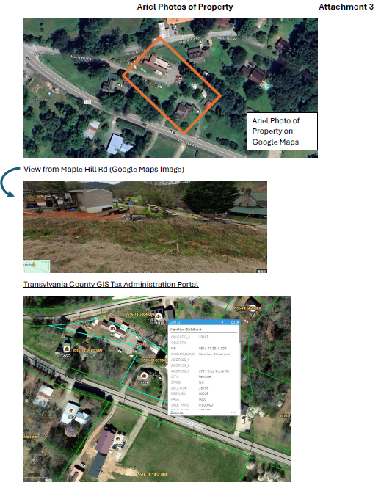
Staff Report
CAI# 24-04 Hamilton

Slide 26
Staff Report
CAI# 24-04 Hamilton

Slide 27
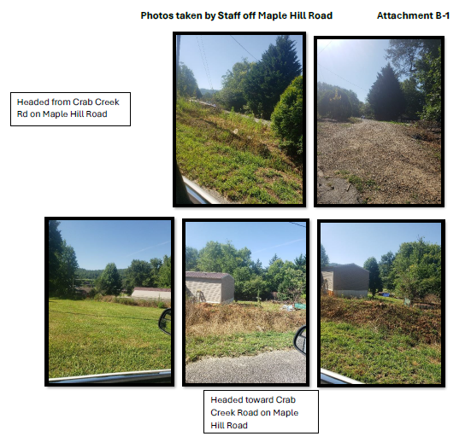
Staff Report
CAI# 24-04 Hamilton

Slide 28
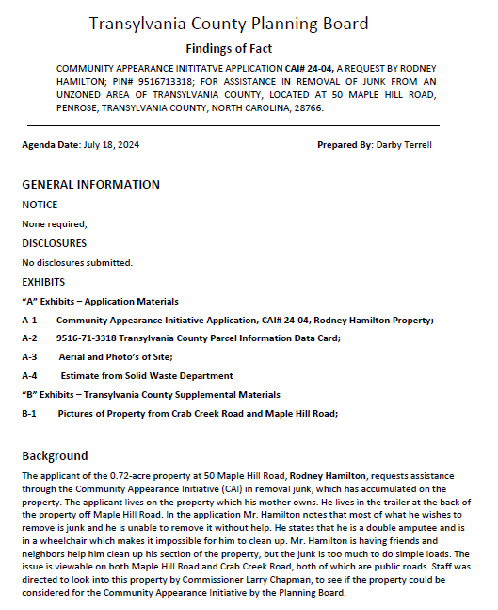
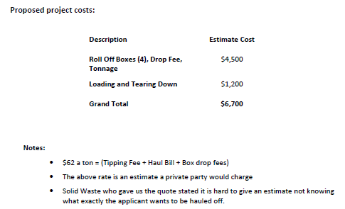
FINDINGS:
CAI# 24-04 Hamilton

Slide 29


FINDINGS:
CAI# 24-04 Hamilton

Slide 30

B. 2050 Comprehensive Plan Update
DRAFT Community Survey

Slide 31

Comprehensive Plan: Survey

Slide 32
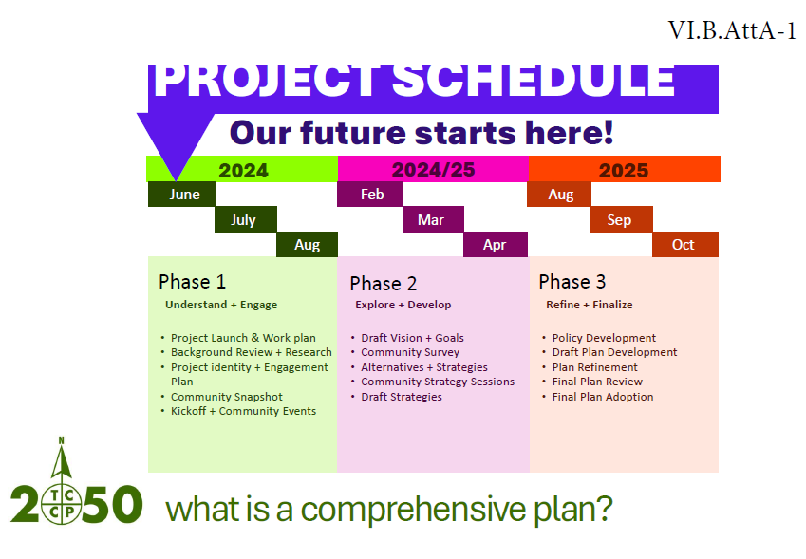
Comprehensive Plan: Project Schedule

Slide 33
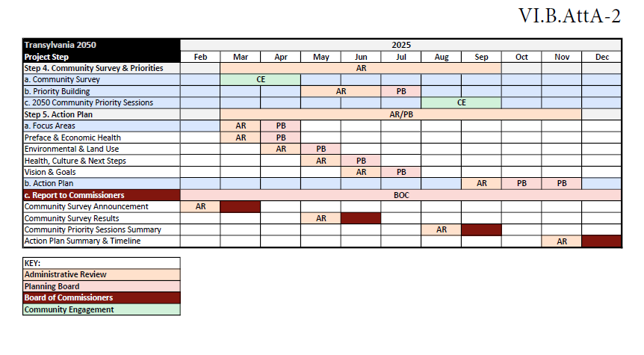
Comprehensive Plan: Project Schedule

Slide 34
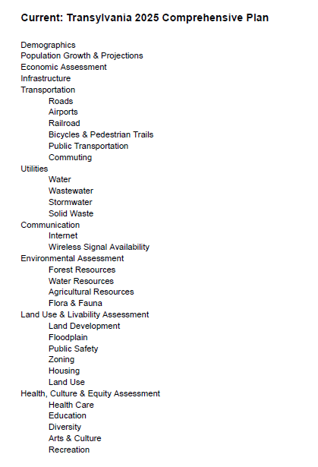
Comprehensive Plan: DRAFT Outline

Slide 35
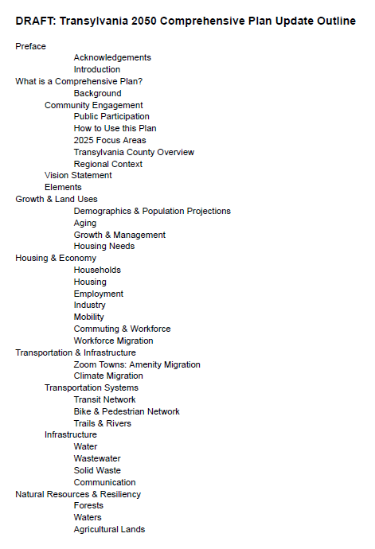
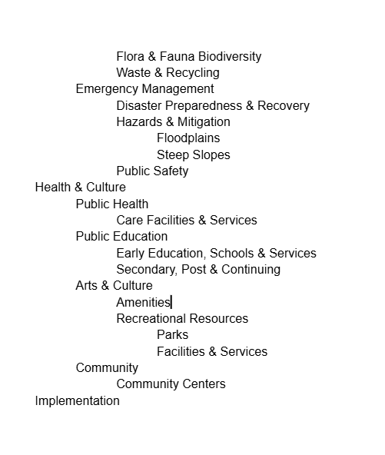
Comprehensive Plan: DRAFT Outline

Slide 36

Vision: Ideal Aspirations of Community
Vision
Goals: Desired Outcomes of each Element
Report
Goals
Policies: Commitment & Direction for Achieving Goals
Actions: Specific Implementable & Assignable Tasks
Actions
Report: Annual Feedback Mechanism & Metrics
Policies
Comprehensive Plan: Vision & Goals

Slide 37
Vision: Ideal Aspirations of Community
Vision: Through community engagement including both a dedicated advisory committee and broad public input opportunities, the planning team crafted a vision for the BLANK County community. This vision is documented through the needs, opportunities, and goals in this plan.
Vision Statement: BLANK County honors its culture, its environment, and its communities, providing opportunities for
its citizens to engage in efforts to create a sustainable County. BLANK County respects its heritage and natural resources
while providing economic opportunities and quality housing for all its citizens. With an efficient government, BLANK County
plans for and develops community facilities and infrastructure to meet the needs of its diverse population and businesses, as well as visitors. With a strong and vital economy, BLANK County offers services and employment opportunities that enable all citizens to live a healthy and productive life.
Vision: A community where innovation and opportunity meet natural beauty and unrivaled quality of life.
Vision: Through leadership and community engagement, BLANK County preserves the county’s natural beauty and cultural resources while developing our built environment to improve the economic, social and cultural conditions of our county.
Vision Themes: Strive to achieve equity; commit to sustainability; achieve livability and affordability; focus on conservation; root efforts in community
Comprehensive Plan: Vision & Goals

Slide 38
ACHIEVE LIVABILITY AND AFFORDABILITY
Residents will have safe, accessible, and affordable housing and multi-modal transportation choices to create a more connected, walkable, healthy community that accommodates the diverse needs of residents. Buncombe County will attract quality jobs that support higher wages and enable livability and affordability.
Vision Themes: Strive to achieve equity; commit to sustainability; achieve livability and affordability; focus on conservation; root efforts in community
STRIVE TO ACHIEVE EQUITY
Buncombe County will strive to address social, economic, and environmental inequities by repairing and investing in historically disadvantaged communities and replacing inequitable land use and transportation policies and regulations.
FOCUS ON CONSERVATION
Natural resources, farms, and rural lands provide picturesque landscapes and water systems; local food systems; healthy water, air, and soil quality; and opportunities for nature and recreation-based economic development. The County will prioritize conservation efforts to protect these land, water, and air resources.
COMMIT TO SUSTAINABILITY
Growth and change in the County will be sustainable and achieve resilience to hazards, conversion to renewable energy systems, protection of natural resources, and support a sustainable local economy in a manner that meets the needs of the present without compromising the ability of future generations to meet their own needs.
ROOT EFFORTS IN COMMUNITY
County decision-making will be rooted in the outcomes of engagement efforts with residents, landowners, and business owners. The County will support opportunities for community interaction and will steward public resources in a fiscally efficient and transparent manner.
Comprehensive Plan: Vision & Goals

Slide 39
Vision: Ideal Aspirations of Community
Vision
2025:
Through leadership and community engagement, Transylvania County preserves the county’s natural beauty and cultural resources while developing our built environment to improve the economic, social and cultural conditions of our county.
Report
Goals
Actions
Policies
Comprehensive Plan: Vision & Goals

Slide 40
Introduction
Community Vision & Goals
Future Land Use
Goals & Policies
Implementation
Comprehensive Plan: Sections

Slide 41
Growth & Land Use
Housing & Economy
Transportation & Infrastructure
Natural Resources & Resiliency
Health & Culture
Comprehensive Plan: Focus Areas or Elements

Slide 42
Informational & Discussion Items

Slide 43
A. Subdivision Approval & Update
Subdivisions & Exemptions Update
Notes:
December 2024- 7 Exemptions and 5 Subdivisions

Slide 44
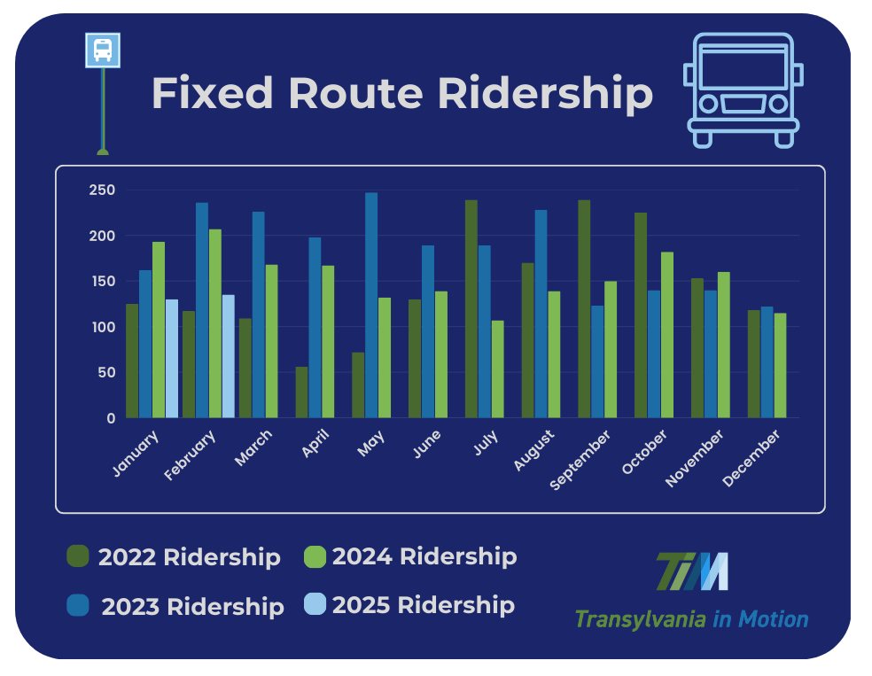
B. Transportation Update
Transportation Update

Slide 45
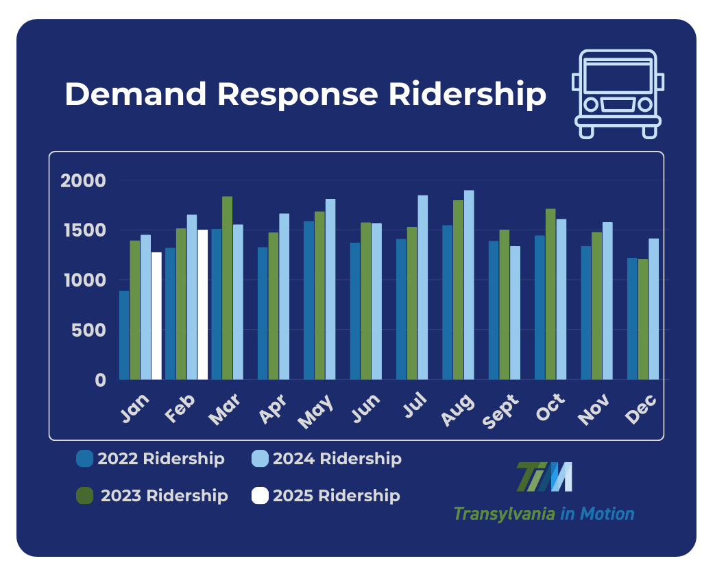
B. Transportation Update
Transportation Update

Slide 46
C. Community Appearance Initiative Update

Slide 47
CAI BUDGET
CAI Update

Slide 48

C. Comprehensive Plan Update

Slide 49
D. Housing Study Update

Slide 50
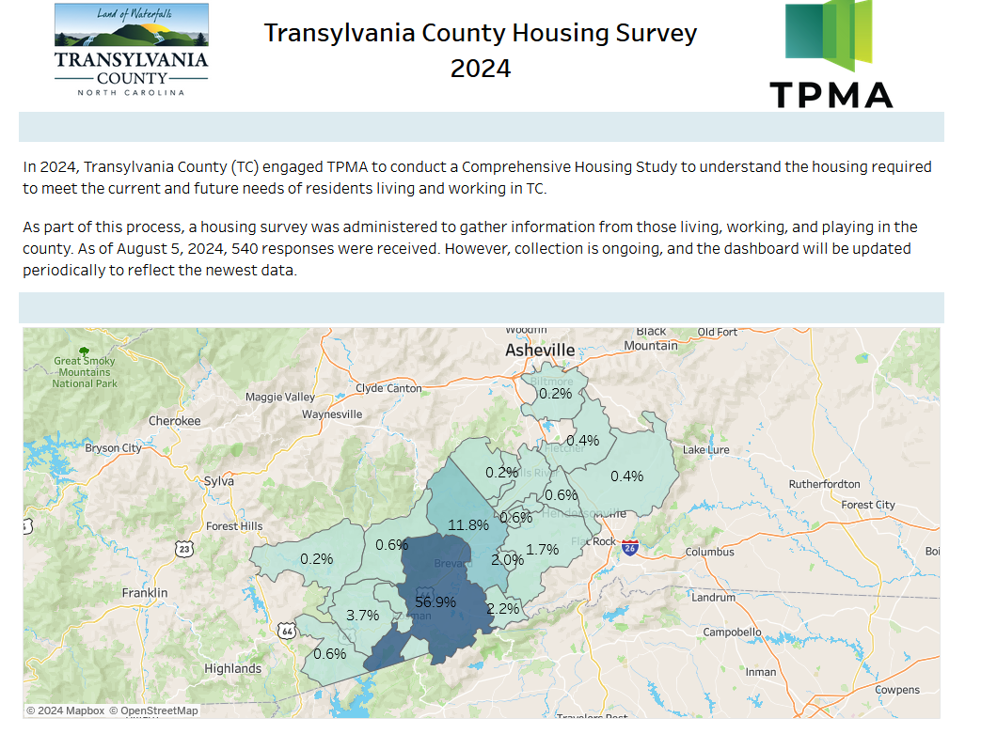
Housing Study Update

Slide 51
Public Comment

Slide 52
Board Members’ Comments

Slide 53

Adjournment

