Slide 1


Transylvania County
Planning Board Meeting | June 2025

Slide 2
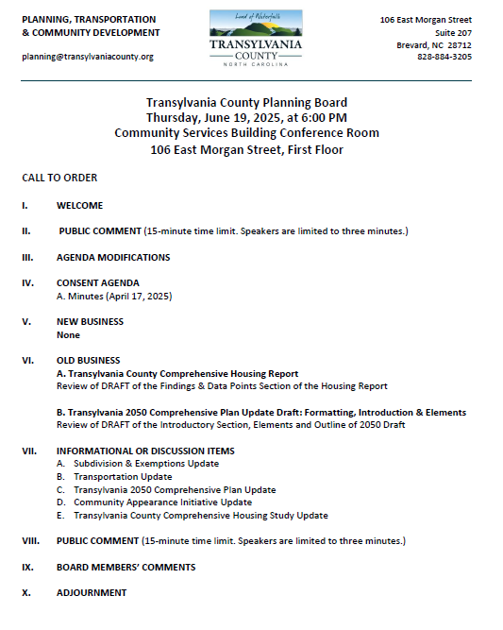
Transylvania County Planning Board Agenda

Slide 3
Public Comment

Slide 4
Agenda Modifications

Slide 5
Consent Agenda

Slide 6
Minutes
April 17th, 2025
Consent Agenda

Slide 7
New Business

Slide 8
A. CAI# 25-01, Pascoe & Skylar
1588 Probart St.

Slide 9
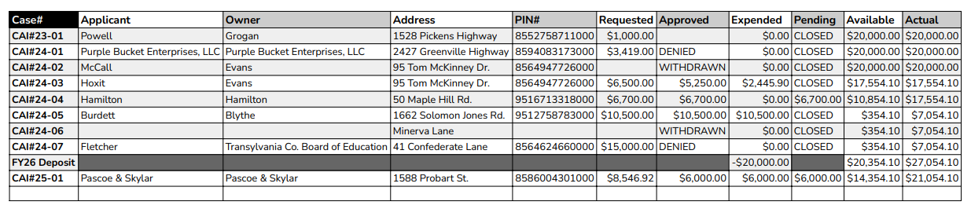
CAI BUDGET
CAI Update

Slide 10
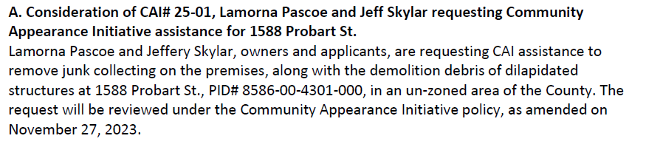
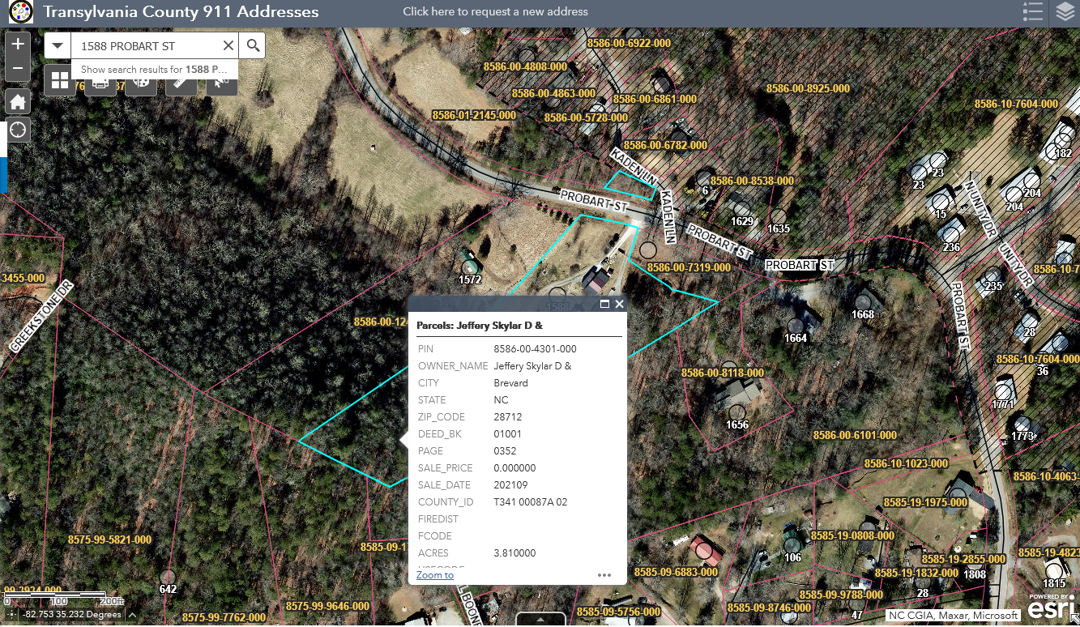
Staff Report
CAI# 25-01 Pascoe & Skylar

Slide 11
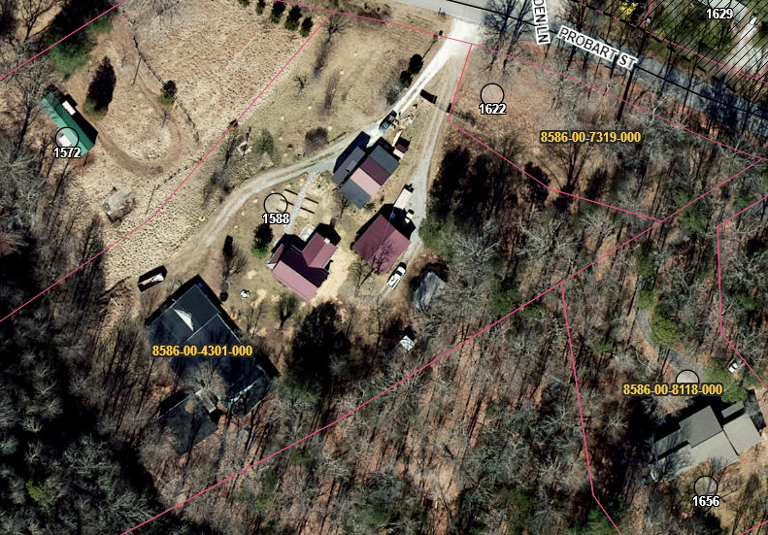
Staff Report
CAI# 25-01 Pascoe & Skylar

Slide 12
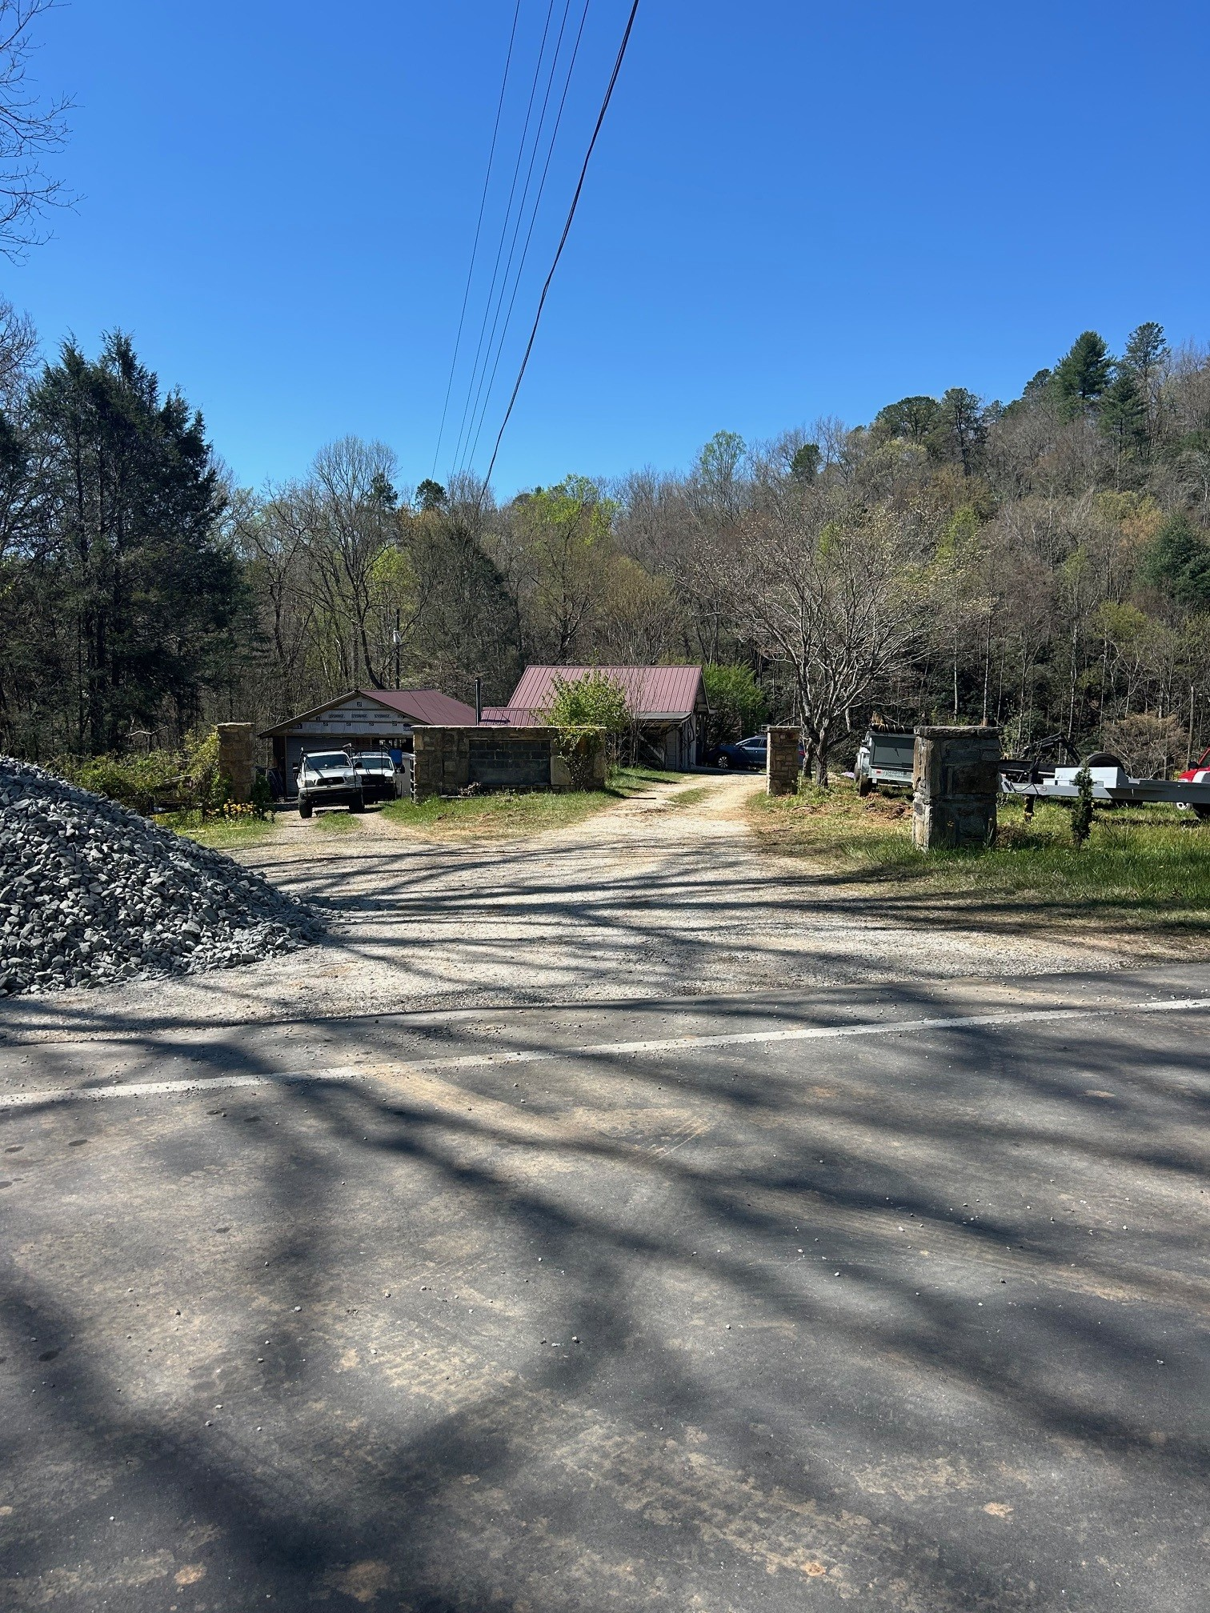
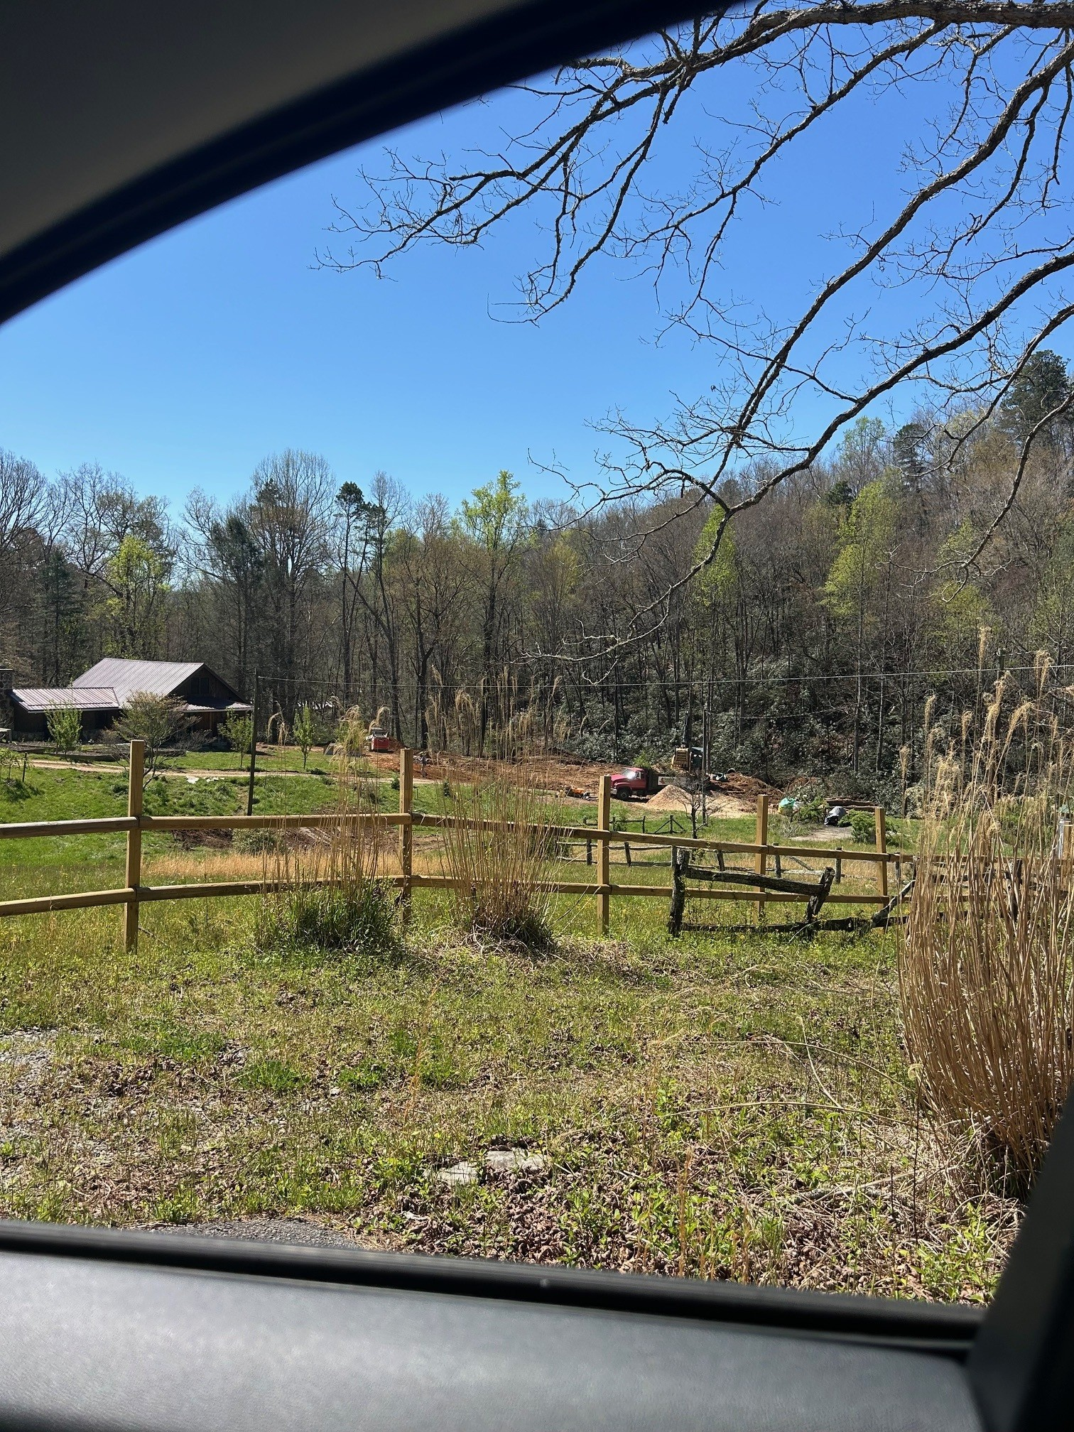
Staff Report
CAI# 25-01 Pascoe & Skylar

Slide 13
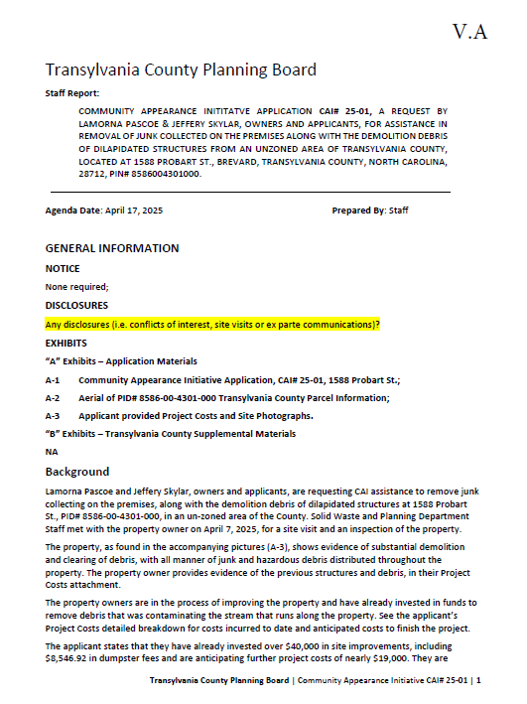
Staff Report
Background
1588 Probart St.
.48 Acre Property
Visible from Probart St. (SR-1348)
April 7th, Site Visit
Demolished structures, embedded trashed and junk collected, possible hazardous materials
Applicant has invested over $40,000 in site clean-up
Projected costs, additional $19,000
Including over $8,000 in dumpster fees
CAI# 25-01 Pascoe & Skylar

Slide 14
Staff Report
CAI# 25-01 Pascoe & Skylar

Slide 15
Staff Report
CAI# 25-01 Pascoe & Skylar

Slide 16
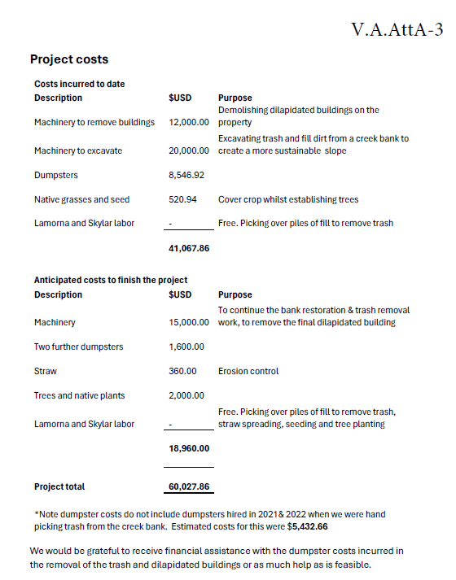
Staff Report
CAI# 25-01 Pascoe & Skylar

Slide 17
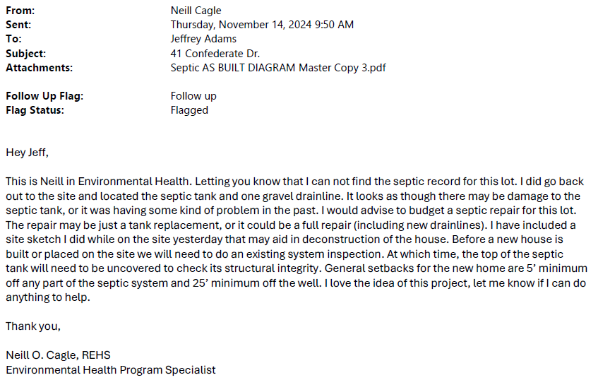
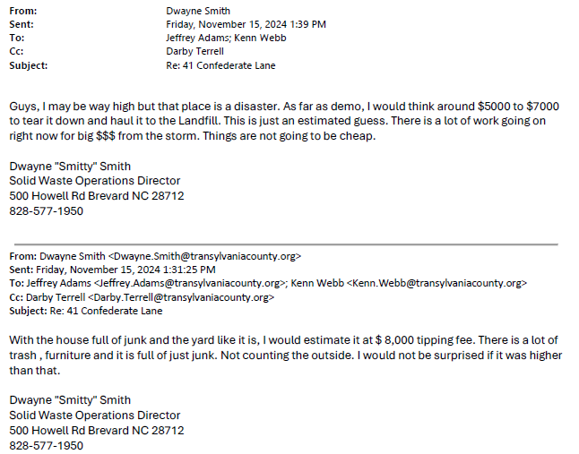
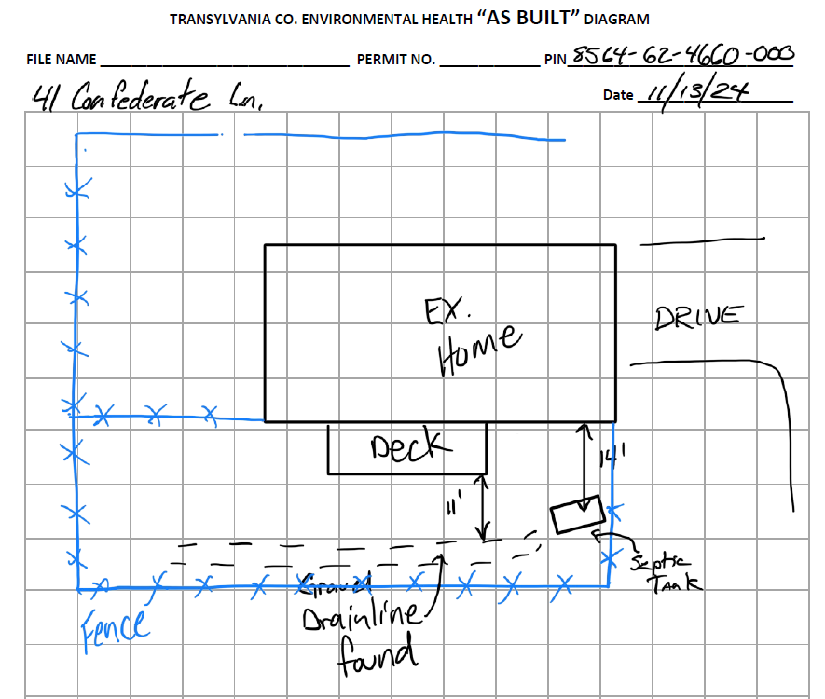
Staff Report
CAI# 24-07 Fletcher

Slide 18
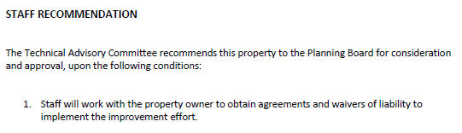
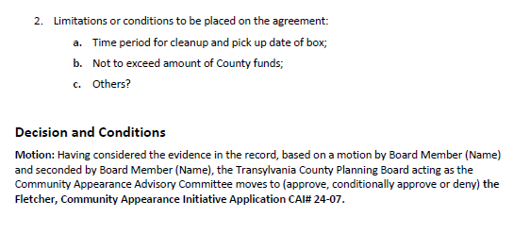
Staff Report
TABLED
CAI# 24-07 Fletcher

Slide 19
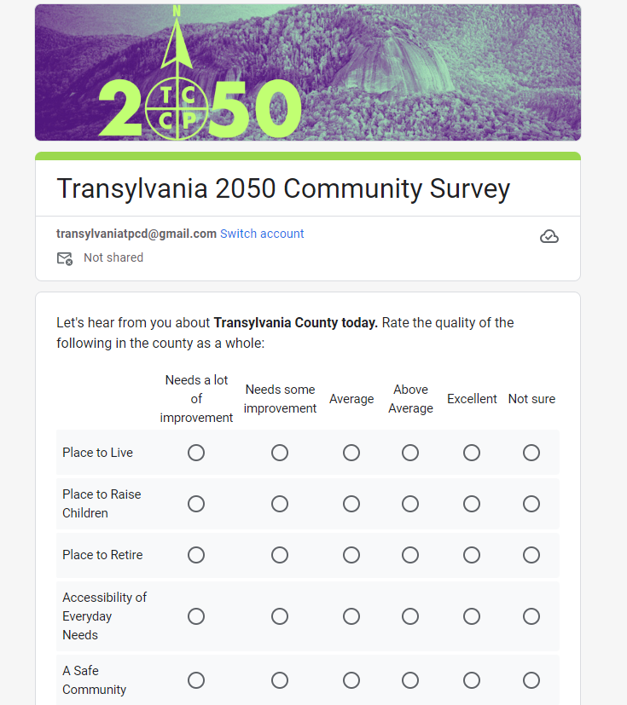

DRAFT
Comprehensive Plan: Survey

Slide 20
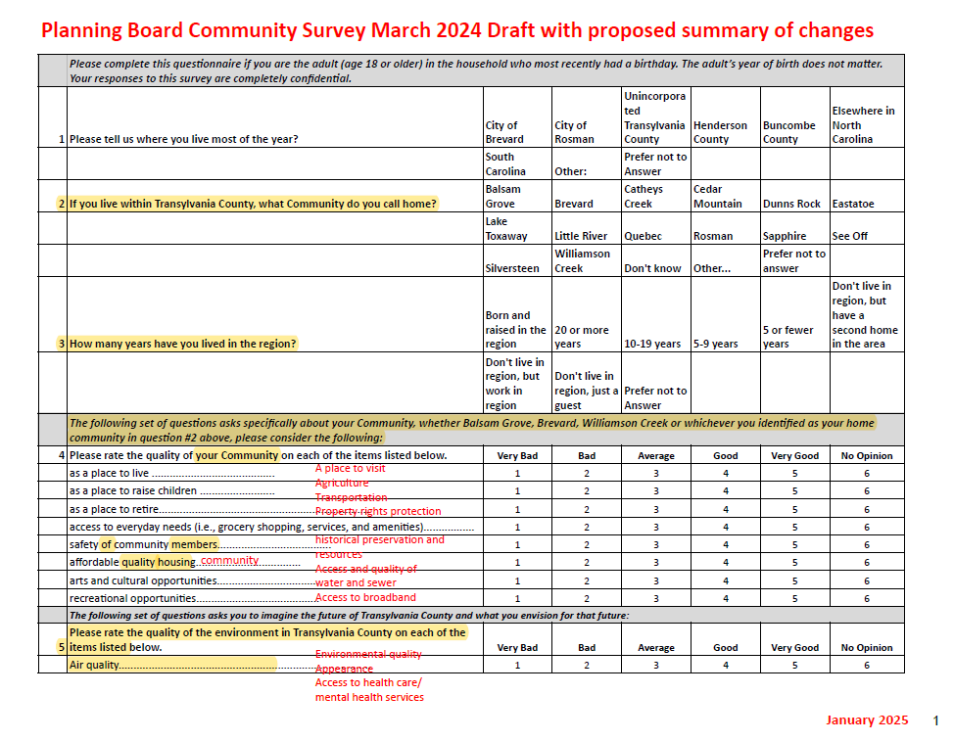
Comprehensive Plan: Survey

Slide 21
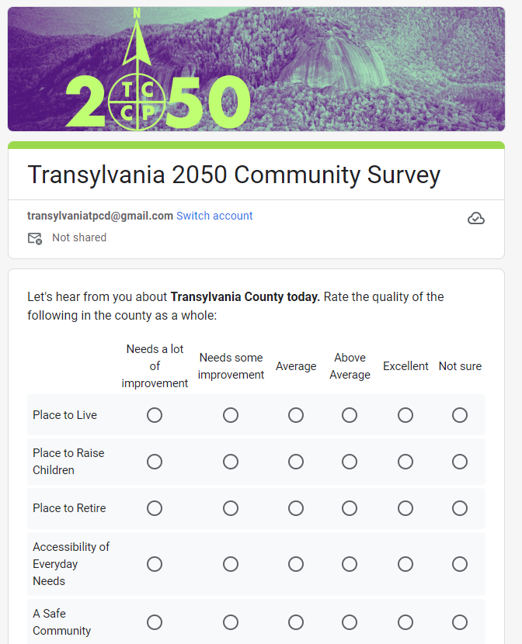
Shortened to six questions
48 responses requested
One qualitative assessment
One focused on transportation
One on participation
One on accessing information
One focusing on the future 2050
One on vision for 2050
With seven demographic questions
Draft Community Survey

Slide 22
Old Business

Slide 23
A. Transylvania County Comprehensive Housing Report: Findings & Data Points

Slide 24

Comprehensive Housing Report

Slide 25
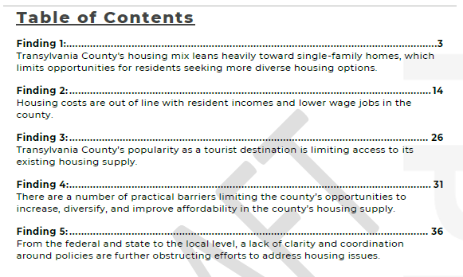
Comprehensive Housing Report

Slide 26

B. Transylvania 2050 Comprehensive Plan Update Draft: Formatting, Introduction & Elements

Slide 27

Comprehensive Plan: DRAFT Outline

Slide 28

Vision: Ideal Aspirations of Community
Vision
Goals: Desired Outcomes of each Element
Report
Goals
Policies: Commitment & Direction for Achieving Goals
Actions: Specific Implementable & Assignable Tasks
Actions
Report: Annual Feedback Mechanism & Metrics
Policies
Comprehensive Plan: Vision & Goals

Slide 29

Comprehensive Plan: Survey

Slide 30
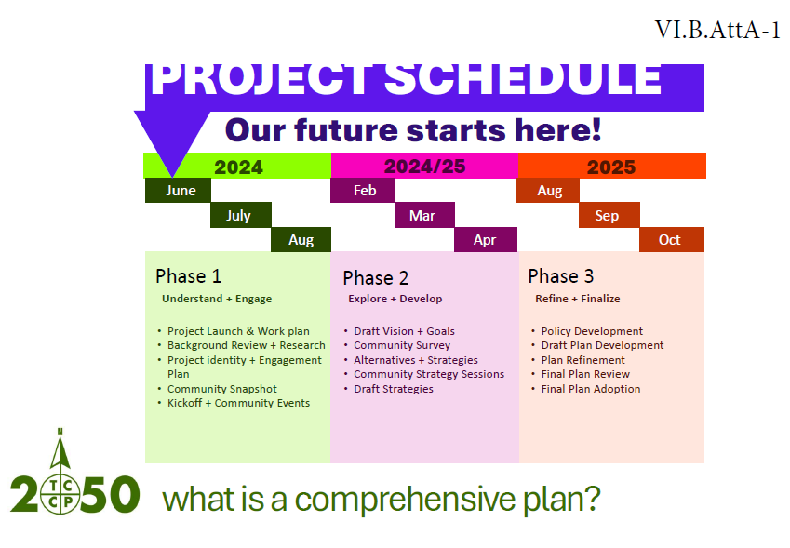
Comprehensive Plan: Project Schedule

Slide 31
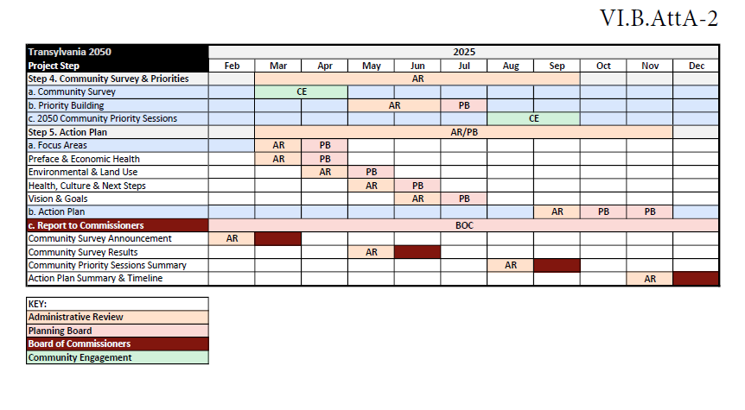
Comprehensive Plan: Project Schedule

Slide 32
Focus Area 1: Economic Health Goal
Transylvania County has a diverse and vibrant economic base that is business-friendly and is supported by exceptional infrastructure.
Focus Area 2: Environmental Health Goal
Transylvania County preserves, conserves, protects, enhances and utilizes its environmental and agricultural resources to provide access for outdoor experiences while increasing recreational and economic development opportunities.
Focus Area 3: Land Use and Livability Goal
Transylvania County recognizes and supports private property rights while actively seeking ways to promote new growth and development through citizen driven policies and procedures that include, but are not limited to, safety, livability, extension of utilities, road improvements and community character.
Focus Area 4: Health, Culture, and Equity Goal
Transylvania County is an inclusive, healthy and well-rounded collection of communities and neighborhoods that all have access to the cultural, recreational, educational and service-oriented resources that support a high quality of life.
Comprehensive Plan: DRAFT Outline

Slide 33
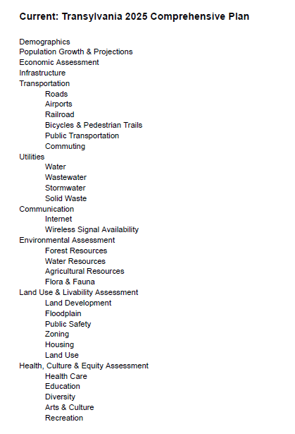
Comprehensive Plan: DRAFT Outline

Slide 34
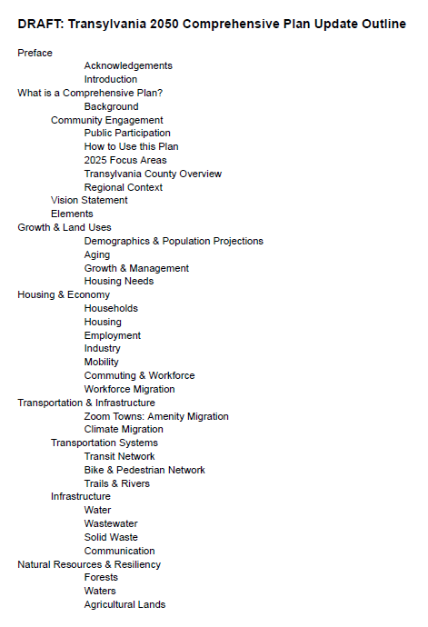
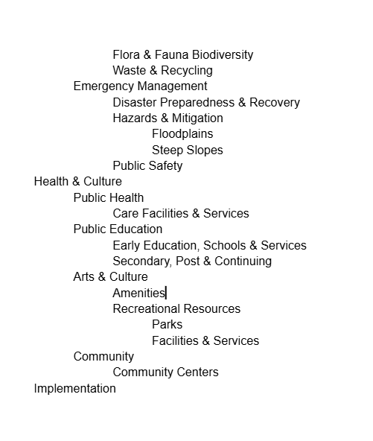
Comprehensive Plan: DRAFT Outline

Slide 35
Introduction
Community Vision & Goals
Future Land Use
Goals & Policies
Implementation
Comprehensive Plan: Sections

Slide 36
Growth & Land Use
Housing & Economy
Transportation & Infrastructure
Natural Resources & Resiliency
Health & Culture
Comprehensive Plan: Focus Areas or Elements

Slide 37
Growth & Land Use
Housing & Economy
Transportation & Infrastructure
Natural Resources & Resiliency
Health & Culture
Implementation
Comprehensive Plan: Focus Areas or Elements

Slide 38
Informational & Discussion Items

Slide 39
A. Subdivision Approval & Update
Subdivisions & Exemptions Update
Notes:
December 2024- 7 Exemptions and 5 Subdivisions

Slide 40
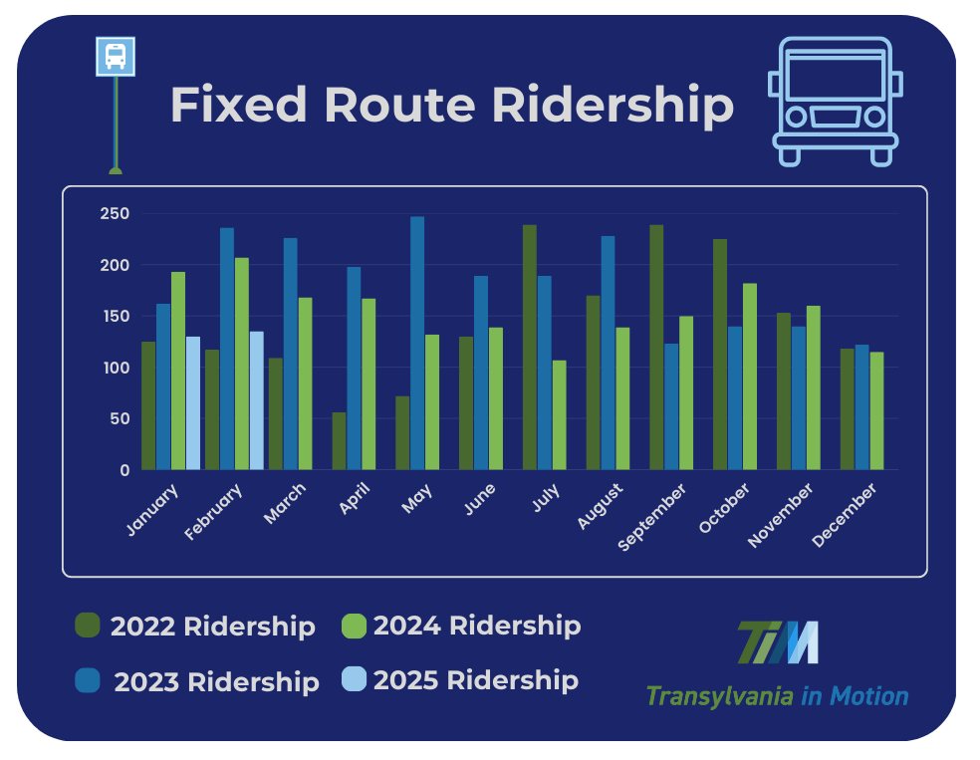
B. Transportation Update
Transportation Update

Slide 41
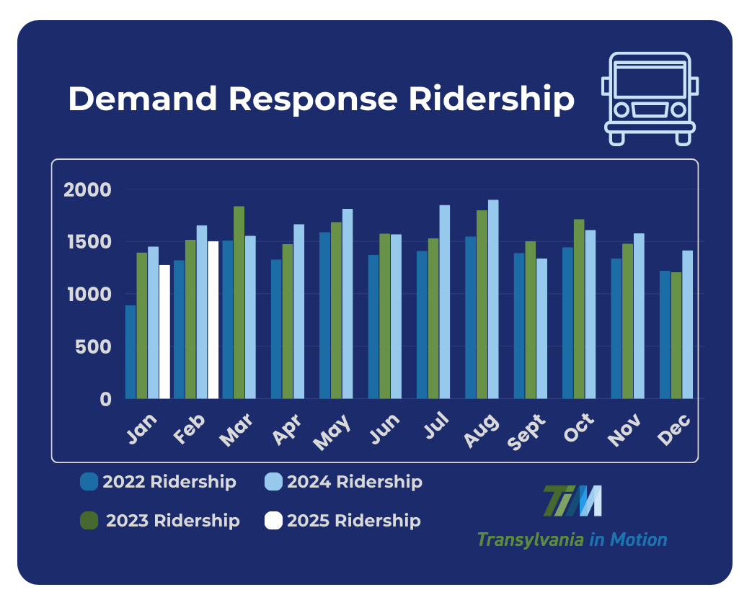
B. Transportation Update
Transportation Update

Slide 42
C. Community Appearance Initiative Update

Slide 43
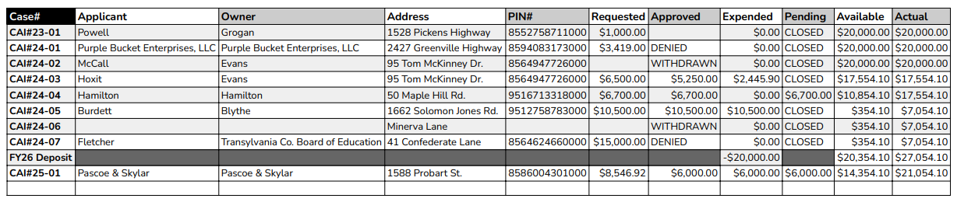
CAI BUDGET
CAI Update

Slide 44

C. Comprehensive Plan Update

Slide 45
D. Housing Study Update

Slide 46
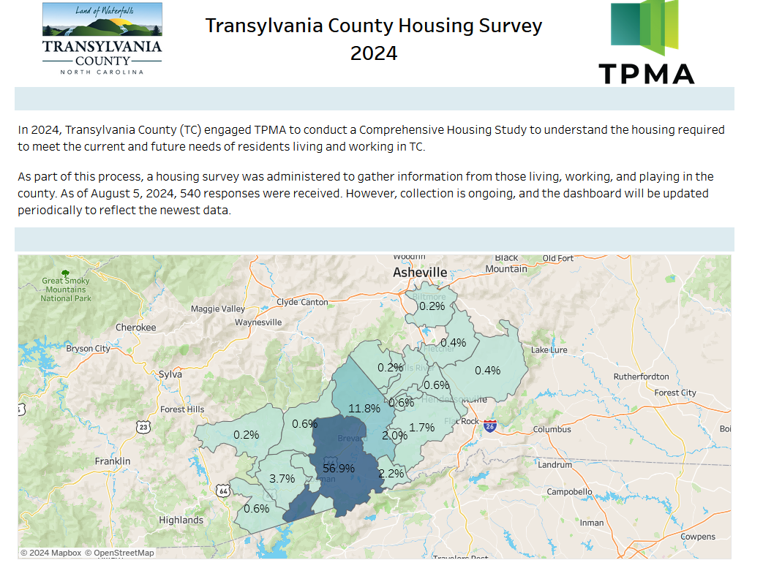
Housing Study Update

Slide 47
Public Comment

Slide 48
Board Members’ Comments

Slide 49

Adjournment

