Slide 1




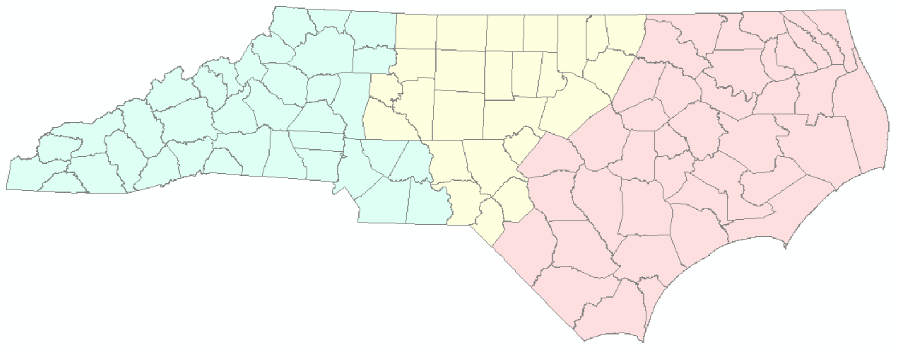



































Roundabouts and Intersection Selection For Safety and Mobility
Copy/paste any of the icons below into your presentation. Please change color to white if using them on a dark background.
Michael P. Reese, PE, CPM
NCDOT Congestion Management Section Western Regional Engineer
Transportation Mobility and Safety Division
Transylvania County TAC Meeting – Brevard, NC
July 11, 2023

Slide 2
ncdot.gov

Slide 3
Other slide variations are available. Select Insert above and choose “new slide” to see all the options.
Roundabout and Intersection Selection-Safety & Mobility
Congestion Management Section
Traffic Management Unit / Transportation Mobility and Safety Division
Mission Statement
Statewide application of cost-effective traffic engineering based operational and safety improvement strategies which mitigate the impacts of traffic congestion, improve system efficiency, enhance traveler safety, and improve economic vitality.
Vision
Optimal system-wide mobility.
Goals
Identify and implement projects that improve travel times
Identify and implement projects that improve travel time reliability
Provide safe and efficient access to people, products and places statewide
Provide superior customer service
Build and share the knowledge base of operational and safety improvement strategies

Slide 4
Intersection Selection
Roundabout and Intersection Selection-Safety & Mobility

Slide 5
Recent NC Safety Statistics
Roundabout and Intersection Selection-Safety & Mobility
ncdot.gov Roundabout and Intersection Selection-Safety & Mobility
Year | Fatalities | Fatalities per 100 mvmt | Fatalities per 100,000 pop.
2017 | 1396 | 1.17 | 13.6
2018 | 1442 | 1.19 | 13.9
2019 | 1470 | 1.20 | 14.0
2020 | 1658 | 1.57 | 15.9
2021 | 1799 | 1.51 | 16.9
2022 | 1772 (prelim) | Not yet | Not yet
Despite NCDOT spending about $4.0 billion per year on highway construction and maintenance
Countries with around 17 fatalities per 100,000 pop. include Uruguay, Algeria, Mozambique, and Russia

Slide 6
ncdot.gov Roundabout and Intersection Selection-Safety & Mobility
USDOT: “More than 50 percent of the combined total of fatal and injury crashes occur at or near intersections.”
https://highways.dot.gov/research/research-programs/safety/intersection-safety
6

Slide 7
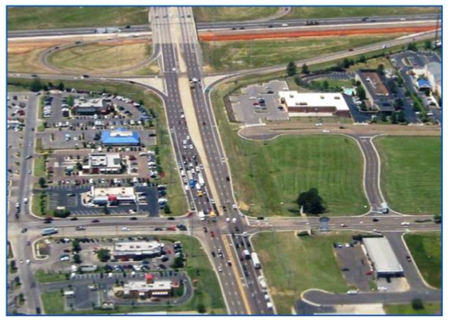
Intersection Basics
Roundabout and Intersection Selection-Safety & Mobility
A point where two or more roadways meet at grade
Can result in multiple traffic flows competing for the same space
Requires traffic controls to assign rights of way
Stop Sign? Yield Sign? Roundabout? Traffic Signal?
7

Slide 8
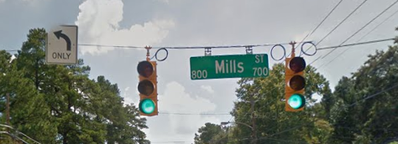
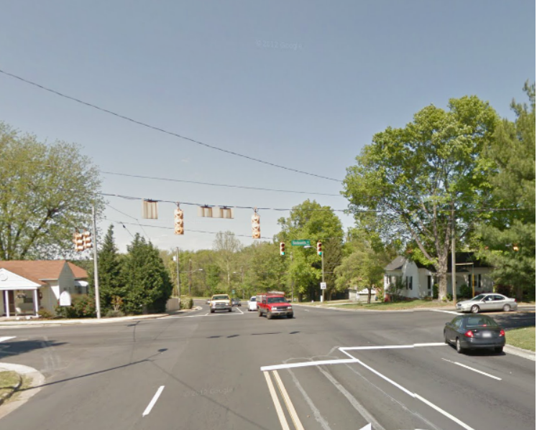
Simple Signal (No Left Arrows)
Roundabout and Intersection Selection-Safety & Mobility
Intersection controlled by a simple traffic signal
Turning movements yield to oncoming traffic (no green arrow signals)
Works where warranted and left- turn volumes are relatively light
Raleigh, NC
8

Slide 9
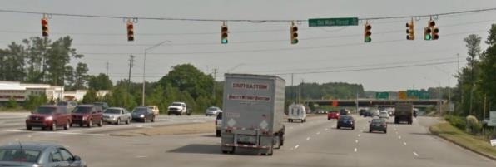
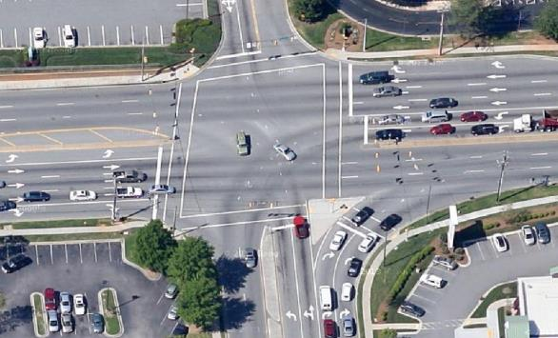
Complex Signal (All Left Arrows)
Roundabout and Intersection Selection-Safety & Mobility
Typically found at higher volume intersections
Multiple turn movements are accommodated with separate signal phases
Can be inherently inefficient resulting in significant delays
Can significantly reduce main street through traffic flow
Difficult for pedestrians and bicycles to cross
Raleigh, NC
9

Slide 10
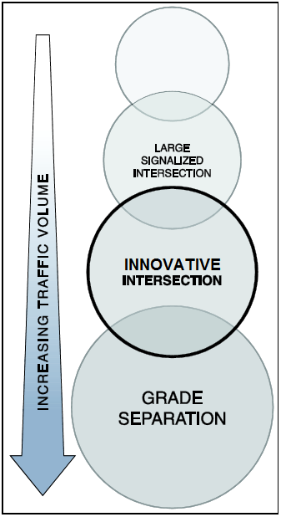
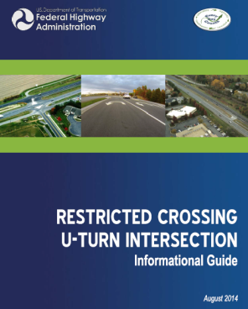
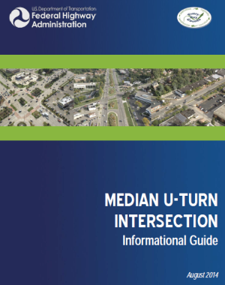
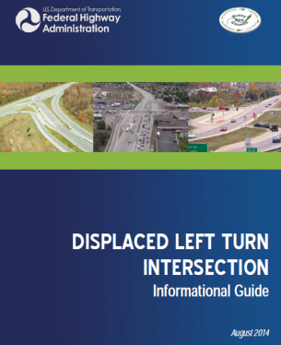
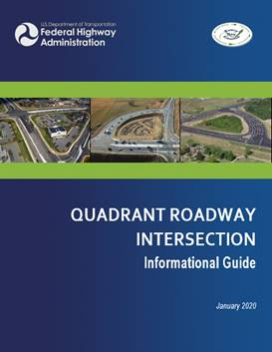

FHWA Everyday Counts Guidance
Site Development and Highway for Practitioners Module 1
Roundabout and Intersection Selection-Safety & Mobility
https://safety.fhwa.dot.gov/intersection/alter_design/

Slide 11
We Can Predict the Safety Performance of Most Designs
ncdot.gov Roundabout and Intersection Selection-Safety & Mobility
Changing from… | Changing to… | Average CMF for all crashes | Average CMF for injury crashes
Two-way stop control (TWSC) | All-way stop control (AWSC) | 0.32 | 0.28
 | Conventional signal | 0.81 | 0.74
 | Mini roundabout | 0.83 | 0.41
 | Full-size one-lane roundabout | 0.51 | 0.16
 | Unsignalized reduced conflict intersection (RCI) | 0.58 | 0.42
 | Right-in-right-out (RIRO) | 0.55 | 0.20
Conventional signal | Full-size one-lane roundabout | 0.74 | 0.45
 | Two-lane roundabout | 0.89 | 0.54
 | Signalized RCI | 0.85 | 0.78
 | Median u-turn (MUT) | 0.63 | 0.77
 | Partial continuous flow int. (CFI) | 0.88 | 0.86
Decades of before-after analyses
Stored in crash modification factor (CMF) Clearinghouse based on national data
  FHWA website
  Quality rated
Also calibrated safety functions
CMF values are expected reductions of crashes compared to a two-way stop or conventional all-movement signal as indicated
  For example, a 0.89 CMF means a predicted 11% reduction of crashes based on statistical data
Source: NCDOT “Selecting Optimum Intersection or Interchange Alternatives” by J. E. Hummer, PhD, PE
https://connect.ncdot.gov/resources/safety/Teppl/Pages/Teppl-Topic.aspx?Topic_List=C62

Slide 12
Roundabout Intersections
Roundabout and Intersection Selection-Safety & Mobility

Slide 13
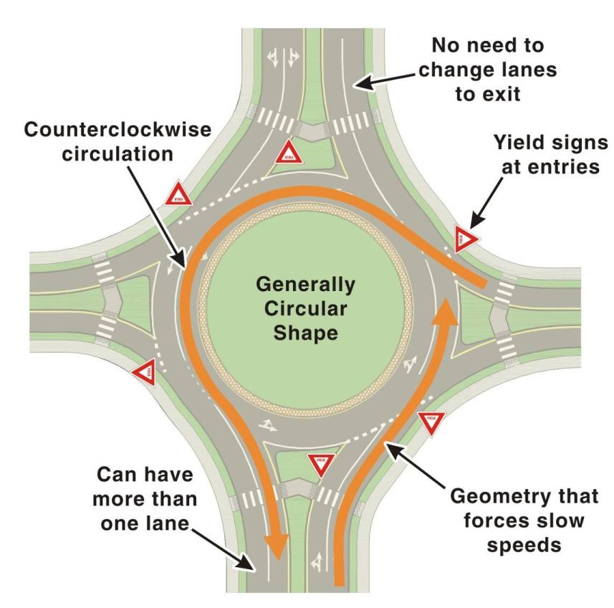
What is a Modern Roundabout?
Roundabout and Intersection Selection-Safety & Mobility
Source: NCHRP Report 672, Exhibit 1-1

Slide 14
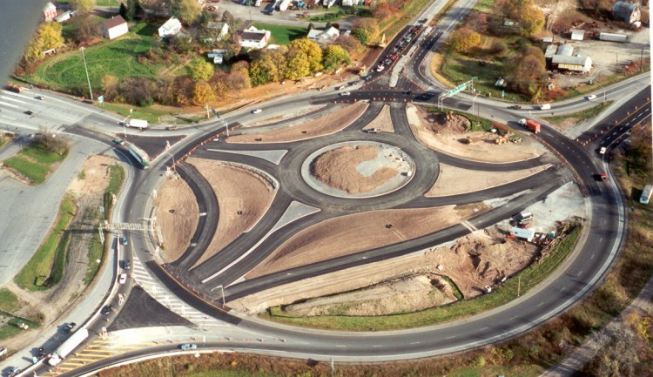
What is not a Modern Roundabout?
Roundabout and Intersection Selection-Safety & Mobility
Neighborhood Traffic Circle
Rotary
Photo: Lee Rodegerdts (left); New York State DOT (right)

Slide 15
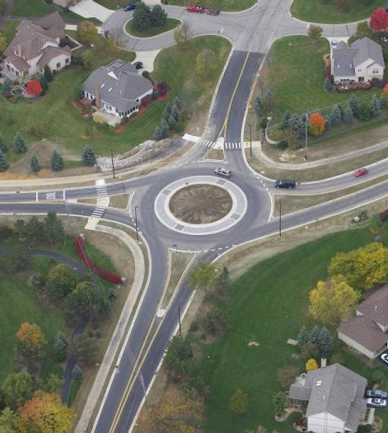
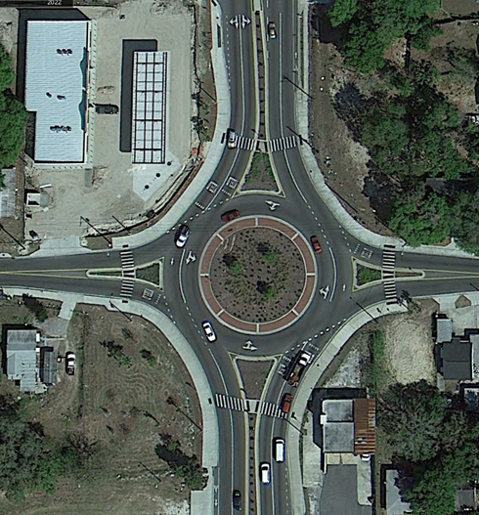
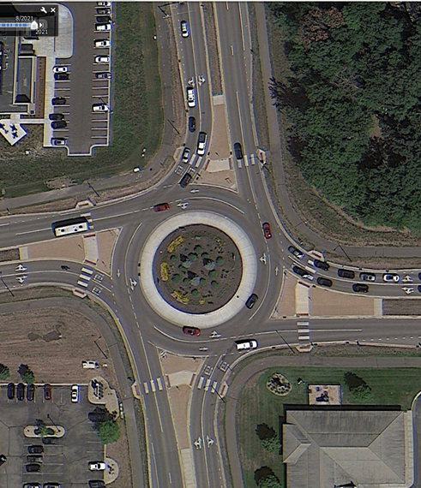
Example Roundabout Configurations
Roundabout and Intersection Selection-Safety & Mobility
Single-Lane
Partial Two-Lane
Two-Lane

Slide 16
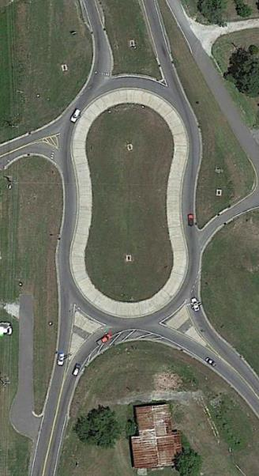
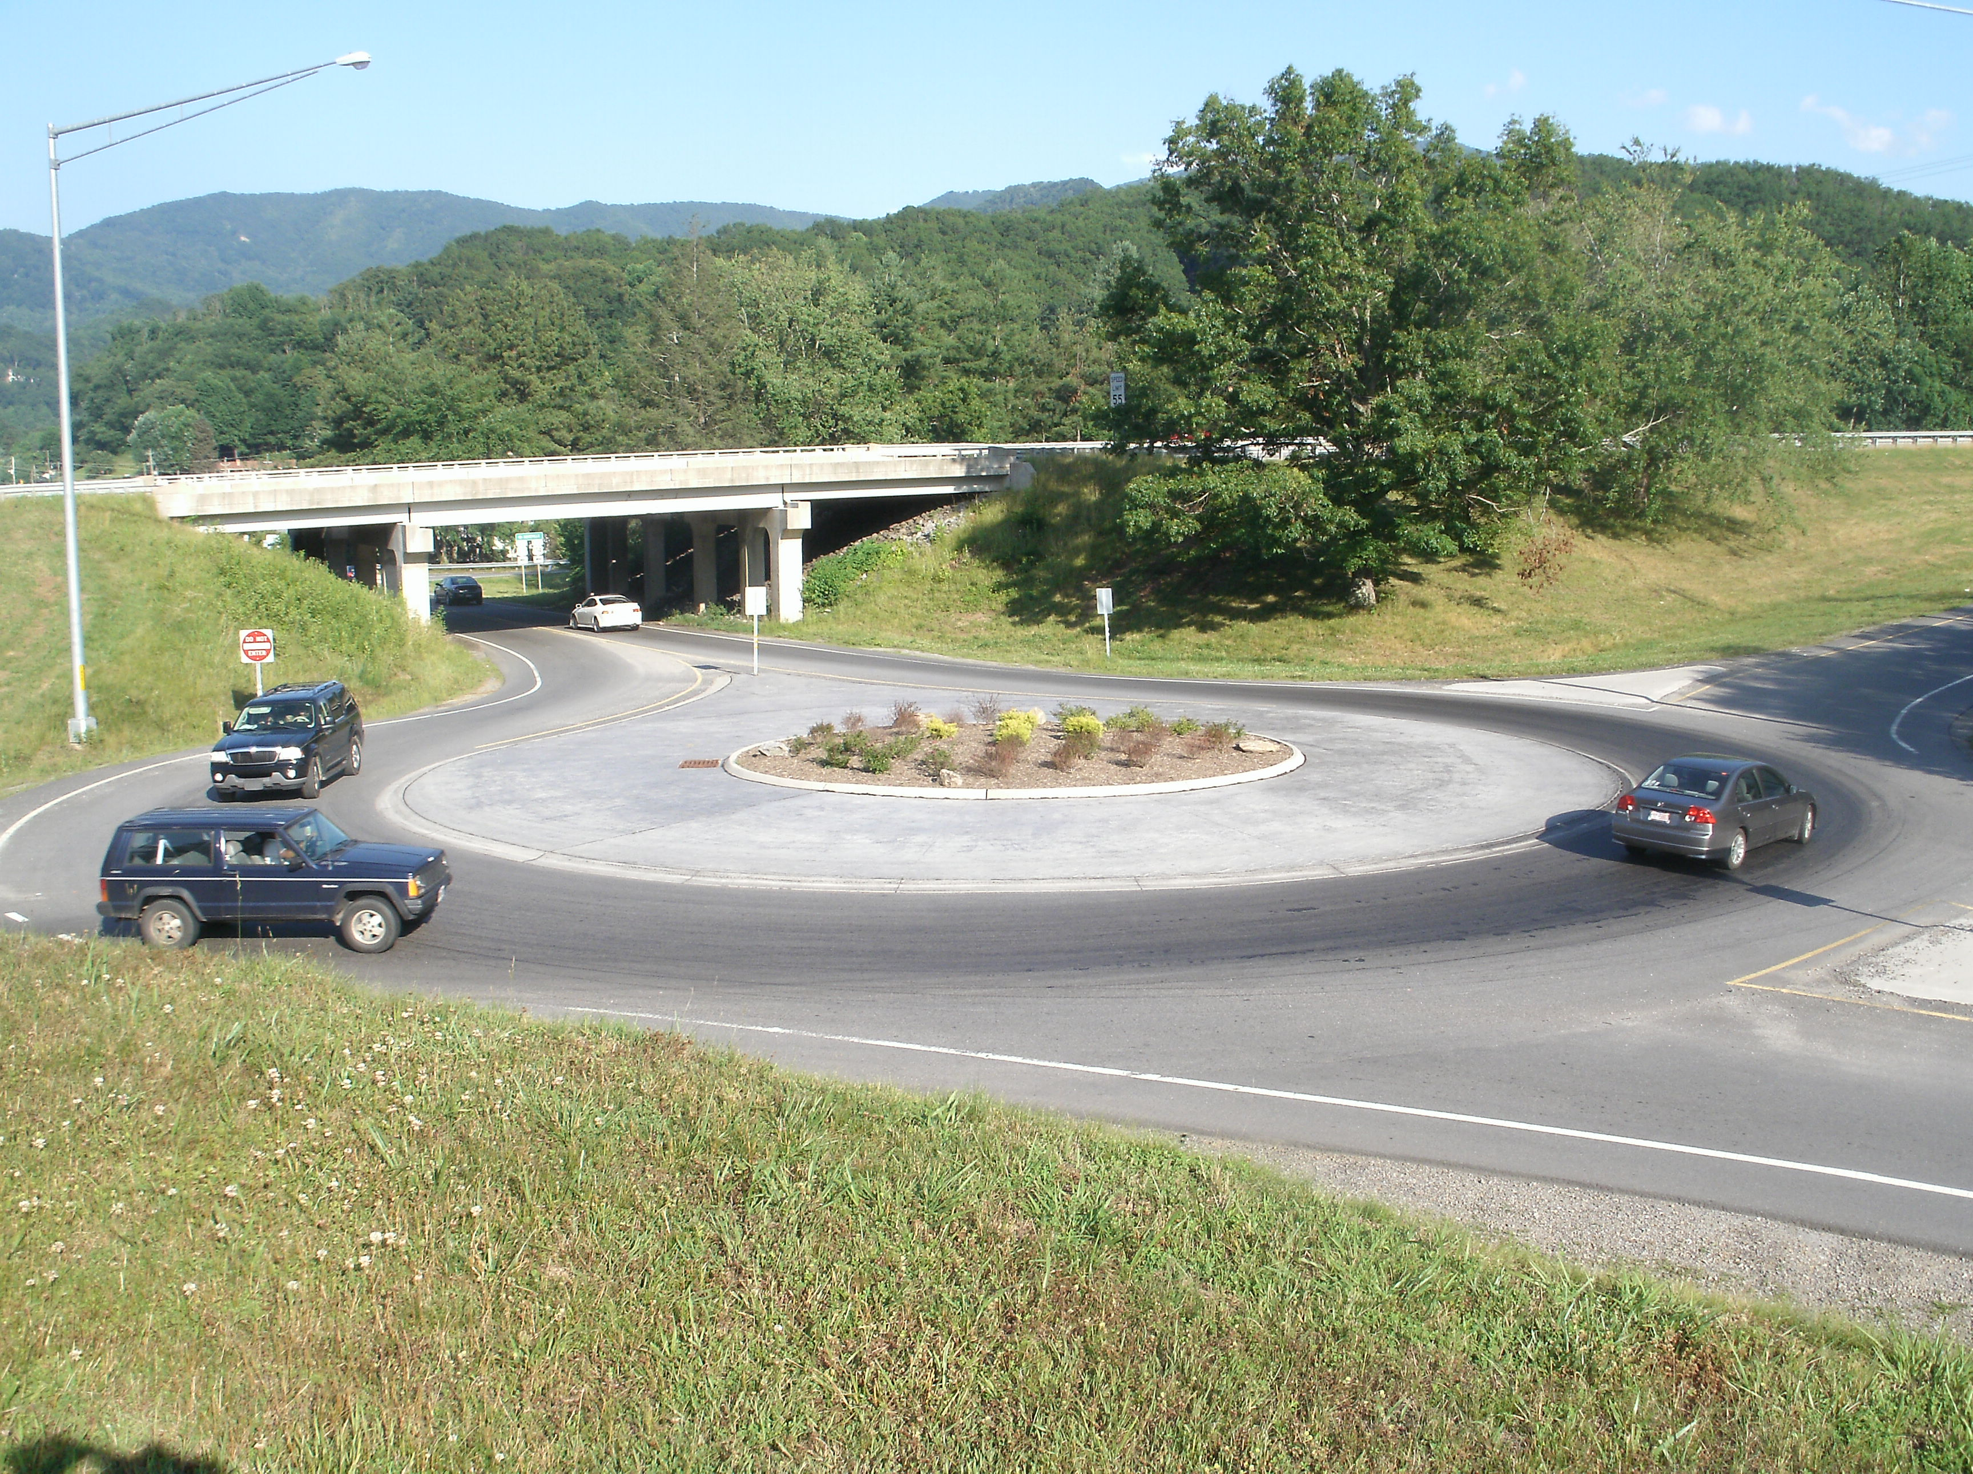
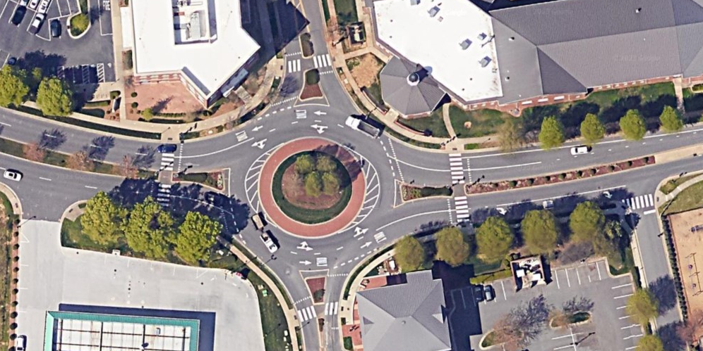
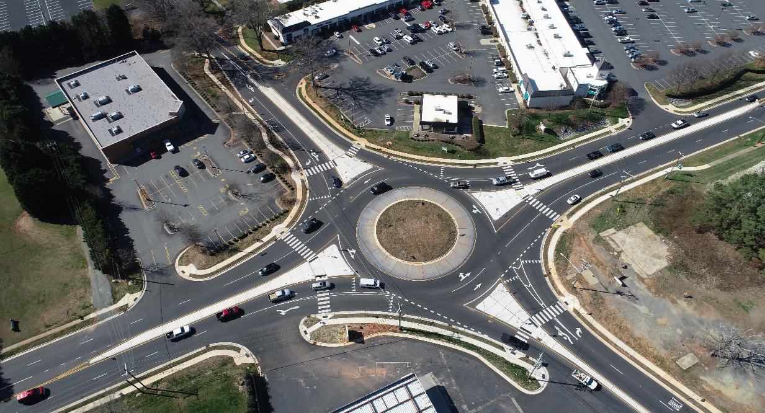
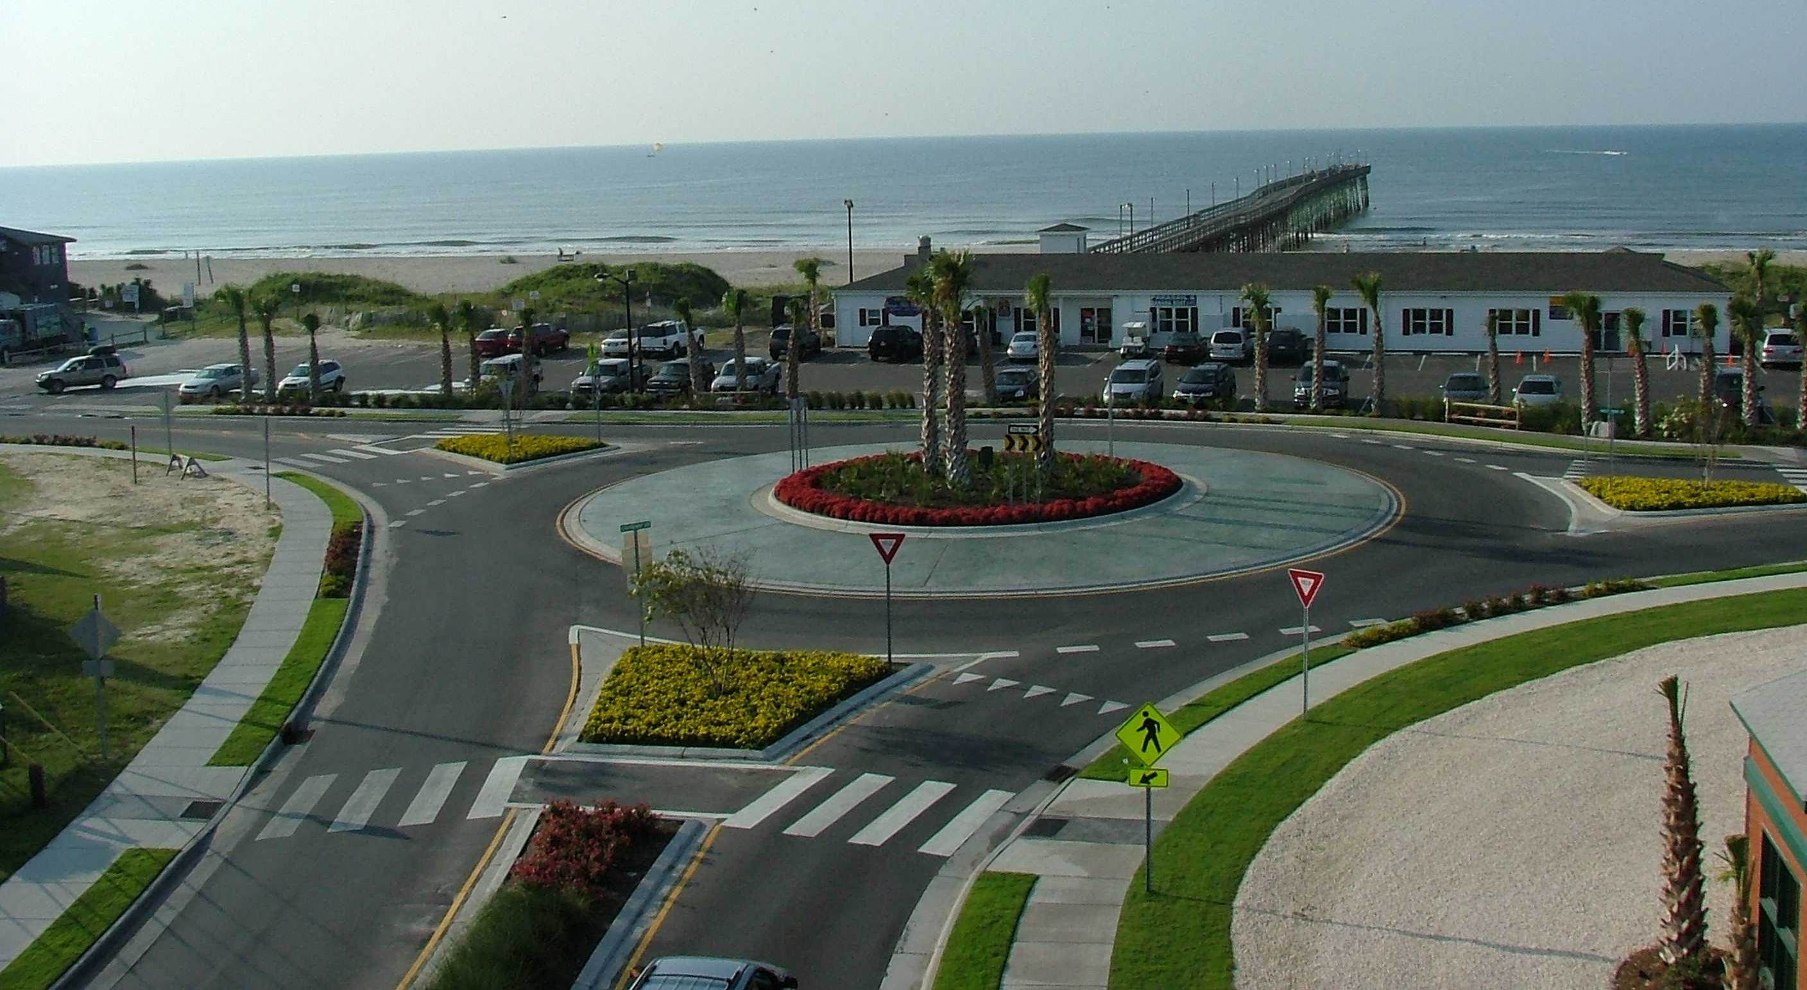
Example North Carolina Roundabouts
Site Development and Highway for Practitioners Module 1
Roundabout and Intersection Selection-Safety & Mobility
Griffith St at Jetton St
Davidson, NC
US 74 and
Hyatt Creek Rd
Waynesville, NC
NC 51 and Idlewild Road Matthews, NC
NC 904 and 1st St
Ocean Isle Beach, NC
US 117 and NC 133/NC132
Castle Hayne, NC

Slide 17
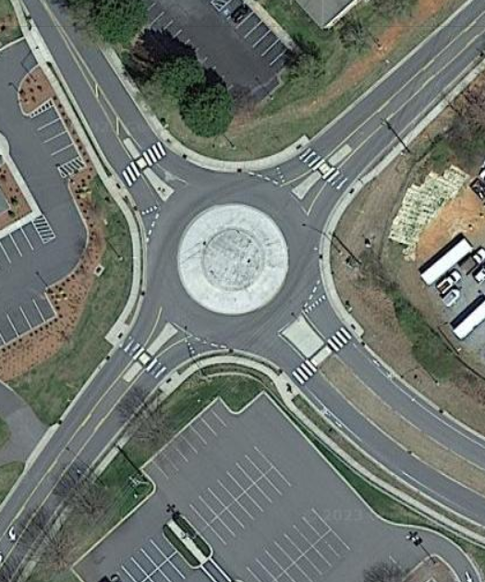
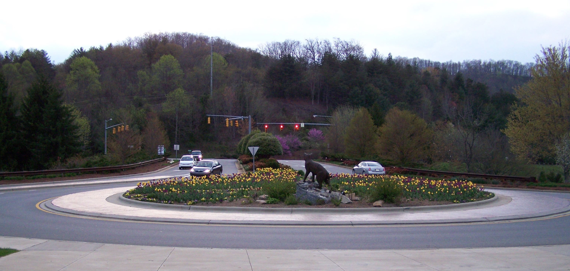
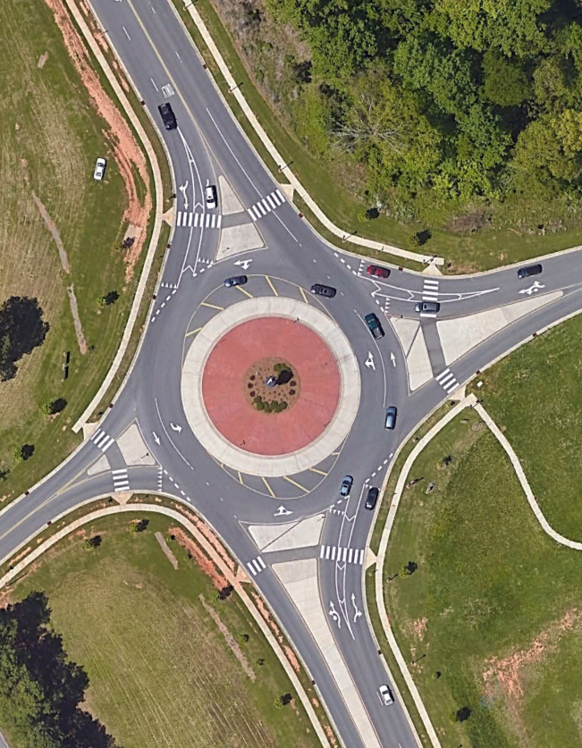
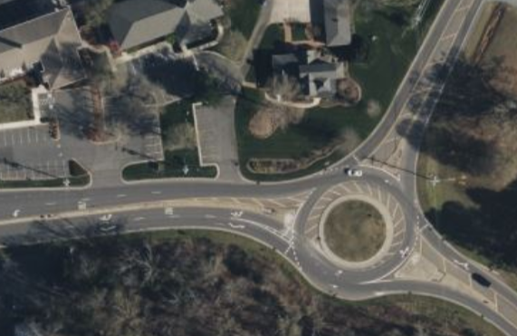
Example North Carolina Roundabouts
Site Development and Highway for Practitioners Module 1
Roundabout and Intersection Selection-Safety & Mobility
Lakewood Rd at Stuart W Cramer High School, Cramerton, NC
Western Carolina University, Cullowhee, NC
NC 84 and Weddington-Matthews Rd, Weddington, NC
NC 116 and SW Comm College Sylva, NC

Slide 18
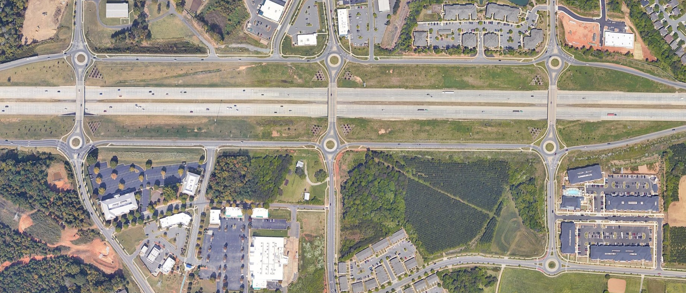
Site Development and Highway for Practitioners Module 1
Roundabout and Intersection Selection-Safety & Mobility
I-485 and Prosperity Village Charlotte, NC

Slide 19
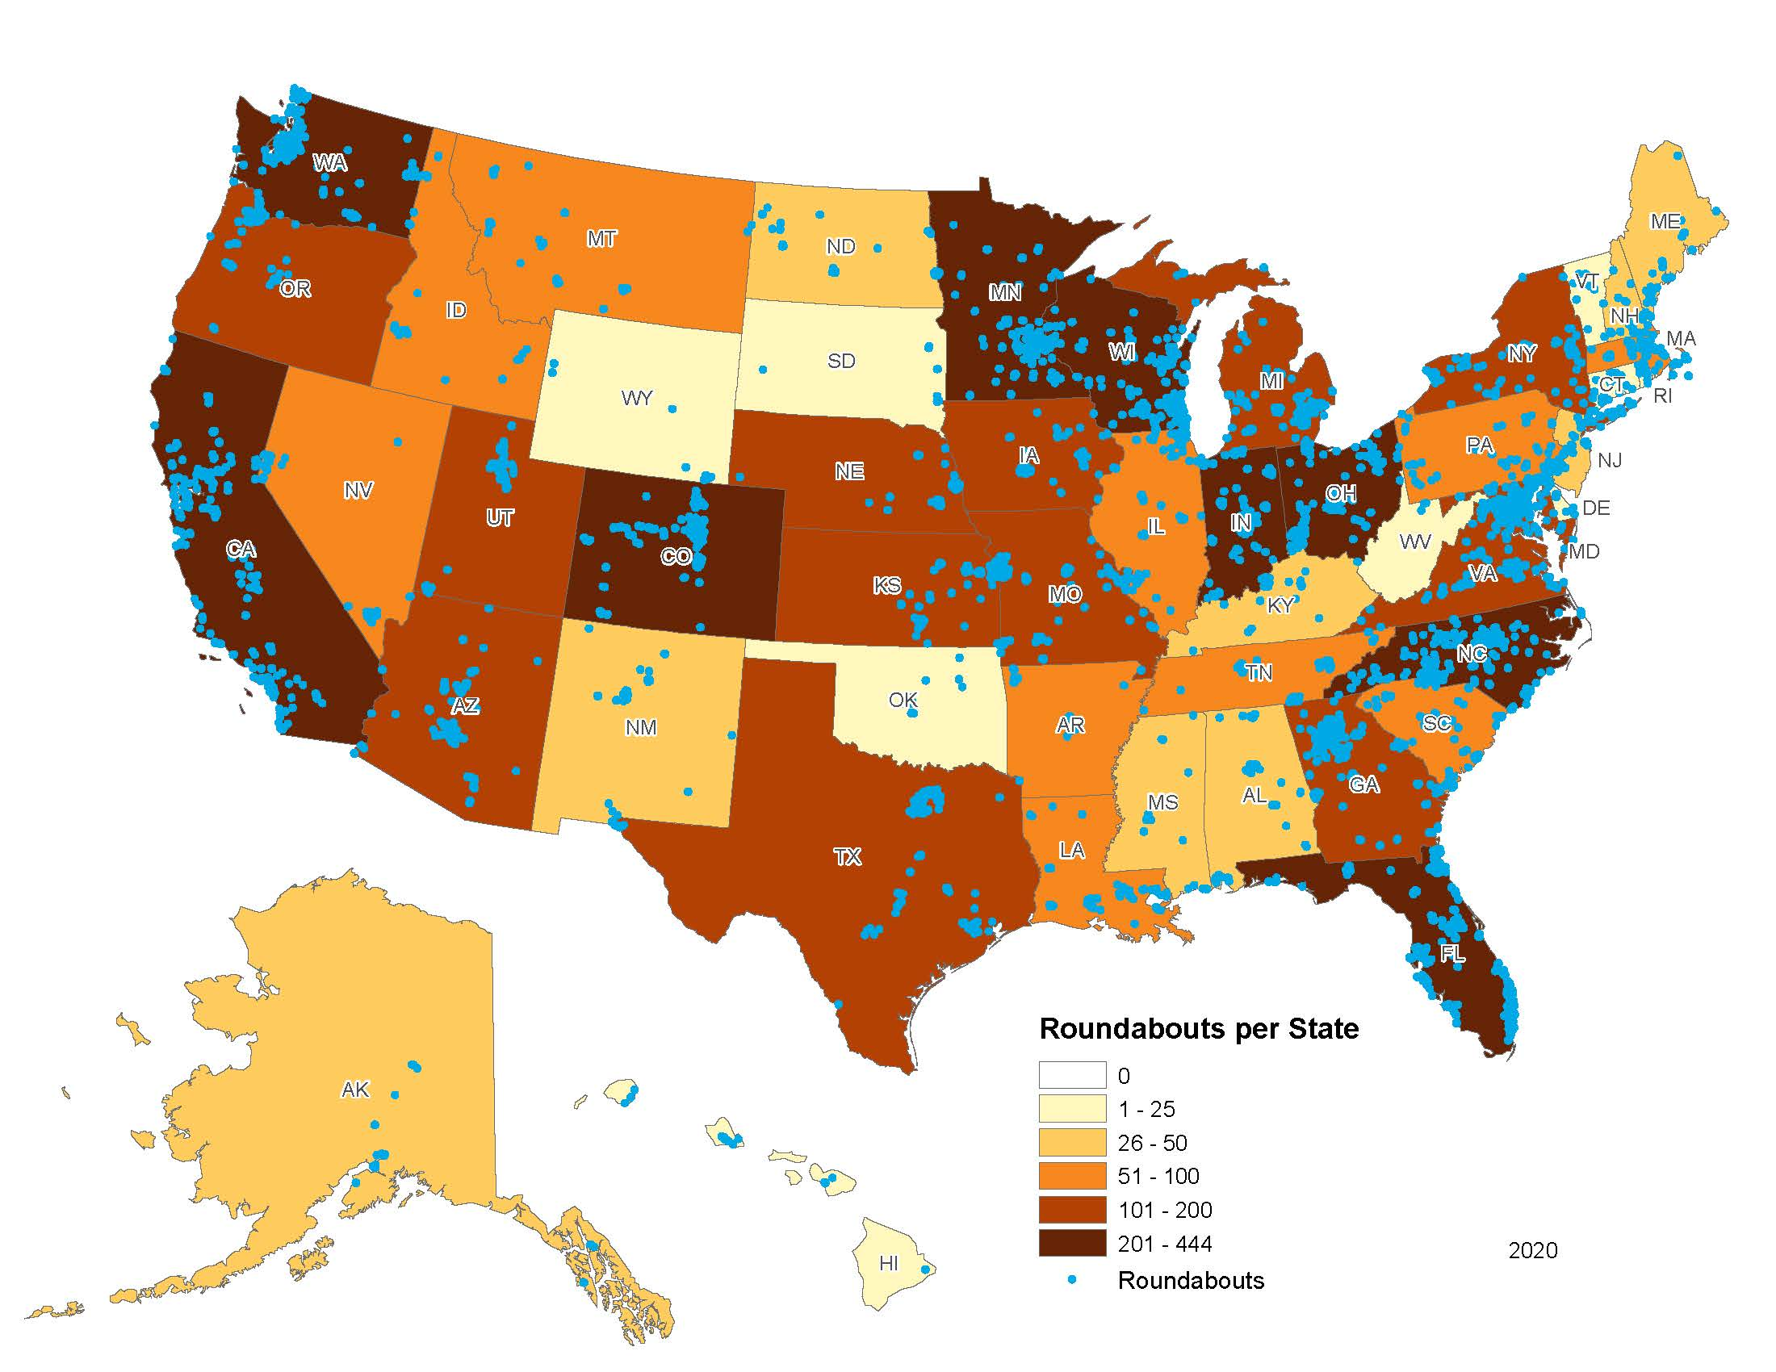
Over 30 Years of US Experience With Roundabouts
Roundabout and Intersection Selection-Safety & Mobility
U.S. sites by state: 2020
Estimated Total Roundabouts: >8,000
Source: Rodegerdts, L. A. “Status of Roundabouts in North America: Analysis of roundabouts.kittelson.com.” Unpublished, 2020.
Notes:
While roundabouts may be new to some, within the US we have over 30 years of experience with roundabout implementation. Roundabouts operate in every state within the US and in a wide variety of contexts, from residential subdivisions to interchange ramp terminals. Over 8,000 roundabouts are estimated to be operational across the U.S.

Slide 20
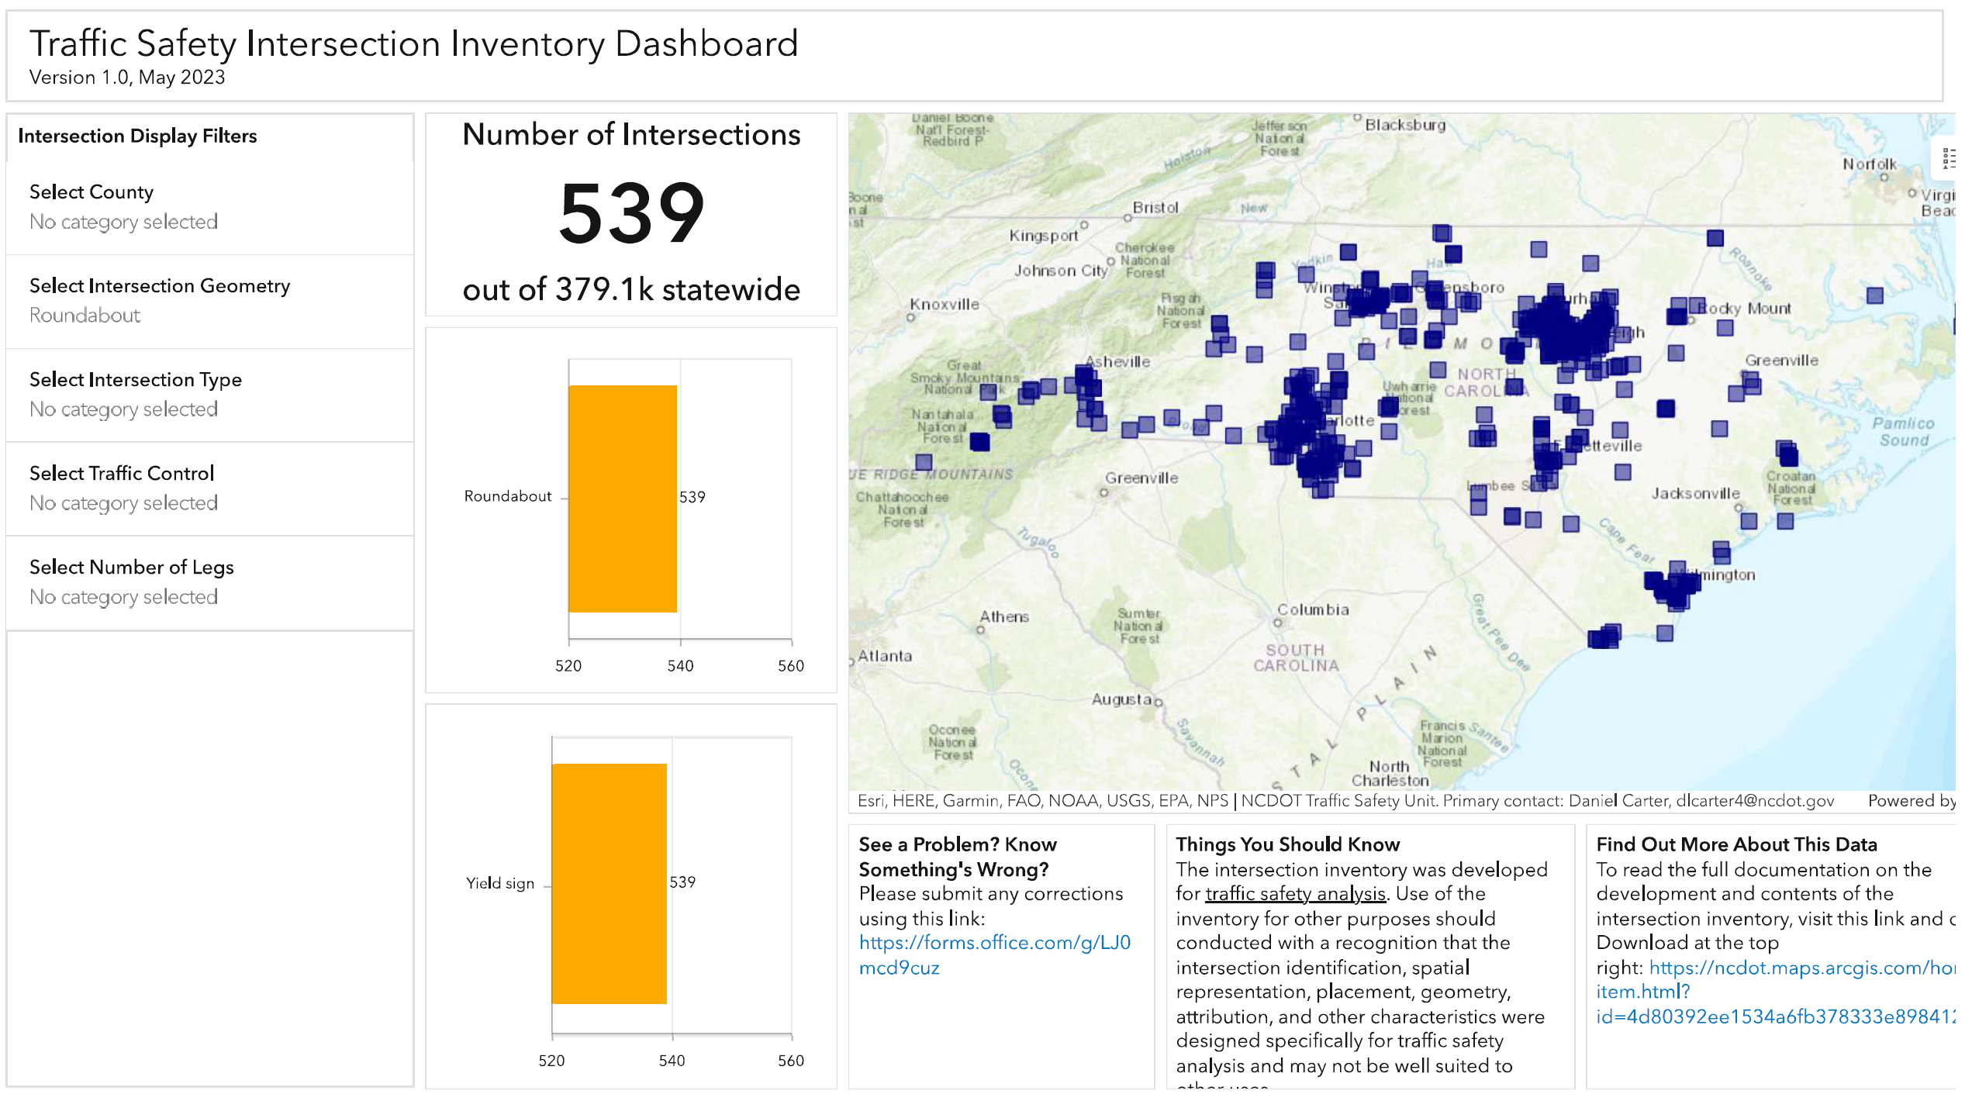
Roundabout and Intersection Selection-Safety & Mobility
Roundabouts in North Carolina
https://ncdot.maps.arcgis.com/apps/dashboards/be4ec3f875d24804a7d069b1b6e4adb6
Notes:
Here’s a map of North Carolina roundabouts, as of January 2022. It includes almost 500 locations. It doesn’t quite stretch yet from “Murphy to Manteo”, however it does go from Hayesville to Kitty Hawk. (And we are looking at a couple of roundabouts in the Murphy area.) Approximately 90% of NC roundabouts are single-lane and 10% are two-lane.
Key – Red are State, Green are Municipal, Blue are others (private or Federal.)

Slide 21
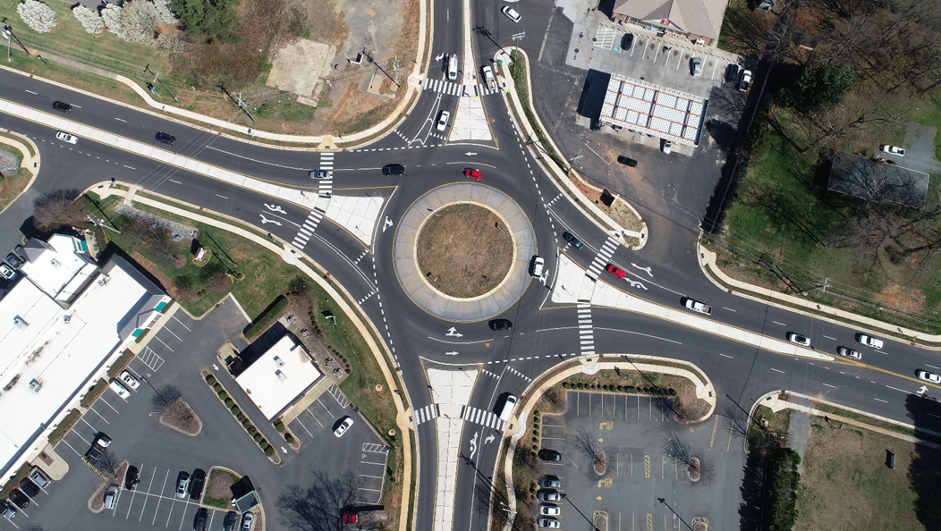
Why Roundabouts?
Roundabout and Intersection Selection-Safety & Mobility
Safer than Signalized or
Stop-Controlled Intersections
Reduces Delay, Improves Traffic Flow
May reduce need for widening a road
or adding turn lanes
Reduced Emissions and Wasted Fuel
Better Aesthetics/Landscaping Options
Supports Access Management
Traffic Calming
Matthews, NC
Source: James Dunlop
Notes:
Safety is a primary benefit for roundabout installation. On average, roundabouts reduce all crashes by about 35% and injury crashes by 76% (all types/sizes of roundabouts and prior control).
Roundabouts typically have lower delay and queues than other types of intersections.
Can reduce lane requirements between intersections or the need for additional turn lanes. This can be a particular benefit at interchange ramp terminals (or other closely spaced intersections) where widening the segment may not be feasible due to bridge structures or other constraints.
Reduced delays and stops results in environmental benefits related to air quality, fuel consumption, and noise.
Roundabouts provide opportunities for improving aesthetics
Roundabouts can be an effective component of an overall roadway access management strategy to provide u-turn locations and limit direct left-turns along the roadway segment (benefits safety and operations).
Roundabouts reduce speeds, which can support transitions in land uses, support speed control in urban/residential/commercial areas, etc.

Slide 22
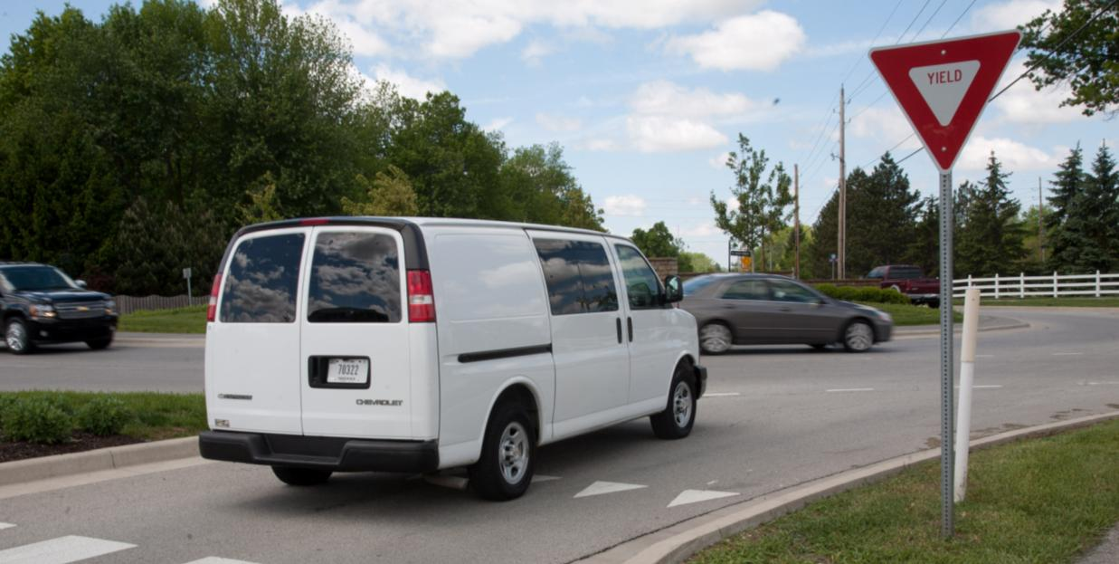
Safety Performance
Roundabout and Intersection Selection-Safety & Mobility
Roundabouts have a proven safety record for reducing motor vehicle crashes,
particularly fatal and injury crashes
Experience is due to basic contributing factors:
  Reduced vehicle speeds
  Reduced conflict severity
  Reduced driver decisions
  Reduced conflict points
Converting to Roundabouts:
  35% reduction in ALL crashes
  76% reduction in INJURY crashes
Notes:
1. In 2008, FHWA began promoting certain infrastructure-oriented safety treatments and strategies, chosen based on proven effectiveness and benefits, to encourage widespread implementation by transportation agencies to reduce serious injuries and fatalities on highways. The initial list became known as the Proven Safety Countermeasures initiative. Roundabouts were on the initial list and continue to be a research-proven safety countermeasures. The list was updated in 2012 and again in 2017. Currently there are 20 Proven Safety Countermeasures.

Slide 23
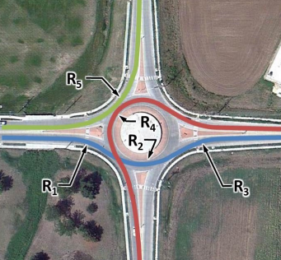
Speeds: REDUCED
Roundabout and Intersection Selection-Safety & Mobility
“Fastest Path” speed control through roundabouts
  25 mph for single-lane
  30 mph for two-lane
Slow intersection speeds =
  Increased time for driver reaction
  Decreased chance for injury or fatality

Slide 24
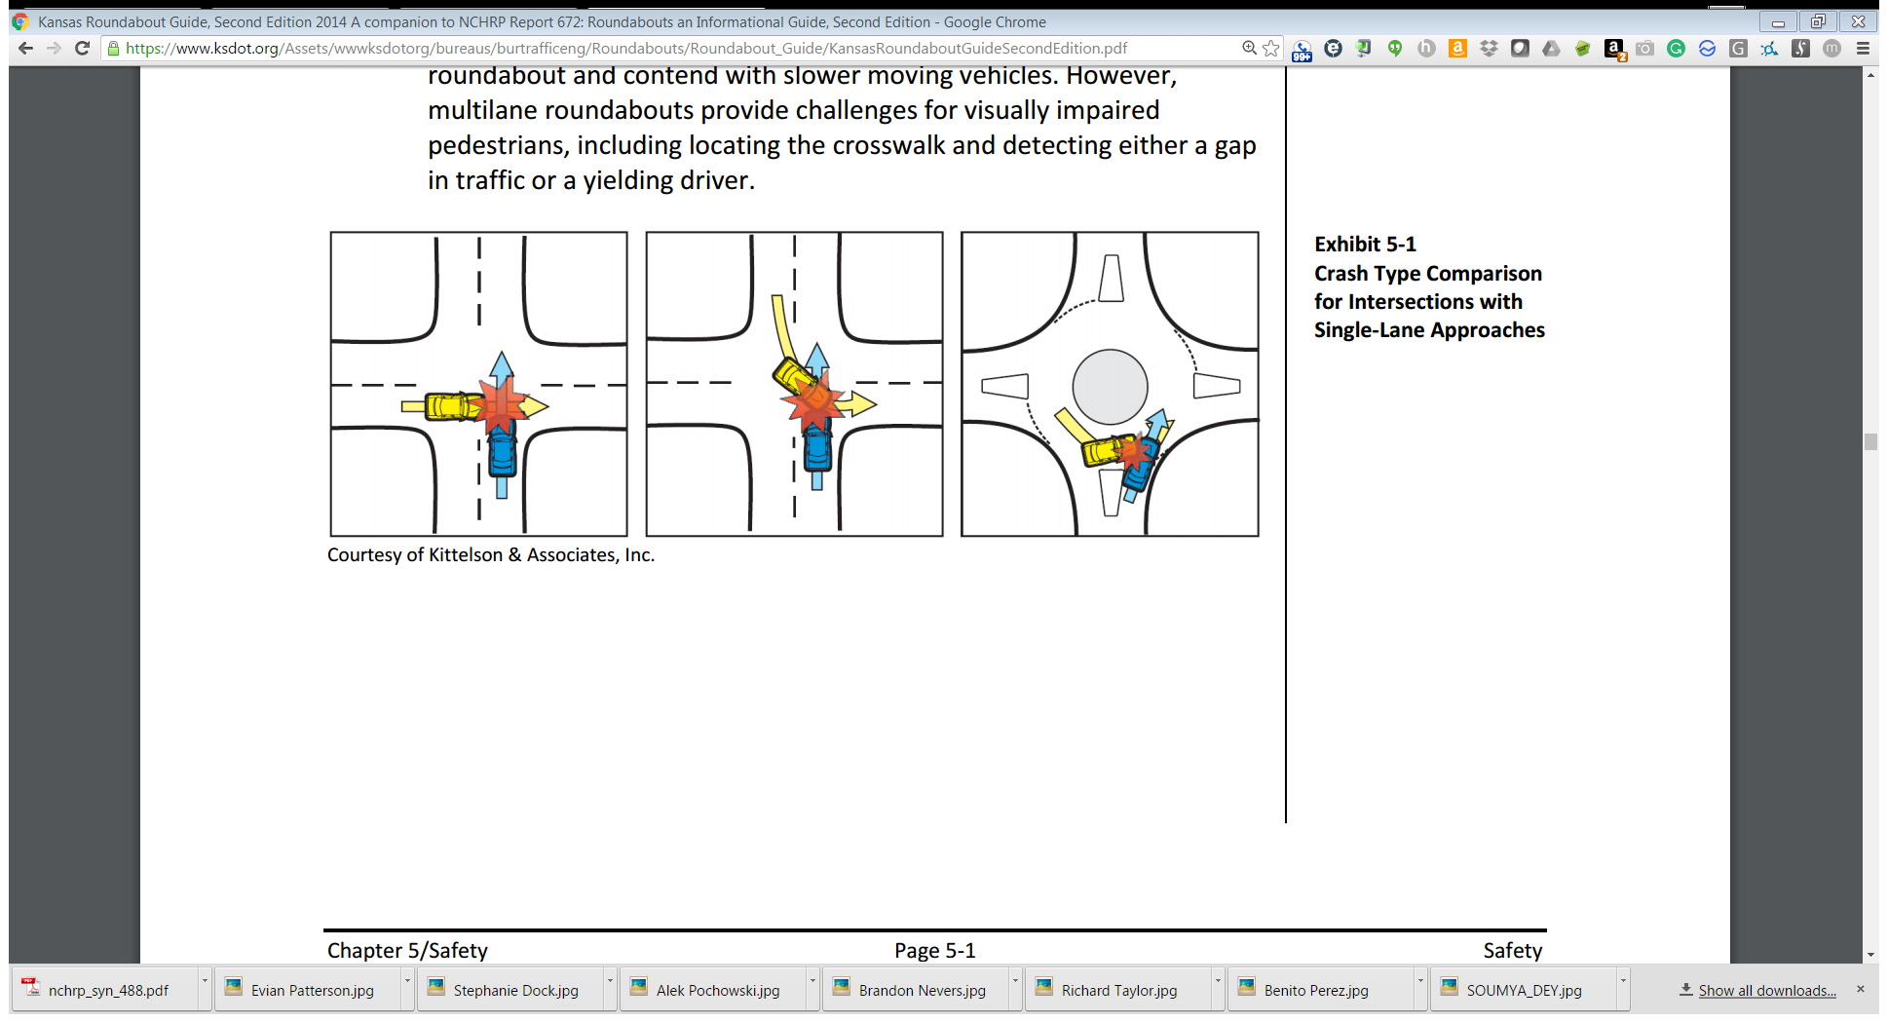
Severity of Conflicts: REDUCED
Roundabout and Intersection Selection-Safety & Mobility
Roundabouts remove the most severe head-on and right-angle crashes
Typical 4-leg intersection
Roundabout
Sideswipe /
Shallow-Angle
Right-Angle
Left Turn
Source: Kansas Roundabout Guide, Second Edition
Notes:
Roundabouts eliminate the most severe crossing conflicts, which typically are right-angle and head-on crash types. The lower speeds at roundabouts allow more time for drivers to react to avoid a crash. When crashes occur, they tend to be more of a shallow angle or rear-end crash type which have a lower chance of injury at slow speeds.
Angle and left turn crashes at a typical 4-leg intersection account for 63% of fatal crashes. Rear-end crashes are another type of crash that is often a problem at signalized intersections. However, these types of crashes are usually (but not always) less severe than the other two types of crashes shown.
Right angle crashes are typically the most severe because of the speed differential of the two vehicles. One vehicle is typically just starting to accelerate from a stop (< 5 mph), the other vehicle is typically going through the intersection at or above normal operating speeds for that street (perhaps 30-50 mph).
At a roundabout, vehicles are traveling at a significantly lower speed (<25 mph). Crashes that occur will be less severe because of this reduced speed differential and the more “sideswipe” nature of crashes.

Slide 25
Vehicle Conflict Points: REDUCED
Roundabout and Intersection Selection-Safety & Mobility
Up to 75% fewer conflict points at single-lane roundabouts.
Up to 32 conflict points
8 conflict points
Merging
Diverging
Crossing
Source: NCHRP Report 672, Exhibit 5-2
Notes:
Major points to make:
These diagrams point out the difference in vehicle conflict points at a basic roundabout (8) and 4-leg intersection (32).
In some respects, the graphic on the left is over simplified (it doesn’t illustrate left or right-turn lanes or multiple lanes). And the graphic on the right only is illustrative of a single-lane roundabout.
BUT the point is, that the roundabout has ZERO vehicle crossing conflict points as opposed to the 16 vehicle crossing conflict points at the 4-leg intersection. This is where most of the safety benefits arise from.
Not shown in the graphics are the typically shorter crossing distances for pedestrians (because they don’t cross left and right turn lanes in addition to the through lanes), thereby limiting their exposure time to vehicle paths.

Slide 26
Safety Study Results
Roundabout and Intersection Selection-Safety & Mobility
Convert Two-Way Stop Control to Roundabouts
Convert Traffic Signal to a Roundabout
44%
21%
All crashes
All crashes
87%
Fatal/injury crashes
in rural area
66%
Fatal/injury crashes
78%
72%
Fatal/injury crashes in
urban/suburban areas
1-lane
2-lane
Source: NCHRP Report 572
Notes:
Major points to make:
This slide shows typical crash reduction data for converting a two-way stop intersection to a modern roundabout. Data comes from NCHRP Report 572: Roundabouts in the United States.
The top two numbers shown are for all roundabouts (1- and 2-lane, rural and urban). However, studies show that crashes are reduced significantly for both 1- and 2-lane configurations.
There have been some studies done on converting 4-way stop intersections to roundabouts. While operations were improved (less delay), the affect on crash reduction was very little (or negative).

Slide 27
Safety Comparison
Roundabout and Intersection Selection-Safety & Mobility
Signal or Stop Control?
Traffic Signal
Roundabout
Higher speeds:
  Little response time
  More severe crashes
Greater conflict points
  Red light-running
  Permissive lefts
Some crash reductions
  Reduce angle crashes compared to TWSC
  May increase rear-end
Slower speeds:
  Increased reaction time
  Fewer severe crashes
Fewer conflict points
Greater crash reductions
FHWA Proven Safety Countermeasure
Notes:
Studies of US roundabouts over the past 20 years have consistently shown that roundabouts reduce total crashes compared to traffic signals. Roundabouts result in even greater reductions in severe injuries and fatalities due to the slower speeds and reduced numbers of conflict points. As a result, FHWA has identified roundabouts as one of 20 proven safety countermeasures.
A signal will help to reduce patterns of angle crashes; however, this may be somewhat offset by increases in rear-end crashes along the mainline, if previously uncontrolled. A signal also allows higher speeds through the intersection on the green indication, which can result in higher chances of a severe injury if a crash occurs. The geometry of the roundabout physically limits speeds to 25 mph or less; meanwhile a higher-speed crashes are possible at a traffic signal. While the signal control dictates right-of-way, it doesn’t eliminate the conflict points due to red-light running, permissive left-turns, right-turns on red, etc.
Lower speeds – conditions change slowly allowing for more time to make the right response
Low energy crashes
Less complicated situations and decision-making
Judging gaps is easier and mistakes are rarely fatal
No wide visual scans needed

Slide 28
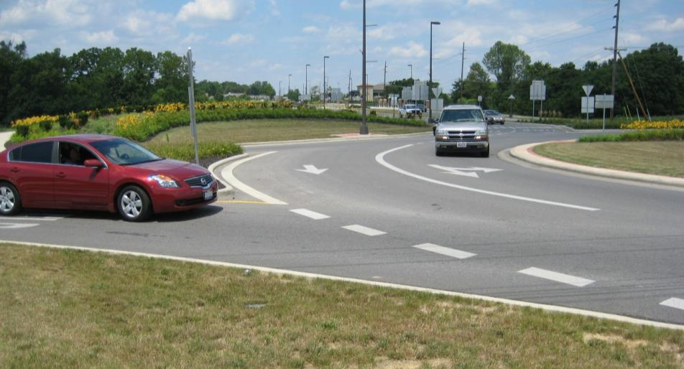
Roundabouts Operations
Roundabout and Intersection Selection-Safety & Mobility
Efficient during peak and off-peak periods
Stops
Idling
Delay
Notes:
Major points to make:
In addition to the safety benefits described in the previous slides, modern roundabouts can also:
Reduce congestion because they are efficient during both peak hours and other times
Impose less delay on drivers
Reduce fuel use
Lead to fewer stops and fewer hard accelerations
Reduce the amount of time drivers spend idling
Lower queue lengths
Works well for closely spaced intersections and interchanges
Flexible to changing traffic patterns through day
Multiple timing plans needed for signals
No unnecessary stopping at roundabouts at off-peak times

Slide 29
Operational Alternatives Comparison
Roundabout and Intersection Selection-Safety & Mobility
Traffic Signal
Roundabout
Vehicles may have to stop regardless of presence/absence of demand on other legs
Longer stopped queues and delay
Higher off-peak delay
Can prioritize major movements
Vehicles do not have to stop if no conflicting traffic is present
Shorter queues - traffic within queues continue to move
Lower peak and off-peak delay
All movements treated equally

Slide 30
Pedestrians and Bicycles at Roundabouts
Roundabout and Intersection Selection-Safety & Mobility
Traffic Signal
Roundabout
Usually higher speeds
More lanes to cross on busy thoroughfares
Often need to cross all lanes of opposing directions at once
Could take a long time to cross at complex signals
Lower circulating speeds by design
Fewer lanes to cross
Pedestrian refuge islands, thus cross one direction at a time
Much shorter time to cross than complex signals with many lanes

Slide 31
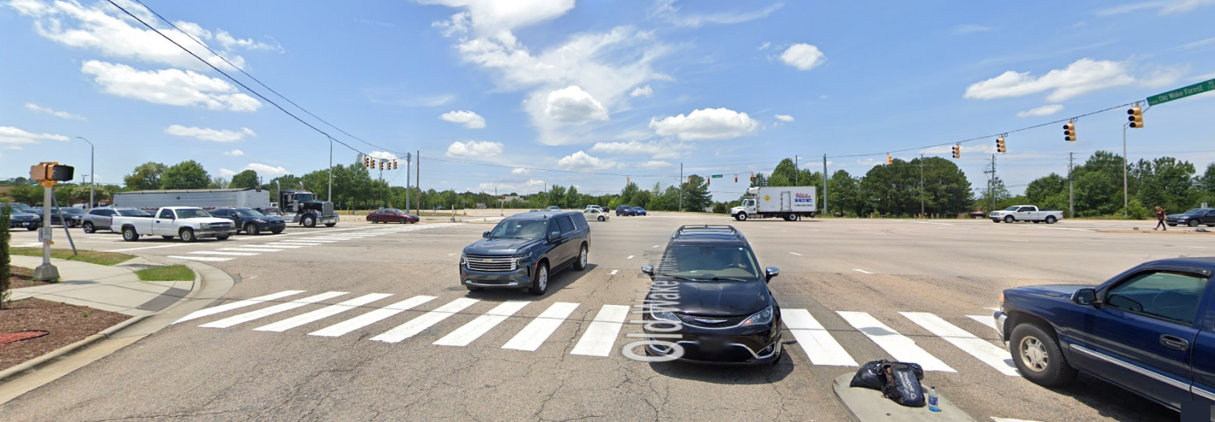
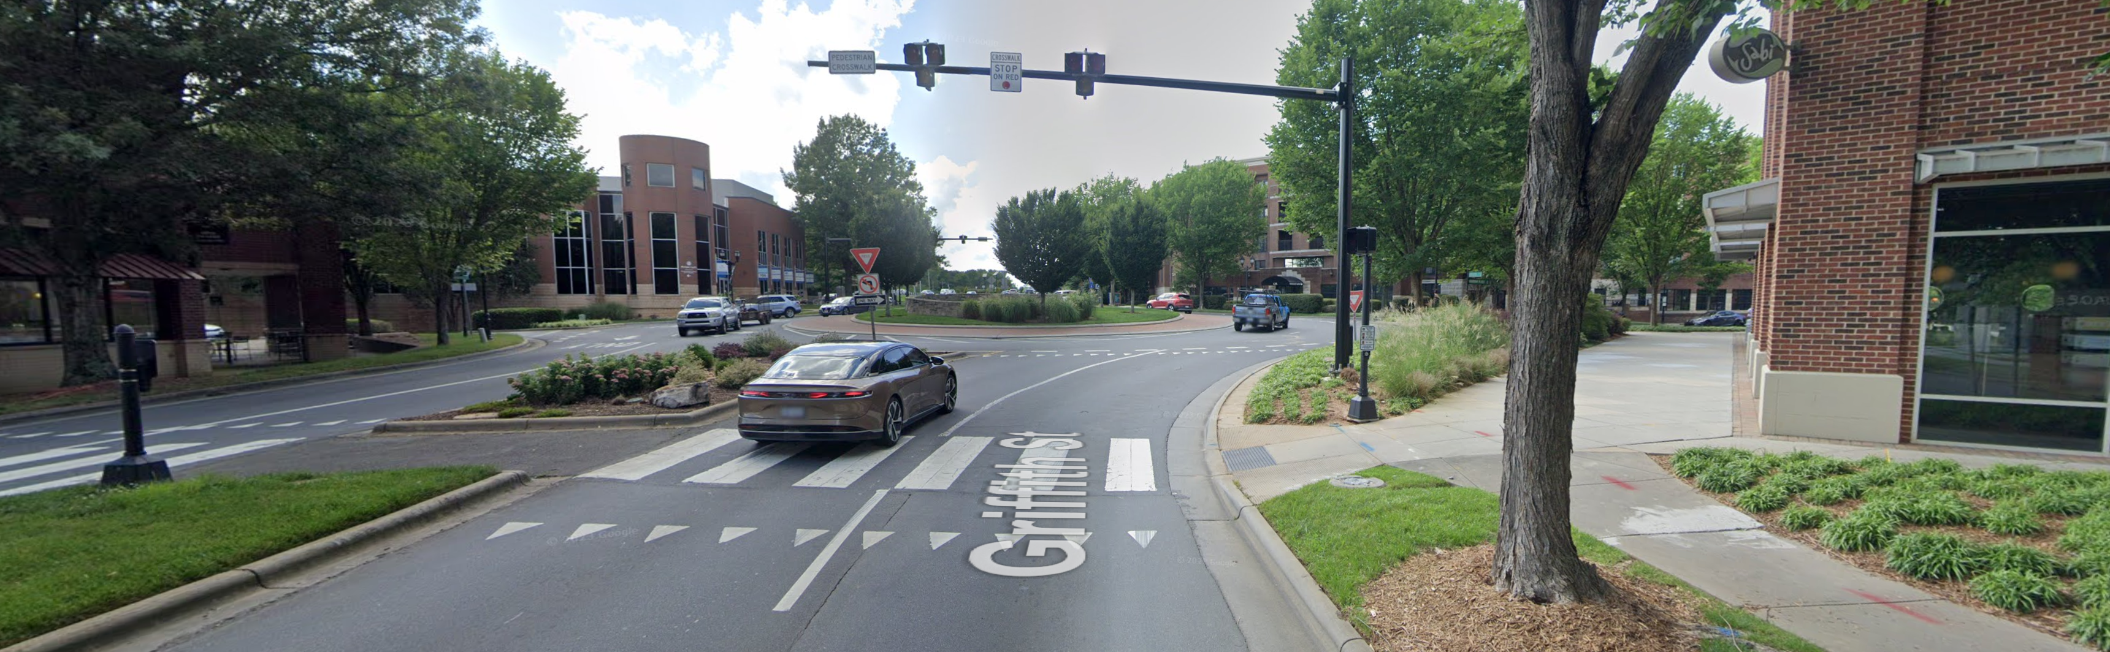
Pedestrians and Bicycles at Roundabouts
Roundabout and Intersection Selection-Safety & Mobility
Traffic Signal
US 1 (Capital Blvd) and Old Wake Forest Rd
Raleigh, NC
Roundabout
Griffith St and Harbour Place Dr
Davidson, NC
Images Courtesy of Google Maps

Slide 32
Why Not Just Install a Signal?
Roundabout and Intersection Selection-Safety & Mobility
Traffic signals can only be considered where the intersection meets warrants in the Manual on Uniform Traffic Control Devices
  Minor street volumes must meet minimum volumes levels to allow for signal consideration
Unwarranted traffic signals can result in excessive delay, noncompliance, and increased frequency of crashes.
Increased stops & delay during off-peak hours.
Less flexible to changing traffic conditions
Require regular updates to signal timings

Slide 33
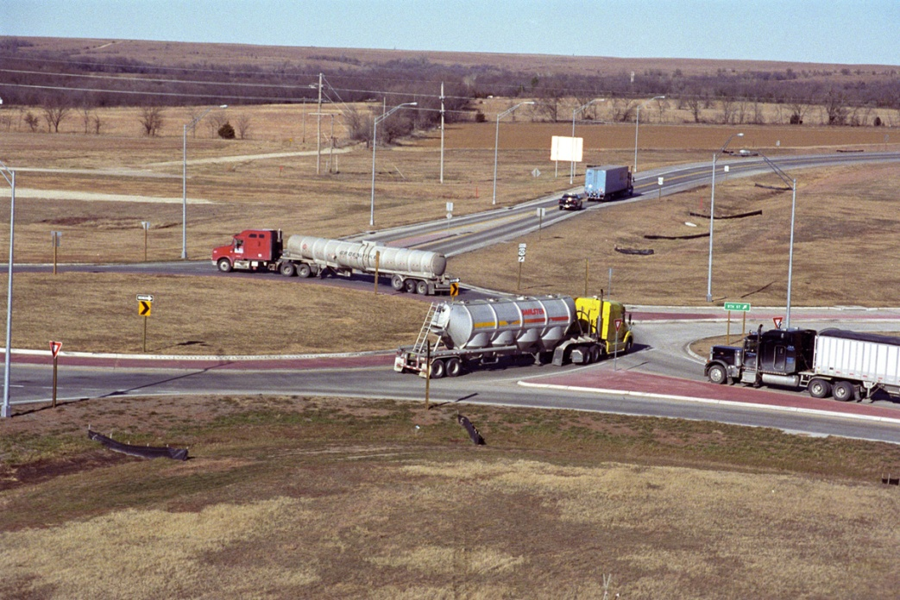
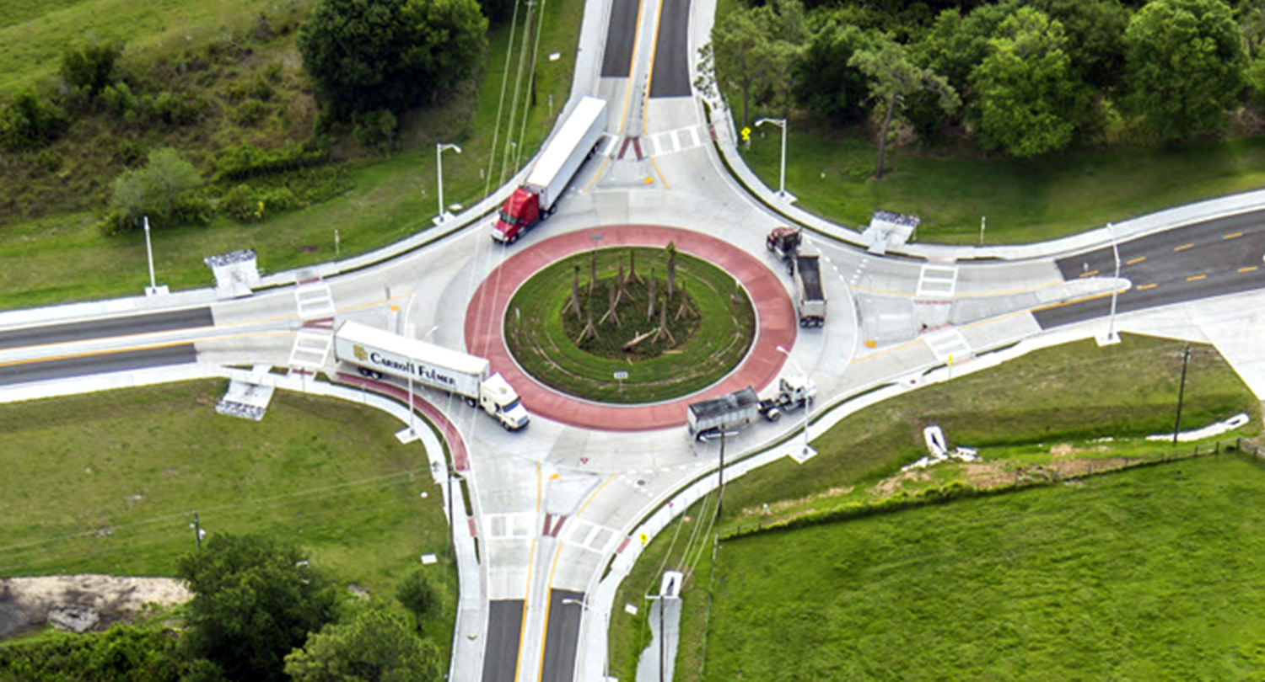
Designing for Trucks
Roundabout and Intersection Selection-Safety & Mobility
Trucks considered during earliest planning stages
Truck aprons provided to accommodate the largest vehicle reasonably anticipated to use the intersection
  May include oversize vehicles (mobile homes, etc.)

Slide 34
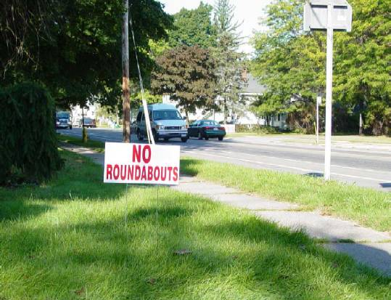
Roundabout Public Reaction
Roundabout and Intersection Selection-Safety & Mobility
Typical experience (but not always):
  Wide range of opinions toward roundabouts
  Negative reactions before construction
  Shift towards neutral or positive reactions after construction
Common misconceptions based on rotaries or neighborhood traffic circles
In some US communities, roundabouts are now being requested by residents

Slide 35
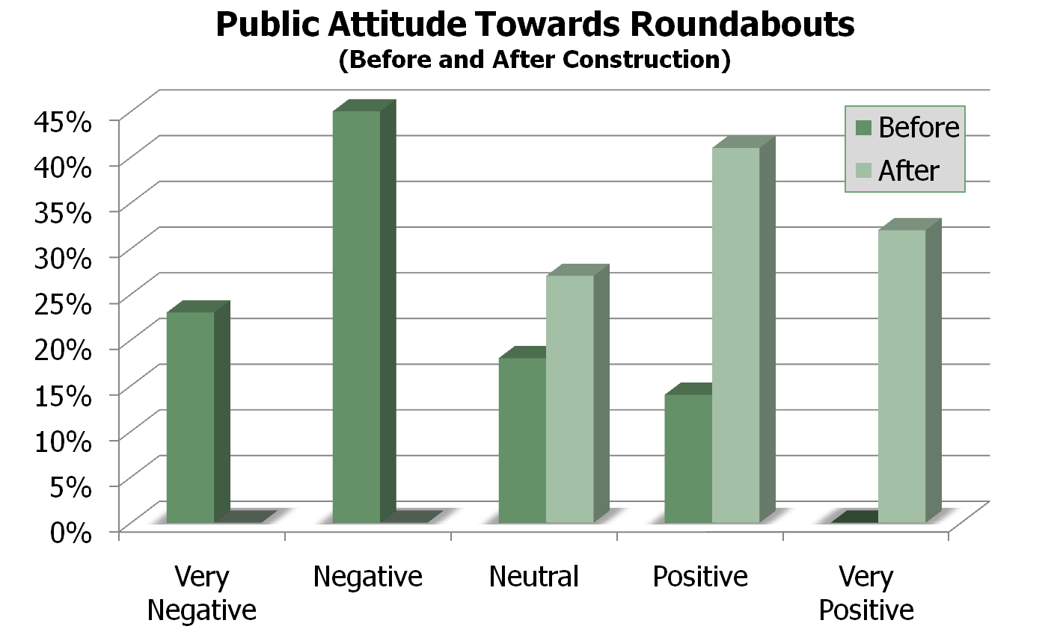
Roundabout Public Opinion
Roundabout and Intersection Selection-Safety & Mobility
Source: NCHRP Synthesis 264
Notes:
Major points to make:
The public usually has an initial fear or negative opinion of roundabouts, but that opinion changes after they’ve experienced their benefits.
Many new sites faced uncertain and intense controversies that received media coverage.

Slide 36
Roundabout Public Opinion
Roundabout and Intersection Selection-Safety & Mobility
 | Before Construction | After Construction
Strongly Favor | 16% | 32%
Somewhat Favor | 15% | 31%
Don’t Know | 14% | 9%
Somewhat Oppose | 14% | 13%
Strongly Oppose | 41% | 15%
31%
63%
55%
28%
Source: ITE Journal, Sept. 2002 (Retting, et al.) Survey in KS, MD, and NV

Slide 37
Examples of Public Reactions
After Roundabout Installation
Roundabout and Intersection Selection-Safety & Mobility
“We don’t even have the striping done yet and it is just working like a dream,” he said last week, watching as cars flowed down Shenandoah Road from the winery loop, merging with vehicles on Highway 49.”
“Sanders initially opposed the roundabout. “I wanted to keep Plymouth the way it was. I liked the old Plymouth with the rural look, no sidewalks. Why are we having to look like Napa?”
Now, she says she loves it.
The Sacramento Bee, Jan 2018
Livingston Parish drivers coming around on roundabouts
A new roundabout has opened in Denham Springs at the intersection of Cockerham and Lockhart Roads.
"It keeps traffic flowing. You're not sitting there waiting for your turn," Make Nevels said.
So far, drivers are giving it rave reviews.
"It's working better than that red light was," Harry Young said.
It's still a work in progress, and it may confuse drivers who haven't seen them before.
Young's Home Appliances has been on Lockhart Road for 37-years. They say the roundabout is an attitude adjustment for their customers.
"People aren't getting stuck in traffic, they don't get aggravated."
WBRZ, Feb 23

Slide 38
Examples of Public Reactions
After Roundabout Installation
Roundabout and Intersection Selection-Safety & Mobility
Intersection fixes might be circular
Time for a retraction.
I know you will find this impossible to believe, but three years ago your favorite columnist erred.
It was not an error of fact, but of judgment. In February 2002, I came before you and ridiculed the ``roundabout,'' a traffic engineering concept that was being tested in a handful of cities around the country.
But since then, I have seen the light.
Barely a year old, Dublin's roundabout is located directly in front of Muirfield. And it's working exactly the way it was drawn up.
In the heart of rush hour on a recent Thursday afternoon, I approached the circle and saw four cars ahead of me. In no more than five seconds, all four cars were out of my way, and I was on the circle. The layout, signs and striping made it obvious who was supposed to do what.
The Beacon Journal, Jun 2005

Slide 39
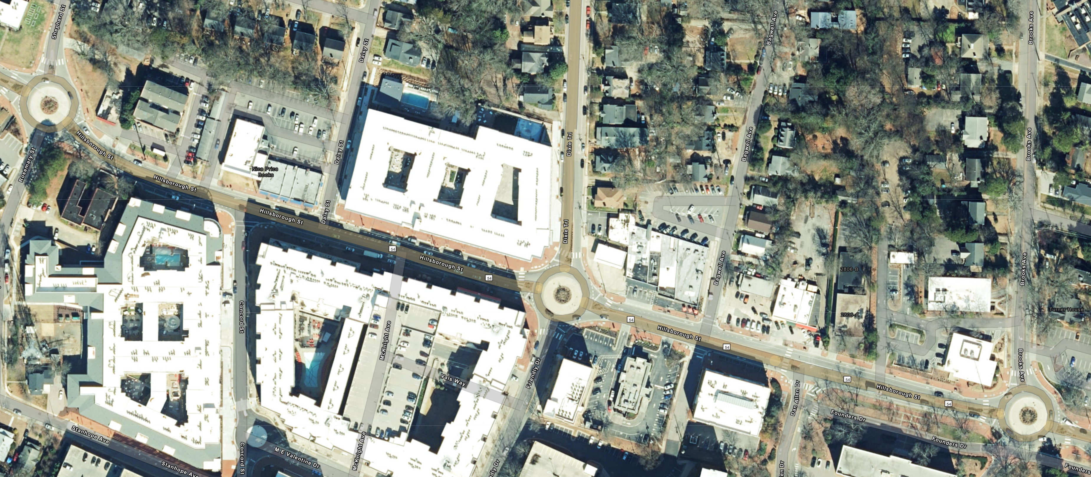
Roundabout Corridors
Roundabout and Intersection Selection-Safety & Mobility
Segment of Hillsborough St Roundabout Corridor
Raleigh, NC (near NCSU)
Golden, Colorado
  Improved traffic flow, vehicular safety and access to businesses combined with amenities such as landscaped medians and pedestrian walkways stimulated economic activity.
  Sales tax revenues increased 60% and 75,000 square feet of new retail/office space has been built in 5 years after roundabout implementation
Bird Rock, CA
  Sales tax receipts increased by ~25% in the years immediately following the opening of 5 roundabouts along the LaJolla Blvd corridor.
  Bird Rock Coffee Roasters increased average daily transactions from 275 per day to 320-350 per day
  New business opened along the corridor, including CVS signing a new 40-year lease following opening of the roundabouts.

Slide 40
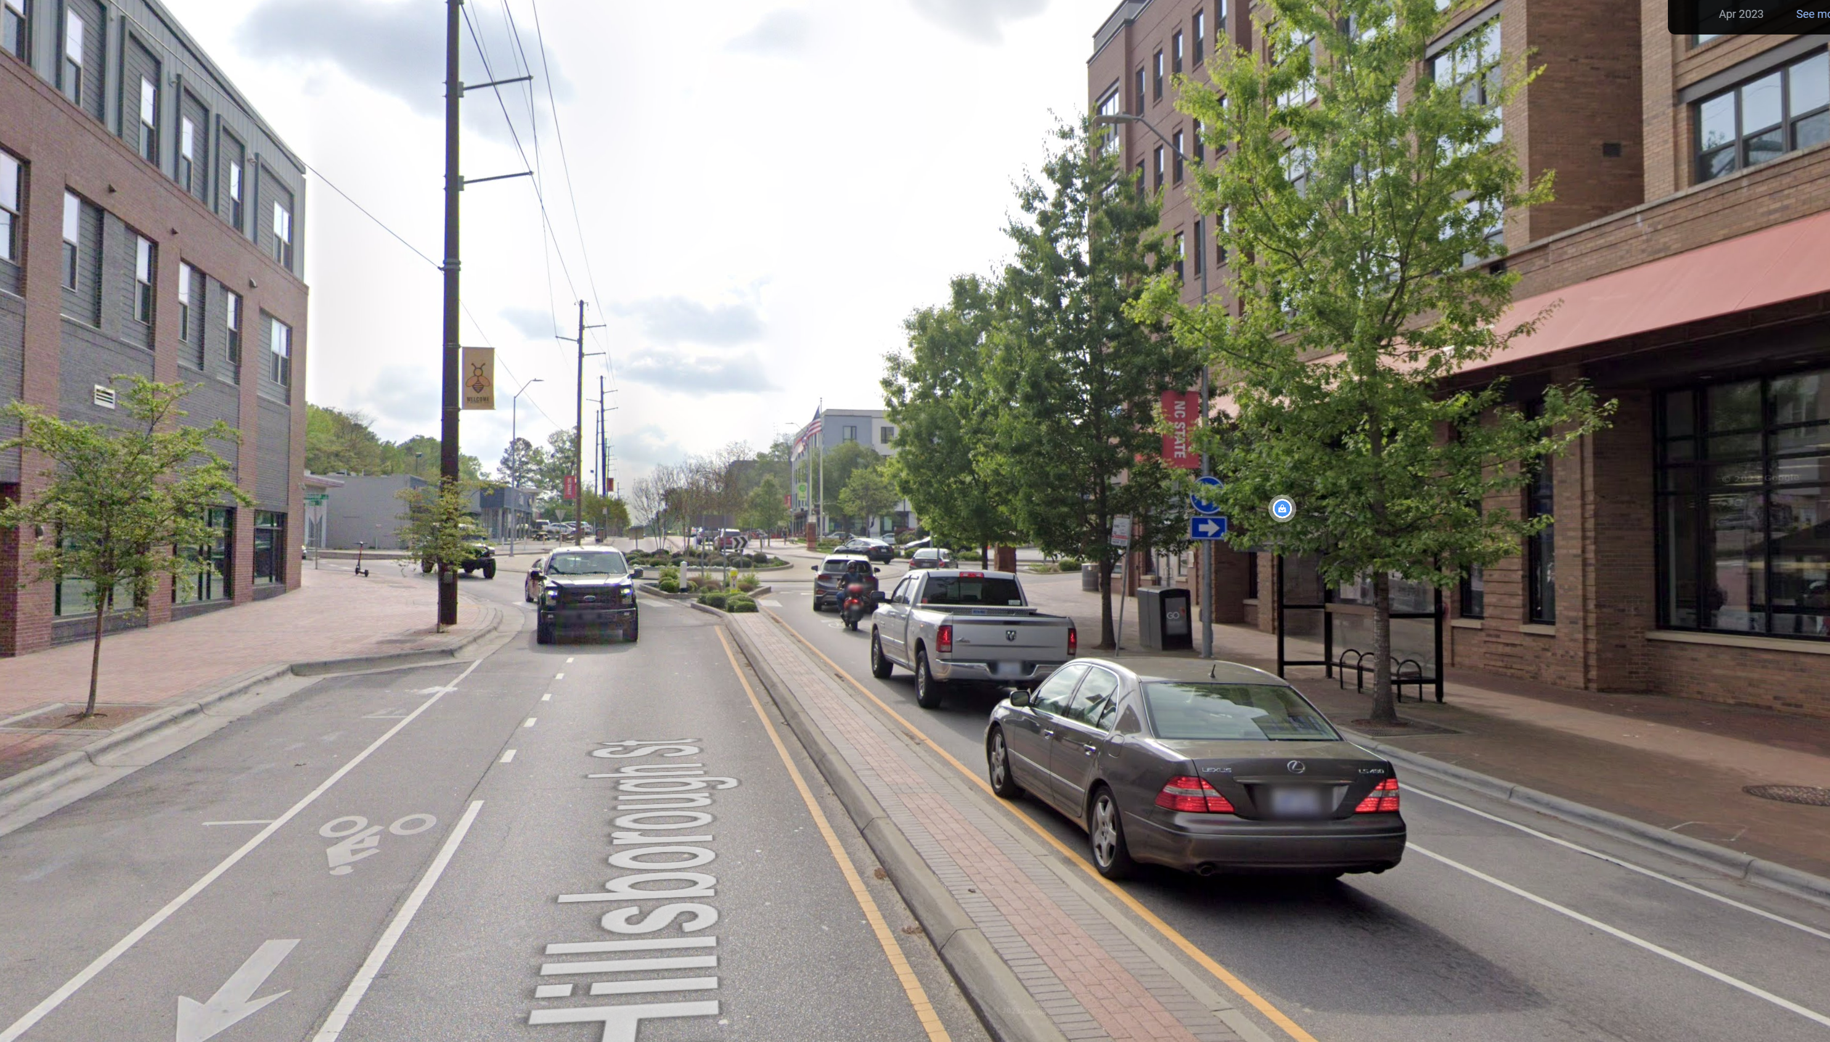
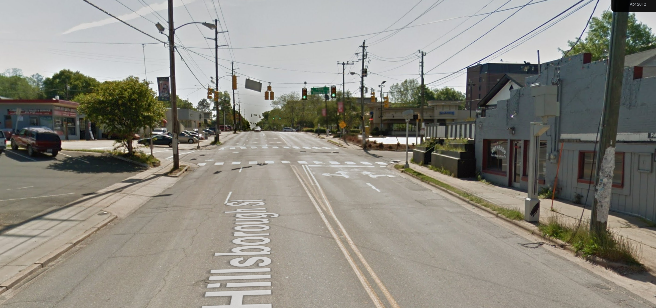
Roundabout Corridors
Roundabout and Intersection Selection-Safety & Mobility
Hillsborough St near Dixie Trail in 2012 vs. 2023
Raleigh, NC (near NCSU)
Images Courtesy of Google Maps

Slide 41
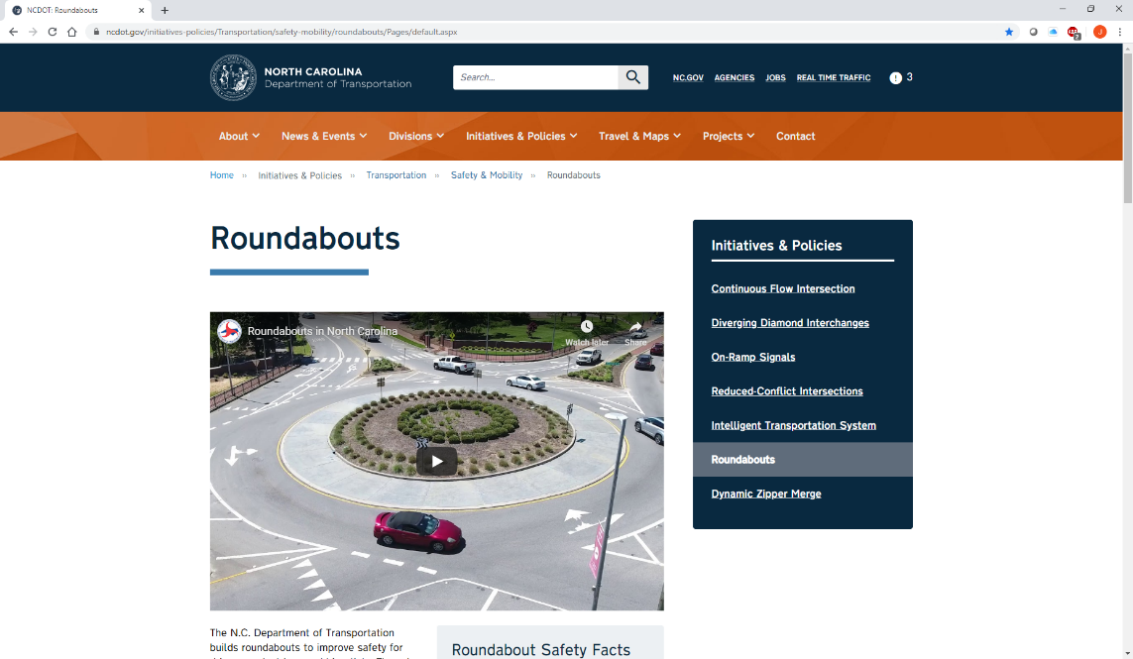
NCDOT Roundabout Web Page
Roundabout and Intersection Selection-Safety & Mobility
https://www.ncdot.gov/initiatives-policies/Transportation/safety-mobility/roundabouts/Pages/default.aspx

Slide 42
NCDOT Roundabout and RCI Videos
Roundabout and Intersection Selection-Safety & Mobility
Roundabouts - https://youtu.be/L6uYbj7Gtyo
Two-Lane Roundabouts - https://youtu.be/3FSeaY224NQ
Reduced-Conflict/RCUT - https://youtu.be/c5lXknBuzys

Slide 43
Mike Reese, PE, CPM
NCDOT Congestion Management Section
mikereese@ncdot.gov
919.814.5000
Some slide content courtesy of Kittelson & Associates, Inc.

